Slide 1



























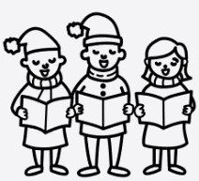
















Personal Development
Year 6
Transition
Parents
evening
PGL residential
Exceptional attendance award
Art gallery for parents
Y6 Prom
Exceptional attendance award
Class party
Y6 Leavers’
Assembly
Y6 fun day
Economic Well-Being
SATS week
Enquiry Question 4
Where does our energy come from?
Exceptional attendance award
Citizenship
Exceptional attendance award
Chinese
New Year
Valentines Disco
School rock bands started
Safety & The Changing Body
Exceptional attendance award
Valentines themed lunch
Open morning
Enquiry Question 3
Were the Vikings raiders, traders or something else?
Christmas
carols
Parents consultation day
Christmas
Lunch
Health & Well-Being
Enquiry Question 2
Would you like to live in the desert?
Exceptional attendance award
Fire Brigade visit
Remembrance
Assembly
Parents
evening
Halloween
disco
Family & Relationships
Open morning
Enquiry Question 1
What is the legacy of the ancient Greek civilisation?
Meet the teacher
Healthy relationships
workshop

