Slide 1
Welcome to worship
This is the day the lord has made
Let us rejoice and be glad in it

Slide 2
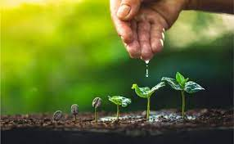
Nurture at Eastry CE Primary

Slide 3
What does the word nurture mean to you?

Slide 4
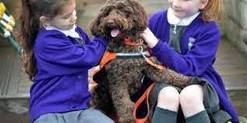
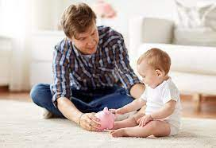
Definition of nurture
To care and protect someone or something while they are growing.
(Oxford dictionary)

Slide 5
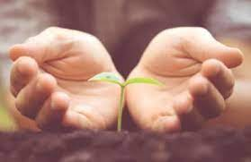
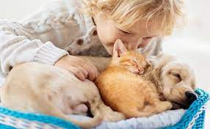
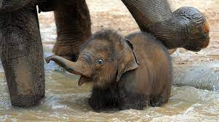
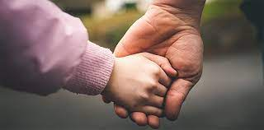
Who or what needs nurture?
All living things require Nurture in order to grow, develop and reach their full potential.
Humans, animals, pets and plants all need loving care and protection in order to flourish and be the best they can.

Slide 6
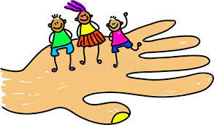
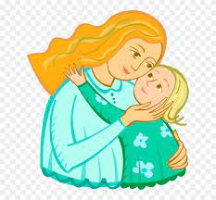
What does being nurtured look like?

Slide 7
Working towards becoming a Nurturing school
At Eastry CE Primary School our aim is to become a Nurturing school, where all our pupils, staff, parents and visitors feel happy, safe, valued and cared for.

Slide 8
What makes a Nurturing School?
A Nurturing School is based on the understanding and application of the 6 key Nurture Principles.
Children’s learning is understood developmentally.
The classroom offers a safe base
The importance of nurture for the development of wellbeing
Language is a vital means of communication
All behaviour is communication
The importance of transition in children’s lives.

Slide 9
Children’s learning is understood developmentally.
We all develop at different times socially, emotionally and behaviourally, and that’s OK.
At Eastry Primary you should feel accepted, valued and included regardless of your age and stage of development.
Adults will understand you and respond to you at your own level

Slide 10
The classroom offers a safe base
Our classroom is somewhere we feel safe, happy and valued.
We have routines, structures and boundaries
Adults and children work together and support each other
We have spaces we can go to and things we can do if we feel sad, upset or anxious

Slide 11
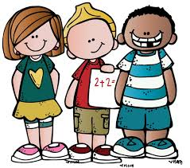
The importance of Nurture for the development of wellbeing
When we feel happy, included, valued and safe, we feel good!
Being in a nurturing environment helps us to develop confidence in ourselves and we are then able to learn and develop new skills.

Slide 12
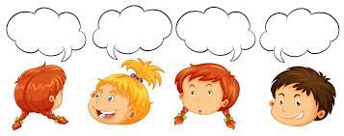
Language is a vital means of communication
It’s good to talk!
Sometimes we can find it tricky to talk about our feelings and emotions, especially when we are feeling angry, worried or upset.
At these times we could write, draw, build a model or use emotion words on our zones to help others know how we are feeling.
These strategies give us the time to think, reflect and communicate our feelings calmly and effectively.

Slide 13
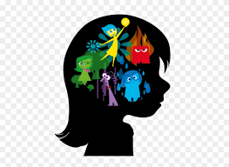
All behaviour is communication
We can usually tell how someone is feeling by looking at their facial expression and their body language.
How they look and act is a way of communicating how they are feeling inside.
Adults will recognise this by looking for these signs and helping you to regulate you emotions

Slide 14
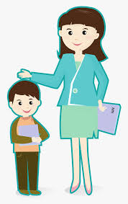
The importance of transition in children’s lives
Sometimes change can make us feel worried, nervous or sometimes very excited!
At these times adults can help us by preparing us for change.
They can talk about the changes with us, show us pictures of what is going to happen, who is going to be there and when these changes will occur.

Slide 15
Together we are on the road to becoming a Nurturing School!

Slide 16
The lord be with you
And also with you

