Slide 1
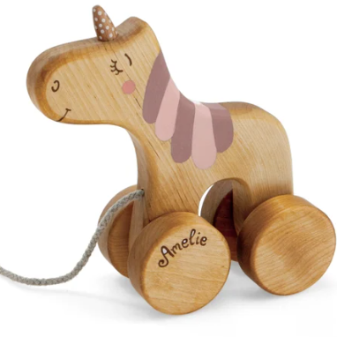



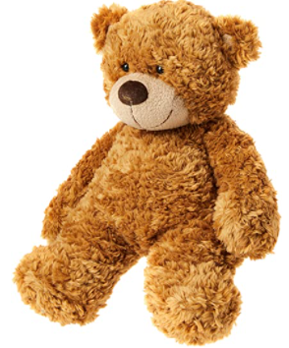
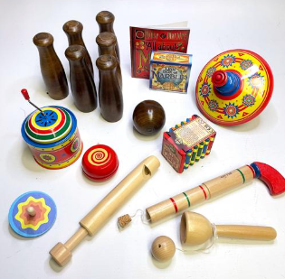
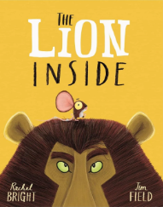
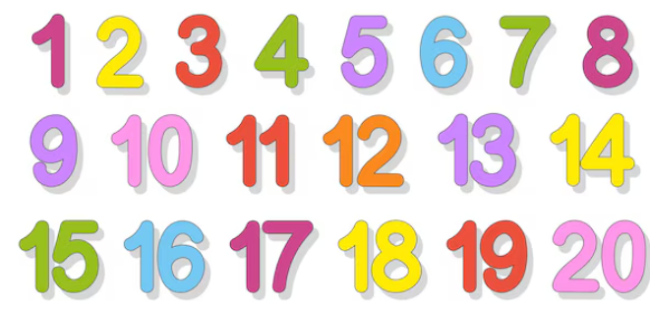
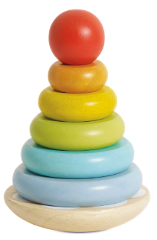
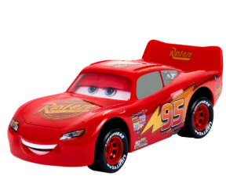
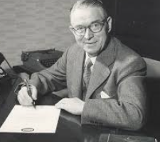
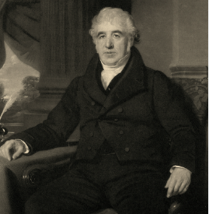
In PSHE children will learn how to keep themselves safe in different situations. They will learn who to go to for help, what to do if they get lost, and how to make an emergency phone call. The children will explore appropriate contact, safety at home, and staying safe with everyday substances. They will also learn about people in the community who help keep us safe and build confidence in recognising risks.
In PE this half term, Year 1 will be learning Gymnastics. They will practice balances, shapes, travelling, and jumping and landing safely. The children will use these skills to create and perform their own simple routines.
In Maths, Year 1 will be covering:
Subtraction within 10
Positions
Numbers to 20
Addition and Subtraction within 20
This half term, Year 1 will be exploring The Lion Inside by Rachel Bright as their class text and Pathways to Write focus. The children will develop their early writing skills by punctuating sentences with capital letters, full stops, question marks, and exclamation marks, and by joining words using and. They will also practise using the prefix un- and adding suffixes such as -ed, -ing, -er, and -est. Through a range of writing activities linked to the story, the children will write about a setting, create different types of sentences, and write a simple recount. By the end of the unit, they will build up to writing their own short story.
In DT, Year 1 will build on their Science and History learning by exploring and evaluating a range of toys and the materials they are made from. The children will think carefully about which materials are most suitable and why, before choosing appropriate materials to design and create their own toys.
This term in Science, Year 1 will revisit Everyday Materials and build on their prior knowledge. The children will explore and classify a range of materials by their properties and carry out simple tests using their senses and basic equipment. They will also learn about recycling and discover how scientists such as Ole Kirk Christiansen and Charles Macintosh have influenced the materials we use today.
This half term, History is our driver subject as Year 1 explore toys from the past and compare them with toys today. The children will look closely at toy artefacts, describing their features and thinking about who may have owned them. They will use the words old and new confidently and learn how toys have changed over time. The children will compare toys from their own lives with those from their parents’ and grandparents’ childhoods. By the end of the topic, they will be able to explain how toys have changed and talk confidently about toys from different times.
In Geography, Year 1 will learn how to read maps and plan routes in their local area using aerial photographs and large-scale maps. They will practice locating places they know, plan simple routes, and use geographical vocabulary to describe features they see along the way. The children will also make their own maps of routes, observe and talk about physical and human features, and think about ways to improve their school grounds.
In Music, Year 1 will learn a new song linked to their toys topic and sing in unison with expression. They will clap rhythms, play untuned instruments to the pulse, and explore different sounds and pitches. The children will also begin composing simple group pieces using pictures.

