Slide 1
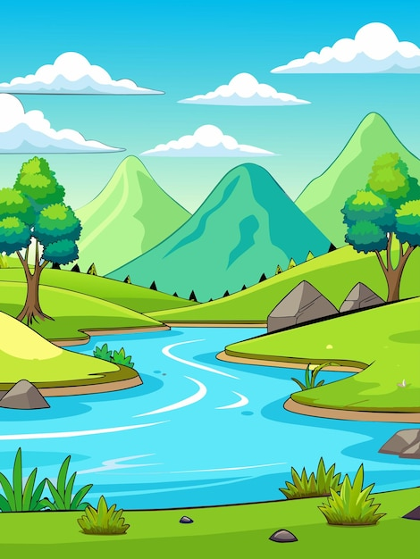
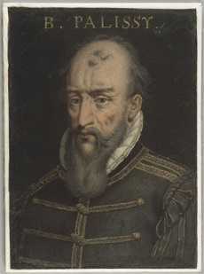
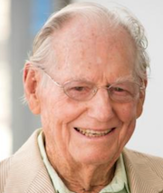
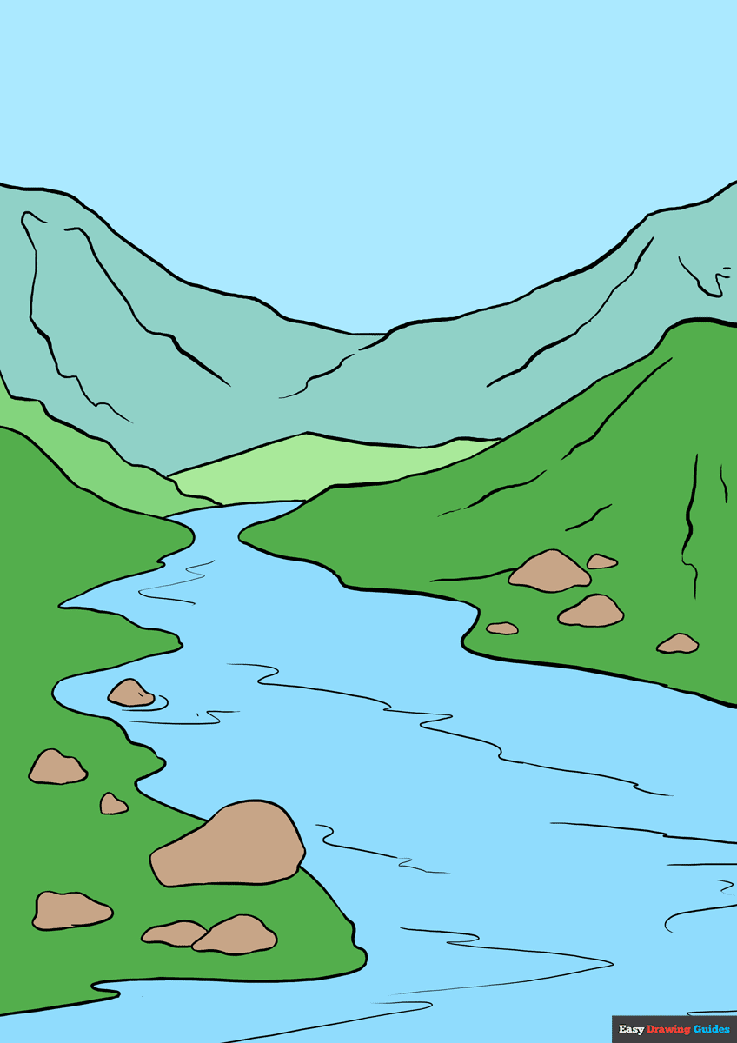
Rivers
Spring 1 2025
KEY QUESTIONS
What is the journey of a river and does it ever change?
Are rivers important to humans and animals?
Is there a reason why rivers flood and do they flood in certain area more than others?
Why are some areas of the world without access to clean water?
Are humans causing damage to rivers?
Science
States of matter
Solid, liquids and gases
Melting, freezing and boiling points
Condensation and evaporation
The water cycle
Geography
Know what a river is and locate the world’s longest on a map
Know uses of rivers
Understand the stages and features of a river.
Look at the effect of human activity on rivers and the effects of flooding.
Explore the world’s longest rivers.
English
This half term, Year 4 will read the book ‘Escape from Pompeii’ by Christina Balit. During the half term, they will write a diary entry, a letter, a setting description and a story retelling the events of Mount Vesuvius in Pompeii.
The children will focus on using accurate speech punctuation, conjunctions, varied vocabulary and standard English.
Year 4 will continue to develop their reading skills through exploring a range of texts.
Scientist: Bernard Palissy
Artist: Morton Wayne Thiebaud.
PE
Gymnastics: Monday and Friday
Swimming: Thursday
Music History of Music: Rock ‘n’ Roll
Create a composition using 3 or more instruments.
Practice using dot notation.
Maths
Further Multiplication and Division (continued), Graphs and Fractions.
Spanish
Talking about what we like an don't like to eat and drink
Art and Design
Focus: Drawing Create a drawing in the style of Morton Wayne Thiebaud.
Computing
Spreadsheets
Add formula to a cell
Formatting cells
Interpret data
Apply a spreadsheet to real-life situations
.
PSHE
Dreams and Goals Aspirations, how to achieve goals and understanding the emotions that go with this.

