Slide 1

YEAR 1
Working in Partnership Presentation
2026-27

Slide 2
Meet the staff
Miss Thorpe – Class Teacher
Miss Whittington - Teaching Assistant
Multiflex Team - PE
Notes:
Brief introduction and explanation of roles with the children this year.

Slide 3
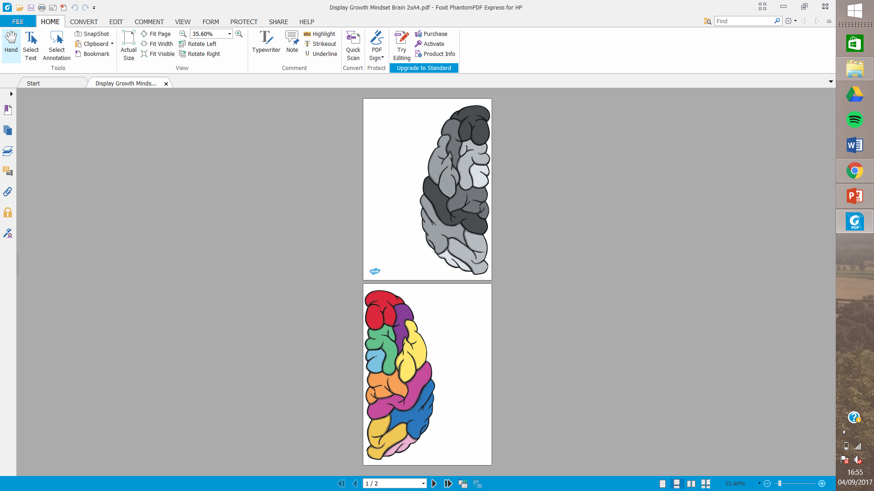
Growth Mindset
To ensure children are practicing a growth mindset we have several strategies in place to help them believe they can do anything they put their mind to!
Mixed talk partners
Effort and strategies matter
No hands up (to encourage everyone to talk confidently) during some activities
Belief that abilities can grow with
effort, practice, and support
Allowing children to understand that mistakes are opportunities to learn
Partner discussion

Slide 4
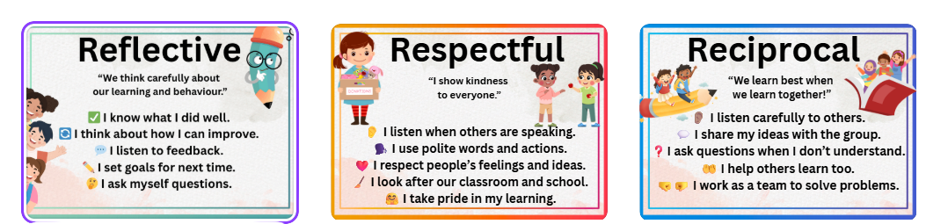

5Rs Posters:
Classroom & Hall Display: Posters visible at all times as visual reminders.
Celebration Assemblies: Link weekly awards, certificates, or praise to the 5Rs.
Lesson Integration: Refer to the 5Rs in lessons so children understand and use the vocabulary.
Monthly Assemblies: Focus on one or two Rs each month with stories, examples, or activities.
Behaviour & Reflection: Encourage children to identify which R they have demonstrated when discussing behaviour or achievements

Slide 5







Themes in Year 1
Toys
Weather
My Town. My School. My Road
Paws, Claws and Whiskers
Kenya: Njoro
Seaside Holidays

Slide 6
Trips and Visits
Tatton Park – Victorian Living History Day in the Mansion – Wednesday 10th February 2027.
Paws, Claws and Whiskers Animal Workshop - TBC

Slide 7
Monday and Thursday – PE
Weekly activities
PE
All children need an Egerton PE kit.
Pumps for indoors.
Trainers for outdoor activities
No jewellery.
No nail varnish.
Hair tied up.
Earrings – only studs.

Slide 8
Continuous Provision
In Year 1 we begin with a continuous provision approach to ensure a smooth transition from EYFS, supporting learning through purposeful play. The classroom will be set up with carefully chosen resources that children can access independently, helping them to apply knowledge in a way that matches their learning style and stage of development. Continuous provision is not an extra – it is the curriculum – and play has a vital role in developing both cognitive and physical skills. This exciting stage allows children to revisit, practice and embed their learning while continuing to build strong learning behaviours as they progress through Year 1.

Slide 9
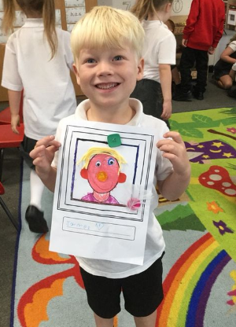
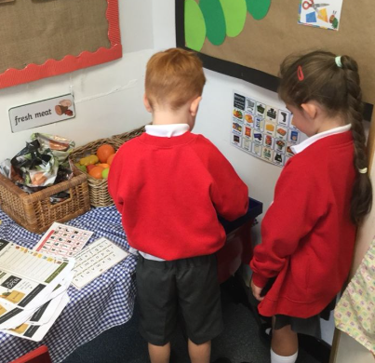
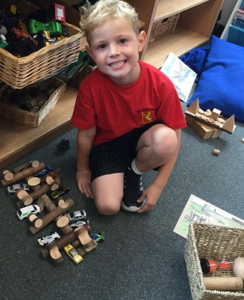
Continuous Provision

Slide 10
Maths No Problem!
Useful website with parent videos:
https://mathsnoproblem.com/en/programs/school-at-home/
https://mathsnoproblem.com/en/parent-videos/
https://mathsnoproblem.com/blog/teaching-tips/parents-can-encourage-everyday-maths-skills-kitchen/

Slide 11



Reading/Spelling
Best Books for Year 1: Recommended Booklist for Ages 5-6
Little Wandle
Same structure as Reception
4 new GPCs per week, Friday review
Main focus of Year 1 – learn graphemes that can have different sounds and sounds that can be made with different letters.
Independent review end of each half term (informs reading groups)
Autumn 1 Class Book
Autumn 2 Class Book

Slide 12

Reading
Reading practice sessions are:
Timetabled three times a week.
Taught by a trained teacher/teaching assistant.
Taught in small groups.

Slide 13
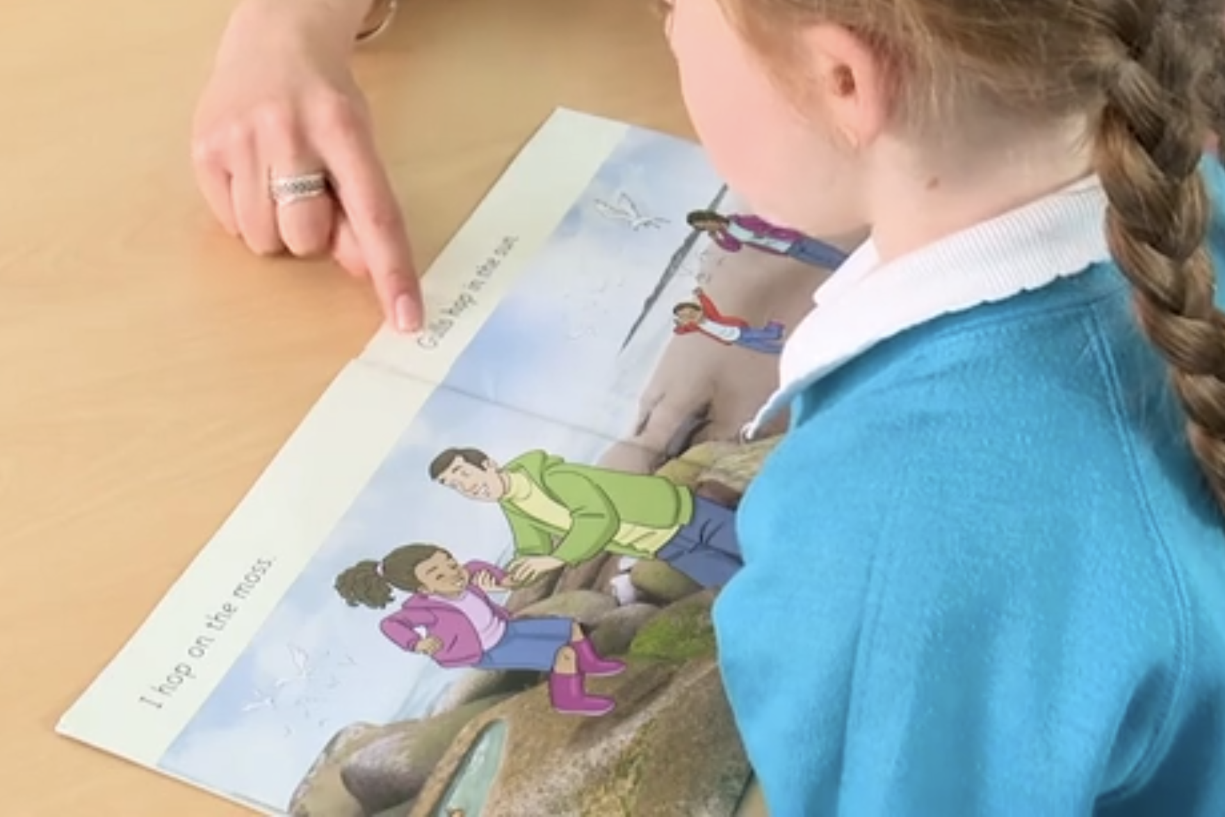
Reading a book at the right level
This means that your child should:
Know all the sounds and tricky words in their phonics book well.
Read many of the words by silent blending (in their head) – their reading will be automatic.
Only need to stop and sound out about 5% of the words by the time they bring the book home – but they should be able to do this on their own.

Slide 14

Reading books at home:
Reading books will go home on a Friday.
They need to be returned the following Thursday.
Your child will have their own reading folder with their book inside. Please return books in their reading folder so we can prepare their new book.

Slide 15


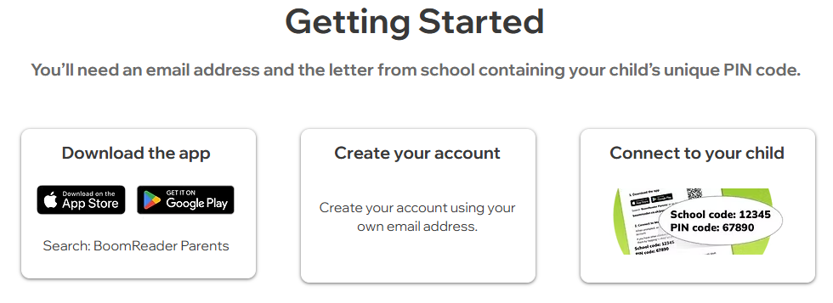

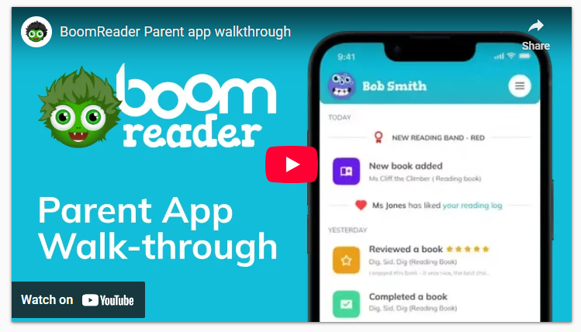

You will receive a letter home with your child’s log in information
Boom reader is a digital reading record designed to make logging reading quick and easy whilst providing teachers with reading insights.
Your child's record builds over time and provides a full, meaningful picture of their reading all the way through school.
https://www.boomreader.co.uk/parents

Slide 16
Homework
English and Maths key skills homework to be given out on a Friday and handed in the following Thursday.
Reading – 10-15 minutes every day and recorded on Boom Reader.
Sometimes Maths will be set on Maths.co.uk. Each child will receive their own login which will be sent home.
Support at home:
Reading
Discuss weekly homework and ensure it is completed mostly independently.
Have a go at any corrections/2nd attempts in a different colour.

Slide 17
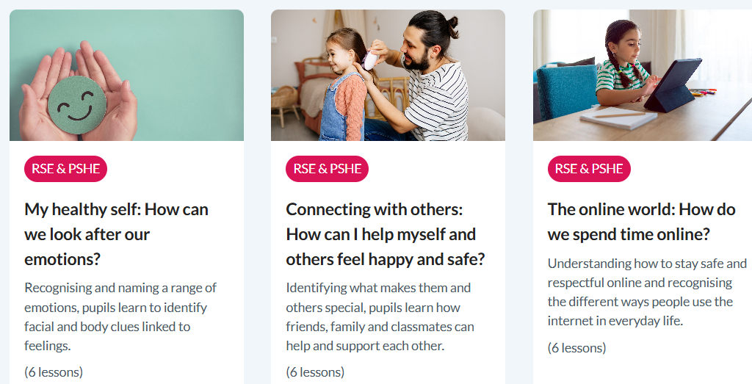

PSHE KAPOW

Slide 18

SeeSaw
Each child has an individual code.
Online learning journey through photos and videos.
Children’s work will be shared on the app.
Please like and comment.

Slide 19
Communication
On our Year 1 school webpage, you can find:
Our curriculum map and key documents.
Updates and news via our School Twitter.
Learning updates and messages through Seesaw.
📩 To book an appointment with a teacher or for general enquiries, please contact the school office:
admin@egerton.cheshire.sch.uk

Slide 20
IMPORTANT THINGS TO REMEMBER
Children to be in school at 8:45am to complete a morning challenge and be ready for their lessons.
All jumpers clearly labelled.
Children bring the minimum to school.
On Monday and Thursday - our PE days, children come wearing PE kit.

Slide 21
Could you share your world of work with our children?
We are keen to build strong partnerships with our families and help our children learn about the many different jobs, careers and opportunities that exist beyond school.
If you would be happy to come into school for a short session, we would love you to:
👩‍⚕️ Tell us about your job or career.
🛠️ Share what you do and what skills you use.
💡 Explain what you enjoy about your work.
🎓 Tell children about the skills, qualifications or experiences that helped you get there.
🌍 Help children understand how different jobs contribute to our community and wider world.
A short, informal talk, demonstration, question-and-answer session or practical activity would be fantastic.
Could you help inspire our children by sharing what you do?

Slide 22

I hope you found this presentation helpful.
If you have any questions, please don’t hesitate to contact me through admin@egerton.cheshire.sch.uk or catch me on the door at drop off and pick up!

