Slide 1





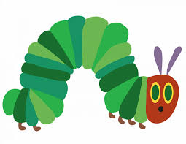
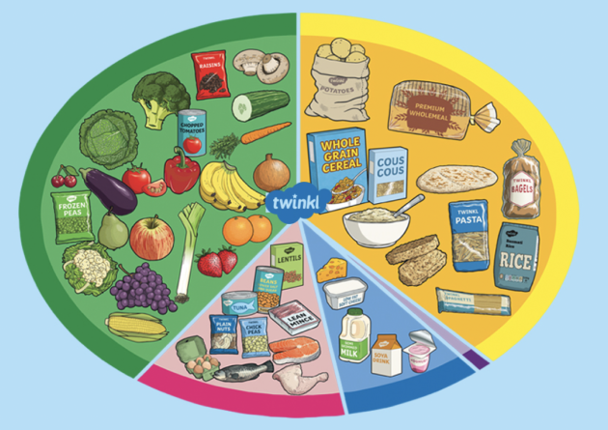
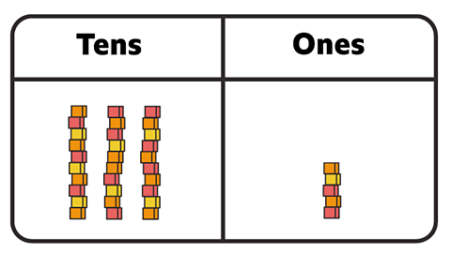


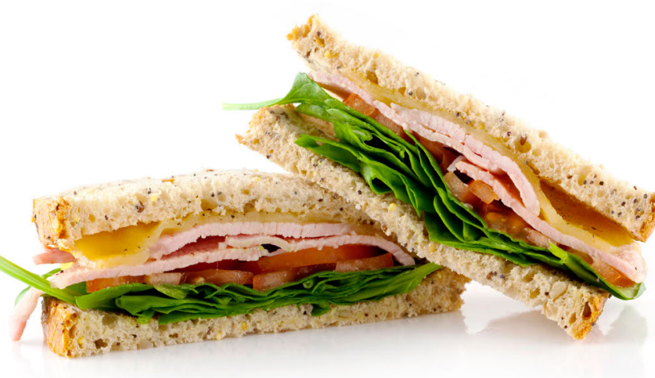
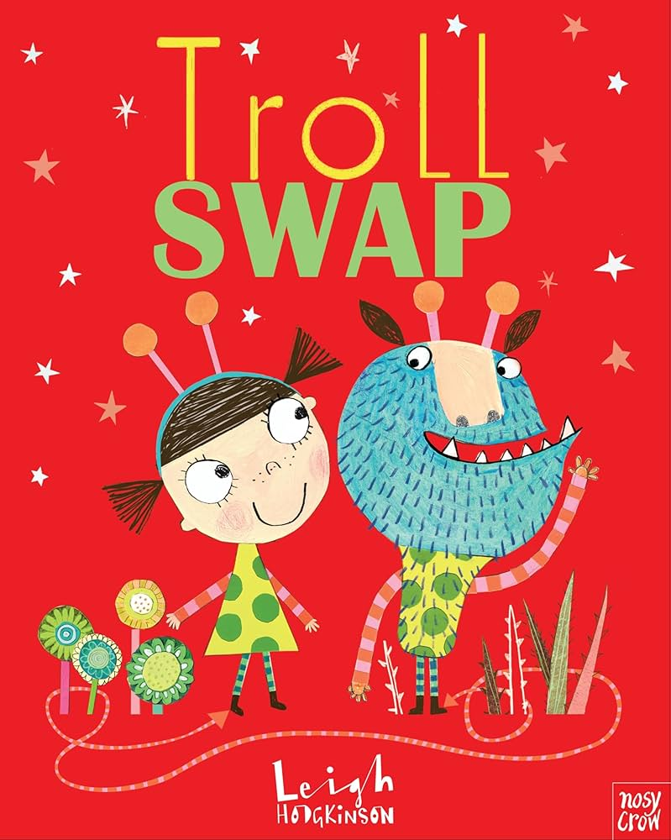
Fighting Fit!
PE:
Invasion Games (Tuesdays and Fridays).
PSHE:
Families and Relationships
Class Novel: The Naughtiest Unicorn by Pip Bird
Spanish:
La Oruga Muy Hambrienta
The Very Hungry Caterpillar.
Computing:
This half term in Computing, the children will explore how information technology (IT) is used to improve our everyday lives. They will learn about the different ways technology helps people at home and in the wider community, including in shops, libraries, and hospitals.
Science:
This half term the children will be learning to:
Notice that animals, including humans, have offspring which grow into adults.
Find out about and describe the basic needs of animals, including humans, for survival (water, food and air).
Describe the importance for humans of exercise, eating the right amounts of different types of food, and hygiene.
Geography – Magical Mapping:
This half term, the children will explore a range of maps at a local, national and global level, developing their understanding of how to navigate an online mapping service to find key locations. They will also devise their own maps and plan routes, building their geographical skills through digital tools and practical activities.. They will look at aerial photographs to spot human and physical features, understand simple map symbols and compass directions.
Maths:
This half term the children will be learning to:
Count in steps of 2, 3, and 5 from 0, and in tens from any number, forward and backwards.
Recognise the place value of each digit in a two-digit number.
Identify, represent and estimate numbers using different representations, including the number line.
Compare and order numbers from 0 up to 100 using <, > & = signs.
Read and write numbers to at least 100 in numerals and in words.
Use place value and number facts to solve problems.
R.E. - Christianity:
They will be exploring the main features of a church, the types of worship that happens there and why churches are so important to Christians.
Music
The children are going to explore the skills of finding the pulse and pitch in different songs this half term. They will practice identifying high and low pitches and clapping out the pulse in a familiar song. They will also work in groups to compose their own piece using crochets and quavers.
D&T:
The focus of the children’s design & technology project this
half term is food technology. The children will begin by exploring where food comes from and be able to sort foods into the 5 main food groups. They will then learn about their chef, Mary Berry. The children will design their own healthy sandwich and label the ingredients and equipment they will need to bake the recipe, before creating their sandwiches.
English:
In English, the children will be exploring ‘Troll Swap’ as their key text. They will be working hard to include their mastery keys in their writing, which are as follows:
Use punctuation correctly – full stops, capital letters.
Use expanded noun phrases to describe and specify.
Use subordination (because) and coordination (and).

