Slide 1
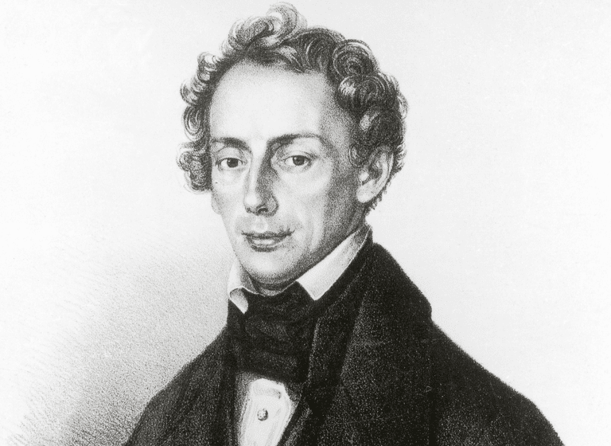
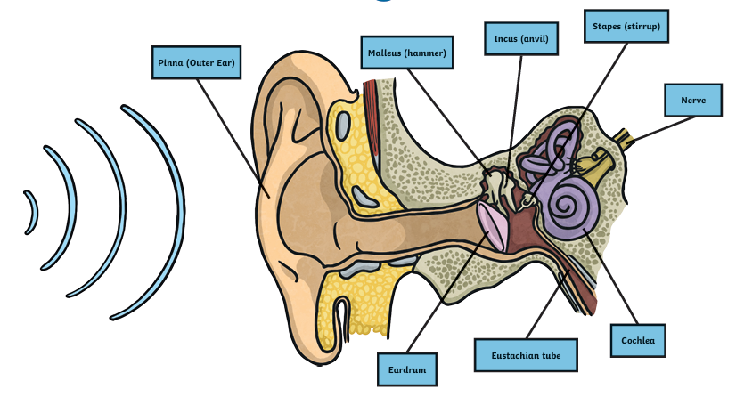
Year 4 Summer 2
Key Questions
What is it inside my ears that allow me to hear sound?
How does sound travel from an object to my ear?
What can stop us from hearing sounds?
Why does a bell feel like its buzzing when it rings?
Why does my friend in the distance sound so quiet when I know he’s shouting so loudly?
English
Over the next few weeks, we’re going to be doing lots of exciting writing based on the story of Julius Caesar.
You will have the chance to write:
A playscript – just like a scene from the play!
A diary entry – from the point of view of one of the characters
A recount – telling what happened in the story in your own words
A formal letter – writing in a clear and serious way
Mastery Keys:
Writing longer, more interesting sentences using conjunctions like when, if, because, and although
Organising writing into clear paragraphs with one main idea in each
Using rich and varied vocabulary to make writing more powerful and exciting
Using the correct tenses, including:
The past tense (e.g. "He marched into the city.")
The present perfect (e.g. "He has made a big decision.")
The progressive form (e.g. "They were planning the attack.")
Maths
Mass, Volume and Length
Area of Figures
Geometry
Position and Movement
Science – Study of Sound.
Identify how sounds are made.
Explore patterns between the pitch of a sound and features of the object that produced it.
Find patterns between the volume of a sound and the strength of the vibrations that produced it.
Recognise that sounds get fainter as the distance from the sound source increases.
Class book
Julius Caesar – by William Shakespeare​
Edited by Angela McAllister​
A Stage Full of Shakespeare Stories

Slide 2
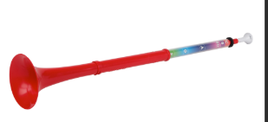
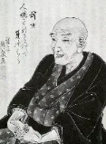
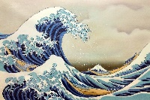
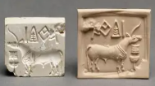
Geography
Earning a living – Exploring different jobs and industries
Computing
Effective Searching & Artificial Intelligence
Music
PBUZZ lessons with Love Music Trust
Spanish
My free time
PE
Striking and fielding
Athletics
Art
Painting Katsushika Hokusai
Jigsaw / PSHE
Changing Me.
Coping positively with change
Reproduction
Puberty
Periods
Understanding changes out of our control
Moving into Year 5
Design and Technology
Mechanisms (Levers & Linkages)
Pop-Up/Slider Books
History
The Indus Valley continued

