Slide 1
Year 3
Parent network

Slide 2
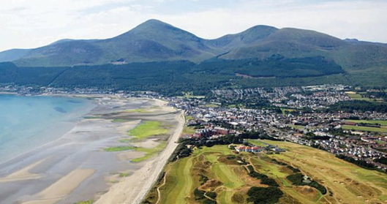
Strangers to teammates…

Slide 3
Our Year 3 team
Miss McAlister
Mrs Bagnall
Mrs Bainbridge-Sales

Slide 4
Day to day
AM
SPAG
English
Break (10:30-10:45)
Maths
Handwriting
PM
Science
History
Geography/music
re/art/pshe/mfl
pe/dt/computing

Slide 5
Assemblies
Monday - KS2 Assembly
Wednesday - Singing assembly
Friday - Celebration assembly

Slide 6
pe
Wednesday (Miss McAlister)
Thursday (Multiflex)
Pe kits to be worn on these days

Slide 7
upcoming
SPRING TERM - MUsic by lovemusictrust
Summer term - swimming
Updates will follow closer to the time

Slide 8
Long term plan for the year

Slide 9
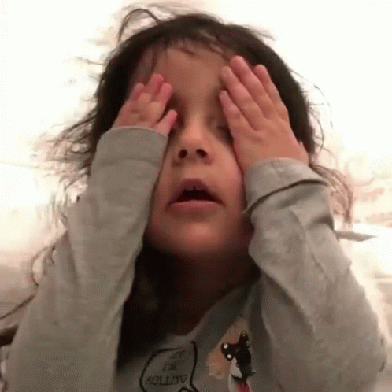
Lunches

Slide 10
Homework
(friday to friday)
Spellings
English (spag/comprehension)
Maths
Reading
Children to take their own homework out

Slide 11
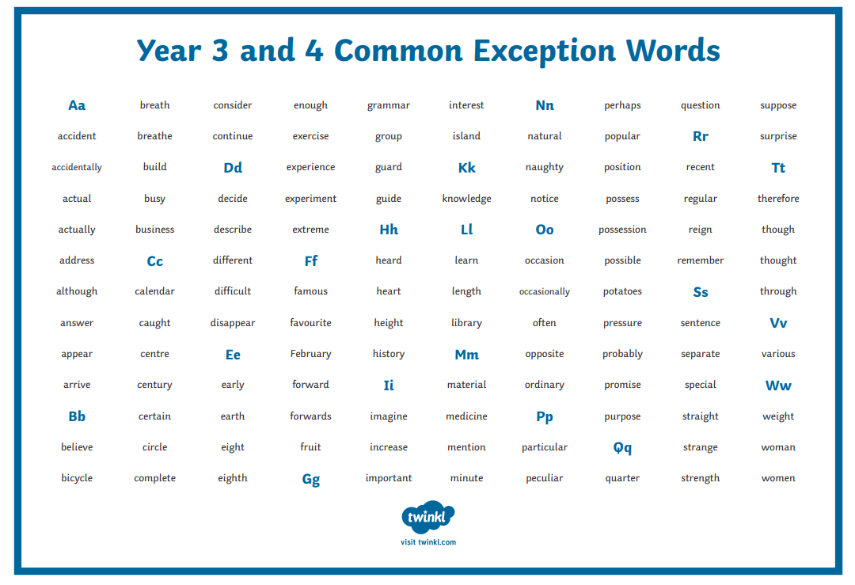
End of year expectations

Slide 12
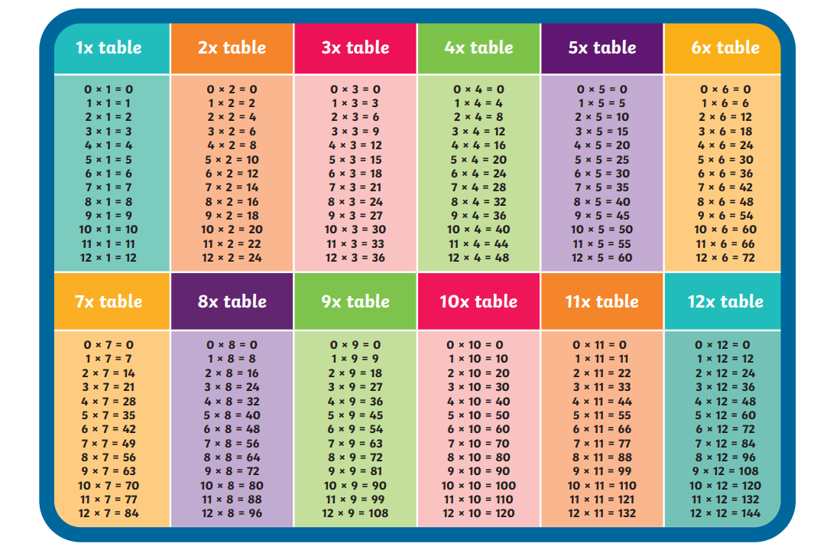
End of year expectations

Slide 13
Online platforms
Seesaw
Edshed
Tt rockstars
Purple mash
Boom reader

Slide 14
Useful websites
Topmarks
White rose maths (1 minute maths)
Wordwall
Bbc bitesize
youtube

Slide 15
Communication
Office
Seesaw
End of the day

Slide 16
ANY QUESTIONS?
SCHOOL TRIPS
Will be more information to come

