Slide 1
YEAR 6 Working in Partnership Presentation

Slide 2
Meet the staff
Mrs Sedgwick – Class Teacher
Mr Pettit - Teacher on Wednesdays
Mrs Horrocks- Teaching Assistant
Mrs Bainbridge-Sales – Teaching Assistant
Mrs Levinsohn - Spanish
Multiflex Team
Notes:
Brief introduction and explanation of roles with the children this year.

Slide 3
Growth Mindset
To ensure children are practicing a growth mindset we have several strategies in place to help them believe they can do anything they put their mind to!
Mixed talk partners
Encourage challenge and children to embrace it
No hands up (to encourage everyone to talk confidently)
Allowing them to understand that mistakes are part of making us better learners
Lots of partner discussion

Slide 4
Building a positive mindset in Year 6
Change of seating every 2 weeks
Talking partners
‘No hands up’ to answer questions
Notes:
How we will keep in touch.

Slide 5
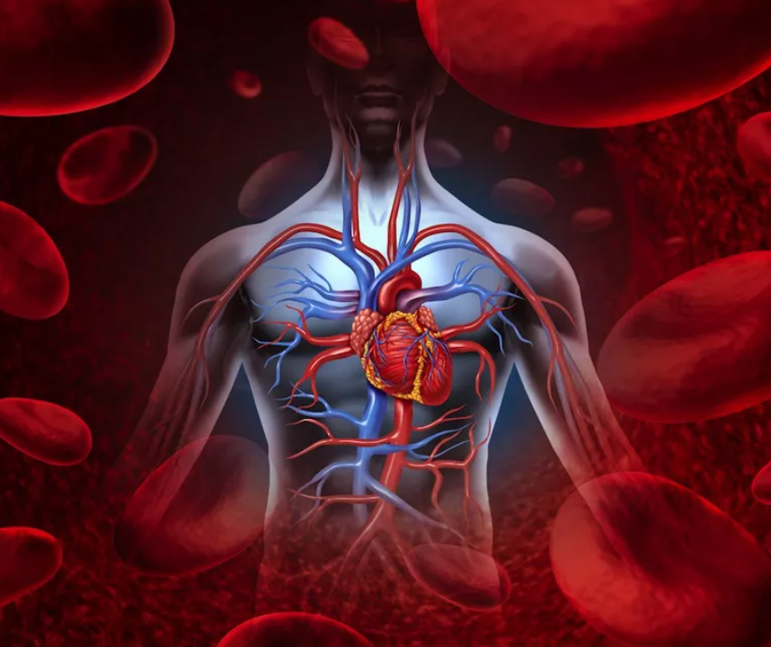
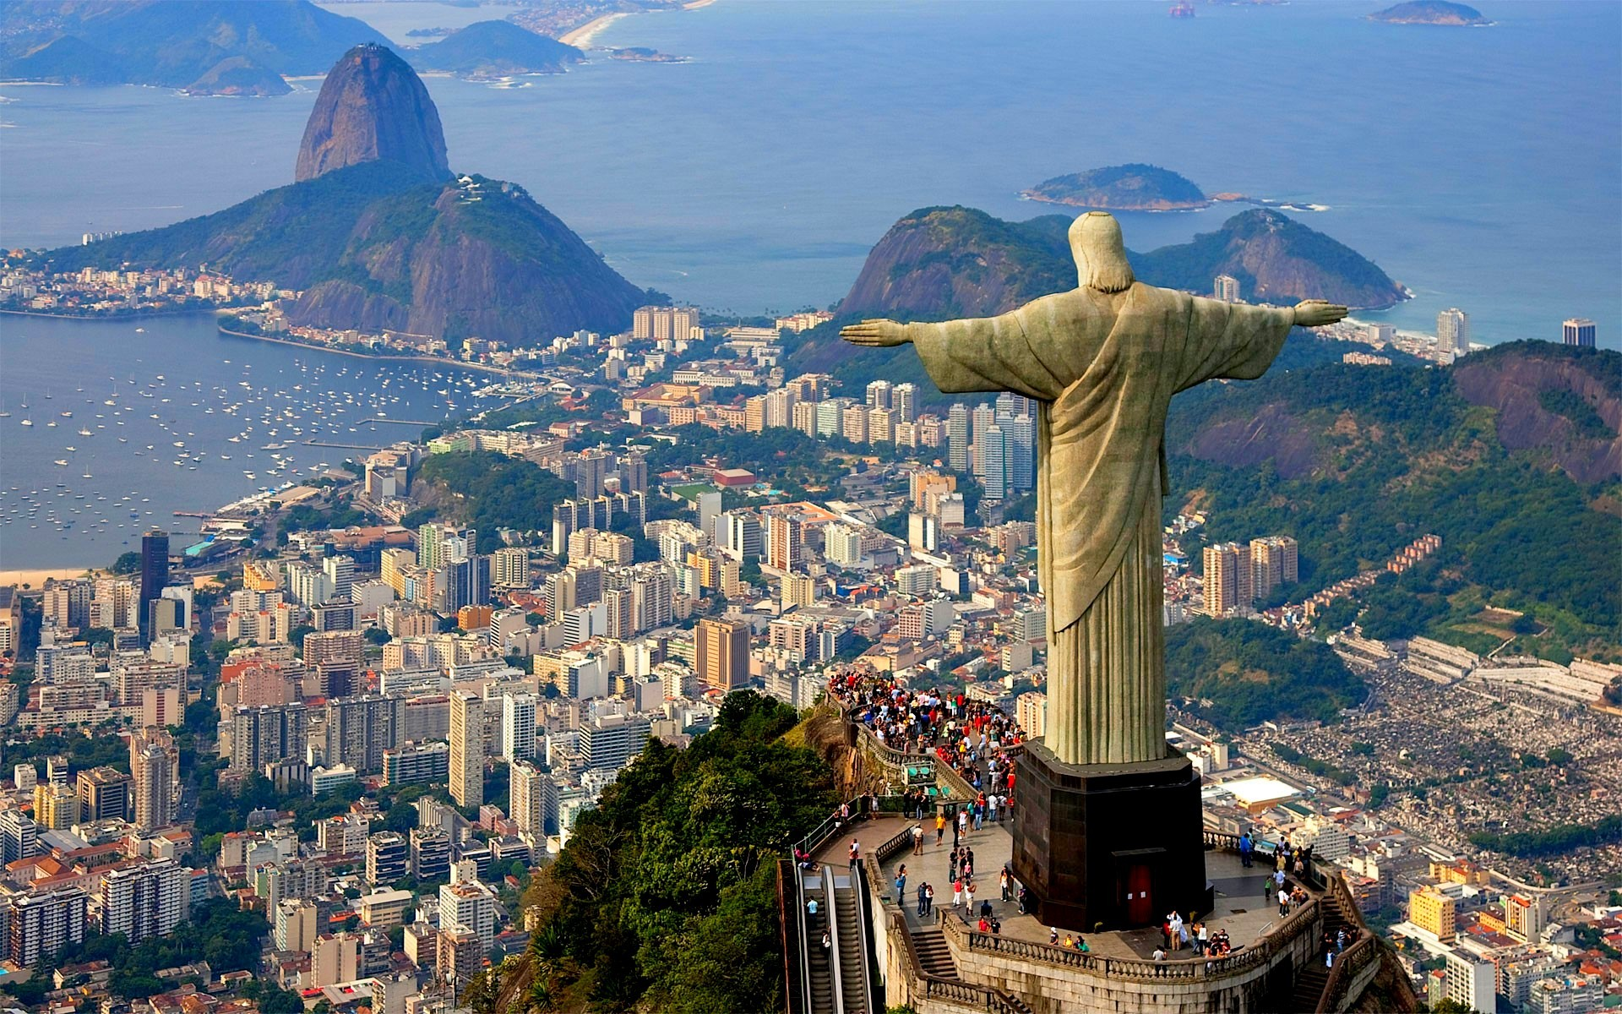
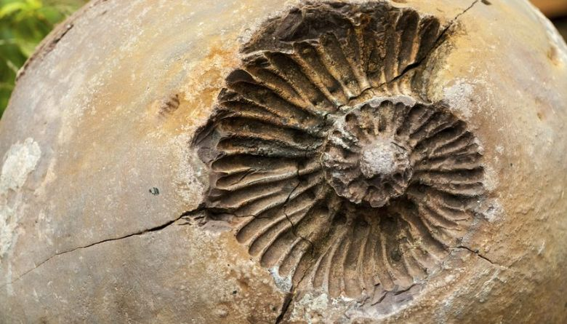
Themes in Year 6
Tudors
Healthy Bodies
Global Trade
Crime and Punishment
Brazil
Evolution and Inheritance

Slide 6
Wednesday and Friday – PE Thursday – Spanish
Weekly activities
PE
All children need an Egerton PE kit.
Pumps for indoors.
Trainers for outdoor activities – Health and safety reasons.
No jewellery.
No nail varnish.
Hair tied up.
Earrings – only studs.

Slide 7
Maths No Problem!
Comprehensive way to teach mathematics
Context – problem solving
Focus on methods rather than answer – conceptual understanding
Text books, work books, journals
Variation
Concrete, pictorial, abstract
Slower pace, greater progress
Work together at the same pace, acceleration through rich, sophisticated problems
Think deeply about maths at a relational level

Slide 8
Maths No Problem!
Useful website with parent videos:
https://mathsnoproblem.com/en/programs/school-at-home/
https://mathsnoproblem.com/en/parent-videos/
https://mathsnoproblem.com/blog/teaching-tips/parents-can-encourage-everyday-maths-skills-kitchen/

Slide 9
Reading
Guided reading and reading comprehension:
four times a week
whole class reading
independent sessions
Sats style questions
focus on vocabulary, inference and summary
finding evidence in a text
Autumn 1 Class Book
Treason by Berlie Doherty
https://www.booksfortopics.com/year-6

Slide 10
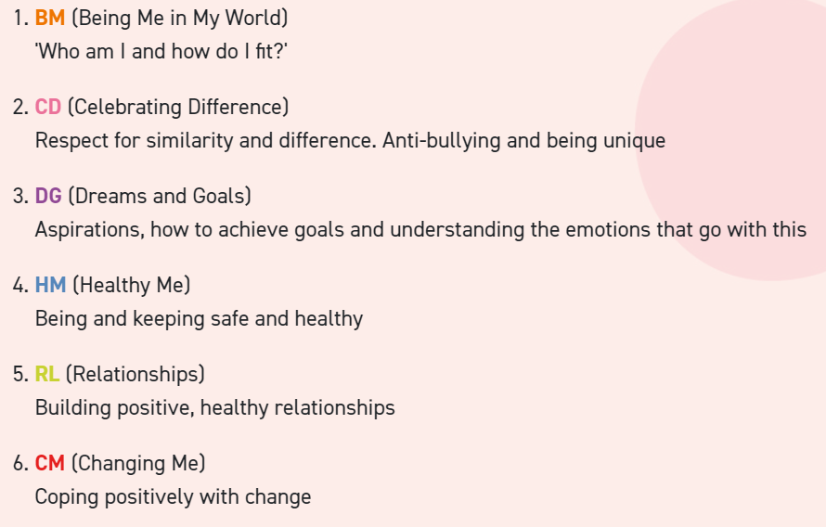
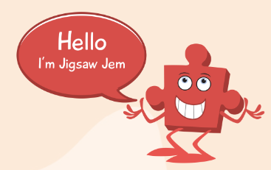
Welcome to the Jigsaw teaching and learning materials for ages 10-11.
Jigsaw is sequential, the six puzzles (units) starting with 'Being Me in My World' (BM) at the beginning of the school year and working through to the end of the year:

Slide 11
Homework
English and Maths key skills homework to be given out on a Friday and handed in the following Thursday
Reading – Home reading as often as possible
Times tables – Continue to practice fluency (multiplication and division facts)
Spellings
Support at home:
Reading
Support fluency of times tables
Spellings
Discuss weekly homework and ensure it is completed independently

Slide 12
SATs 2023 w/b 8th May
Overview of tests
The KS2 tests consist of:
English grammar, punctuation and spelling Paper 1: questions
English grammar, punctuation and spelling Paper 2: spelling
English reading
Mathematics Paper 1: arithmetic
Mathematics Paper 2: reasoning
Mathematics Paper 3: reasoning

Slide 13
SeeSaw
Online learning journey through photos and videos
Children’s work will be shared on the app
Each child has an individual code
Like and comment

Slide 14
Communication
Year 6 page on the school website: here you will find information including our curriculum map and other important documents
School Twitter
Seesaw
Email school admin to book an apointment with the teacher or any other inquires
admin@egerton.cheshire.sch.uk

Slide 15
IMPORTANT THINGS TO REMEMBER
Children to be in school at 8:45am to complete a morning maths or English challenges
Ask children everyday for letters
All jumpers clearly labelled
Children bring to school only the minimum
On Wednesday and Friday, our PE days, children come wearing PE kit

Slide 16
Helping your child
Read with your child as often as you can (discuss what they are reading, make predictions, talk about the plot and characters)
Encourage independence when completing homework and discuss anything they are finding tricky
Visit seesaw and discuss learning and what they are doing in class

Slide 17
PTA
Every parent is automatically part of the school PTA.
The PTA make a positive contributions to school life in so many different ways. They always welcome support so if you can attend meetings, volunteer your time to support their events or have ideas to share please do.

