Slide 1
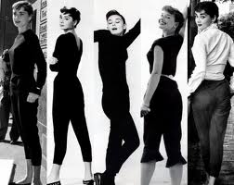
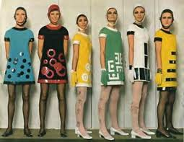
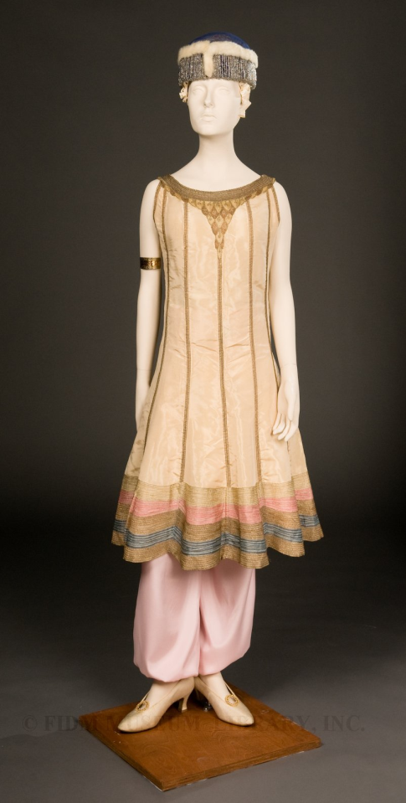
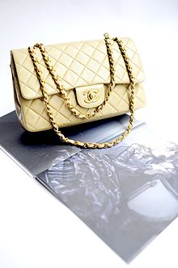
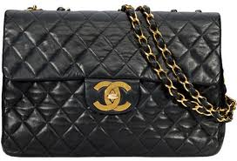
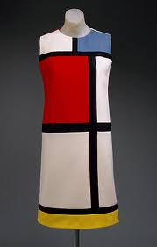
Iconic Fashion Pieces

Slide 2
The Mini Skirt
In 1966 Mary Quant was producing short, waist skimming, mini dresses and skirts that were set 6 or 7 inches above the knee.
She didn’t invented the fashion mini skirt but took her ideas from the 1964 designs by Courrèges and liked the shorter styles and made them even shorter for her boutique Bazaar.
She is rightly credited with making popular a style that had not taken off when it made its earlier debut
The fashion trend took off because it was so different and to wear it well you had to be youthful to get away with an outfit that was so controversial, particularly among adults.
The Quant style was soon known as the Chelsea Look

Slide 3
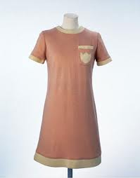
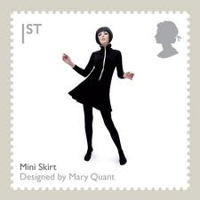
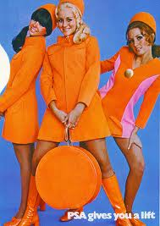
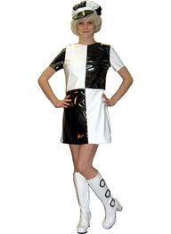
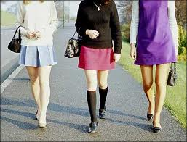

Slide 4
The 2.55 Quilted Chain Bag
In the 1920s, Coco Chanel became tired of having to carry her handbags in her arms and decided to design a handbag that freed up her hands. Inspired by the straps found on soldiers’ bags she added thin straps and introduced the resulting design to the market in 1929.
After her successful comeback to the fashion industry in 1954, Chanel decided to update her handbag, for the modern women. The resulting design was called 2.55 after the date of creation, February 1955.

Slide 5
Chanel recognising that the modern women needed to have their hands free while attending social functions designed a double chain shoulder strap, something common in downmarket products, but rare in luxury circles at the time
The bag originally came with a front lock called “the Mademoiselle Lock”. Since the 1980s, versions can also be supplied with a lock in the shape of a double CC logo. These are called “Classic Flaps
The bag has a quilted diamond or herringbone pattern on the exterior. Using a running stitch, this gives the bag shape and volume

Slide 6
Capri Pants
Capri pants were introduced by European fashion designer Sonja de Lennart in 1948.
The pants' name comes from the Italian island of Capri, where they rose to popularity in the late 1950s and early 1960s.
The American actress Grace Kelly was among the first movie stars who wore capris on the island.

Slide 7
Capris' acceptance in the United States was influenced by the 1960s television series The Dick Van Dyke Show. The character of Laura Petrie, the young housewife, played by Mary Tyler Moore, caused a fashion sensation – and some mild controversy – by wearing snug-fitting capri pants during the show's run.
After a drop in popularity during the 1970s through the 1990s capris returned to favour during the 2000s.
Spanish tennis player Rafael Nadal wore capris in the majority of his matches before 2009.

Slide 8
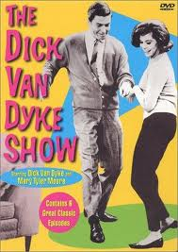
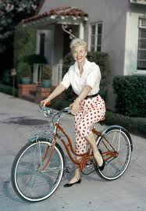
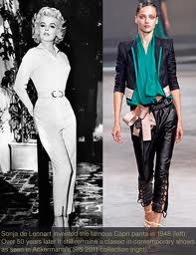
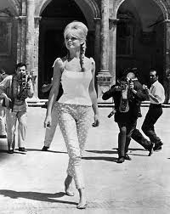
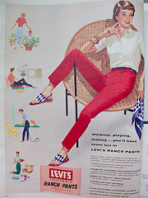
Capri Pants

Slide 9
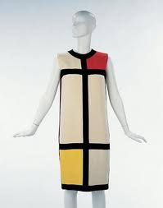
The Mondrian Dress
The dress was inspired by the abstract paintings of the Dutch De Stijl artist Piet Mondrian (1872-1944).
Yves St Laurent designed a group of bold dresses based on intersecting black stripes and blocks of primary colours.
It became known as the Mondrian Collection and was featured on the front of French Vogue in September 1965 and in many other fashion magazines.
The designs were immediately taken up by mass manufacturers who made cheap copies.
It was a feat of dressmaking, each block of jersey, pieced in order to copy the Mondrian order and to accommodate the body by hiding all the shaping in the grid of seams.

Slide 10
Haram Pants
Poiret loved bright colour and introduced brilliant hues whilst the sweet pea colours of the Edwardian era were still very fashionable.
He had been influenced by the Ballets Russes and in 1911 he produced exotic designs based on oriental harem pants.
Poiret introduced "jupe-culottes" or harem pants. These full pants fell together almost as a skirt would and were worn under a tunic. This style was popular primarily among women with bohemian tendencies, as most women did not yet wear pants on a regular basis

