Slide 1
Fashion through the Decades

Slide 2
Research Task
Read through the power point slides and make notes

Slide 3
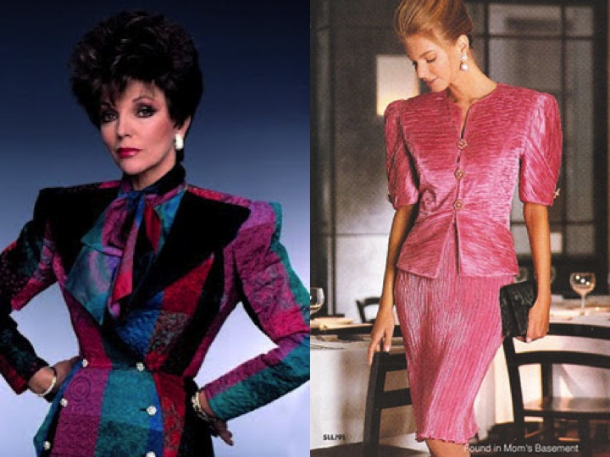
What Decade am I ?
BIG QUESTION
Key Words
Decade
History
Edwardian

Slide 4
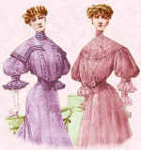
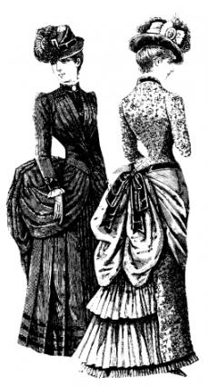
Edwardian 1890 - 1914
The fashionable hour glass silhouette belonged to the mature woman of ample curves and full bosom. The S-bend health corset set the line for fashion conscious women until 1905. The corset was too tightly laced at the waist and so forced the hips back and the drooping monobosom was thrust forward in a pouter pigeon effect creating an S shape

Slide 5
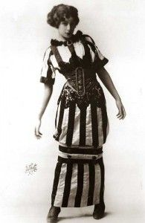
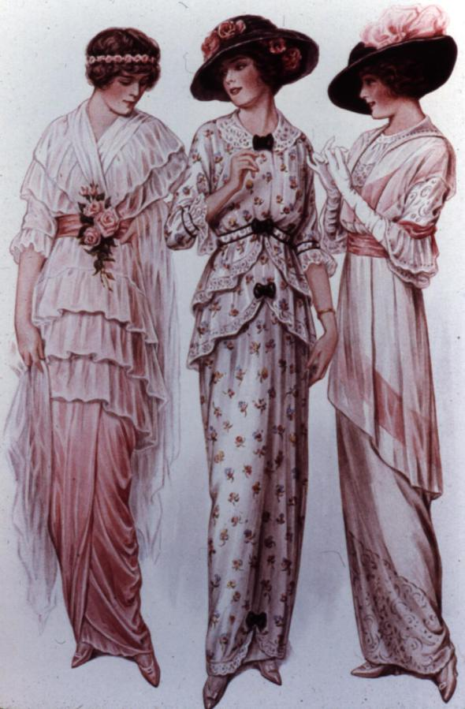
Paul Poiret
The term 'hobble skirt' came into popular use in the early 1910s, when a European fashion trend started by French designer Paul Poiret introduced long skirts that were narrow at the hem, thus 'hobbling' the wearer.

Slide 6
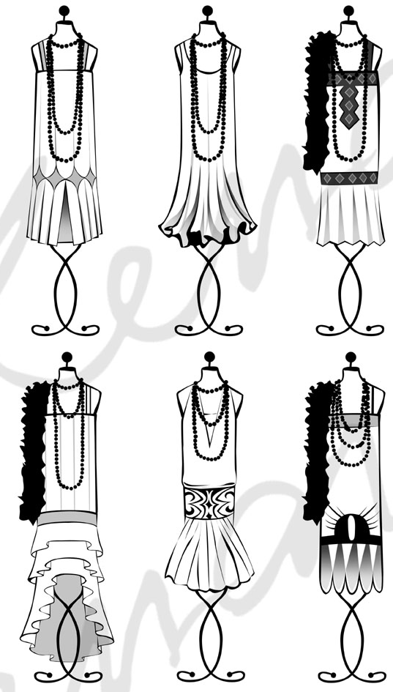
Roaring 20’s
Dipping, scalloped and handkerchief hemlines in floating fabrics. It was only in 1925 that skirts rose 14 to 16 inches (45 to 50 cm) from the ground making the shorter hemline we associate with the era.
Female clothes became looser and more shapeless in fit. The bust was suppressed, the waist disappeared, the shoulders became broader and hair shorter and shorter. Narrow boyish hips were preferred. The silhouette emphasised a flattened chest and womanly curves were eliminated as the line became more simplified.

Slide 7
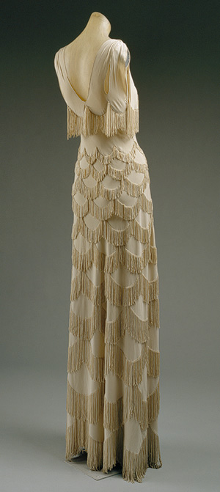
Madeleine Vionnet, 1930’s
In the 1930s, the ideal of slimness remained but the silhouette regained some curve.
Evening dresses during this period were made of clinging bias-cut fabrics that expressed the body underneath with every motion

Slide 8
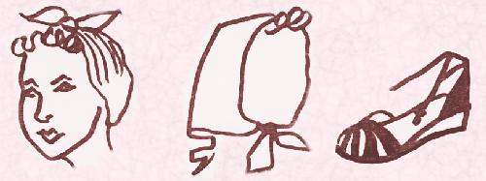
Rationing, 1940’s
Fashion items that became popular were the wedge sole shoe, the turban, the siren suit and the kangaroo cloak. The turban equalised people of all sorts. It began as a simple safety device to prevent the wearer's hair entangling in factory machinery. It doubled as a disguise for unkempt hair which women had less time to attend to being so busy running homes, jobs and giving extra help wherever they could.

Slide 9
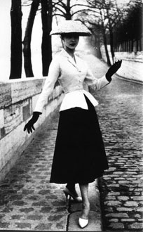
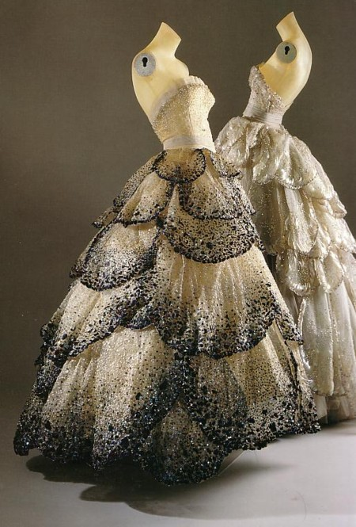
1940’s New Look
women's fashion in the 1940s combined style and practicality to achieve a lasting elegance.
In 1947 a revolutionary new fashion style dubbed the New Look by the press thrust fashion designer Christian Dior into the headlines. Styles began to change silhouette as skirts lengthened and increased in volume or became long slim line columns. This set the silhouette style trends for the next ten years.

Slide 10
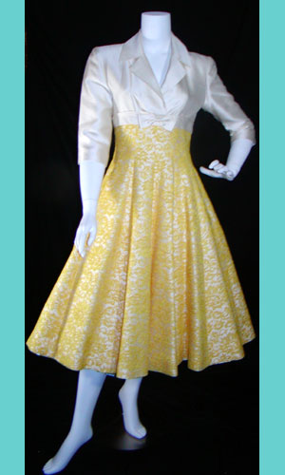
Jacques Fath, 1950’s
The fashion in the 1950s could be considered sophisticated as defined by flowing ‘Dior’ ball gowns but it can also be described as gritty which can be seen in the teddy boy movement that helped define fashion in the 1950’s england.

Slide 11
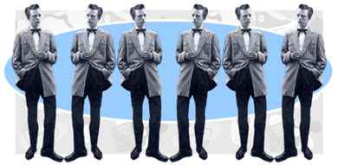
‘Teddy Boys, 1950’s’
featuring slim coats with velvet trim and the impeccable tailoring preferred by upper class gentlemen. The Teds built their own characteristic look by mixing the Edwardian style with American Western and rock and roll looks.
This conjunction of styles from the past and the present created a “neo-Edwardian” look that would earmark the start of fashion conscious youngsters.

Slide 12
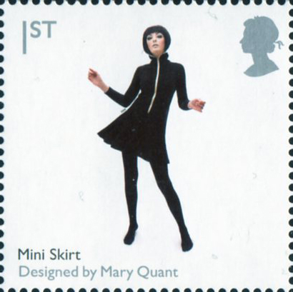
Mary Quant, 1960s
The 1960s featured a number of diverse trends. It was a decade that broke many fashion traditions, mirroring social movements during the period.

Slide 13
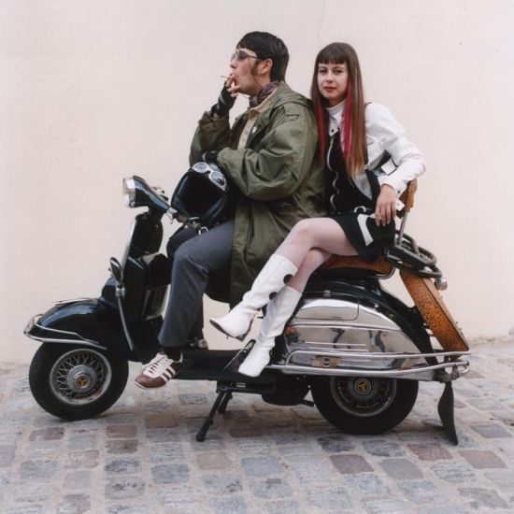
‘Mods, 1960’s’
Male mods adopted a smooth, sophisticated look that emphasised tailor-made Italian suits (sometimes white) with narrow lapels, mohair clothes, thin ties, button-down collar shirts, wool or cashmere jumpers (crewneck or V-neck), pointed-toe leather shoes that were nicknamed winklepickers, as well as Chelsea or "Beatle" boots.

Slide 14
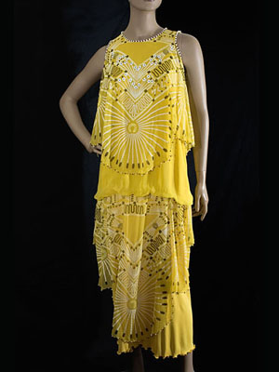
Zandra Rhodes, 1970’s
1970s fashion, which began with a continuation of the mini skirts, bell- bottoms and hippie look.

Slide 15
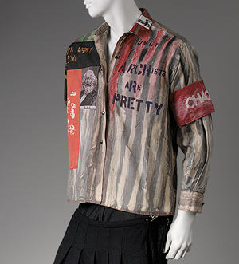
Vivienne Weswood, 1970’s
The "punk style" included safety pins, bicycle or lavatory chains on clothing and spiked dog collars for jewellery, as well as outrageous make-up and hair.

Slide 16
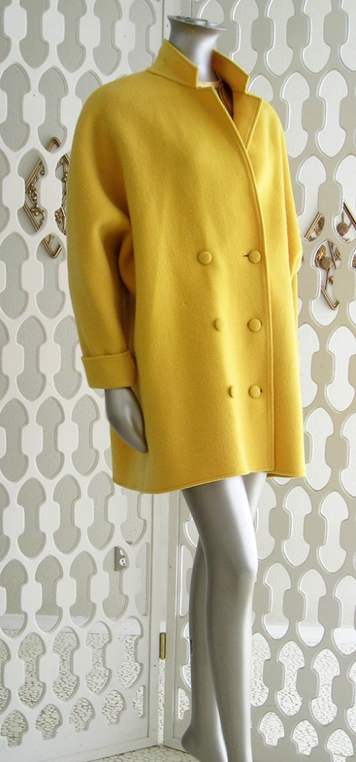
Calvin Klein, 1980’s
1980s as both men and women began to wear looser shirts and tight, close-fitting jeans.

Slide 17
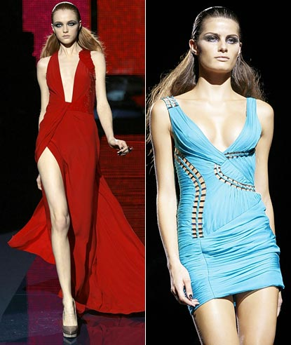
Marc Jacob, 1990
Most of the fashion trends of the 1990s are based around blue jeans and the T-shirt.
men's cardigan sweaters and collarless polo shirts for girls and women.
Colours such as coral, hot pink and turquoise became popular among girls and young women in 1991.
Hypercolour clothing, made of material which changes colours according to temperature, was briefly popular in 1992.

Slide 18
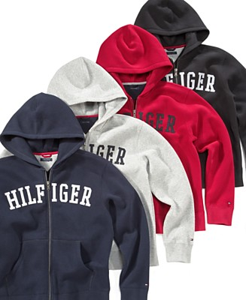
Tommy Hilfiger, 2000
Hip hop fashion progressed a lot during this decade. Hip hop culture fashions (especially hoodies and sweatpants) influenced many subcultures.
Hoodies were also worn under a sport coat. Within hip hop clothing, baggy jeans, denim-jean jackets with matching jeans were popular, along with tracksuits (primarily made of fleece that matched top and bottom usually worn with a headband for men).
Bandanas with rhinestones were popular from late 2000 to early 2002.

