Slide 1
3D Art and Design
A Level
Year 11 to 12 transitiom

Slide 2
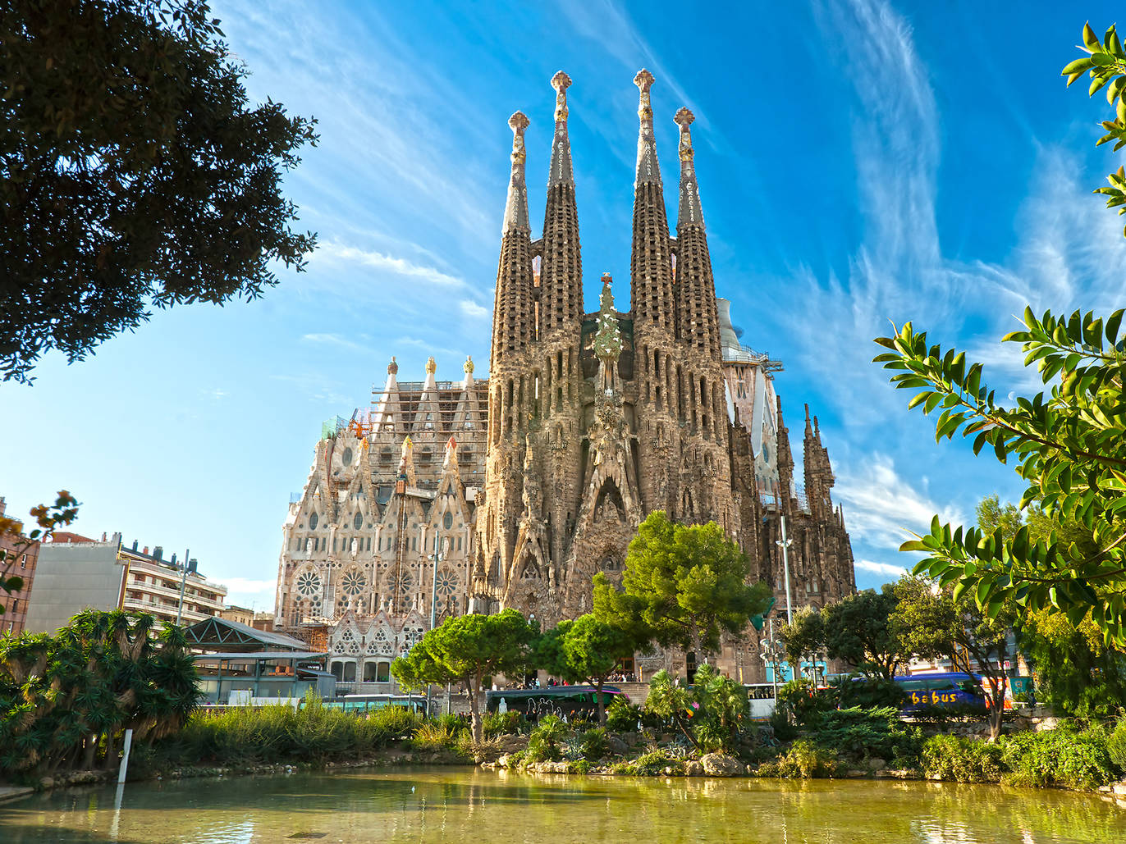
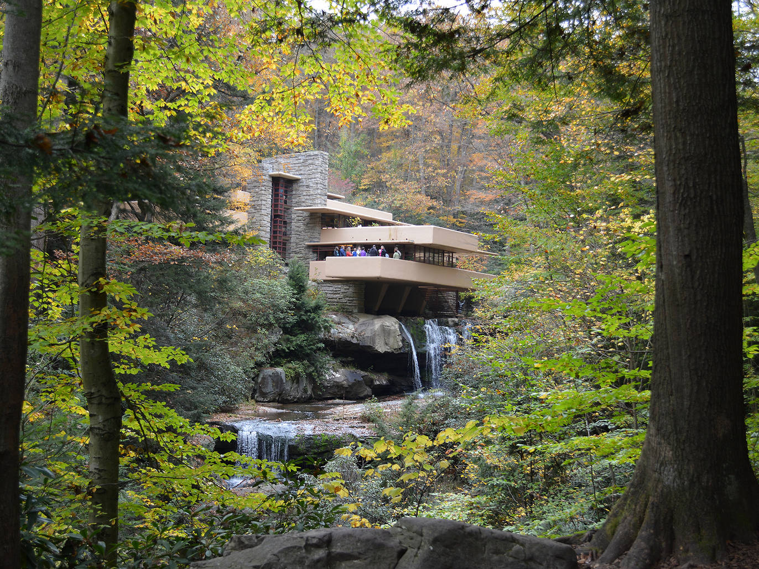
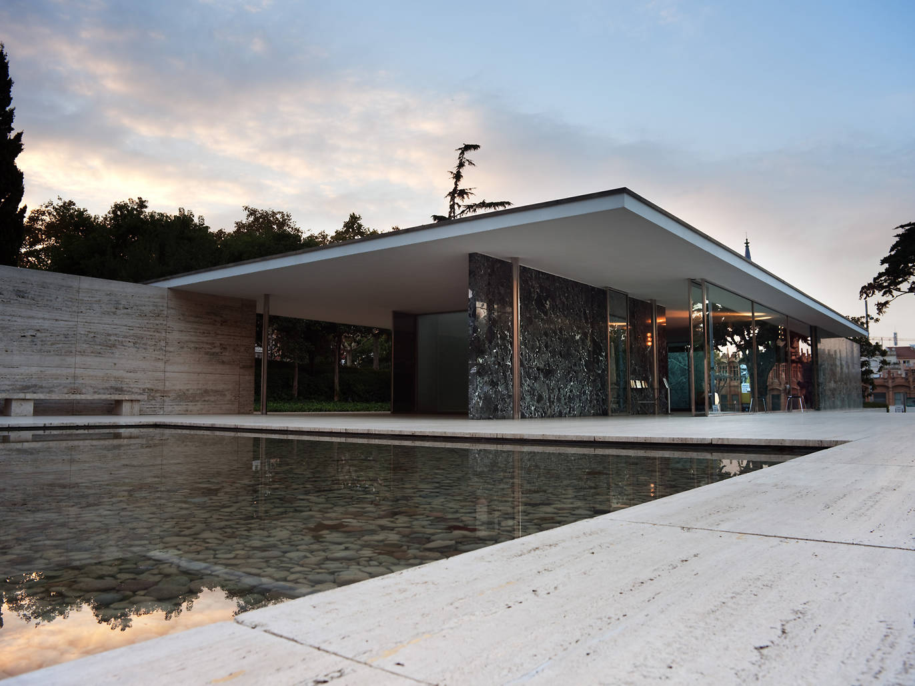
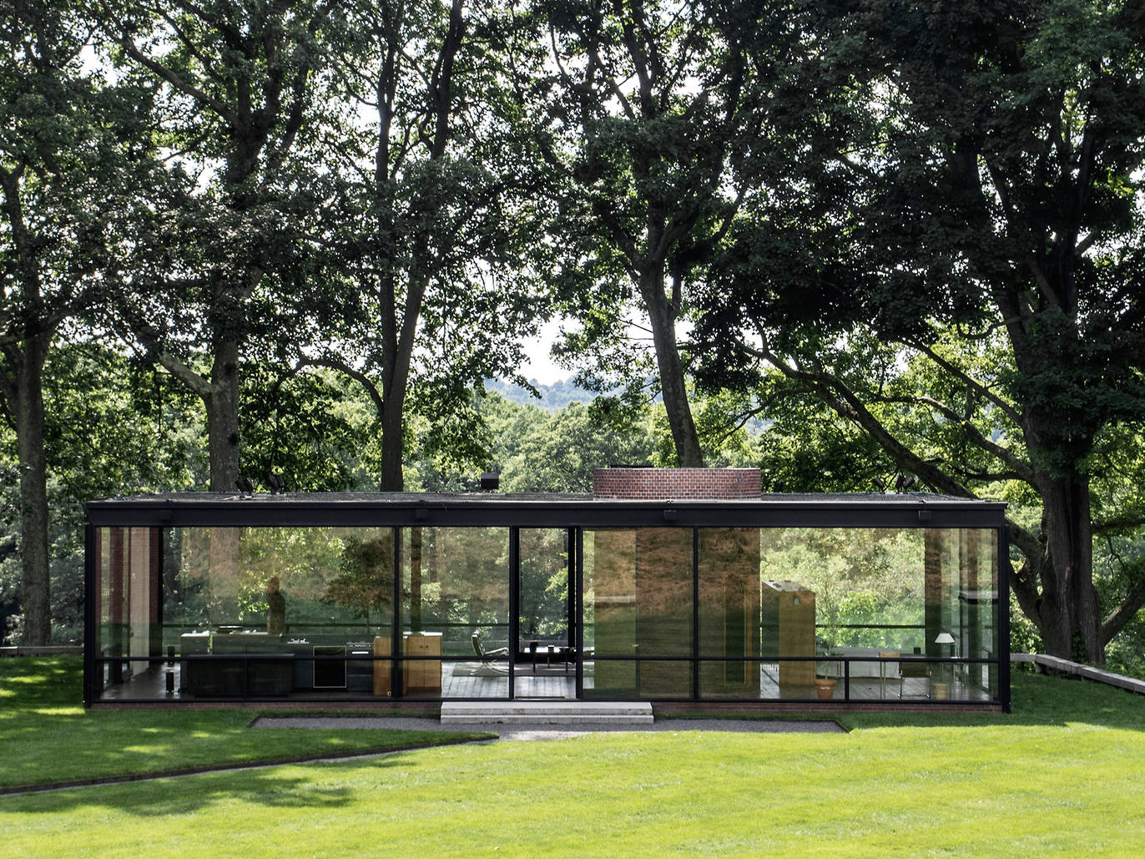
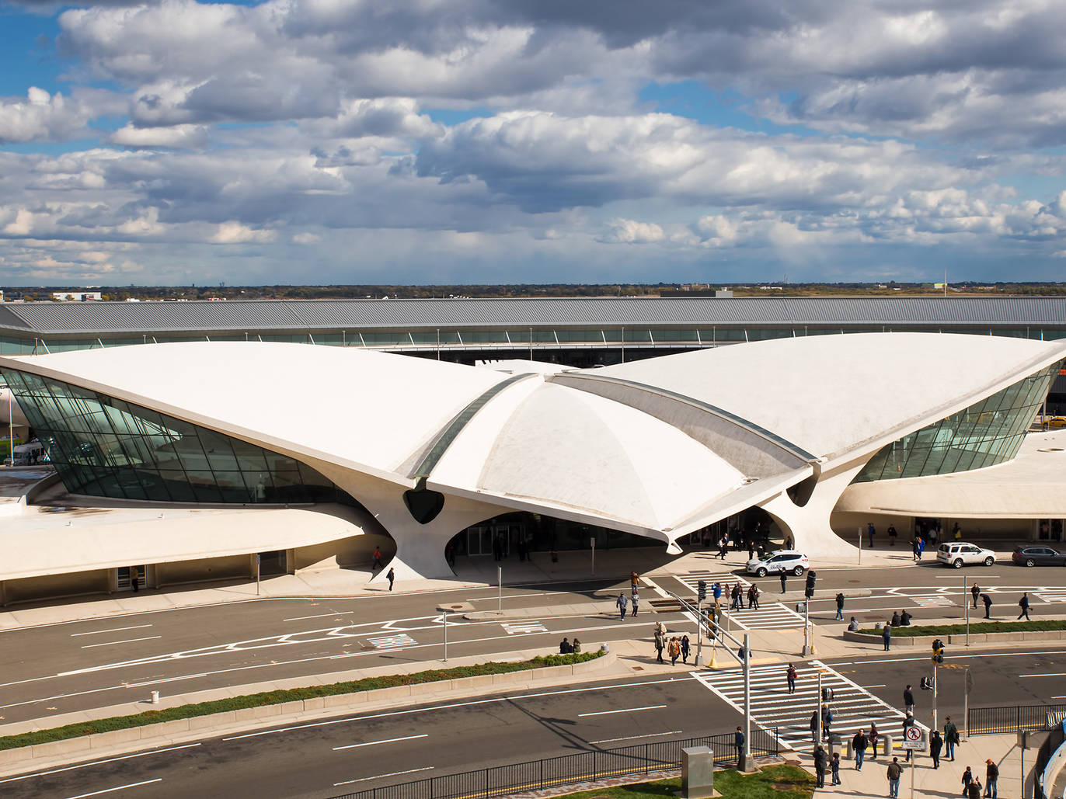
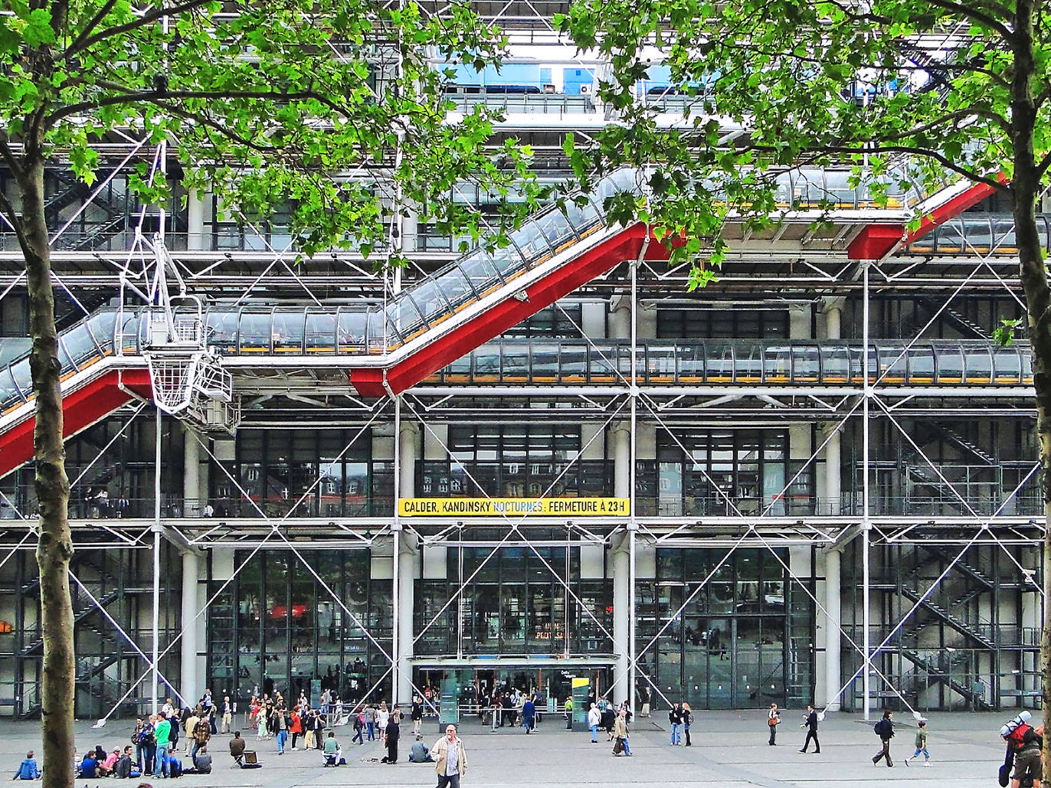
Antoni Gaudi
Frank Lloyd Wright
Mies Van der Rohe
Philip Johnson
Eero Saarinen
Richard Rogers

Slide 3
If you are thinking of choosing 3D Art and Design at A Level, there are a few tips in this PowerPoint to help you start thinking about the course.
The course encourages you to be independent and creative individuals and enables you to focus on a particular field within 3D that you wish to specialise in.

Slide 4
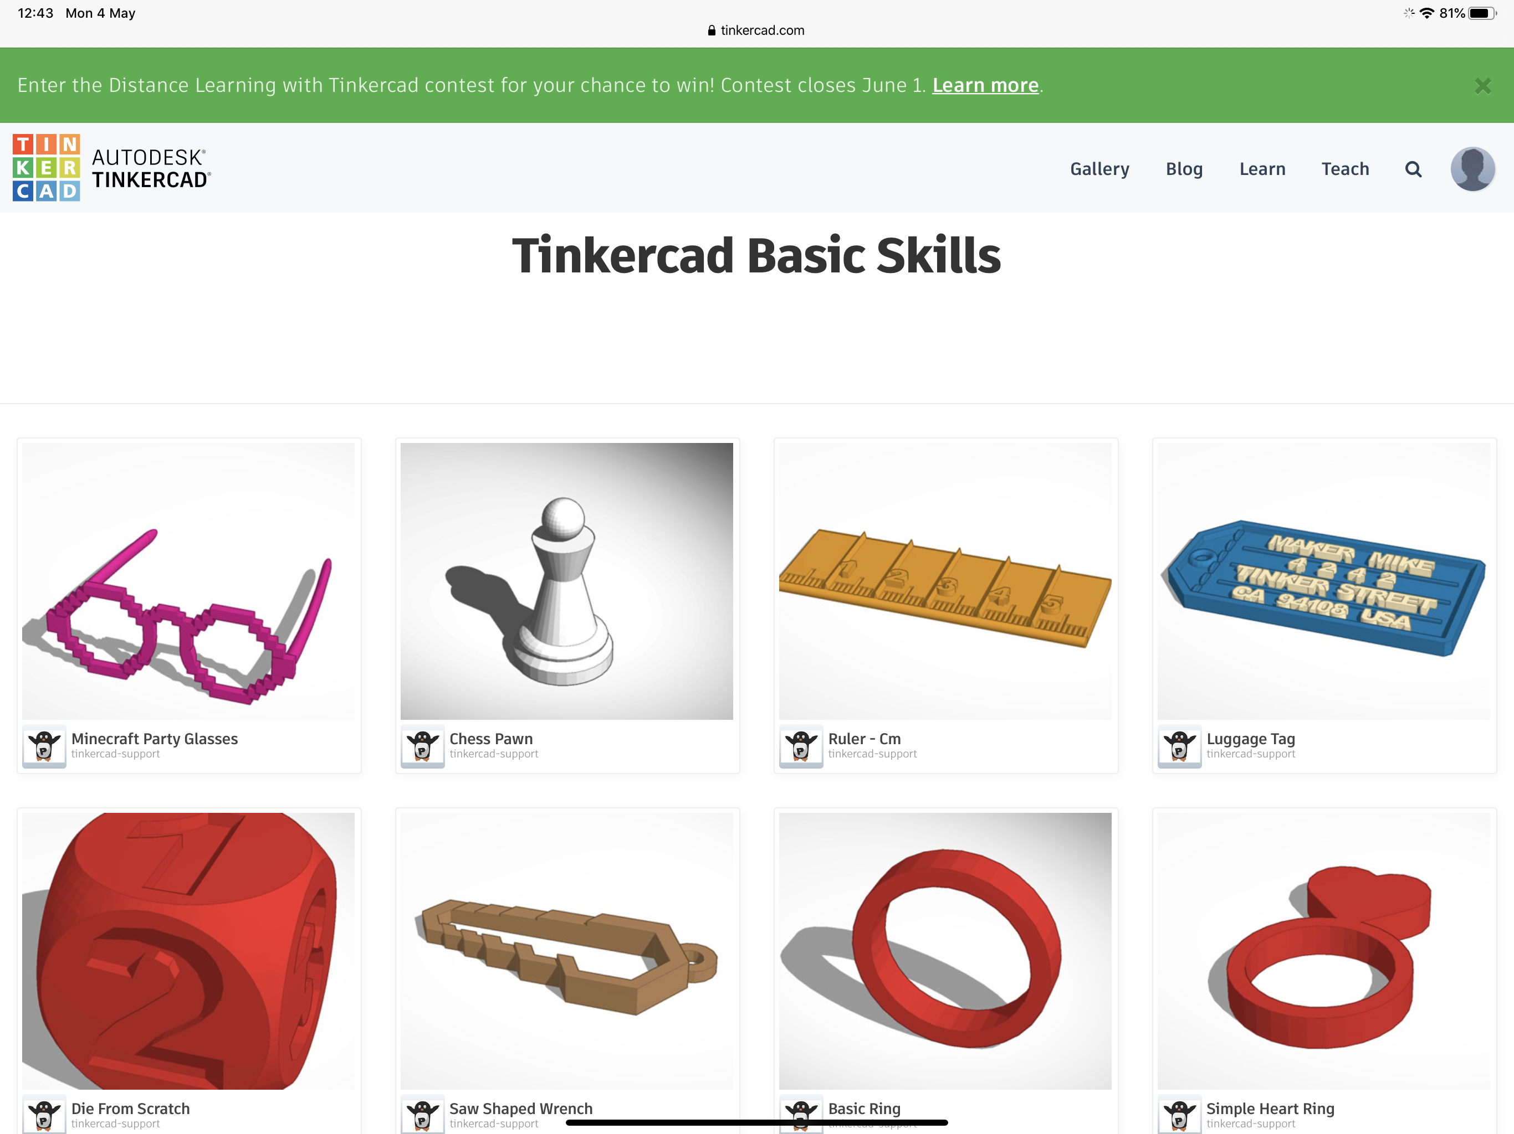
Tinkercad
Tinkercad is a program that you will come back to throughout the 3D course and therefore it will be an advantage for you to get to grips with it if you don’t know it already.
Got to www.tinkercad.com and set up an account. Use your own email address and password.
There are some tutorials that you can work through to help you learn the basics of the program. Click on the learn tab and work through the lessons available.
When you have done the lessons and tutorials, experiment with the program. Try and create your dream house, for example.

Slide 5
Areas of study
When you begin the course, there are areas of study within 3D design that you can choose to work in. They may explore overlapping areas and combinations of areas:
• ceramics
• sculpture
• exhibition design
• design for theatre, television and film
• interior design
• product design
• environmental and architectural design
• jewellery/body ornament
• 3D digital design.
It is important that you work to your strengths or your interests. For example, if architecture is a career path, then you should focus your studies on architects and architecture.
Using the theme on the next slide, start to do some research on a field within 3D that you think interests you.

Slide 6
Grand Scale
Architects, artists and designers often need to produce maquettes and models for work to be realised on a grand scale. They use approaches that include traditional and electronic media to develop ideas and to visualise their designs. Richard Rogers produced a skeletal design for T4 at Madrid airport. Christo and Jeanne-Claude worked on a grand scale in their wrapping projects. Claes Oldenburg produced large scale sculptures of everyday objects. Antony Gormley is famous for producing sculpture on a large scale.
Research relevant examples and produce your own finished maquette or model.

Slide 7
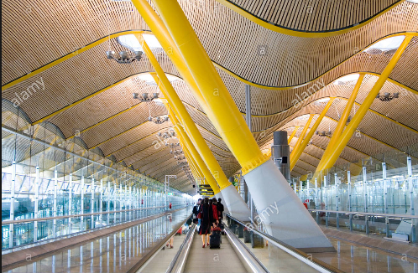
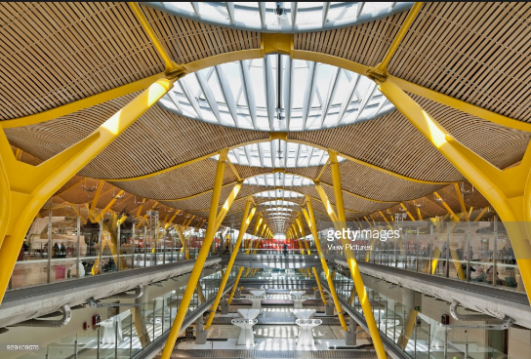
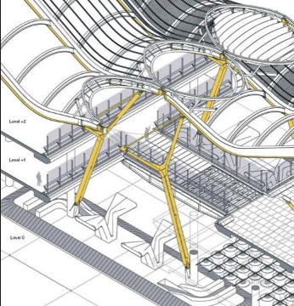
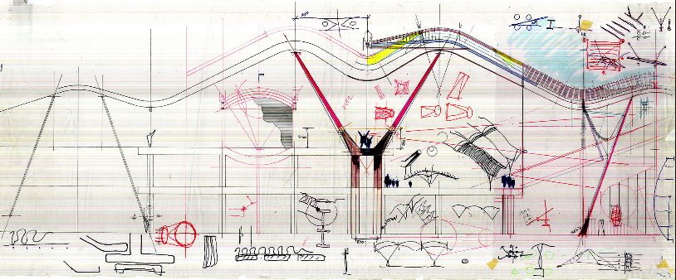
Richard Rogers
T4 Madrid Airport

Slide 8
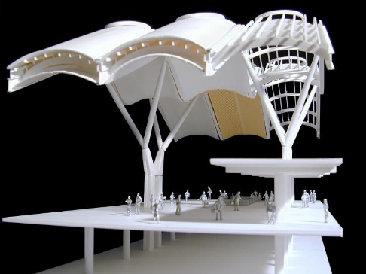
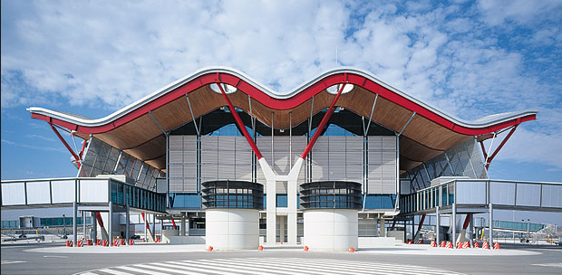
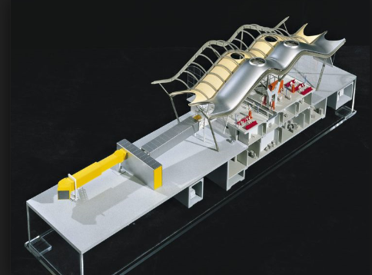
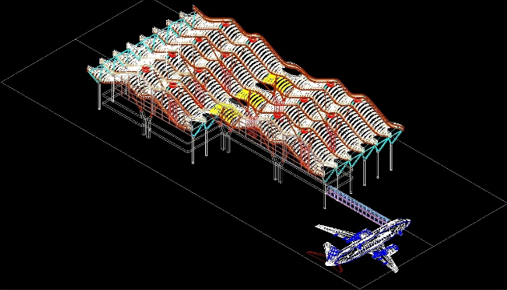

Slide 9
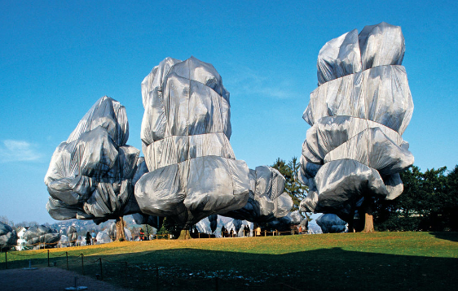
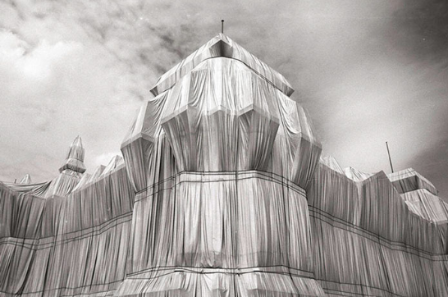
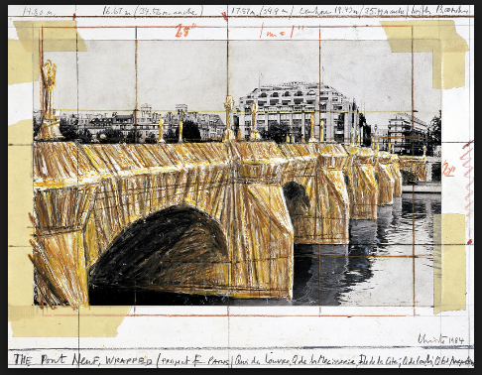
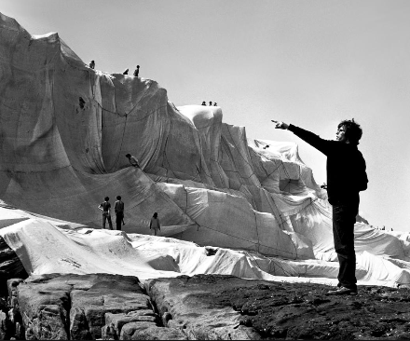

Slide 10
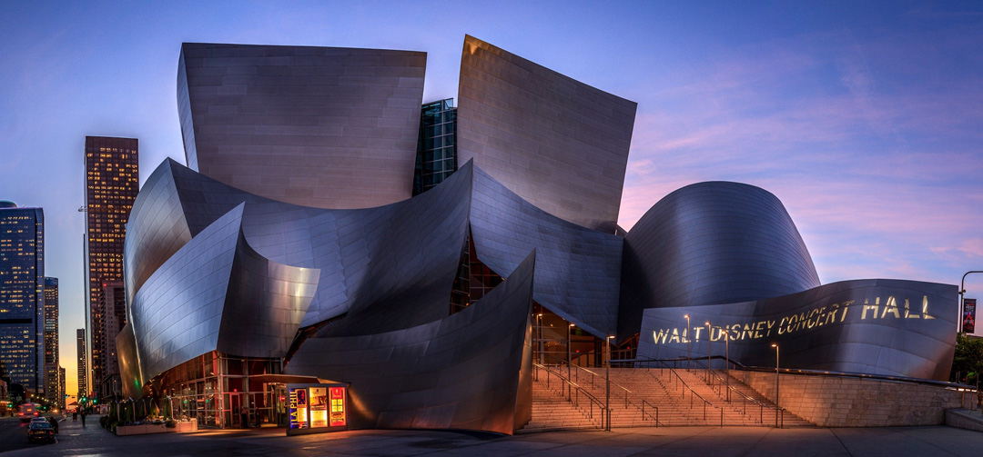
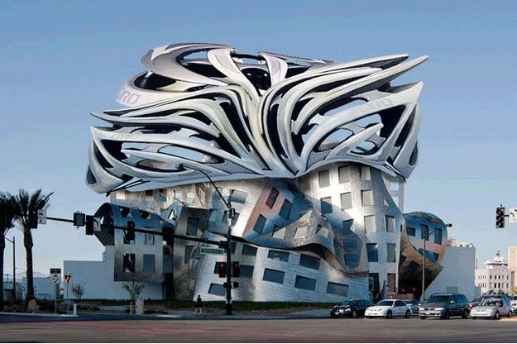
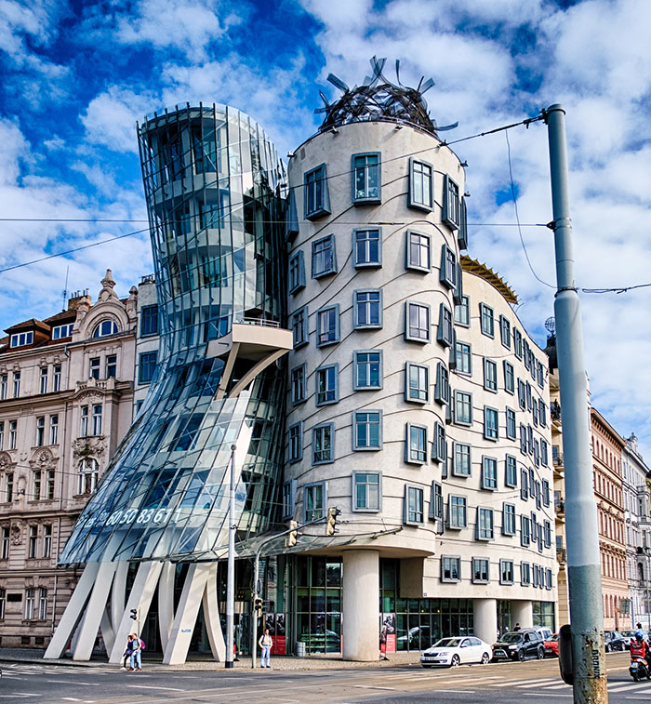
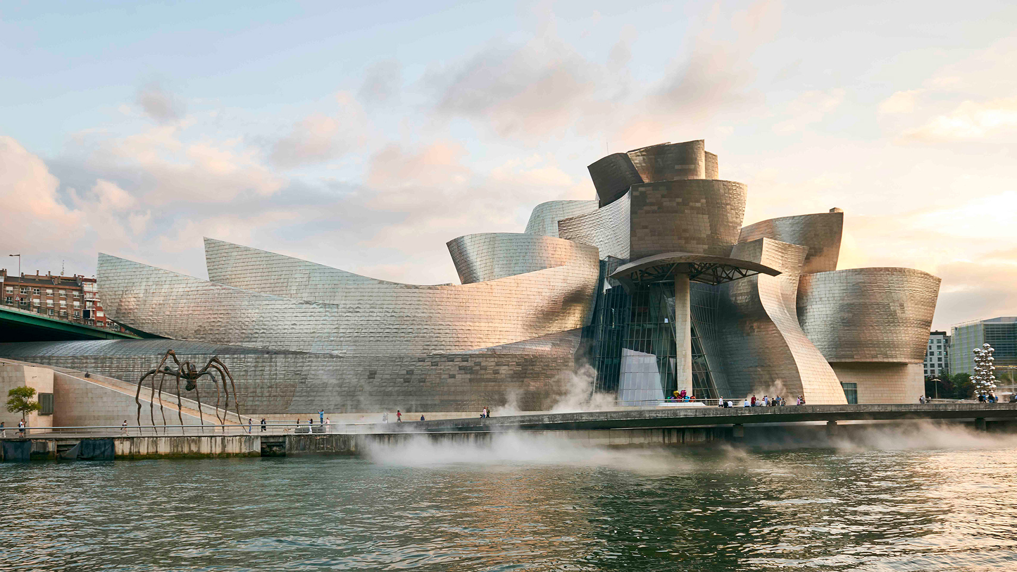
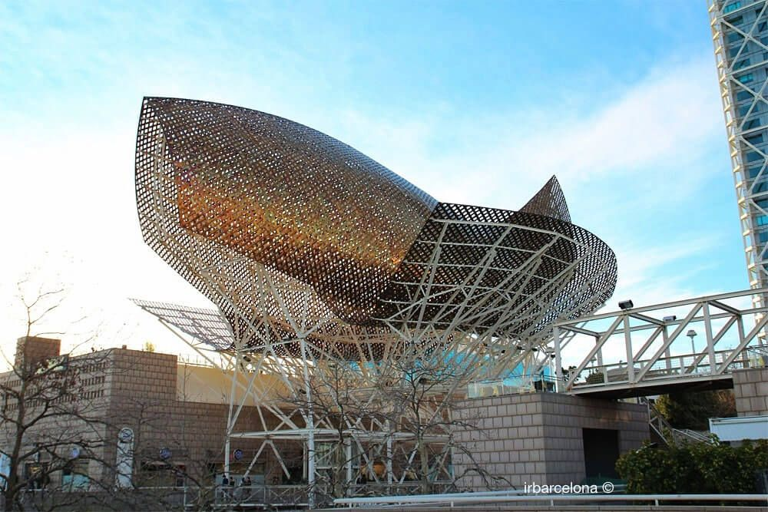
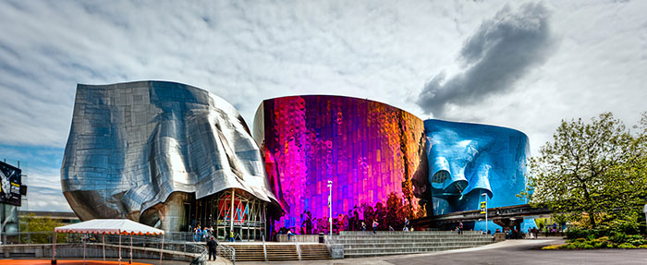
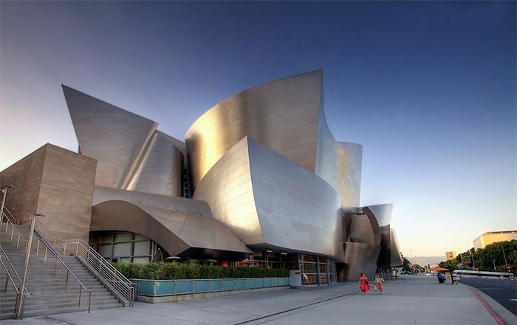
Frank Gehry
Here are some examples of good research. All of these images are by architect Frank Gehry. You can see some are sculptures and some are buildings.
Start to research some examples of 3D artists that you can research for the project Grand Scale.

Slide 11
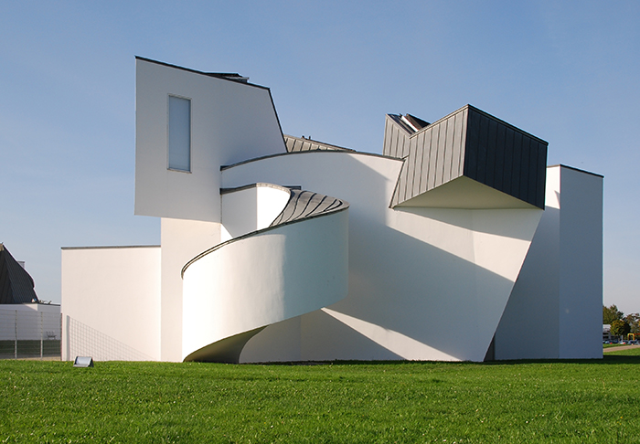
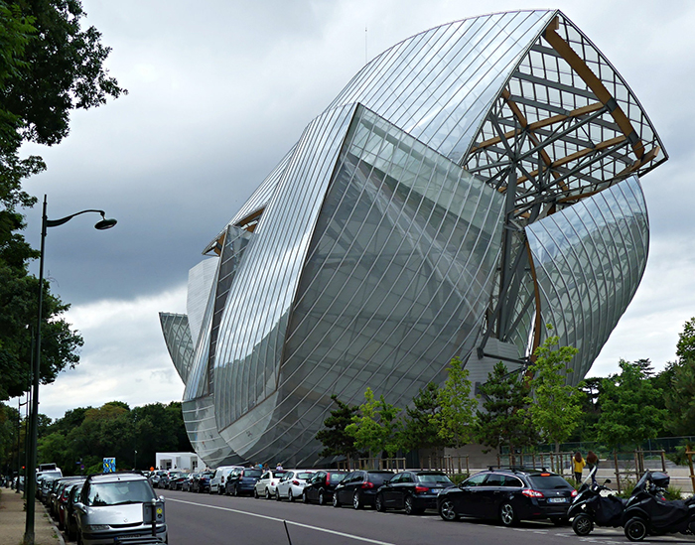
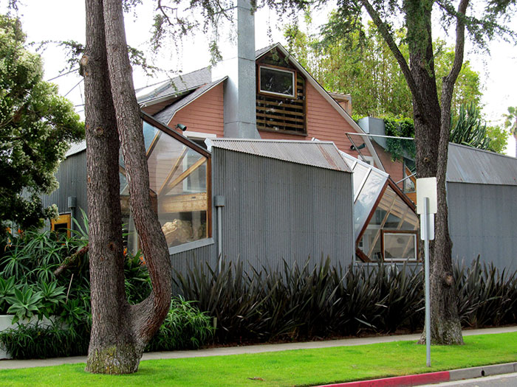
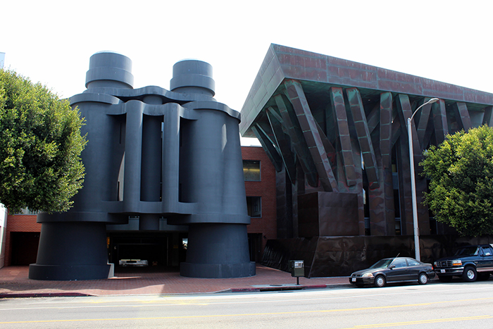
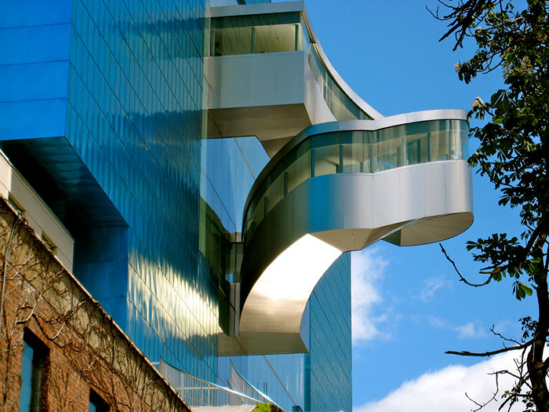
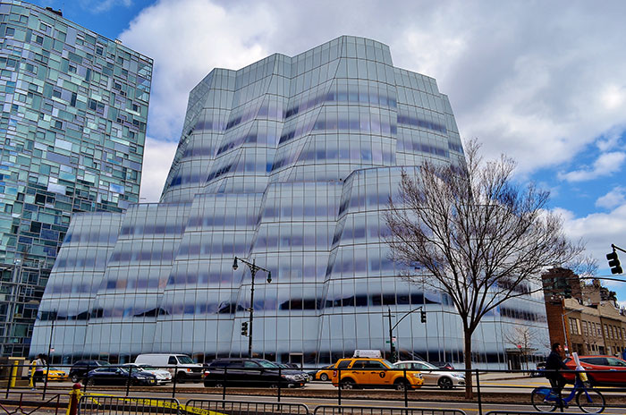
Use these images of Frank Gehry’s architecture and try to produce a design for a building or sculpture using the Tinkercad program from earlier in this PowerPoint. This work will all contribute to you’re a level and give you a head start for when you start the new course.

