Slide 1
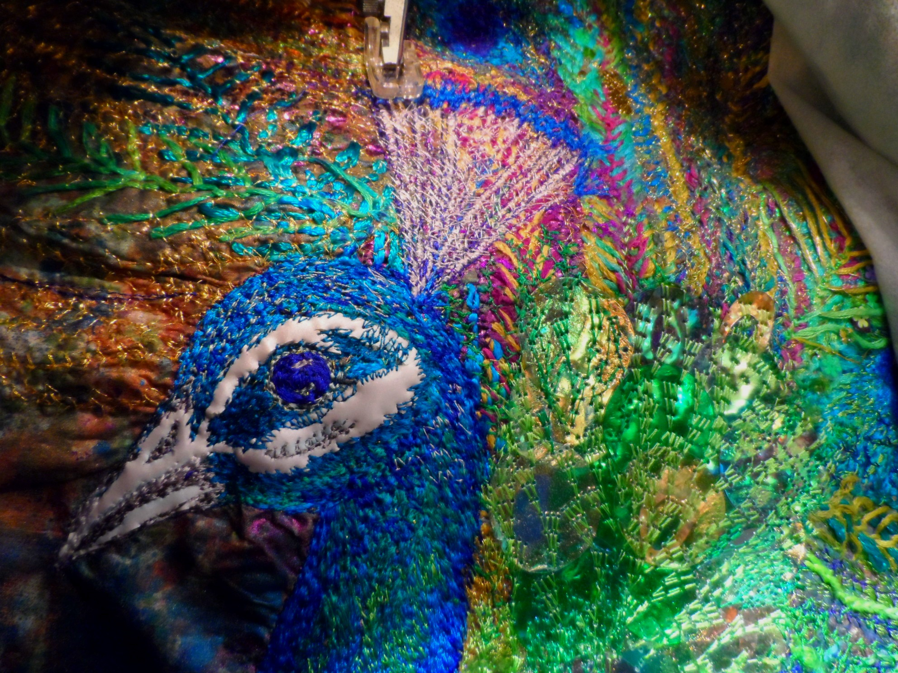

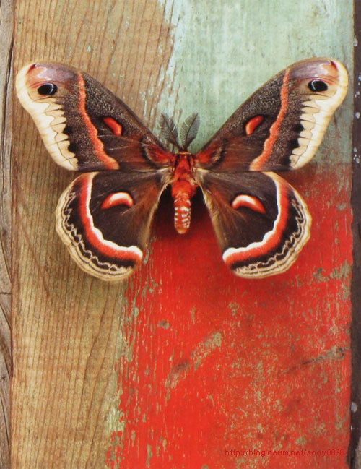
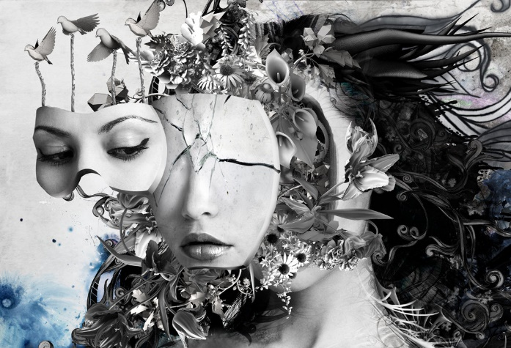
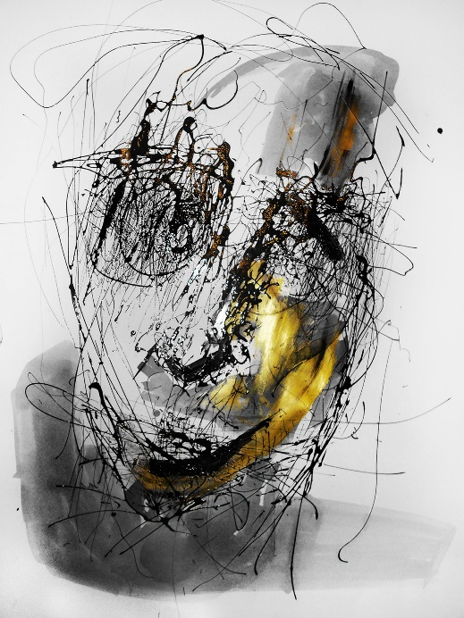
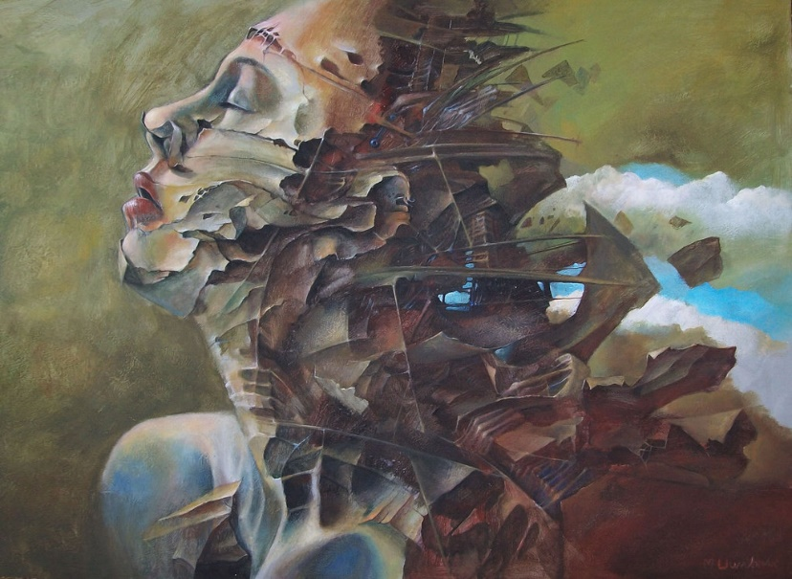
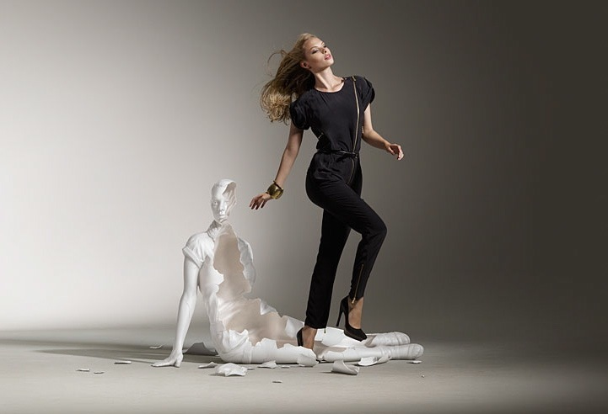
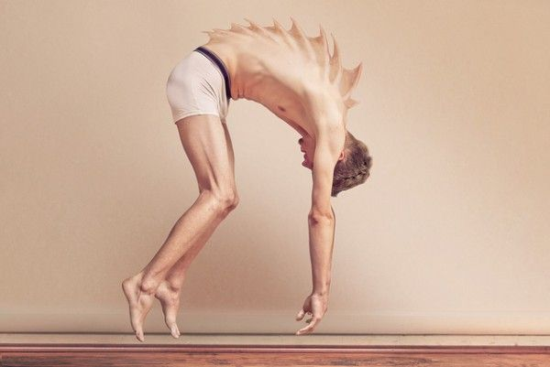
EMS Art &Design Department
Year 12:
Metamorphosis
“AN A level inspired approach to learning and investigation in Art and Design to promote individuality, independence and creativity.”

Slide 2
EMS Art &Design Department
Year 12 - 2020
This time has been very strange for us all. If You are thinking of returning to Art in September (please) I have provided here a basic power point around a theme I set for year 12 the last couple of years.
The theme is broad and designed for you to take in any direction you wish.
However if this theme does not inspire then please feel free to study whatever you wish style wise, theme wise, artist wise etc
I am open to anything you are interested in With exception (sorry to Manga and Disney..we are bigger than this)
If you are able to start a new sketchbook or work on papbe great. I will make sure I reimburse you for money spent on a new book (not your Burger King
drive through) receipts please!!!!
Also please ignore last slide.. Time planner not needed yet.
Best wishes Mrs P
“

Slide 3
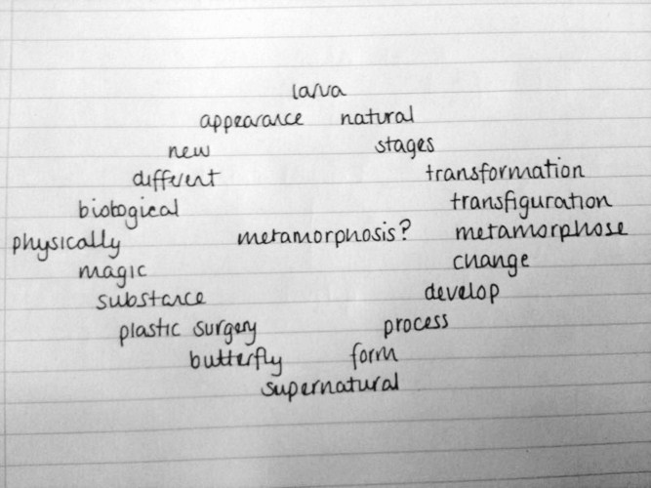







YEAR 12: METAMORPHOSIS
APECTS OF LEARNING
RESEARCH STAGE: metamorphosis
AT THE BEGIINING OF YOUR BOOK YOU NEED TO CREATE A TITLE PAGE. THIS CAN BE IN ANY FORMAT AND INCLUDE DRAWINGS, COLLAGE, PHOTOGRAPHS ETC. REMEMBER THIS IS THE FIRST PAGE SO MUST LOOK IMPRESSIVE
NEXT CREATE A STATEMENT OF INTENT
CREATE A MIND MAP, MAKE IT VASTLY MORE INTERSTING AND ADVANCED THAN THE ONE HERE!
TASK:
Complete a Detailed mind map and expand on this example which is very basic. I will provided you with an example to work from
Key Words
Detail, Explore, Investigate, Research, Analyse

Slide 4
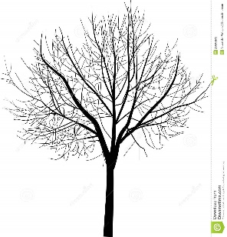
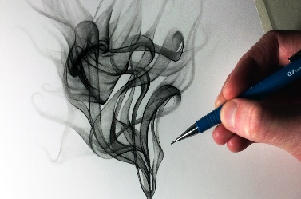
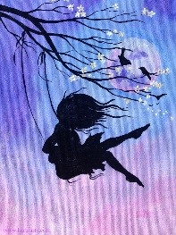

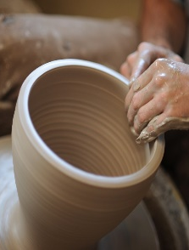
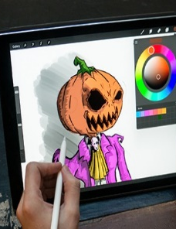
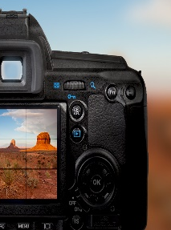
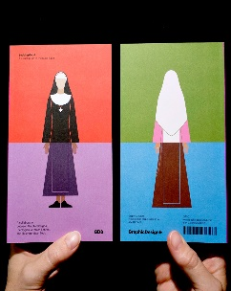
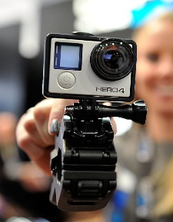
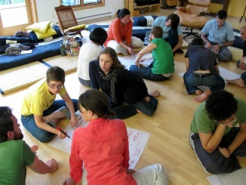
Project Theme: METAMORPHOSIS
Some suggested starting points
Natural forms
Man made
Decay
Insects and animals
Life cycle
Human form
Architecture
Surrealism
change
Tree Map
Transformation
physical
mutation
Ageing
Appearance
Emotion
Weathering
Seasons
Stages
Key areas to focus on throughout year 12:
Lots of detailed artist research, with pastiche work
Experimentation with a wide range of media and materials.
Use of a wide range of techniques and working methods
Evidence of 2D and 3D work
Evidence of a wide range of primary sources
High quality critical analysis
Evidence is clear that you are using study support sessions in the Art department
Evidence that you are working at home
Working independently and hold discussions about what you plan to do next

Slide 5
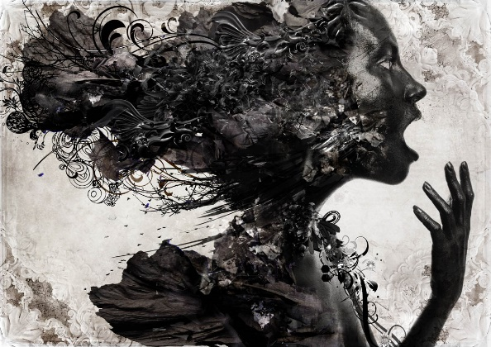
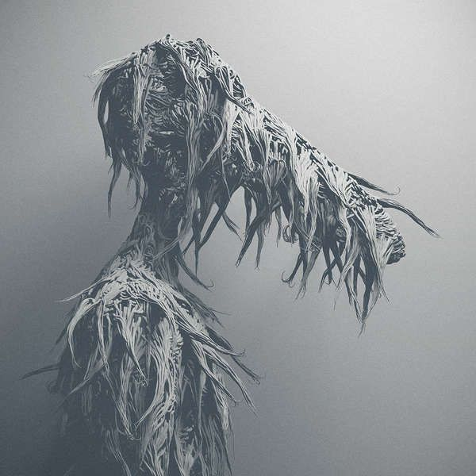
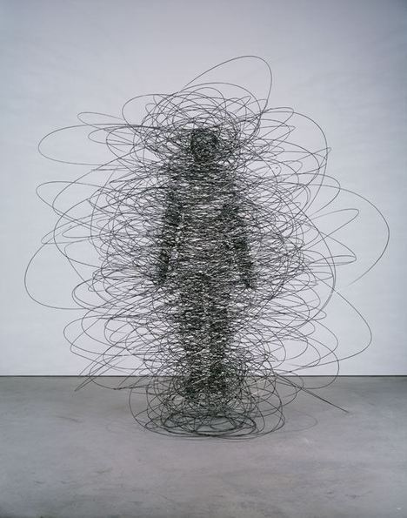
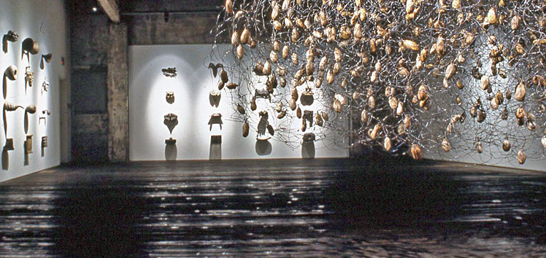
T H E B I G P I C T U R E
YEAR 12: Metamorphosis
RESEARCH:
Make a note of the artists you have researched
APECTS OF LEARNING
INTRODUCTION
Many creative people have explored the theme of Metamorphosis. Your first task is to explore the theme widely using the given starting points. I will provide examples of artists that you may find interesting, but the majority of the research should be done individually. In the first full week I will expect for you to be able to have a discussion about your starting point. Remember this year is all about creating a body of work where you have experimented and researched in a broad sense to enable to narrow your area of interest later in year 12, going in to year 13.
This will lead to exciting work.
TASK:
Research appropriate sources, using the prompts provided, to help you produce your own work that explores Metamorphosis.
Key Words
Explore, Investigate, Research, experiment Analyse

Slide 6
YEAR 12: STATEMENT OF INTENT: METAMORPHOSIS
APECTS OF LEARNING
LEARNING ACTIVITY:
STATEMENT OF INTENT
The theme of this project is.……. The aim of the project is to strengthen my use and understanding of ……. I will also focus on working from direct observation and primary sources. I will be working with a range of media and materials and be expected to work with new processes and techniques, which will include working with……
I will also be set tasks that use photographic techniques in lessons and as part of homework. This will help me to show evidence in my sketchbook of primary sources. As part of the project I will also research relevant artists, craftspeople, sculptors and photographers to give me inspiration for my own sketchbook work, design ideas and outcomes.
After completing a body of sketchbook work I will then go on to create a range of design ideas for a final outcome which will hopefully demonstrate the skills I have developed and the artists that have inspired me. The final outcome could be in any media of my choice, but must reflect the research and exploration carried out in the sketchbook. At the end of the project I will critically analyse and evaluate the project.
Key Words
line, form, shape, proportion, scale, texture, surface, detail, form

Slide 7
Year 12 : PERSONAL INVESTIGATIONS AROUND THE THEME
EACH OF YOU HAVE TACKLED THE ABOVE SUGGESTED THEME IN DIFFERENT WAYS AND DEVLOPED YOUR OWN PERSONAL COURSE OF STUDY. AT THIS POINT IT IS VITAL THAT YOU
SPEND THE NEXT 12 WEEKS PLANNING TIME EFFECTIVELY TO COMPLETE THE COURSE WORK TO THE HIGHEST OF STANDARDS. THIS MEANS A STRONG VISUAL AND SKILFUL SKETCHBOOK
AND A RANGE OF ORIGINAL OUTCOMES OUTSIDE OF THE SKETCHBOOK FOR YOUR PORTFOLIO. THE EXAM PAPER WILL BE ISSUED THE FIRST WEEK IN FEBRUARY AND COUSREWORK WILL
BE COMPLETE.
Natural forms
Man made
Decay
Insects and animals
Life cycle
Human form
Architecture
Surrealism
change
Tree Map
Transformation
physical
mutation
Ageing
Appearance
Emotion
Weathering
Seasons
Stages
Key areas to focus on throughout the remaining time in year 13 for coursework:
Lots of detailed artist research, with pastiche work
Experimentation with a wide range of media and materials.
Use of a wide range of techniques and working methods
Evidence of 2D and 3D work
Evidence of a wide range of primary sources
High quality critical analysis
Evidence that you are working at home
Working independently and hold discussions about what you plan to do next

Slide 8
T H E B I G P I C T U R E
YEAR 12: PERSONAL INVESTIGATION. STARTING POINT METAMORPHOSIS
TIME PLANNER
Complete this today, plan what you need to do over the remaining time for coursework. The plan will be reviewed on a weekly basis with myself and Miss bown. Although the plan may change slightly over time it is recommended that you stick to your aims with regards to the amount of work that should be produced. For example we recommend that you should be working at a pace of 3/4 pages in your book per week, and loose outcomes outside of the sketchbook. Your studio wall space should be full of this evidence by the first week in December.
APECTS OF LEARNING
Today take the time to think about the theme of Metamorphosis. In essence the theme is change..which we have seen up close lately. I suggest that you should start by looking on Pinterest and gathering some visual imagery to get started. Please make a note of the artists names as I always forget to do this and regret it later
If you want to take this a step further I would suggest creating some of your own work around this theme. This could be drawn work or even easier photography via your phones. Think as freely as you can about the theme. It might be something very everyday like a sunflower you are growing that is getting bigger..take a picture everyday ? Or in my case how much I have messed my hair up in lock down..loots, dye jobs, hair cuts gone wrong record!!! Don’t laugh when we get back!!!!!!
Remember year 12 is anew beginning and I hop eto see many of you in my class. But in the mean time if you are coming back to me..or even thinking about it …is all about experimenting and enjoying art with no pressures.
Please don’t feel like you will be assessed (unless you want to be) on the work you produce. Have a great time creating Art
I hope you and your families are all well. Take care Year 11..possibly year 12
Best wishes Mrs P
TASK:
COMPLETE THE TIME PLANNER. SELECT AN IMAGE/DRAWING/SKETCH FOR YOUR BOOK FROM WHICH YOU CAN START TO CREATE A LARGER PIECE OF WORK FOR YOUR PORTFOLIO. ALSO CONSIDER URGENTLY..DO YOU HAVE ENOUGH EVIDENCE OF PRIMARY SOURCES?
Key Words
Explore, Investigate, Research, experiment Analyse

Slide 9
YEAR 13 A LEVEL COURSE WORK TIME PLANNER
APECTS OF LEARNING
Week 1 NOV 4TH – 11TH
Week 2 NOV 11TH -18th
Week 3 NOV 18TH 25TH
Week 4 NOV 25th – 2ND DEC
Week 5 DEC 2ND – 9TH
Week 6 DEC 9TH – 16TH
Week 7 DEC 16th – 20TH
Week 8/9 DEC 20th – 6TH JAN | CHRISTMAS HOLIDAY
Week 10 JAN 6TH – 13TH
Week 11 JAN 13th - 20th
Week 12 JAN 20th – 27TH
Week 13 Week JAN 27TH - 3RD FEB EXAM PAPER TO BE GIVEN MONDAY 3RD FEBRUARY

