Slide 1
Year 12 Graphic Design

Slide 2
If you are considering Graphic Design at A level, we have put this PowerPoint together to help you generate some ideas and give you a head start on the first project in Year 12.
1985 Movies – 35th Anniversary DVD covers
There are some classic movies that were made in 1985. Your task is to redesign the DVD cover and promotional material for a special 35th Anniversary edition DVD of one of the movies for a release this year. The package could take the form of a ‘box set’ along with designs for the dvd sleeve and promotional material such as a poster and point of sale.
This is a good opportunity for you to do some research and start to think about which movie you may choose.
Your dvd should be a complete re-Design of the original, including suitable artwork and fonts.
This is a great project to learn about typefaces, the relationship between text and image and generally what works for a project such as this. We want to see professional results that you could see on the shelf in a store.

Slide 3
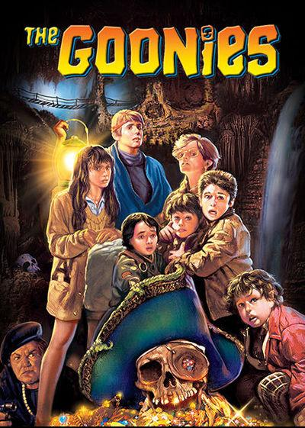
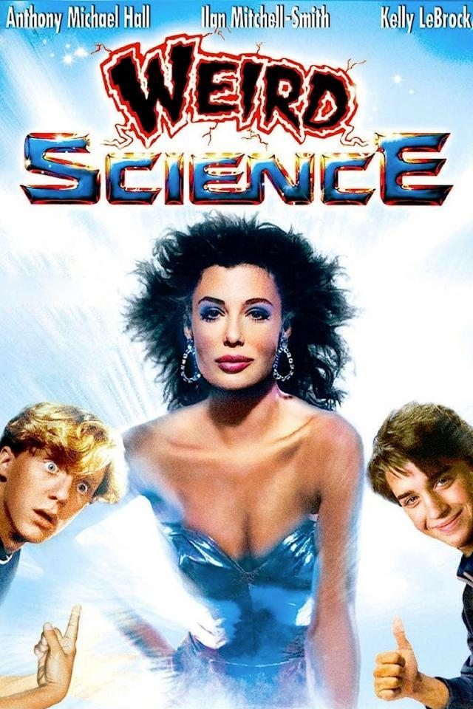
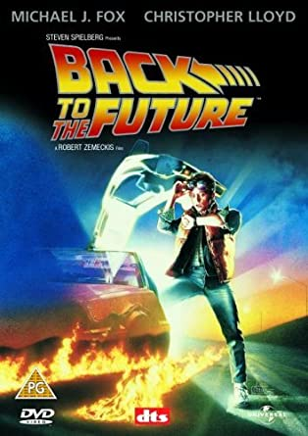
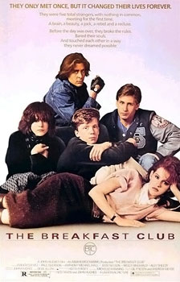
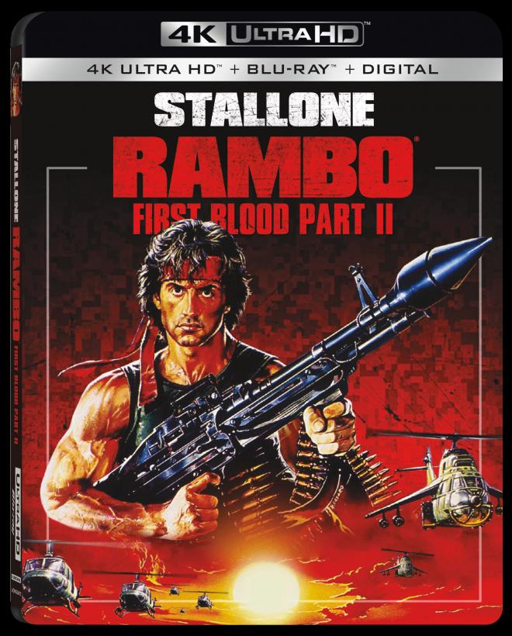
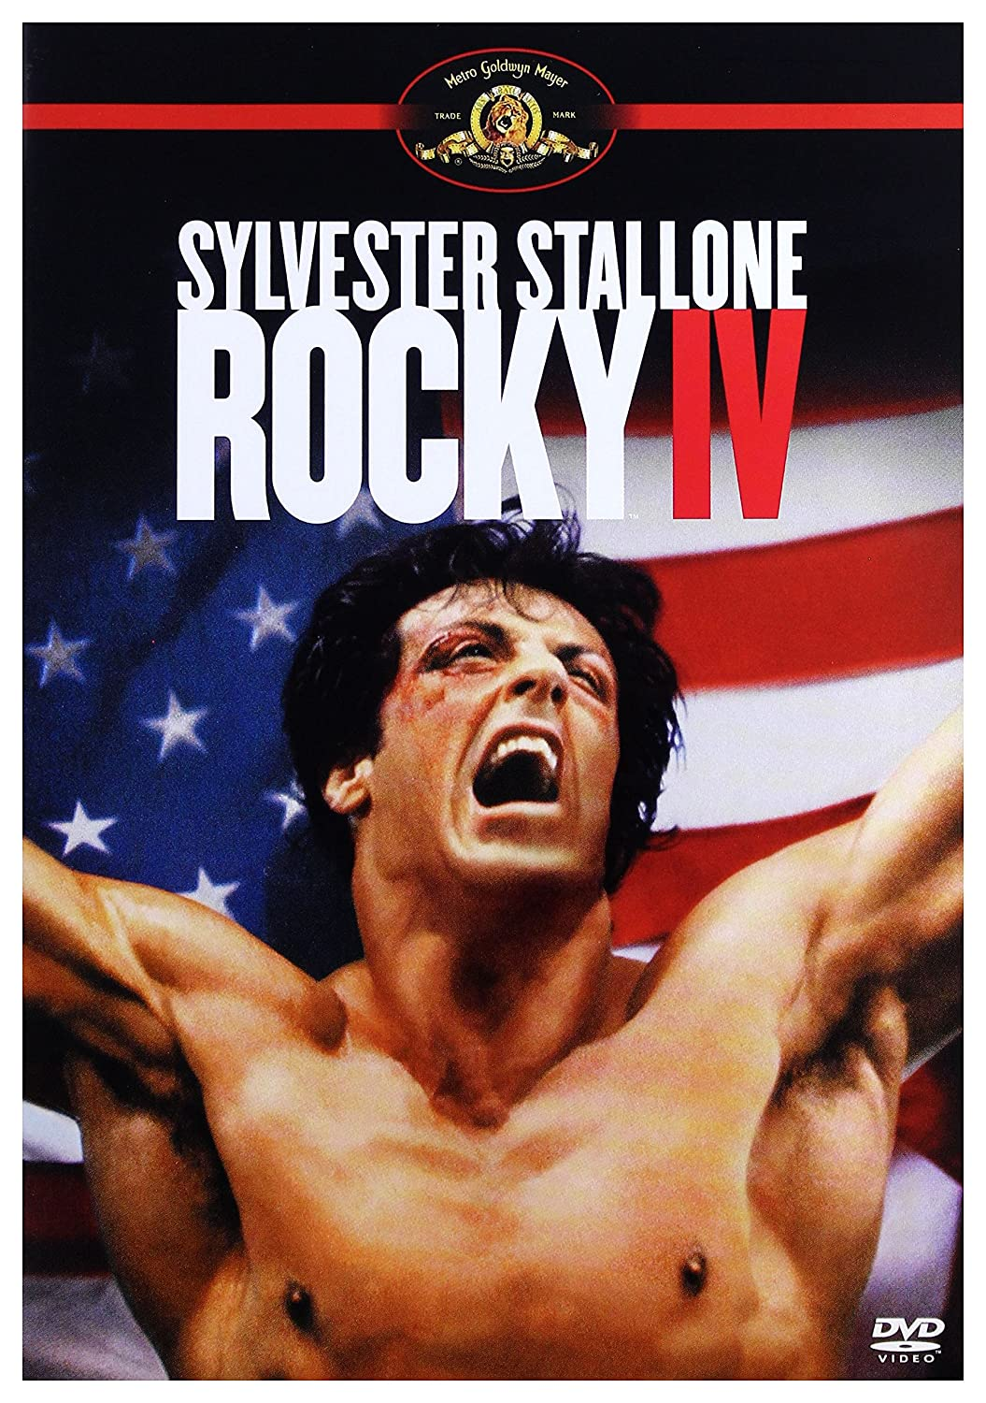
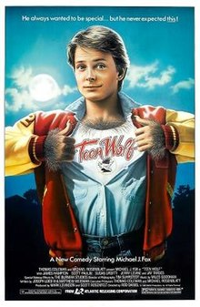
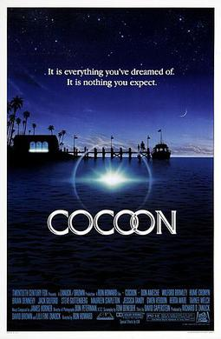
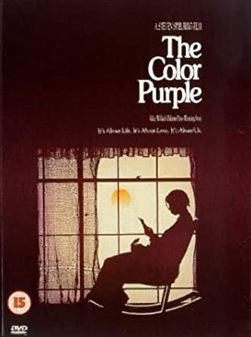
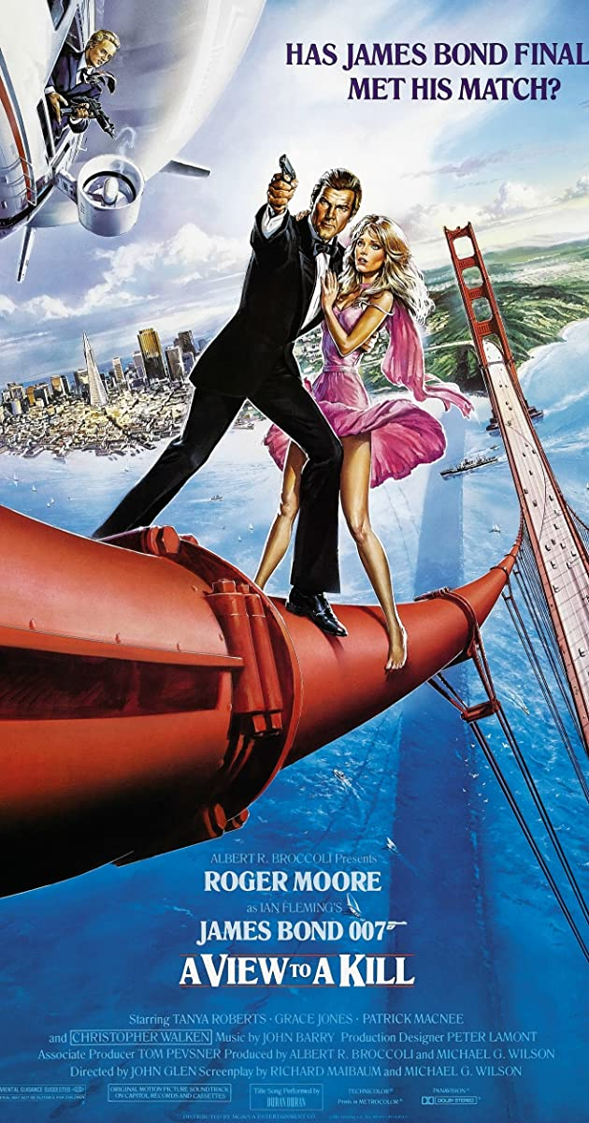
Just some of the great movies released in 1985. You may need to watch them if you have not already seen them!

Slide 4
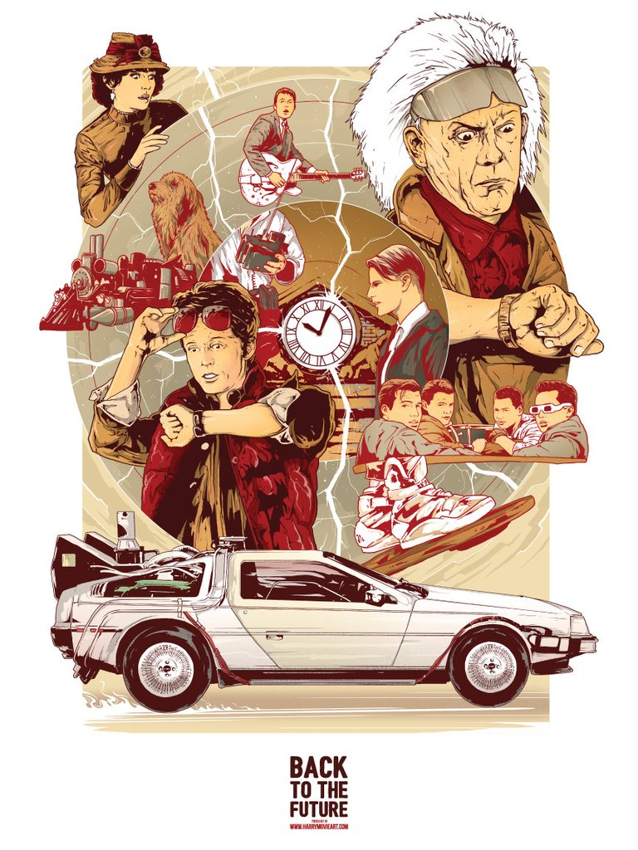
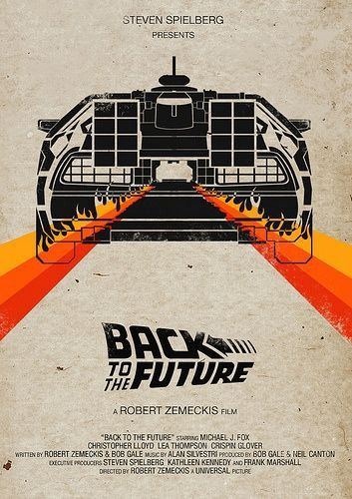
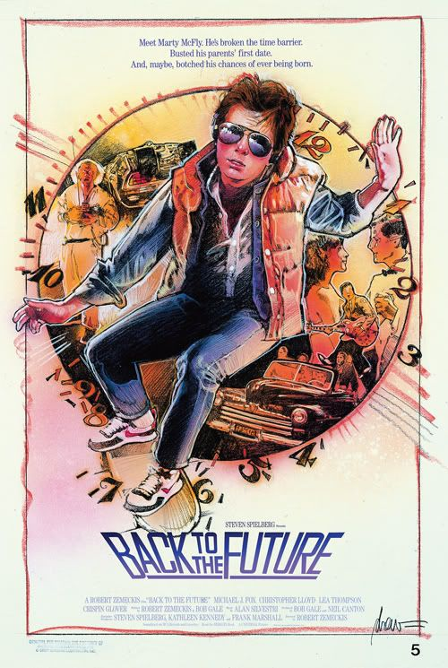
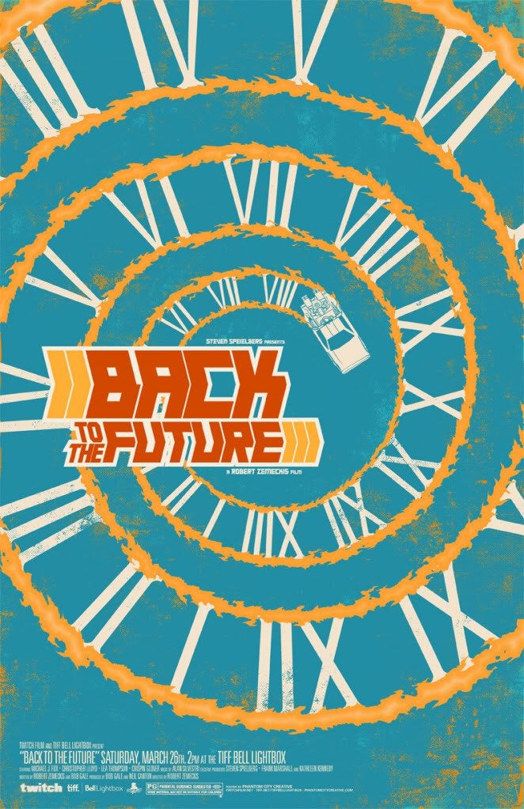
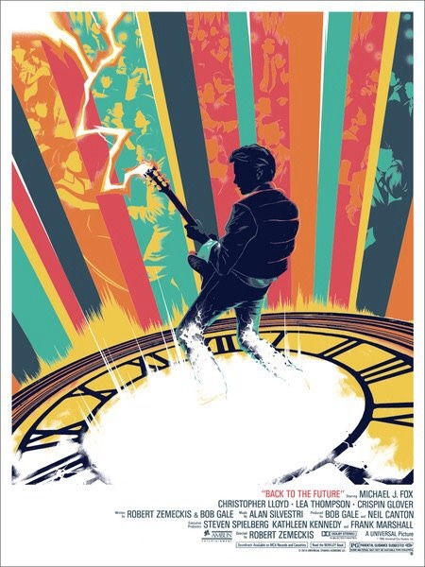
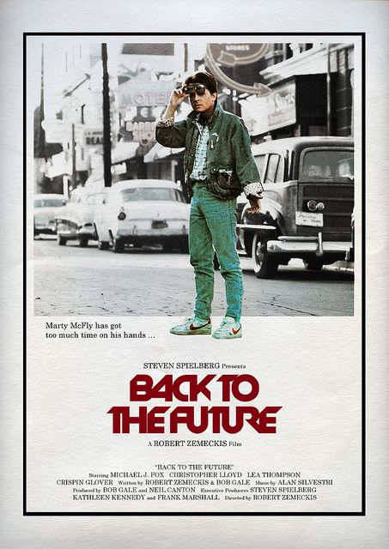
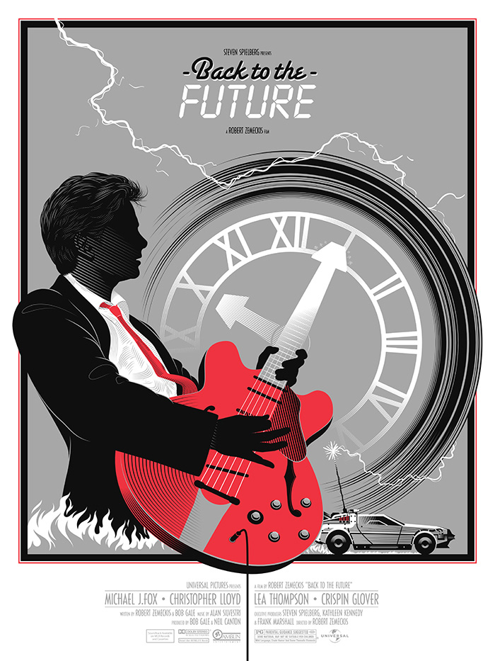
These are some alternative versions of Back to the Future which should give you an idea of how you can re-imagine the existing covers using illustration and typography.

