Slide 1
AQA A LEVEL LAW
INTRODUCTION TO LAW AT EMS

Slide 2
L.O. To be able to define what is meant by law

Slide 3
Activity 1: What do we mean by ‘the law’?
Definition: Write it on your sheet

Slide 4
2. Can you add to this (on your sheet) after listening to the lecturer’s definition of ‘the law’?
https://www.youtube.com/watch?v=1_ecJOUlHCY

Slide 5
Answers: Definitions of ‘the law’ could include/refer to:
a set of binding rules
rules set down by the government
rules that allow us to do certain things and stop us from doing other things
a form of regulation for society
ideas that holds society together
an agreement to do what is required in everyone’s best interests.
what are the problems in defining ‘the law’? Answers could include:
Something that covers such a broad number of issues is difficult to pin down to one thing
Differences in opinion as to what should or should not be law
The conflict between accepting a law’s moral or pragmatic origins e.g. abortion

Slide 6
LO To be able to describe the differences between civil and criminal law

Slide 7
Law Table Activity 3 - Please complete the table which shows the differences between civil and criminal law (we will add relevant cases).
ELS | Civil Law/Cases | Criminal Law/Cases
Purpose of the Law
Legal name for the individual starting the case
Main courts dealing with/hearing the case
Standard of proof required
Person(s) making the decision
Legal name(s) of the decision
Powers of the court

Slide 8
ANSWER: Activity 3 - Law Table
ELS | Civil Law/Cases | Criminal Law/Cases
Purpose of the Law | To establish and uphold the rights of the individual and to regulate the interaction of individuals | To protect society from criminal activities and to maintain law and order in society
Legal name for the individual starting the case | Claimant (the person who feels that their rights have been interfered with). | The police, the Crown Prosecution Service and certain private organisations
Main courts dealing with/hearing the case | County Court or High Court | Magistrates’ Court or Crown Court
Standard of proof required | On the balance of probability | Beyond all reasonable doubt
Person(s) making the decision | Judge – but on rare occasions, a jury | Magistrates or jury (depending on where case is heard)
Legal name(s) of the decision | Liable or not liable | Guilty or not guilty
Powers of the court | Often will grant damages but can also grant specific performance, an injunction or other contractual or equitable remedy. | Wide variety of sentences including discharges, fines, disqualification from driving, community sentences and prison.

Slide 9
ACTIVITY 4 – Civil/criminal terminology
Prosecuted
Punishment
Liability
Fine
Damages
Compensation/
Sentence
Sued
Claimant
Private law
Public law
Defendant
Guilty

Slide 10
ACTIVITY 4 – Answers - Civil/criminal terminology
Prosecuted
Punishment
Liability
Fine
Compensation/damages
Sentence
Sued
Claimant
Private law
Public law
Guilty
Defendant
Key: Red = criminal Green = civil Blue = civil and criminal

Slide 11
ACTIVITY 4 – Criminal Terms – more information
Public law – Crimes are committed against the state.

Slide 12
ACTIVITY 4 – Criminal Terms
Prosecuted – offenders are prosecuted by the Crown Prosecution Service on behalf of the Crown.

Slide 13
ACTIVITY 4 – Criminal Terms
Punishment – criminals are punished for their wrongdoing.

Slide 14
ACTIVITY 4 – Criminal Terms
Fine – this is a financial penalty which is a form of punishment for certain crimes.

Slide 15
ACTIVITY 4 – Criminal Terms
Sentence – this is the choice of penalty given to a criminal.

Slide 16
ACTIVITY 4 – Criminal Terms
Guilty – this is the verdict in a criminal case where the crime has been proved.

Slide 17
ACTIVITY 4 – Criminal /Civil
Criminal Liability – an offender is found criminally liable (or guilty)
also
Civil Liability – the person responsible is said to be liable.

Slide 18
ACTIVITY 4 – Criminal/Civil Terms
Criminal - Defendant – this is the name given to the person charged with a crime.
also
Civil - Defendant – the person who the claim is made against.

Slide 19
ACTIVITY 4 – Civil - Terms
Private law – civil disputes are between private individuals.

Slide 20
ACTIVITY 4 – Civil Terms
Sued – the person making the claim sues the other party.

Slide 21
ACTIVITY 4 – Civil Terms
Compensation/damages – this may be awarded to the winning party to restore any losses they have suffered.

Slide 22
ACTIVITY 4 – Civil Terms
Claimant – the person making the claim.

Slide 23
Activity 5 - Complete the table with the correct civil v criminal terms
 | Criminal Law | Civil Law
Public or private?
Which courts?
The defendant is…?
The outcome of the case is…?
If responsible, the defendant is…?
Examples:
Burden of proof
Standard of proof
Cases are written as:
Example of a case:

Slide 24
Answers | Criminal Law | Civil Law
Public or private? | Public - a crime is committed against the state. | Private - a civil case is a dispute between individuals.
Which courts? | Magistrates’ Court deals with petty crimes / Crown Court deals with serious crimes. | Trials held in County Court or the High Court depending on the value and complexity of the case.
The defendant is…? | The defendant is prosecuted. | The defendant is sued.
Outcome of case is D is ? | Guilty or not guilty | Liable or not liable
If responsible, the punishment/remedy is? | The wrongdoer is punished and sentenced. | If found to be liable, the defendant may have to compensate the claimant – e.g. damages
Examples: | Examples of crimes include: theft, murder, assault etc. | egs of civil disputes: negligence, contract law & family law.
Burden of proof | The prosecution has the burden of proof to show the defendant is guilty. | The claimant has the burden of proof to show the defendant is liable.
Standard of proof | The standard of proof is ‘beyond all reasonable doubt’. | The standard of proof is on a ‘balance of probabilities’.
Cases are written: | R v Defendant | Claimant v Defendant
Example of a case: | R v Dudley & Stephens | Donoghue v Stevenson

Slide 25
Answers: Activity 5 – Civil v Criminal Terms
 | Criminal Law | Civil Law
Public or private?
Public - a crime is committed against the state.
Private - a civil case is a dispute between individuals.

Slide 26
Activity 5 - Table of terminology
 | Criminal Law | Civil Law
Which courts?
The Magistrates’ Court deals with petty crimes and the Crown Court deals with the serious crimes.
Trials are held in the County Court or the High Court depending on the value and complexity of the case.

Slide 27
Activity 5 - Table of terminology
 | Criminal Law | Civil Law
The defendant is…?
The defendant is prosecuted.
The defendant is sued.

Slide 28
Activity 5 - Table of terminology
 | Criminal Law | Civil Law
The outcome of the case is…?
Guilty or
not guilty
Liable

Slide 29
Activity 5 - Table of terminology
 | Criminal Law | Civil Law
If responsible, the defendant is…?
The wrongdoer (guilty person) is punished and sentenced.
If found to be liable, the defendant may have to compensate the claimant.

Slide 30
Activity 5 - Table of terminology
 | Criminal Law | Civil Law
Examples:
Examples of crimes include: theft, murder, assault etc.
Examples of civil disputes include: negligence, contract law & family law.

Slide 31
Activity 5 - Table of terminology
 | Criminal Law | Civil Law
Burden of proof
The prosecution have the burden of proof to show the defendant is guilty.
The claimant has the burden of proof to show the defendant is liable.

Slide 32
Activity 5 - Table of terminology
 | Criminal Law | Civil Law
Standard of proof
The standard of proof is ‘beyond all reasonable doubt’.
The standard of proof is on a ‘balance of probabilities’.

Slide 33
Activity 5 - Table of terminology
 | Criminal Law | Civil Law
Cases are written:
R v Defendant
Claimant v Defendant

Slide 34
Quiz – just for you
1. Name two civil courts
2. Name 2 criminal courts
3. Who brings a criminal case?
4. Who brings a civil case?
5.What is the standard of proof required in a criminal case?
6. What is the standard of proof required in a civil case?

Slide 35
LO
To examine an actual criminal and a civil case to extract the most important points
To apply your knowledge in order to decide whether specific cases are civil or criminal

Slide 36
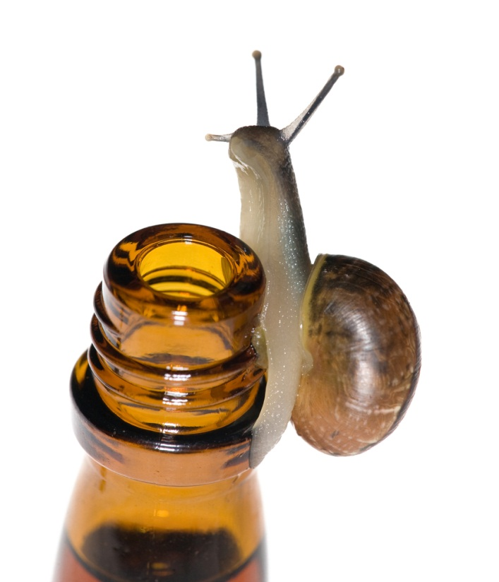
ACTIVITY 6 – a civil case
Donoghue v Stevenson (1932)

Slide 37
Civil v Criminal
Activity 6 – Donoghue v Stevenson 1932
http://news.bbc.co.uk/1/hi/business/8367223.stm
Complete the activity

Slide 38
Donoghue v Stevenson (1932)
What are the important facts of this case?
Who won the case?
What did the claimant want from the defendant?
What law comes from this case?
How does this law affect you?

Slide 39
Answers - Donoghue v Stevenson (1932)
What are the important facts of this case?
The claimant had no right to claim in contract law so she claimed in negligence. The defendant argued that they did not owe her a duty of care because she did not pay for the drink.
Who won the case?
The claimant – Donoghue.
What did the claimant want from the defendant?
Compensation for suffering gastroenteritis.
What law comes from this case?
The ‘neighbour principle’ as a way to establish a duty of care in negligence cases.
How does this law affect you?
It means that the ultimate consumer can make a claim even if they didn’t pay for the goods e.g. if your parents buy the food in your house and you get sick from it, you can still claim for compensation.

Slide 40
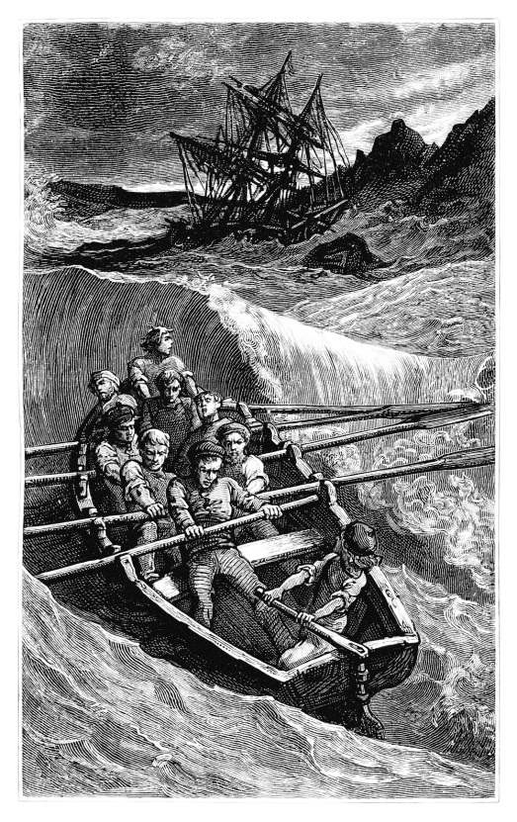
ACTIVITY 7 – a criminal case
R v Dudley & Stephens (1884)

Slide 41
Activity 7 – R v Dudley and Stephens (1884)
There is a short video clip about this case taken from the BBC Coast programme: http://www.bbc.co.uk/programmes/p018gjjp

Slide 42
Activity 7 – R v Dudley and Stephens
What are the important facts of this case?
What defence did they raise?
What was the verdict?
What law comes from this case?
What would your decision have been?

Slide 43
Answers Activity 7 – R v Dudley and Stephens
What are the important facts of this case?
The defendants were charged with murder. They claimed that they would all die if they didn’t eat the victim.
What defence did they raise?
Necessity.
What was the verdict?
They were found guilty of murder.
What law comes from this case?
The defence of necessity cannot be raised for the crime of murder. It can never be justified to kill a person to save yourself.
What would your decision have been?

Slide 44
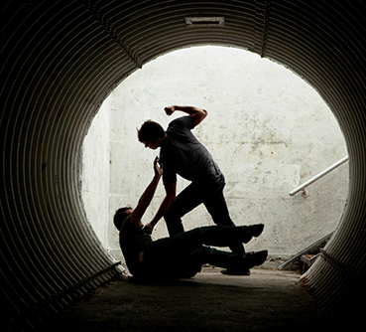
Activity 8 Criminal and Civil Law
James and John
State whether the criminal law, civil law or both would deal with the following situations:
1. James has an argument with John and punches him in the face and breaks his nose.

Slide 45
Answer - James and John
This is a criminal offence (Actual Bodily Harm).

Slide 46

Criminal and Civil Law - Sarah
2. Sarah plays her music very loud into the night. Her neighbours want to get her to stop.

Slide 47
Answer- Sarah
This is a civil dispute between neighbours (private nuisance).

Slide 48
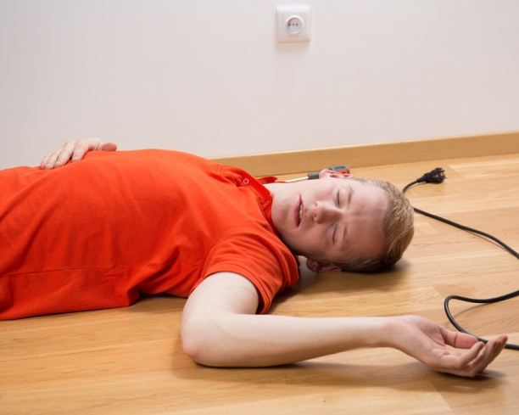
Criminal and Civil Law - Simon
3. Simon buys a DVD player from a shop. When he plugs it in he receives an electric shock.

Slide 49
Answer- Simon
Simon will most likely want compensation for his injuries so will take a civil action.

Slide 50

Criminal and Civil Law - Victoria
4. Victoria takes a bottle of wine from the supermarket and does not pay for it.

Slide 51
Victoria - Answer
This is a criminal offence (theft).

Slide 52
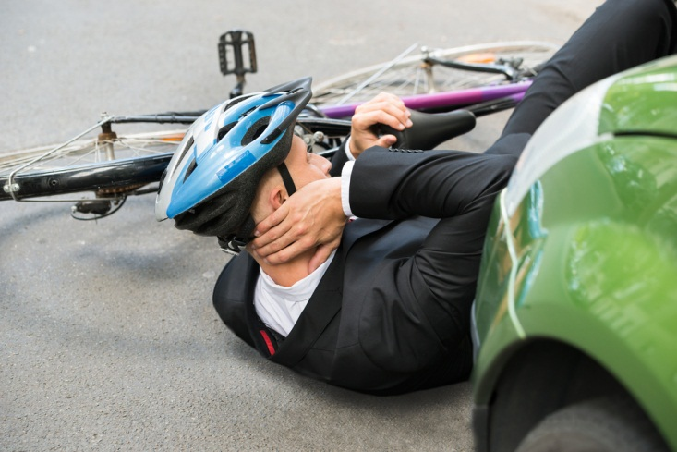
Criminal and Civil Law - Natalie
5. Natalie is late for work. She drives over the speed limit and knocks a cyclist off his bike.

Slide 53
Natalie - answer
This is both criminal and civil. Speeding is a criminal offence and the cyclist would also be able to sue for compensation under the law of negligence.

Slide 54
ACTIVITY 9 – law in every day life
Law is part of everyday life. You will have made many legally binding agreements (e.g. buying a bus ticket is a legal contract). To illustrate this point, complete the following activity:
Instructions: Look at the home page of a news website (e.g. BBC News). Try to spot the link that the law has with each story.

