Slide 1
Transition from Year 11 to 12
If you are thinking about choosing Photography in Year 12, take a look at this PowerPoint. This will give you a head start on the A Level course. You will start the course looking at a range of experimental photography techniques. There are some ideas here.
The main thing we would suggest is to take photographs. Use some of the guidelines here but take photographs of anything around your house or on your daily exercise. Perhaps the easiest thing for you to do is look at the macro part of this PowerPoint. You can take close up photographs of anything. Explore the detail of the things around you, In the house, the garden and if you go on a walk.
The formal elements are important. These include line, tone, pattern, texture, shape, form and colour. Remember these things as they are the fundamentals that you will need for A Level photography. We are always available over email if you need anything.

Slide 2
A level PHOTOGRAPHY UNIT 1 EXPERIMENTAL PROJECT Create, imagine, experiment

Slide 3

Look at this website for creative photography ideas
https://www.studentartguide.com/articles/creative-photography-ideas

Slide 4
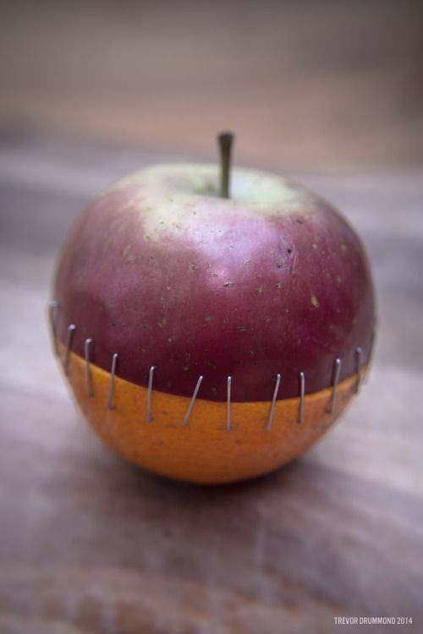


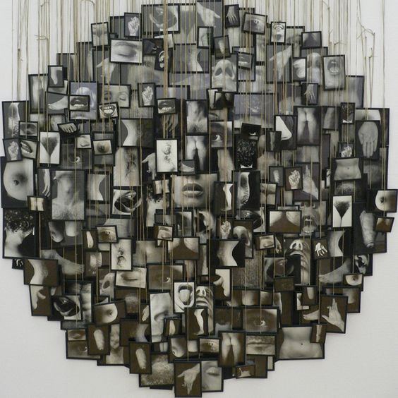

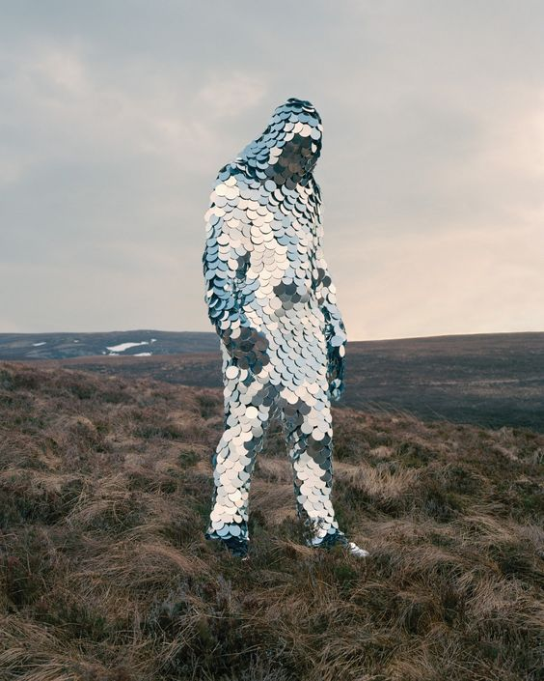
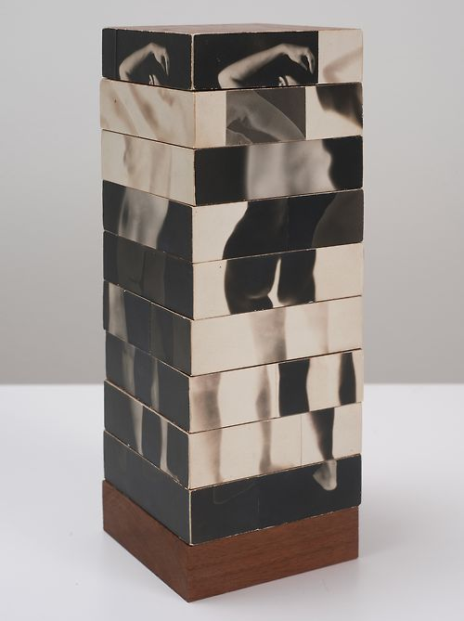
Key Words: Traditional processes, Photogram, Rayograph, Man Ray, MARK MAKING, TEXTURE
Areas of study
Students are required to work in one or more area(s) of photography, such as those listed below. They
may explore overlapping areas and combinations of areas:
Portraiture
Landscape photography (working from the urban, rural and/or coastal environment)
Still life photography (working from objects or from the natural world)
Documentary photography, photojournalism
Fashion photography
Experimental imagery
Multimedia
Photographic installation
Moving image (video, film, animation).
Sources of inspiration!
Pinterest, Google Images, Books on the shelf!

Slide 5


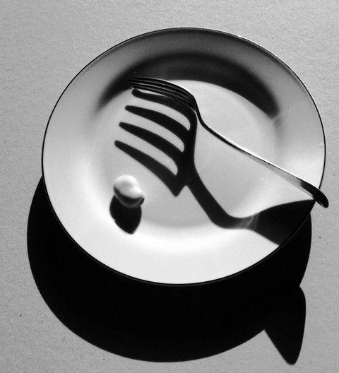
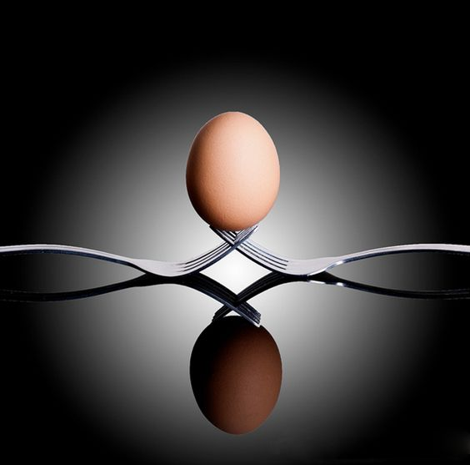
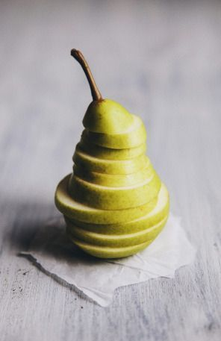
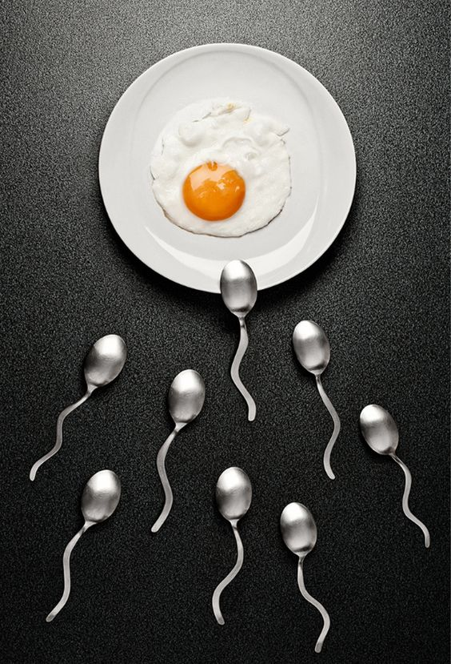
Learning Objectives
To know how to use the traditional and contemporary photographic processes correctly and achieve positive results.
To understand how various photographic methods work and produce high quality photographic imagery.
To be able to explore and experiment confidently leading to successful photographic outcomes that are inspired by prior planning and organisation.
Success Criteria
All students will be exploring and experimenting with digital and non digital photographic means in order to produce individual imagery.
Most students will successfully utilise and operate the equipment successfully. Persistence will be needed to refine and modify work as it progresses.
Some students will produce a body of experimental photography work that successfully illustrates the manipulation of all featured techniques and processes.

Slide 6
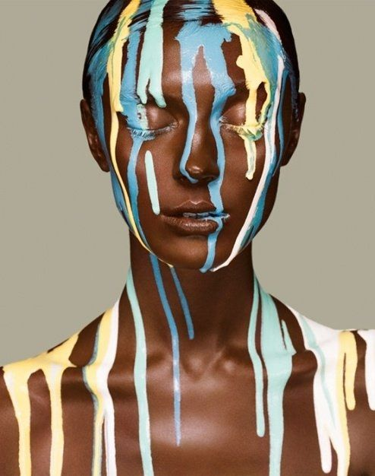

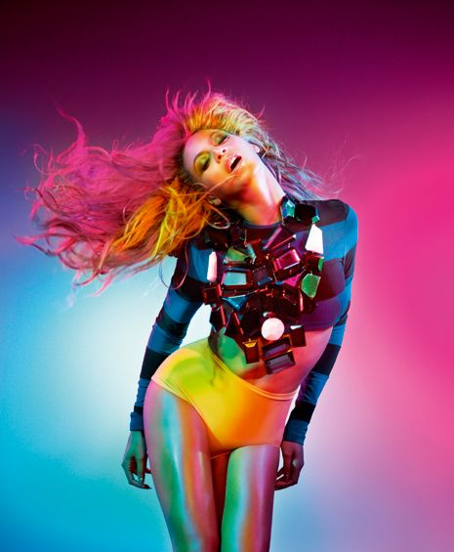
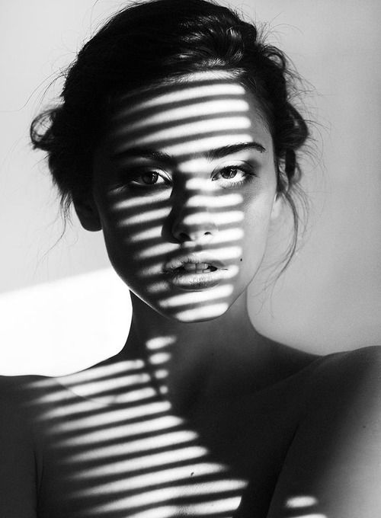
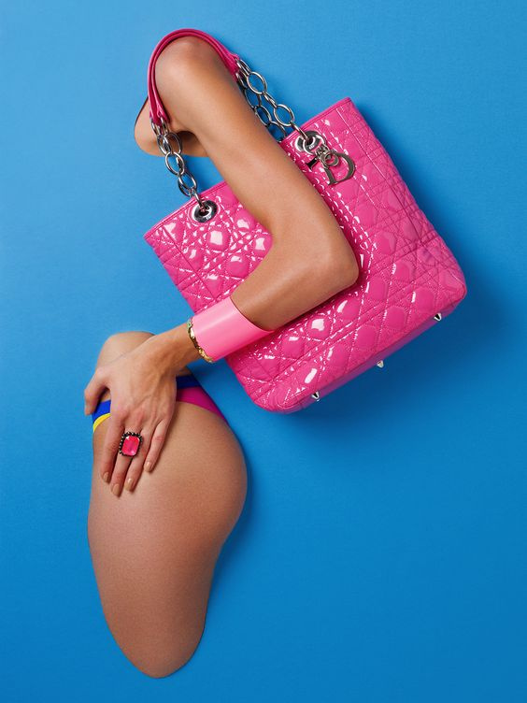
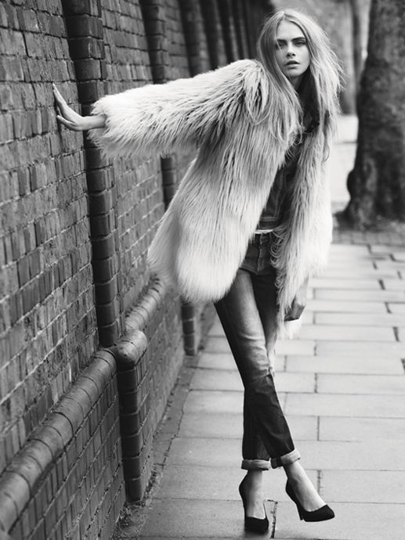
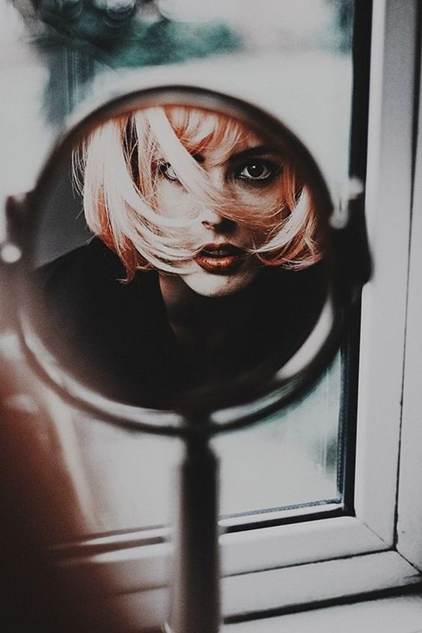
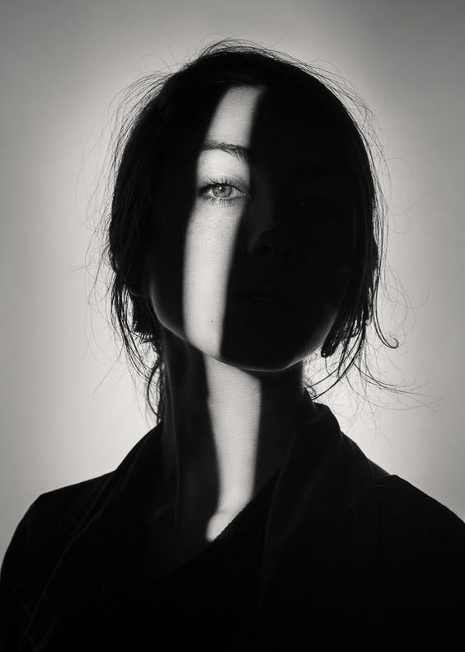
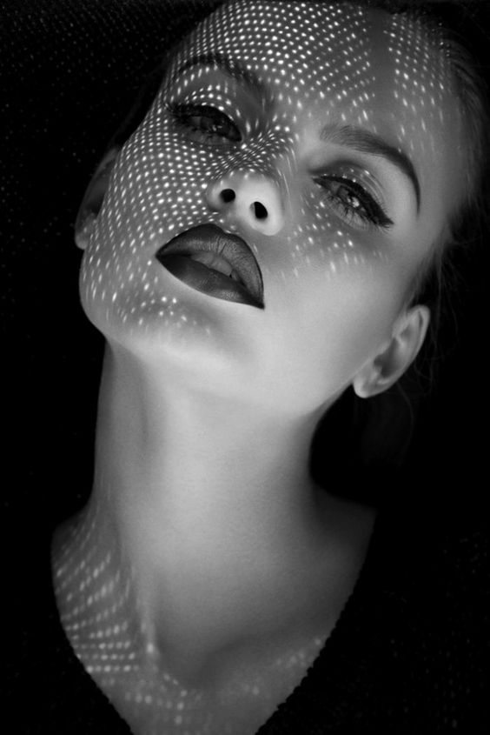


Slide 7
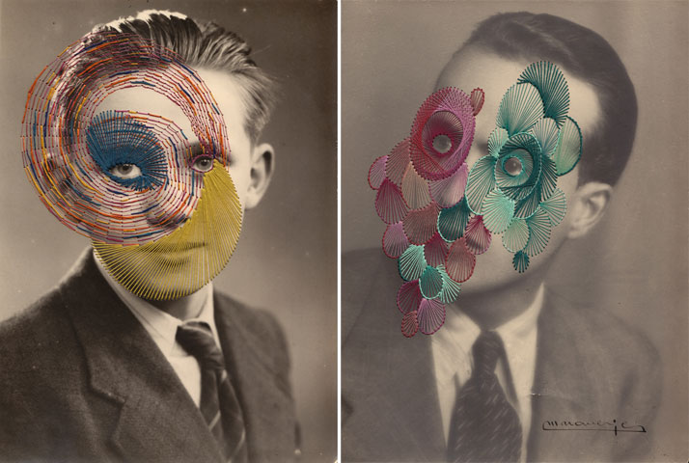
Key Words: Traditional processes, Photogram, Rayograph, Man Ray, MARK MAKING, TEXTURE

Slide 8

Keywords: formal elements, line, tone, composition, focus, shape, texture
Macro or Close up Photography - Digital
Macro photography is extreme close up photography usually of small objects upscaled to larger than life. Macro photography focuses on picking out a number of or single formal elements such as line/ pattern/ texture/ shape/ colour.
A Macro or extreme close up shot is only of a small section of an object never the entire object.

Slide 9
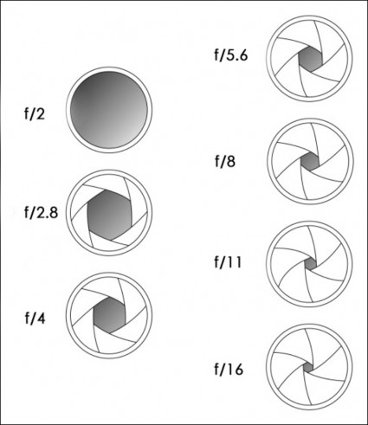
How is Aperture measured?
Aperture is measured in the size of the “hole” opening in the lens
Aperture is measured in a measurement called “f-stops”
The size of the aperture hole opening determines the f-stop number
The BIGGER the aperture hole opening, the MORE light comes in, which gives a SMALLER f-stop number.

Slide 10

OK, so what exactly does this Aperture thing-y do? How will it give me more choices and creative control? – Answer: DEPTH of FIELD
The primary creative control of Aperture is to control the “Depth of Field”, which means how much of the image you want to be in focus.
By controlling the amount of light coming into the camera by the size of the Aperture hole opening, you control how much FOCUS you want.
When you’re photographing something with a NARROW or SHALLOW depth of field, that simply means that you want something specific to be in focus (only one part) and the rest to be kinda blurry.
When you’re photographing something with a WIDE or DEEP depth of field, that simply means that you want more of the picture to be in focus.
The tomato picture has very NARROW or SHALLOW depth of field because only a specific, selected point is in focus, where as the rest of the image is blurry.
Foreground: the single tomato and the wood in the very front of the image is sharp, in focus.
Middle ground: the cluster of tomatoes is less in focus, kind of blurry
Background: the tomato leaf, and basket of tomatoes is very blurry, out of focus.

Slide 11
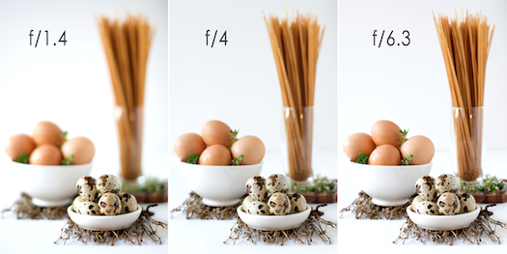
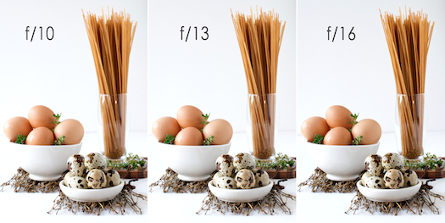
Egg & Pasta Image:
In the f/1.4 image, you can see how selective the focus is: only the quail eggs in the foreground are in focus.
As the f/stop closes to let less light in (number gets bigger), more of the image starts to come into focus.
In f/6.3, the brown eggs start to come into focus.
In f/16, everything is in focus: quail eggs, brown eggs and pasta.

Slide 12
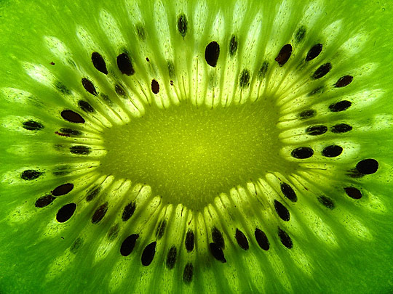
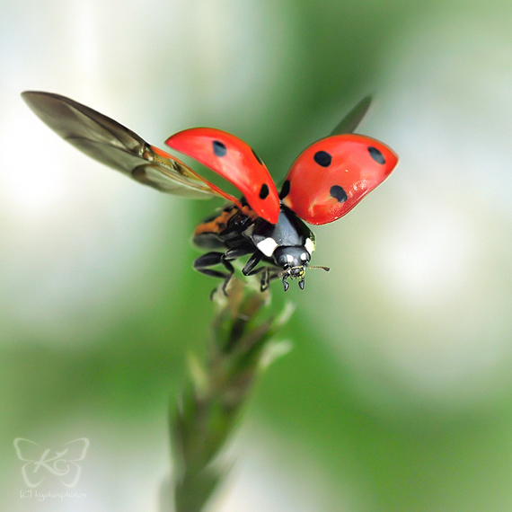
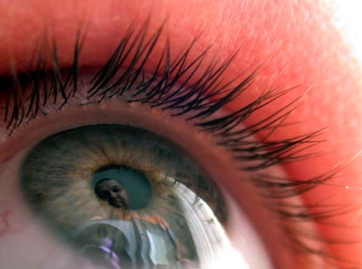
Keywords: formal elements, line, tone, composition, focus, shape, texture
This is a simple process that creates some outstanding visuals.
Some things to remember:
The camera must be still, if handheld try your best to eradicate any camera shake, if not hand held use a tripod.
Zoom in using the lens and actually getting closer your self. The lens zoom is limited and will require you to move closer.
Experiment with automatic and manual focus to enhance different elements of the objects when photographing.
Persistence is the key here. Try and try again.

Slide 13
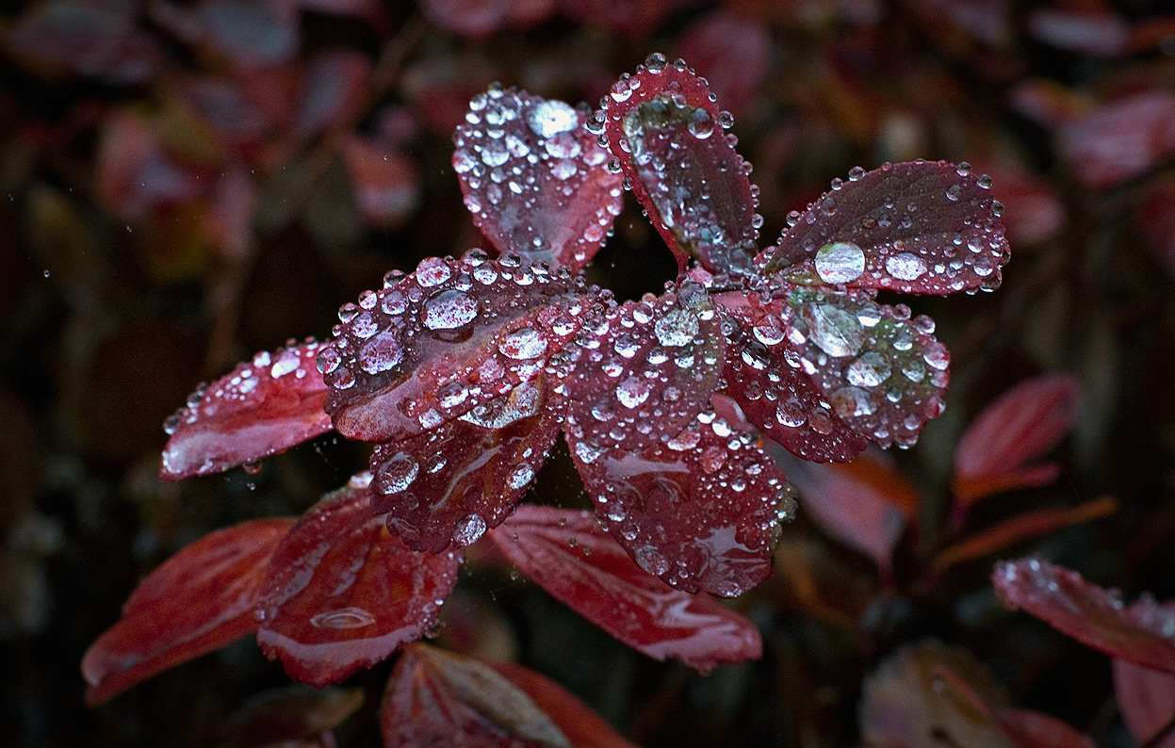
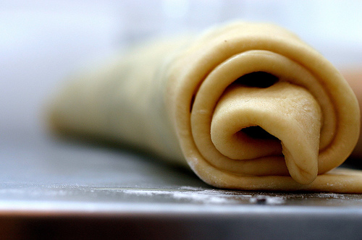
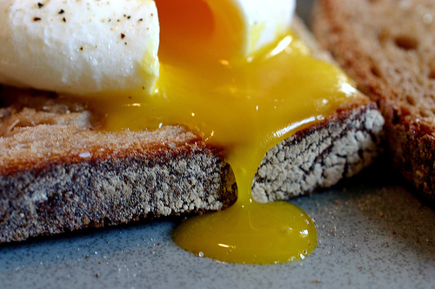
Keywords: formal elements, line, tone, composition, focus, shape, texture
Andy Small and Damon Clarke
Andy Small and Damon Clarke are contemporary photographers specialising in macro or extreme close ups. The bulk of their work is largely catered around finding formal elements within food and flowers.
Check the work and websites out.

Slide 14
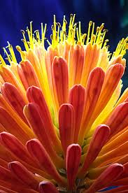

Keywords: formal elements, line, tone, composition, focus, shape, texture

Slide 15
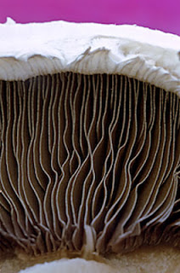
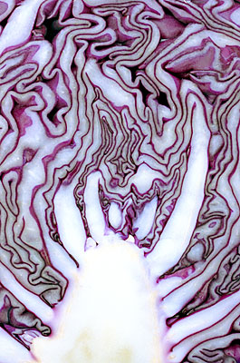
Keywords: formal elements, line, tone, composition, focus, shape, texture

Slide 16
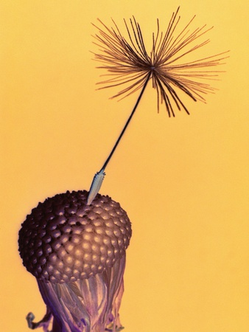
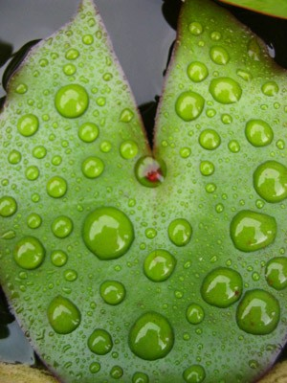
Keywords: formal elements, line, tone, composition, focus, shape, texture

Slide 17
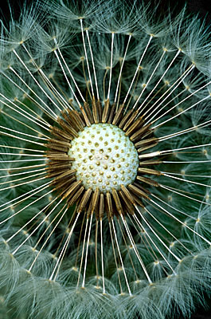
Keywords: formal elements, line, tone, composition, focus, shape, texture
Learning Objectives
To know how to use the traditional and contemporary photographic processes correctly and achieve positive results.
To understand how various photographic methods work and produce high quality photographic imagery.
To be able to explore and experiment confidently leading to successful photographic outcomes that are inspired by prior planning and organisation.
Success Criteria
All students will be exploring and experimenting with digital and non digital photographic means in order to produce individual imagery.
Most students will successfully utilise and operate the equipment successfully. Persistence will be needed to refine and modify work as it progresses.
Some students will produce a body of experimental photography work that successfully illustrates the manipulation of all featured techniques and processes.

Slide 18
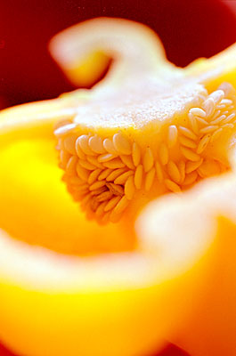
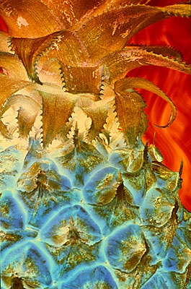
Keywords: formal elements, line, tone, composition, focus, shape, texture

Slide 19
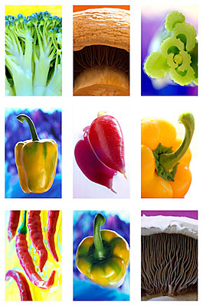
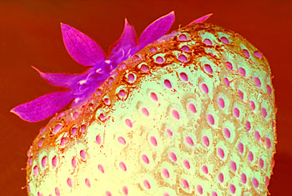
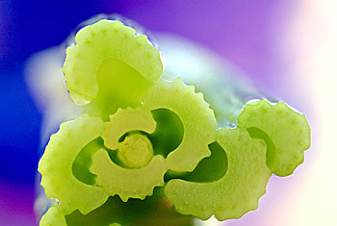
Keywords: formal elements, line, tone, composition, focus, shape, texture

Slide 20
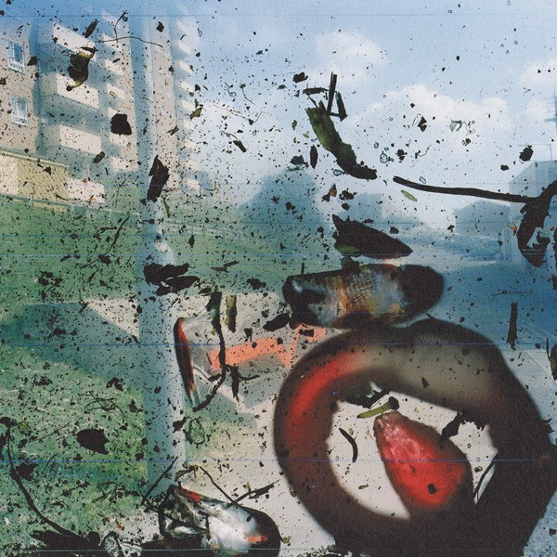
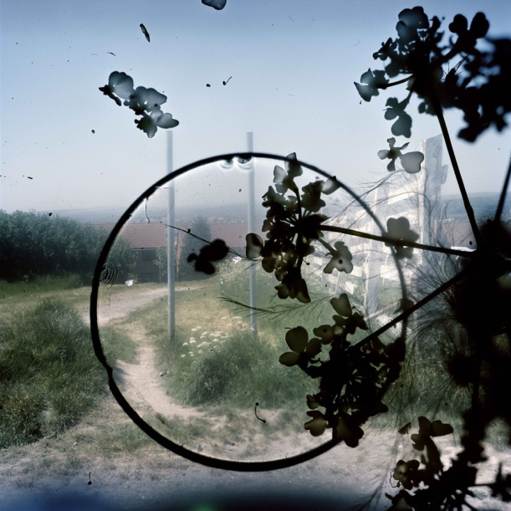
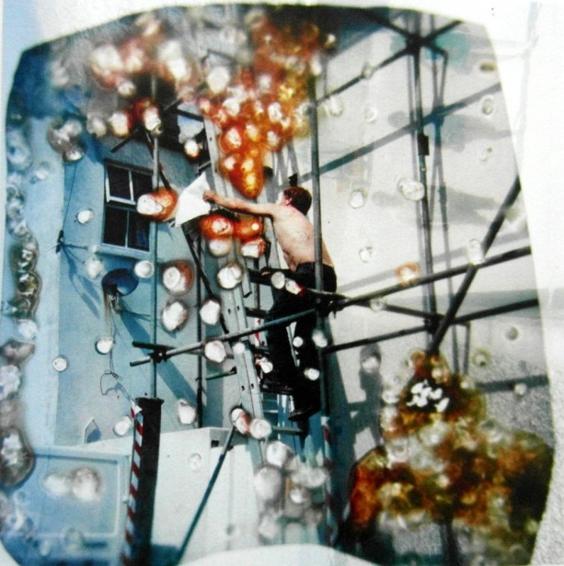
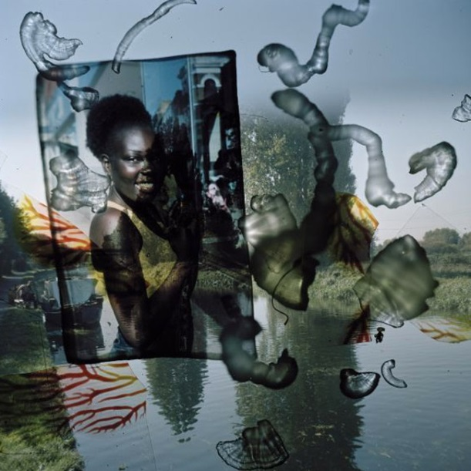
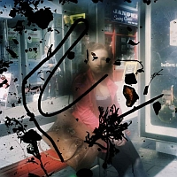
Starting point 1: IMPERFECTIONS
STEPHEN GILL
Keywords: Experiment, Create, Investigate, individuality.

Slide 21

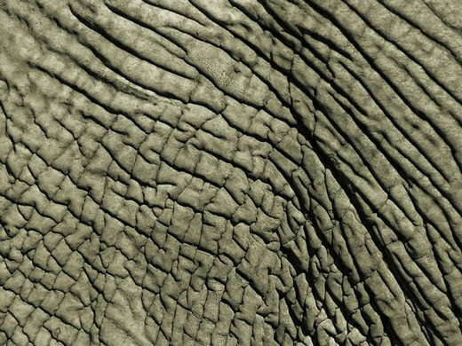
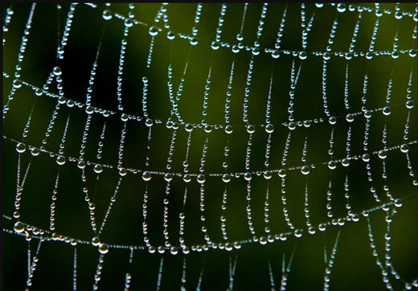

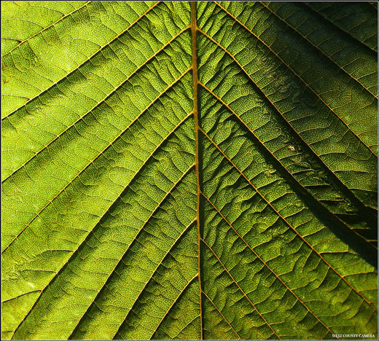


Keywords: formal elements, line, tone, composition, focus, shape, texture
Formal Elements in Photography
Pattern

Slide 22
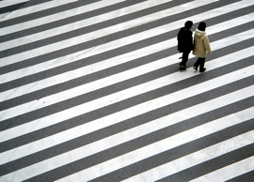
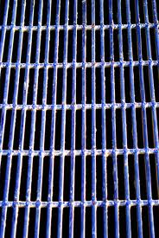

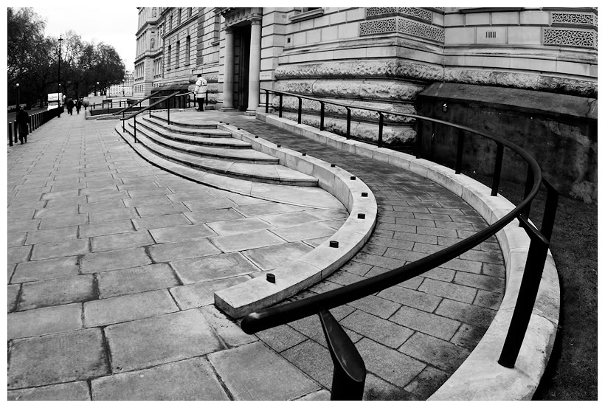



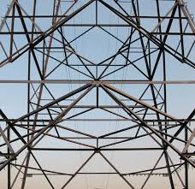
Keywords: formal elements, line, tone, composition, focus, shape, texture
Formal Elements in Photography
Line
leading lines

Slide 23
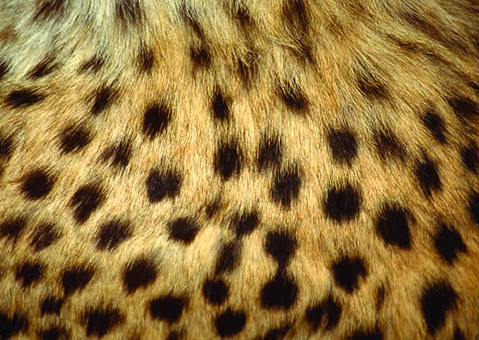







As level EXPERIMENTAL PROJECT - INTRODUCTION TO PHOTOGRAPHY
Formal Elements in Photography
Texture
Rough or smooth

Slide 24







Keywords: formal elements, line, tone, composition, focus, shape, texture
Formal Elements in Photography
Shape

Slide 25







Keywords: formal elements, line, tone, composition, focus, shape, texture
Formal Elements in Photography
Tone

Slide 26







Keywords: formal elements, line, tone, composition, focus, shape, texture
Formal Elements in Photography
Colour

Slide 27




Keywords: formal elements, line, tone, composition, focus, shape, texture

Slide 28



Keywords: formal elements, line, tone, composition, focus, shape, texture

Slide 29


Keywords: formal elements, line, tone, composition, focus, shape, texture

Slide 30


Keywords: formal elements, line, tone, composition, focus, shape, texture
Glass Ball Photography

Slide 31




Keywords: formal elements, line, tone, composition, focus, shape, texture

Slide 32
Key Words: Animation, Stop motion, ICT, Digital, Movement, frame by frame, models, backgrounds, props, storyboard, Modelling clay
Keywords: formal elements, line, tone, composition, focus, shape, texture
Learning Objectives
To know how to use the traditional and contemporary photographic processes correctly and achieve positive results.
To understand how various photographic methods work and produce high quality photographic imagery.
To be able to explore and experiment confidently leading to successful photographic outcomes that are inspired by prior planning and organisation.
Success Criteria
All students will be exploring and experimenting with digital and non digital photographic means in order to produce individual imagery.
Most students will successfully utilise and operate the equipment successfully. Persistence will be needed to refine and modify work as it progresses.
Some students will produce a body of experimental photography work that successfully illustrates the manipulation of all featured techniques and processes.

