Slide 2
Aim
To find out about the Stone Age.

Slide 3
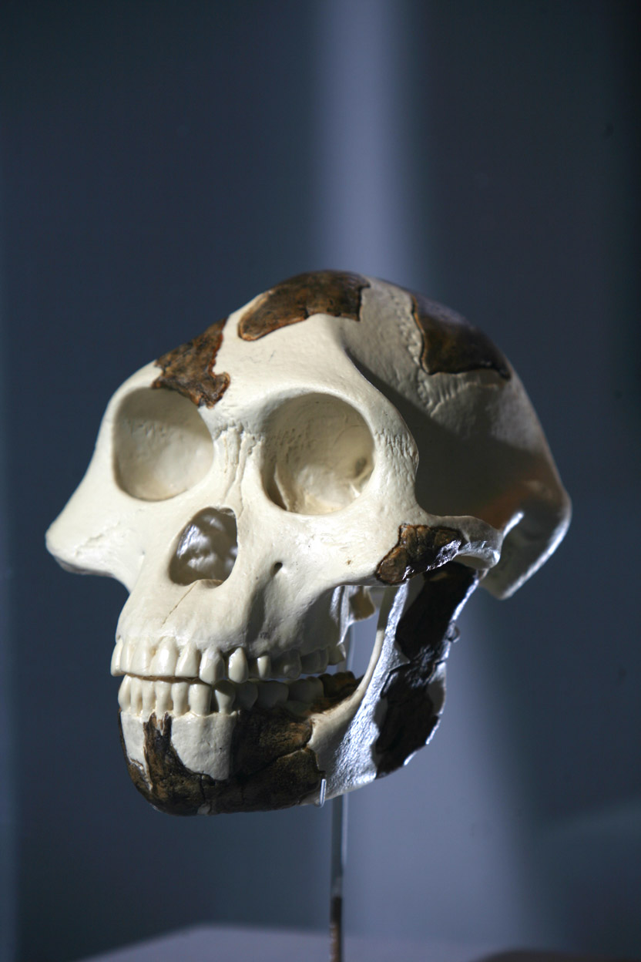
What does prehistoric mean?
Prehistoric comes from ‘pre-history’.
It means a time before written records existed.
There is no recorded history of this time that we can read, just clues left behind that archaeologists have to interpret.
Photo courtesy of Tadius magazine@flickr.com - granted under creative commons licence - attribution

Slide 4
When was the Stone Age?
The Stone Age covers a huge period of time, over 3 million years!
The Stone Age starts from when the first human like animals came into existence. The earliest evidence has been found in Africa.
Early humans arrived in Britain more than 800,000 years ago but Britain has not been constantly lived in since that time due to climate changes.
The ice and the cold temperatures during the last period of time known as the Ice Age meant that early humans left Britain in search of warmer climates.
At this time Britain was not an island so they could walk across the land into Europe and Africa.

Slide 5
The Stone Age is broken down into smaller time periods
Palaeolithic – around 3,000,000 BC
During this long period of time, the earliest hominids (humans or close relatives of humans), Homo habilis, who used simple stone tools, slowly developed into the modern humans we call Homo sapiens. Britain was still connected by land to France and Denmark.
Mesolithic – around 10,000BC
People led largely nomadic lives as hunter-gatherers, constantly on the move in order to survive. It was during this time that Britain became an island.
Neolithic – around 4,500 BC – 2,400BC
This is the time that farming began, pottery was developed and villages were built.

Slide 6
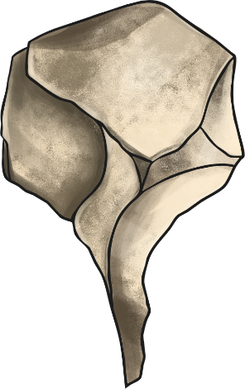
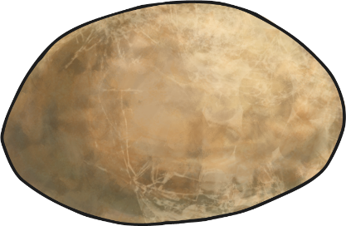
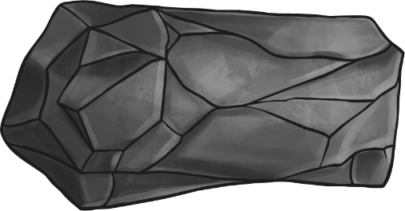
Why is it called the Stone Age?
The Stone Age is so called because the earliest humans used stone to make tools with a sharp edge or point.
Stone was the material predominantly used for tools throughout the Stone Age.

Slide 7
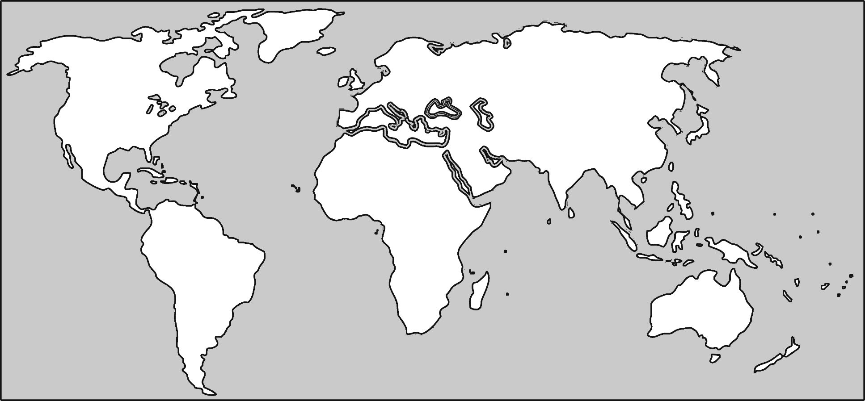
Which countries were populated?
Today there are over seven billion people in the world (7,000,000,000).
Even at the peak of the stone age it was likely that there were less than five million (5,000,000).
About 2 million years ago Homo habilis appeared in eastern Africa.

Slide 8
Which countries were populated?
About 1.5 million years ago Homo erectus were living in the Southern Caucasus and Northern China.

Slide 9
Which countries were populated?
By 400,000 years ago the early human population had spread to Indonesia and Europe.

Slide 10
Which countries were populated?
By 27,000 years ago they had set foot in Australia, Poland, Japan and Siberia.

Slide 11
Which countries were populated?
It wasn’t until around 10,000 BC that early humans reached North and South America via the Bering land bridge that at that time connected Siberia and North America.

Slide 12
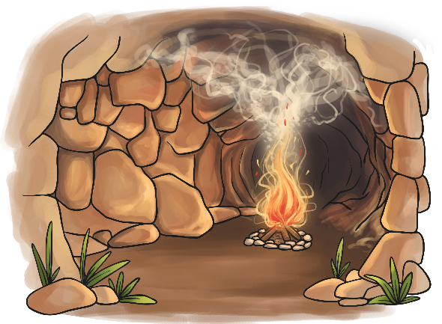
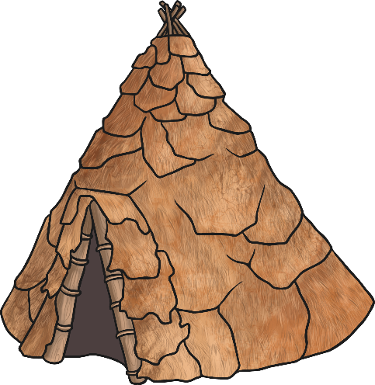
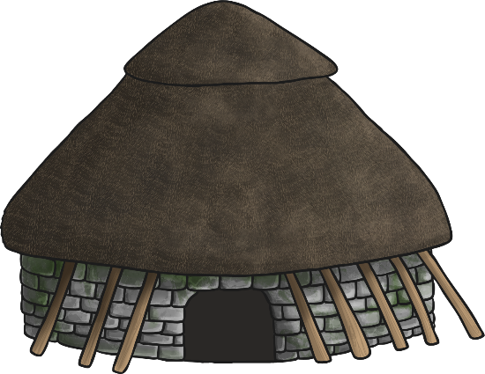
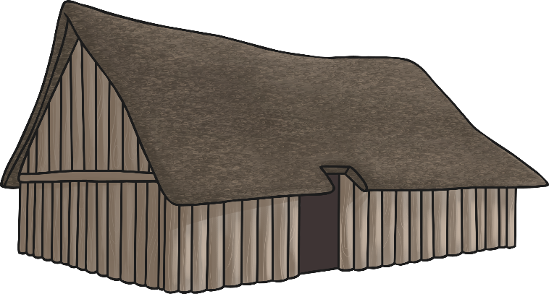
What type of houses did they live in?
This depended on the time, and the country.
In Britain, archaeologists have found evidence of four different types of dwelling.

Slide 13
What type of houses did they live in?
During the Palaeolithic time period when the ice came, some early humans sheltered from the cold in caves.
Why build your own house when there's one already available?

Slide 14
What type of houses did they live in?
Evidence found in Howick from Mesolithic times indicates a circular structure made from wooden posts.
There are no existing houses remaining but archaeologists have found marks in the ground that they believe were made from the timber poles.
The frame may have been round, or conical like a tepee.
They may have used animal skin, thatch or turf to cover the frame.
There was evidence that the floor was covered with a layer of moss, reeds and other soft plant materials.

Slide 15
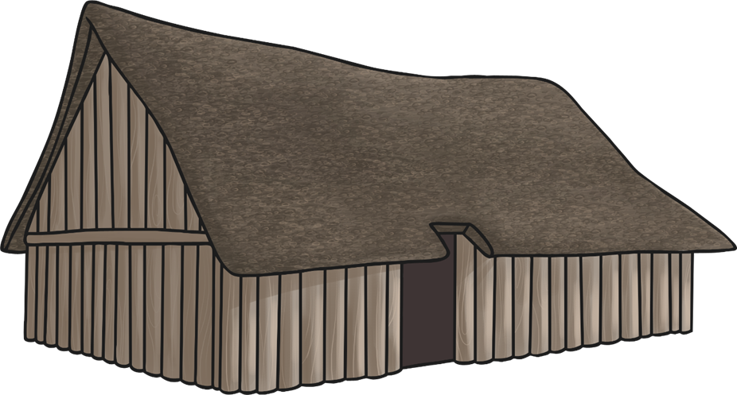
What type of houses did they live in?
Evidence suggests that houses were usually rectangular and constructed form timber in the Neolithic period.
None of these houses remain but we can see the foundations.
Some houses used wattle and daub for walls and thatched roofs.
There was evidence that the floor was covered with a layer of moss, reeds and other soft plant materials.
Wattle and Daub: A mixture of manure, clay, mud and hay stuck to sticks that have been woven in and out of the timber frame.

Slide 16
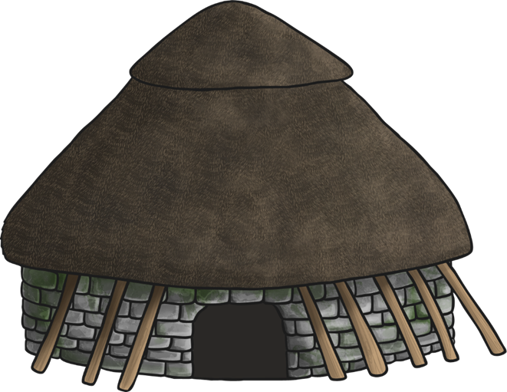
What type of houses did they live in?
Some houses in the Neolithic period, like those uncovered at Skara Brae, were built from stones.
They were built into mounds of rubbish known as midden. This could include small stones, shells, mud and animal bones.
It would provide some stability as well as insulation.
The houses were usually round.
They had beds and storage shelves, and a hearth in the middle.

Slide 17
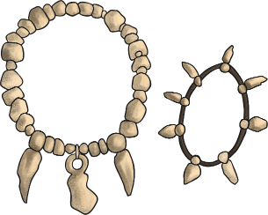
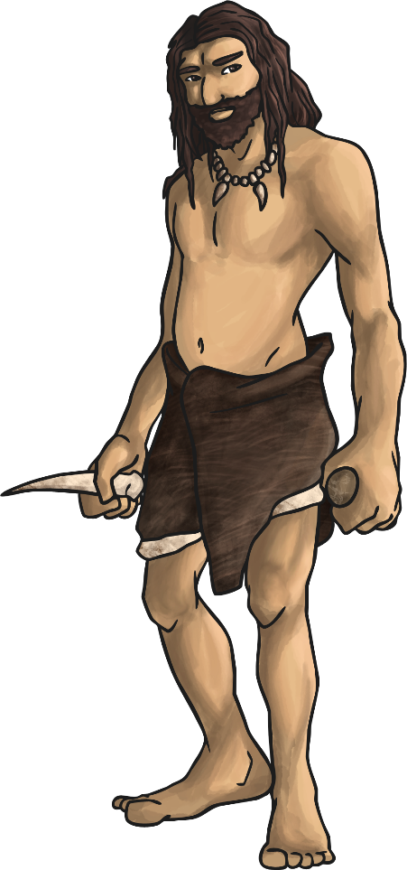
What clothes did they wear?
People wore animal skins to keep them warm, sewn together using bone needles.
The fine bone needles that have been found were probably used for embroidery as well. The bodies of a boy and a girl buried around 28,000 years ago in Russia were found with thousands of ivory beads and fox teeth covering them, work that would have taken years to complete.
We also know that people were weaving fabric back then (which could have been used for clothes) and dying spun plant fibres different colours, so maybe fashion started a lot earlier than you might think!

Slide 18
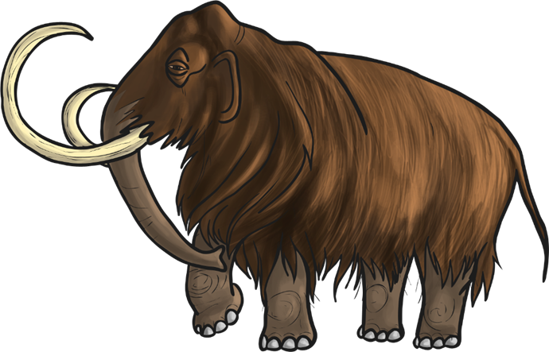
What food did they eat?
Animals were the main source of food.
They would eat all of the animal. When all the meat was stripped off the bones, the bones would be smashed so the marrow could be eaten from the inside.
Marrow is high in fat and would have been a good energy source.
Did You Know...?
Some archaeologists believe that early humans would have cut open the stomach of an animal and eaten their last meal!

Slide 19
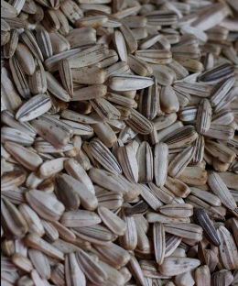
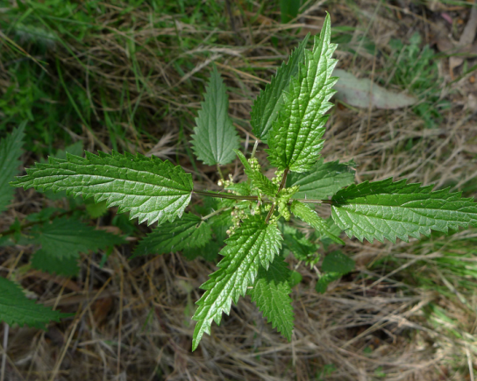
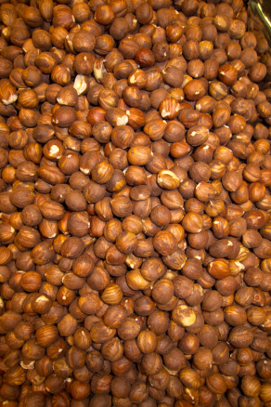
What food did they eat?
Although it is thought that farming largely began in the Neolithic time, when many more plant based foods became part of people’s diets, there is evidence that people were eating food such as beans, seeds, lentils, nuts and grains over 23,000 years ago in the Palaeolithic period.
Their diet was a lot more varied than you might think, including many plants that today we treat as weeds.
Sunflower seeds
Nettle leaves
Hazelnuts
Photo courtesy of simplyla@flickr.com , Tann@flickr.com, quinet@flickr.com - granted under creative commons licence - attribution

Slide 20
How did they communicate?
Symbols have been found alongside cave paintings in Europe, used repeatedly in the same clusters in different caves.
Similar symbols have also been found on jewellery, suggesting that there was possibly a communication system in existence 30,000 years ago.

Slide 21
What did they do?
dug for flint
hunted and gathered food
made tools and weapons
prepared animal skins to make clothes
hunted and gathered food
started fires to cook food and keep warm
made objects out of clay
made jewellery
made thread from plant fibres and dyed it
painted – like the paintings we can still see today in caves

Slide 22
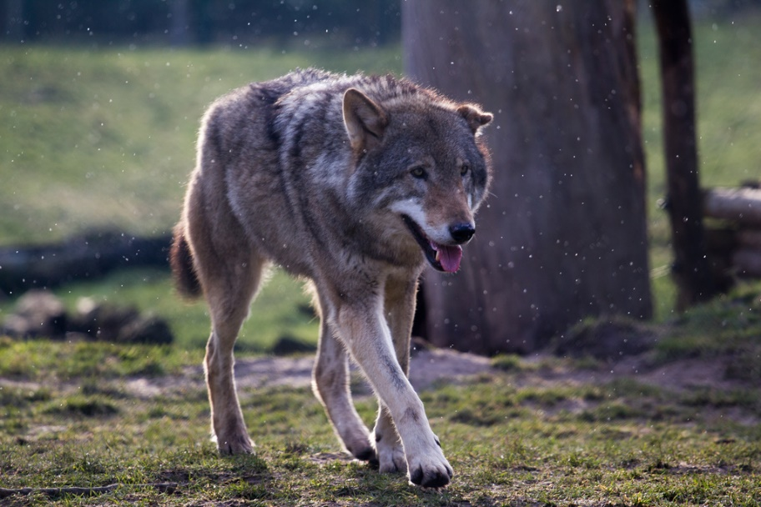
Did you know the origins of the domestic dog can be traced back to the Stone Age?
Dogs would help with hunting.
Graves have been found where dogs had been buried with tools, like they buried humans with.
This tells us that dogs were treated like part of the family.
Photo courtesy of Lennart Tange @flickr.com - granted under creative commons licence - attribution

