Slide 1

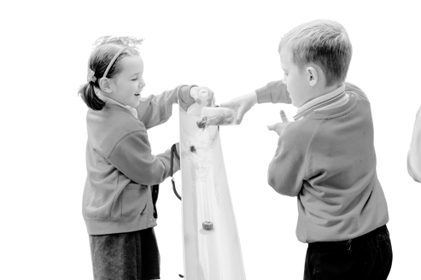






School Badge
BUILDING BLOCKS FOR SUCCESS
Ensuring a strong start for all learners: English
Early education should be ambitious for all, especially those who are disadvantaged. Communication and language skills, educational attainment and health and well-being are all built on strong foundations. If these gaps are not closed in the early years of education, the gap only widens.
At English Martyrs’ Catholic Primary School we aim to equip all children, without fail, with the knowledge and skills they need to make progress in Reception, through key stage one and beyond.
Planning for learning through ensuring clarity in the curriculum
What do we want children to learn?
Our early years education provides children with strong foundations so that they can successfully learn how to:
communicate
read
write
calculate
Executive function for learning and well-being
Physical, social and emotional readiness for learning
It is crucial for children to develop a life-long love of reading.
Reading consists of two dimensions: language comprehension and word reading. Language comprehension (necessary for both reading and writing) starts from birth. It only develops when adults talk with children about the world around them and the books (stories and non-fiction) they read with them, and enjoy rhymes, poems and songs together. Skilled word reading, taught later, involves both the speedy working out of the pronunciation of unfamiliar printed words (decoding) and the speedy recognition of familiar printed words.
Writing involves transcription (spelling and handwriting) and composition (articulating ideas and structuring them in speech, before writing).
At English Martyrs’ Catholic Primary School, we have high expectations for all our pupils to gain the knowledge they need for future success. In doing so we spend time identifying precisely what children need to know.

Slide 2
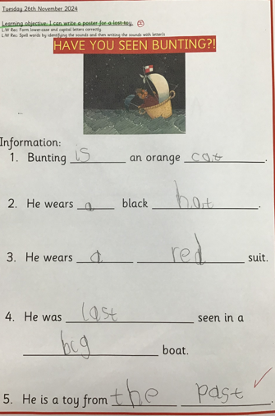

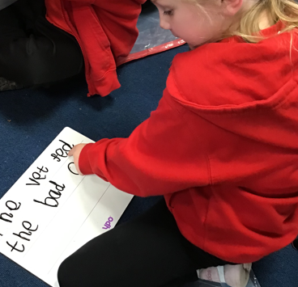
ENGLISH IN RECEPTION
Word reading
Comprehension
read
Reading:
Children at the expected level of development will:
  Say a sound for each letter in the alphabet and at least 10 digraphs.
  Read words consistent with their phonic knowledge by sound-blending.
  Read aloud simple sentences and books that are consistent with their phonic knowledge, including some common exception words.
Comprehension:
Children at the expected level of development will:
  Demonstrate understanding of what has been read to them by retelling stories and narratives using their own words and recently introduced vocabulary.
  Anticipate – where appropriate – key events in stories.
  Use and understand recently introduced vocabulary during discussions about stories, non-fiction, rhymes and poems and during role-play.
Transcription
Insert image linked to writing (EYFS)
Spelling
Handwriting
write
Composition
Writing:
Children at the expected level of development will:
  Write recognisable letters, most of which are correctly formed.
  Spell words by identifying sounds in them and representing the sounds with a letter or letters.
  Write simple phrases and sentences that can be read by others.

Slide 3
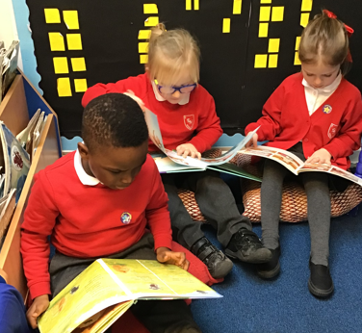
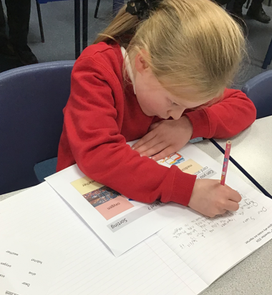
ENGLISH IN KEY STAGE ONE
Insert image linked to reading
Word reading
Comprehension
read
It is essential that teaching focuses on developing pupils’ competence in word reading and comprehension (both listening and reading). Different types of teaching are needed for each.
Skilled word reading involves both decoding and the speedy recognition of familiar printed words. Underpinning both is the understanding that the letters on the page represent the sounds in spoken words. This is why phonics is such an important part of the early teaching of reading to our youngest pupils.
Comprehension skills develop through pupils’ experience of high-quality discussion with the teacher, as well as from discussing a wide range of stories, poems and non-fiction to establish an appreciation and love of reading, and to gain knowledge across the curriculum.
Transcription
Insert image linked to writing
Spelling
Handwriting
write
Composition
It is essential that teaching develops pupils’ competence in transcription and composition. Writing down ideas fluently depends on effective transcription; that is on spelling quickly and accurately through knowing the relationship between sounds and letters (phonics).
Effective composition involves forming, articulating and communicating ideas and then organising them coherently for a reader. Writing also depends on fluent and legible handwriting.
Writing tasks are broken down into small steps of learning, ensuring that all pupils have the knowledge they need to complete the task well.

Slide 4

During year 1, teachers should build on work from the Early Years, making sure that pupils can sound and blend unfamiliar printed words quickly and accurately using the phonic knowledge the already have. The understanding that the letter on the page represents the sounds in spoken words should underpin pupils’ reading and spelling of all words. This includes for common exception words. Pupils should be helped to read words without overt sounding and blending after a few encounters.
Writing typically develops at a slower pace to reading because children need to encode the sounds they hear in words for spelling, develop the physical skill needed for handwriting and learn how to organise ideas in writing. Teachers should ensure that their teaching develops a pupils oral vocabulary as well as their ability to understand and use a variety of grammatical structures.
By the beginning of year 2, pupils should be able to read all common graphemes, in familiar and unfamiliar words, accurately and without hesitation. Pupils’ reading of common exception words should be secure. In writing, pupils should be able to compose individual sentences orally and write them down. They should be able to spell correctly many of the words covered in year 1 and have phonetically plausible attempts at others not learnt yet, forming individual letters correctly.
Writing is intrinsically harder than reading: pupils are likely to be able to read and understand more complex reading (in terms of vocabulary and structure) than they are capable of producing themselves.
WORD READING AND TRANSCRIPTION
 | Autumn 1 | Autumn 2 | Spring 1 | Spring 2 | Summer 1 | Summer 2
R | Initial Code Unit 1-4 | Initial Code Unit 5-7 | Initial Code Unit 8-10 | Initial Code Unit 11 | Consolidate initial code | Bridging units
Y1 | Extended Code Unit 1-4 | Extended Code Unit 5-9 | Extended Code Unit 10-14 | Extended Code Unit 15-18 | Extended Code Unit 19-22 | Extended Code Unit 23-26
Y2 | Extended Code Unit 27-30 | Extended Code Unit 31-33 | Extended Code Unit 34-37 | Extended Code Unit 38-41 | Extended Code Unit 42-45 | Extended Code Unit 46-49
At English Martyrs’ Catholic Primary School we use Sounds-Write phonics

Slide 5
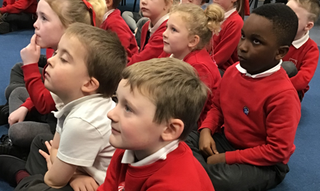
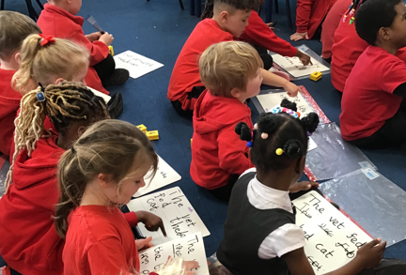
We have chosen Sounds-Write because it is a programme structured primarily around the sounds of speech. We know that the children in our school acquire language naturally. Writing systems were designed to represent speech. We understand the importance of following a phonics programme that recognises that our writing system is secondary knowledge and we need to teach it explicitly.
Reading and writing are taught in parallel in every phonics lesson. Sounds-Write starts with the language that children acquire naturally - the sounds of their language; it teaches how to read and write them. The programme is sound led rather than code or spelling led. It works from speech to print.
Guiding principles:
  Sounds-Write teaches the essential skills required to become confident readers and spellers: blending, segmenting, phoneme manipulation. These skills are taught explicitly and are practised in the context of reading and spelling real words in every single lesson from the very beginning.
  The conceptual knowledge teaches children how our alphabetic code works (all 175 representations/spellings of the 44 sounds of English in the context of real words).
  Teachers are consistent in the language they use from the very beginning, we teach that letters or combinations of letters spell/represents sounds. They do not say or make sounds. The same consistent approach is applied from EYFS to Y6. Whether a Reception child is being taught ‘mat’ or a Y6 child is being taught ‘chlorophyll’, the language used will be the same; staff will use the same strategies/ language to explain error corrections when students make mistakes.
How is the programme implemented?
  Whole class teaching, with appropriate scaffolds, caters for all students within the lesson. No child is left behind. Diagnostic assessment tools are used so that teachers can identify children who need intervention. Analysing and interpreting assessments enables teachers to plan effective interventions.
  Scripted lessons support consistent practice across school. All adults use the same clear language. Scripts cover reading and writing in every lesson and allow for practise. Scripts reduce cognitive load for students. They become so secure with activities, cognitive attention is on what they’re learning and not second guessing how new games or activities might work.
  Cumulative (everything builds on what has been taught previously).
  Multi - sensory - the children are constantly revisiting:
    Saying the sounds
    Seeing the spellings of sounds
    Hearing the sounds
    Writing the spellings of sounds
All senses are interacting to enhance that connection between speech and print.

Slide 6
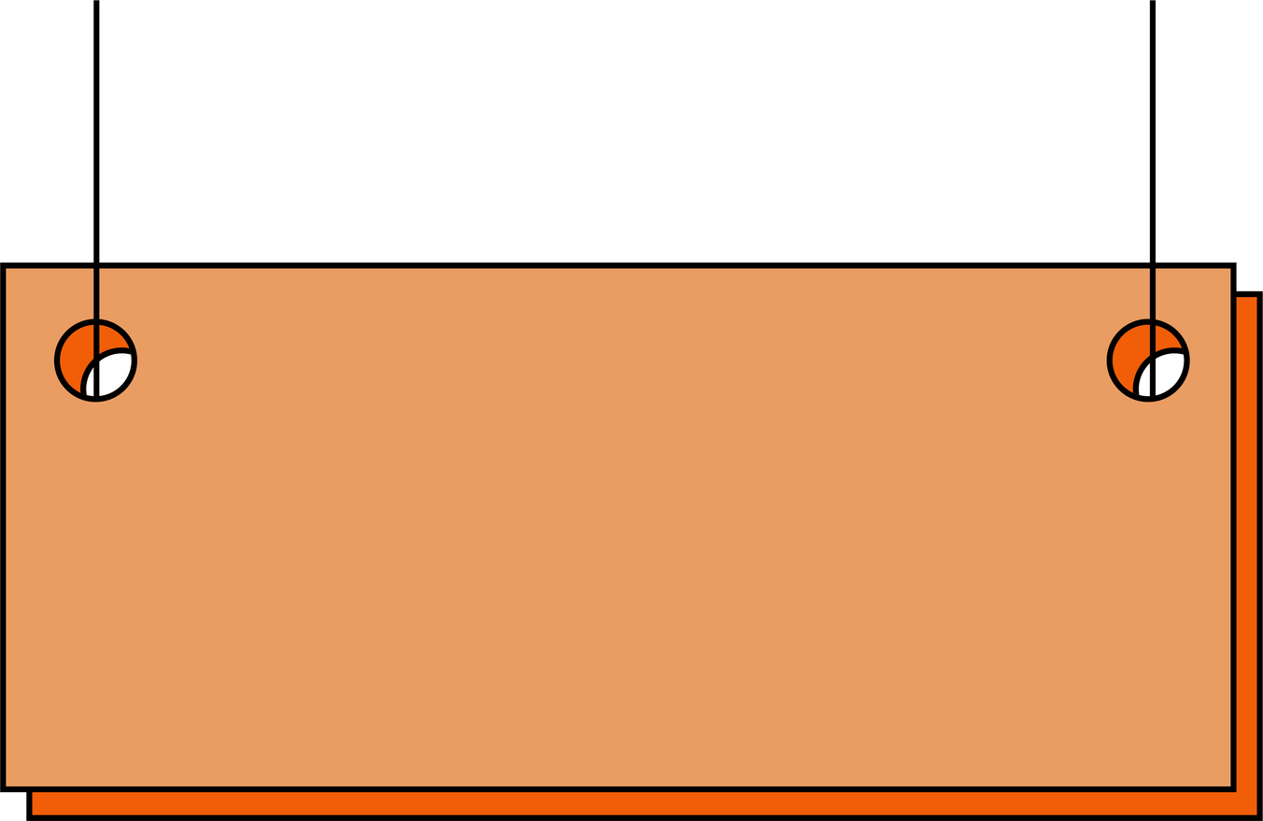
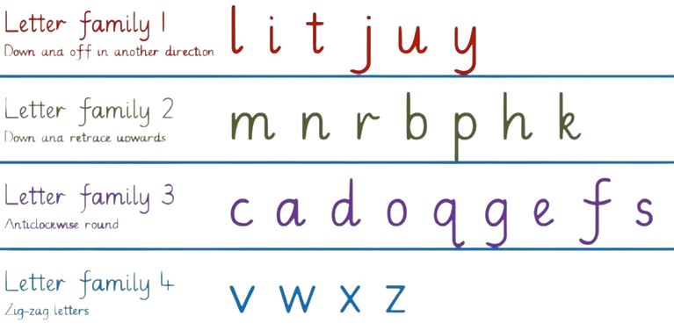
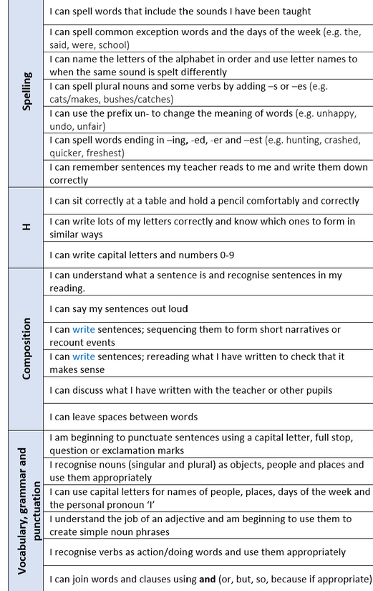

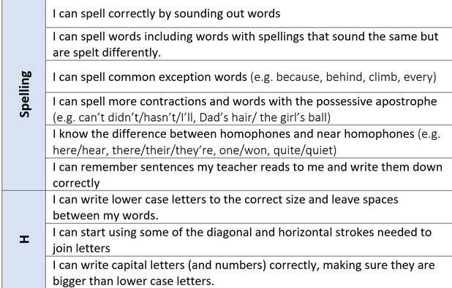
Letter Families
We use letter families to help young children recognise patterns and practise similar strokes. Letter families combine groups of letters that share similar shapes, movements, or starting points.
This method also builds muscle memory, making handwriting smoother and more consistent.
Year One to Year Two

Slide 7





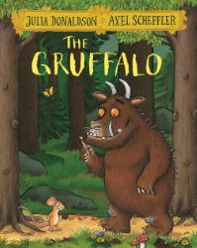

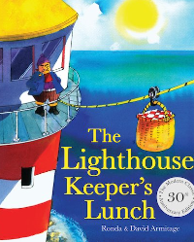




COMPREHENSION AND COMPOSITION
Our KS1 Journey
Using storybooks as a foundation for teaching writing at Key Stage One is very powerful, as they provide a rich and engaging context for developing key literacy skills, including:
Welcome to KS
Develops understanding of narrative structure: Stories model clear structures, such as beginning, middle and end. They also introduce characters, settings, problems and resolutions - all of which our pupils can emulate.
Improves sentence structure: Repeated phrases in storybooks help children to understand sentence structures from a young age. Sequencing events provides opportunities for children to organise ideas logically.
Welcome to KS2
Build vocabulary: Story books expose children to rich and varied vocabulary beyond that which they would use in the every day, helping them to expand their word choices. Words in stories are presented in meaningful ways, making them easier to understand and apply in their own writing.
Curriculum links: Stories can draw in elements of other subjects and themes, providing opportunities for broader learning. They can develop cultural awareness and celebrate diversity.

Slide 8
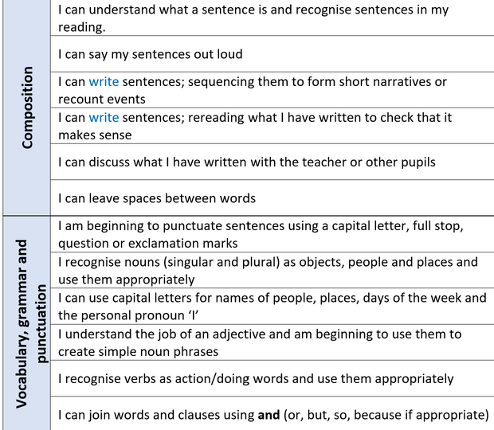
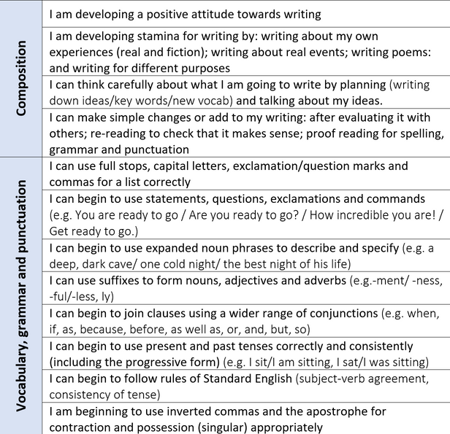
Accurate sentence punctuation
Year One to Year Two
Having ideas for writing
Oral composition
Comprehension: hearing and reading
Drawing from what they know already about character, events, story structure...

Slide 9


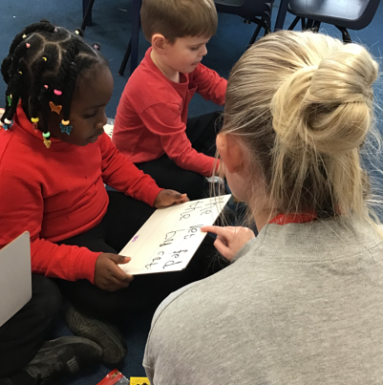

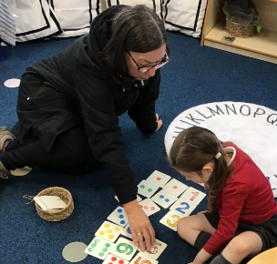
School Badge
Helping all pupils to learn
Whilst our work to ensure we are establishing strong foundations for later success will benefit all pupils, it is particularly important for those whose early learning has been limited. In doing so, we follow some key teaching principles.
Role of the adult in developing children’s spoken language:
  the rate at which children develop their language depends on the quality and quantity of interactions with adults.
  children start school life with different levels of language understanding and communication literacy.
  where there are gaps, support is needed to develop spoken language
Insert image linked to role of adult
Adults at English Martyrs’ Catholic Primary School:
  notice what children know and can do.
  know the curriculum planning in advance.
  ensure all children (including those who are quieter), experience enough planned and incidental interactions to learn what they need.
Every interaction is a teaching moment.
Role of dictation:
The curriculum for Y1 and Y2 sets out an expectation for children to write from memory simple sentences dictated by the teacher that include words using their current phonics knowledge.
Adults at English Martyrs’ Catholic Primary School:
  use dictation as a regular part of their phonics lessons, supporting pupils to transfer sounds into writing.
  use dictation as part of writing lessons and when supporting pupils to write in continuous provision. This enables the teacher to influence the content of the writing, linking it closely with the phonics knowledge of the child.
Dictation
Insert image linked to parent partnership
Parent Partnerships:
Involving parents, as the first educators of their child, is exceptionally important to us.
Adults at English Martyrs’ Catholic Primary School:
  engage with parents, informing them of how they can best help their child to progress with their learning. Sharing clarity of expectations and strategies that will help rather than hinder pupil learning.
  Regularly communicate what the children are learning.

Slide 10

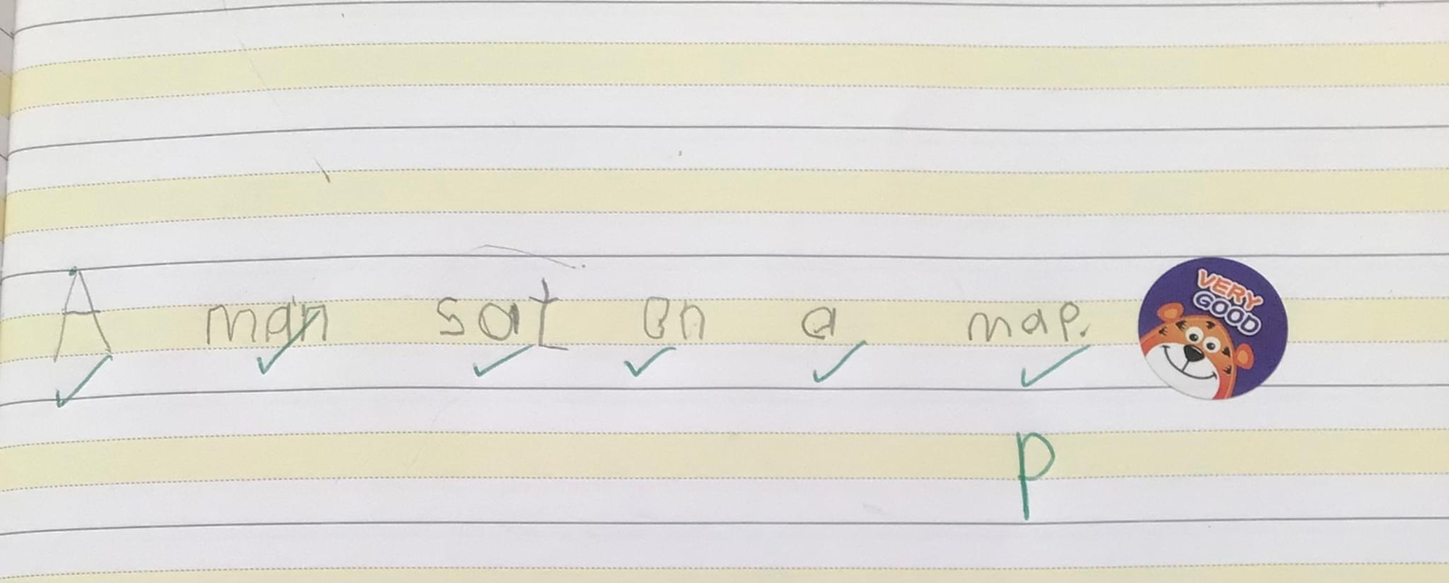
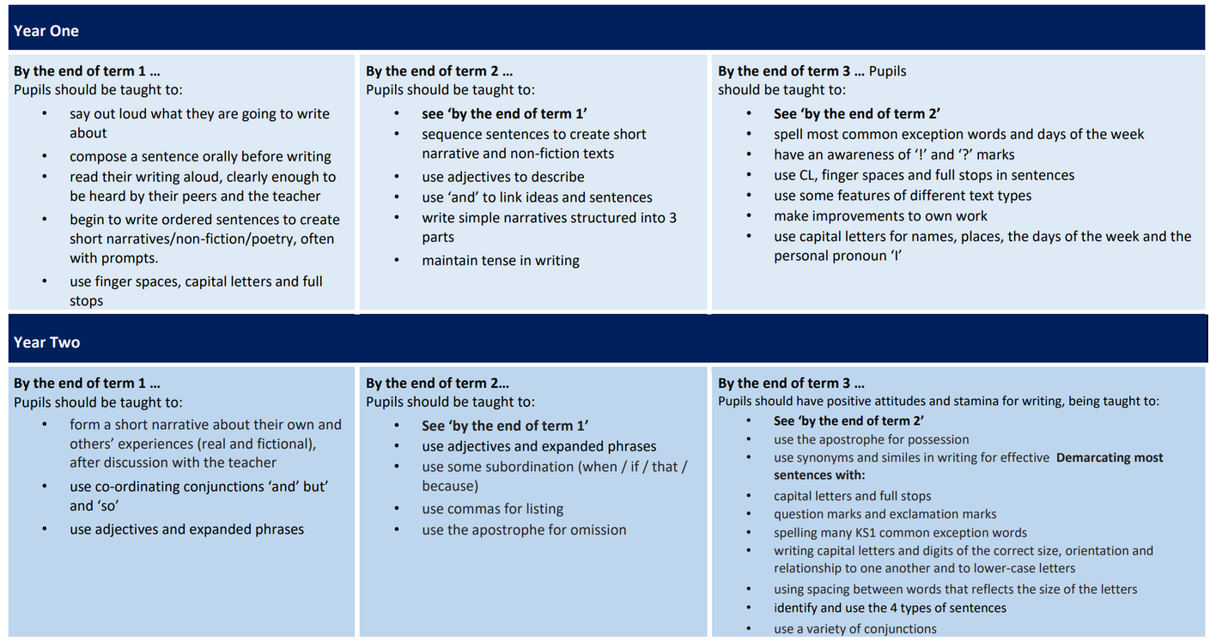
Letter Families
Set children up with the skills for success:
Handwriting requires frequent and discrete, direct teaching. Children should be taught to hold their writing implement easily and correctly. Prioritising the physical skill of writing ensures that bad habits are avoided.
Adults at English Martyrs’ Catholic Primary School:
  support children to correctly hold a pencil, noticing and correcting when incorrect pencil grip is being used.
  model using tramline books correctly, building muscle memory and making handwriting smoother and more consistent.
  teach letter families so that young children recognises patterns and practise similar strokes.
Plan for small steps, with enough teaching and practice:
Our curriculum clearly identifies important knowledge to learned by all children by key points. This helps our teachers know what to emphasise in their teaching and assessment.
Adults at English Martyrs’ Catholic Primary School:
  provide sufficient teaching and practice so that children are confident with the steps they need to take to be successful in any given task, recognising that some children may need more teaching and practice than others.
  prioritise effective talk, for all children, to develop their spoken language and rehearse what they want to write.
  notice those children who may be less involved and actively seek to bring them into the learning.
  know that some children are at different stages of the same curriculum and can effectively identify when pupils have gaps, providing additional opportunities for teaching to close gaps ‘as fast as possible, but as slow as necessary’ for those pupils.

