Slide 1

Ben Nevis
2026-2027

Slide 2
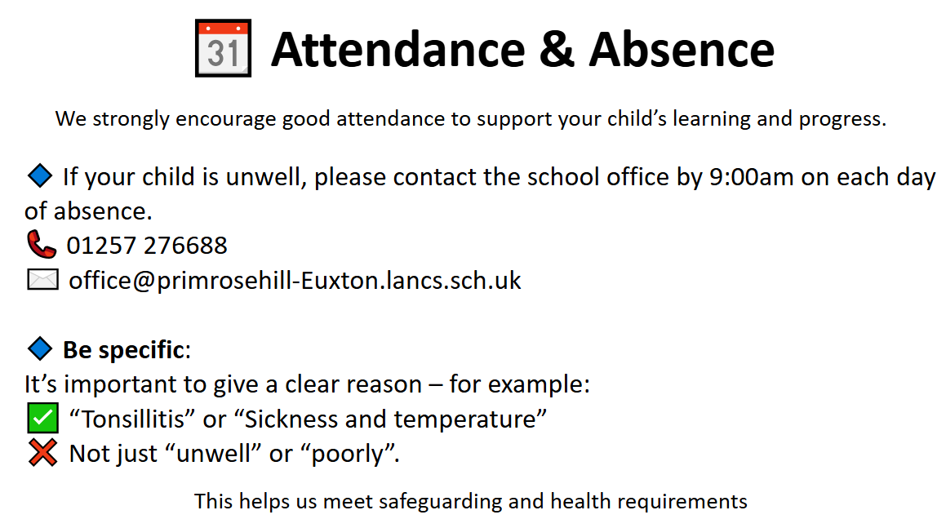

Slide 3
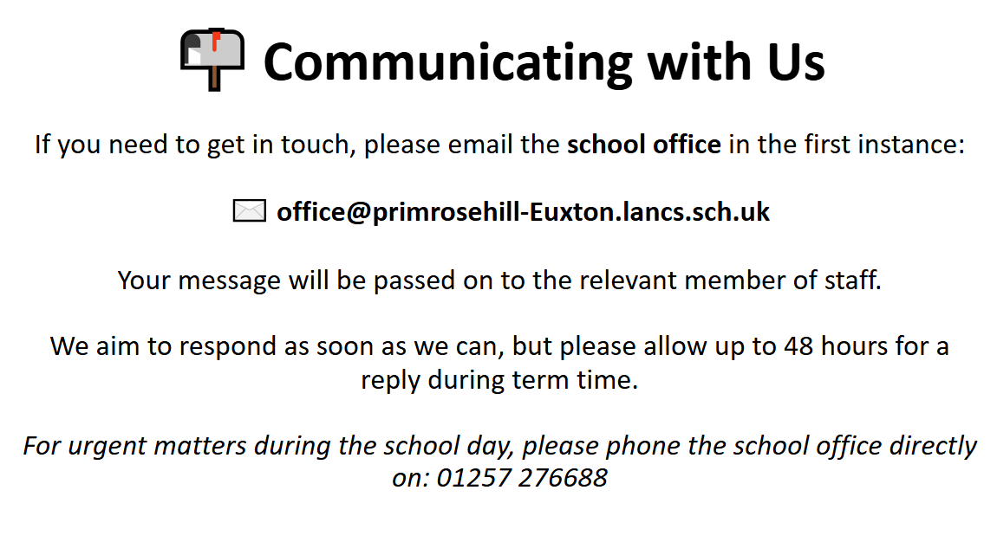

Slide 4


Slide 5
Concerns
If you’re concerned about something, we want to work in partnership with you.
If you’re ever worried or unhappy about a situation, please follow this order of contact via the school office:
Class Teacher – your first point of contact – Miss Shannon Boyle
Phase Leader – if further support is needed – Mr Lloyd Davies
Assistant Headteacher – Miss Amie Dobbs
Deputy Headteacher – Mrs Emma Swinburn
Headteacher – Mrs Claire Jones
We’re here to help and will always do our best to resolve any concerns quickly and fairly.

Slide 6
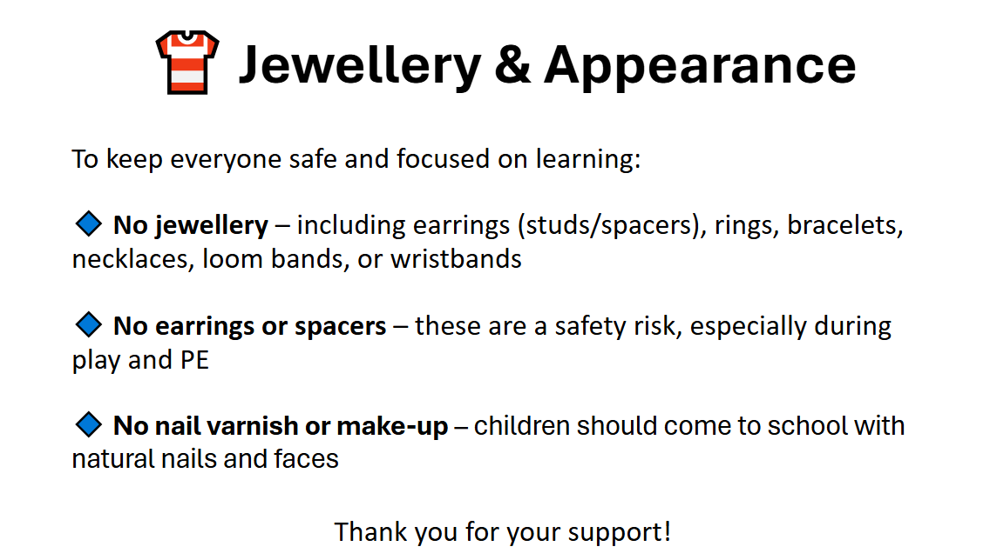

Slide 7


Slide 8


Slide 9
PE
Wednesday and Friday
Brass
Instruments in on Tuesday
Lessons on Wednesday
PPA Cover
Mrs Milward and Miss Ahmed

Slide 10
Goals for Year 4
Your child to be happy at school.
To develop to the best of their abilities.
Develop strategies to help them deal with challenges they meet in class and the wider world.
Feel they can take a risk and push themselves.
Feel supported and cared for.
Gain a sense of achievement, a desire to build on previous progress.
Work hard and feel satisfied with all they do.
To develop independent learning techniques and self- organisation.
To enjoy learning!

Slide 11
Reading is fundamental to a child’s education, and as a school we expect children to read at least 3 times per week.
I appreciate that by Year 4 many children are becoming more competent readers and may want to read independently.
I would suggest that an adult takes the time to discuss the book with the child to ensure a sound understanding.
As children are in Year 4 now, it is their responsibility to change their own reading book. We will endeavour to do this as frequently as needed.

Slide 12


Slide 13
PSHE & Relationships Education (RSE)
Updated Government Guidance
The Department for Education has published updated statutory guidance for Relationships, Sex and Health Education (RSHE), which schools are implementing from September 2026. We have reviewed our curriculum to ensure it reflects the new requirements and continues to meet the needs of our pupils.
Our updated PSHE/RSE Policy will be published on our school website in September, and a link will be shared with all parents and carers. Our curriculum is taught in an age-appropriate way and supports children's wellbeing, safety, healthy relationships and respect for others.
If you have any questions, please don't hesitate to speak to us.

Slide 14
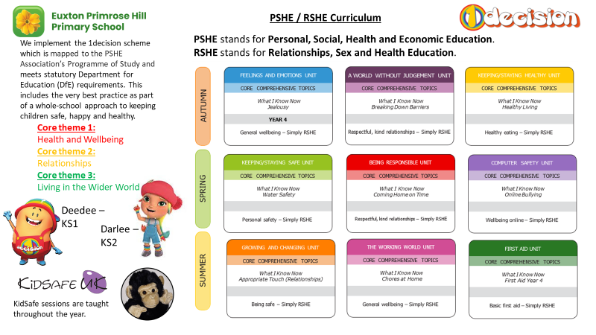
PSHE & Relationships Education (RSE)

Slide 15
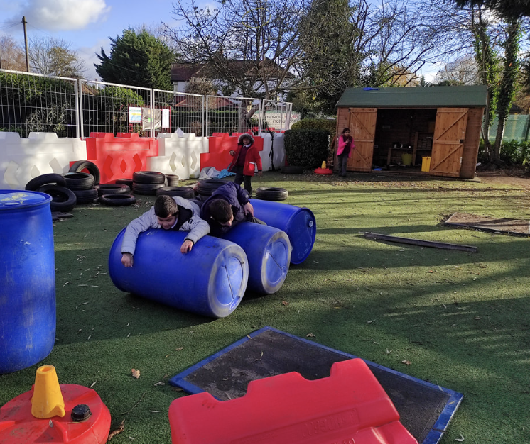

Children in British primary
schools spend 20% or 1.4 years
of their school attendance in play
Play is the process through which children learn everything that they need to know that cannot be taught. Play wires the brain, builds capable bodies, and is the foundation of building relationships.
OPAL's programme enables schools to provide every child with rich opportunities to be creative, collaborative and active in their outdoor play, in environments that are safe enough for 'health and safety' but challenging enough for children's ongoing development.
We will be beginning our whole school OPAL journey in September and are excited to share this journey - with your help and support.

Slide 16




Apps we use… a lot!
Login details will be sent home in the first week​
Showbie, Doodle Maths, TTRS

Slide 17
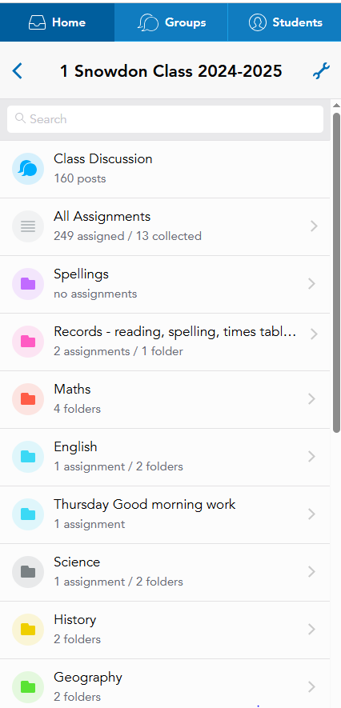
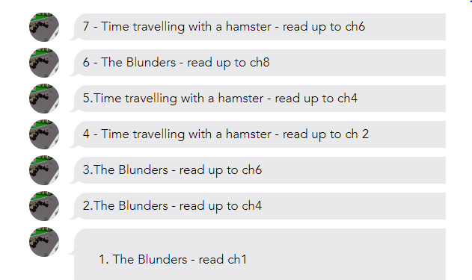
Showbie

Slide 18
Homework Expectations in Year 4
The expectation in Year 4 is that your child spends 15 minutes per day completing homework tasks. These involve reading, TTRS, Doodle Maths and learning spellings.
In the Spring and Summer terms a curriculum enhancement project will be set. It is totally up to yourselves how you plan to complete this; an example is given below.
Monday | Reading (10) | Doodle (5)
Tuesday | Spelling (5) | TTRS (10)
Wednesday | Reading (10) | Doodle (5)
Thursday | Spelling (5) | TTRS (10)
Friday | Reading (10) | Doodle (5)
Reading should be 5-10 minutes at least 3x per week.

Slide 19
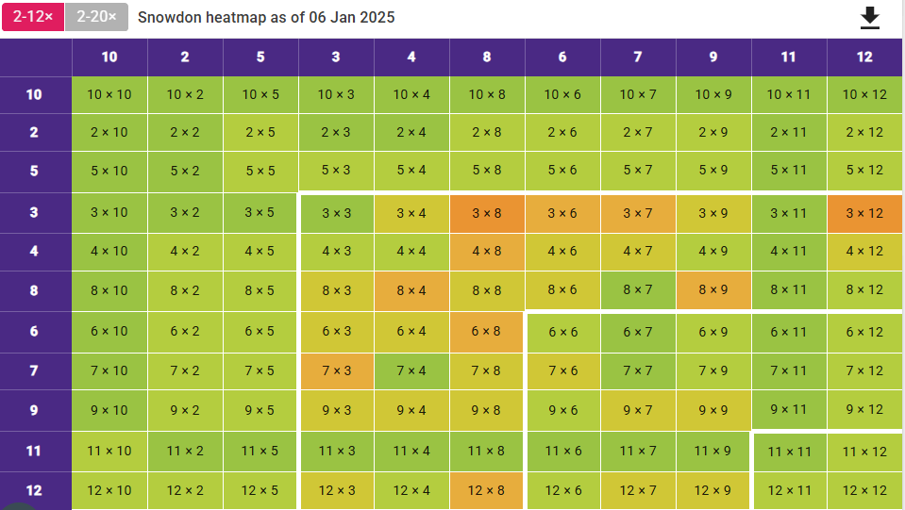
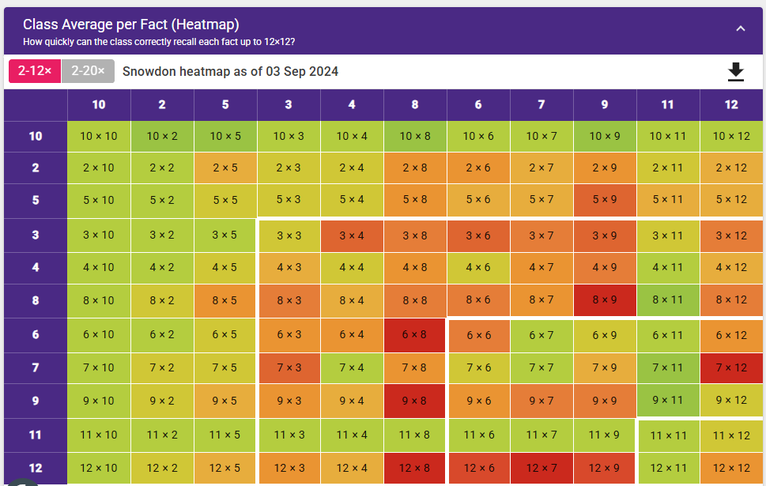
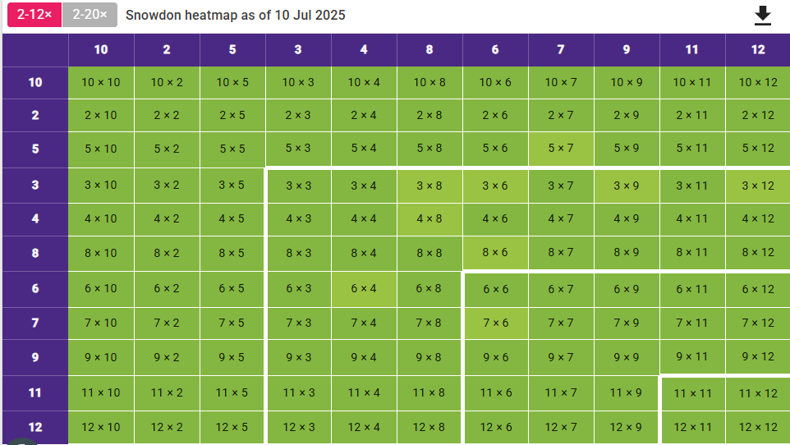
Multiplication Check (MTC)
Usually 2nd-3rd week of June
Children have 25 questions to answer, with 6 seconds per question
Over to you - have a go…

Slide 20



Pencil cases are not required, each child has their own kit.
It is however really helpful if your child has…
I can’t stress enough – name everything! We will write names into coats and jumpers to help things get back to the correct child.
USB-C

Slide 21
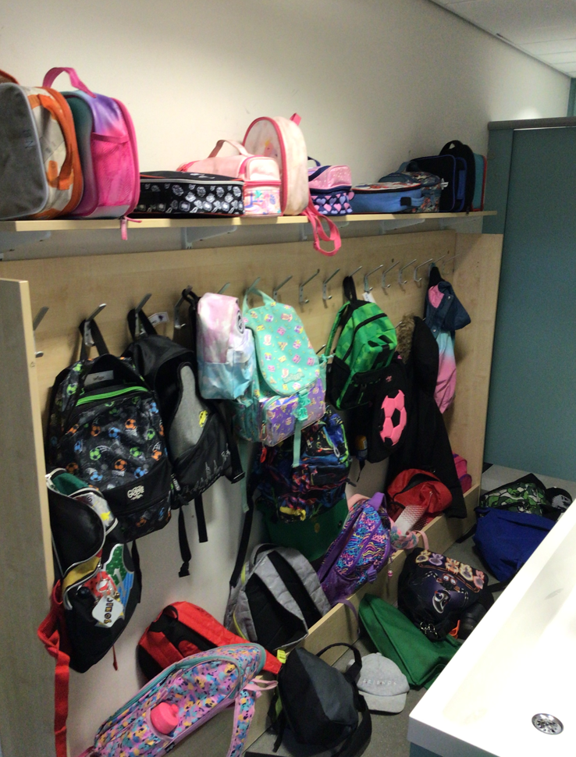

Slide 22
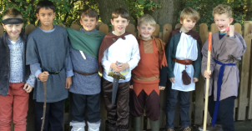
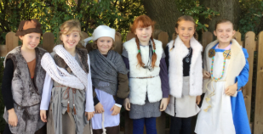
Mere Tun
Thursday 24th September
We will all dress as Saxons for the day and take part in activities which will help the children understand more about life in Saxon times.
Volunteers are always needed.

Slide 23
Thank You
Please keep in touch!
I want to support each and every child, and that support extends to you and your family; if there’s anything I can help with then I’ll try my best to do so.
A problem shared is a problem halved!

