Slide 1

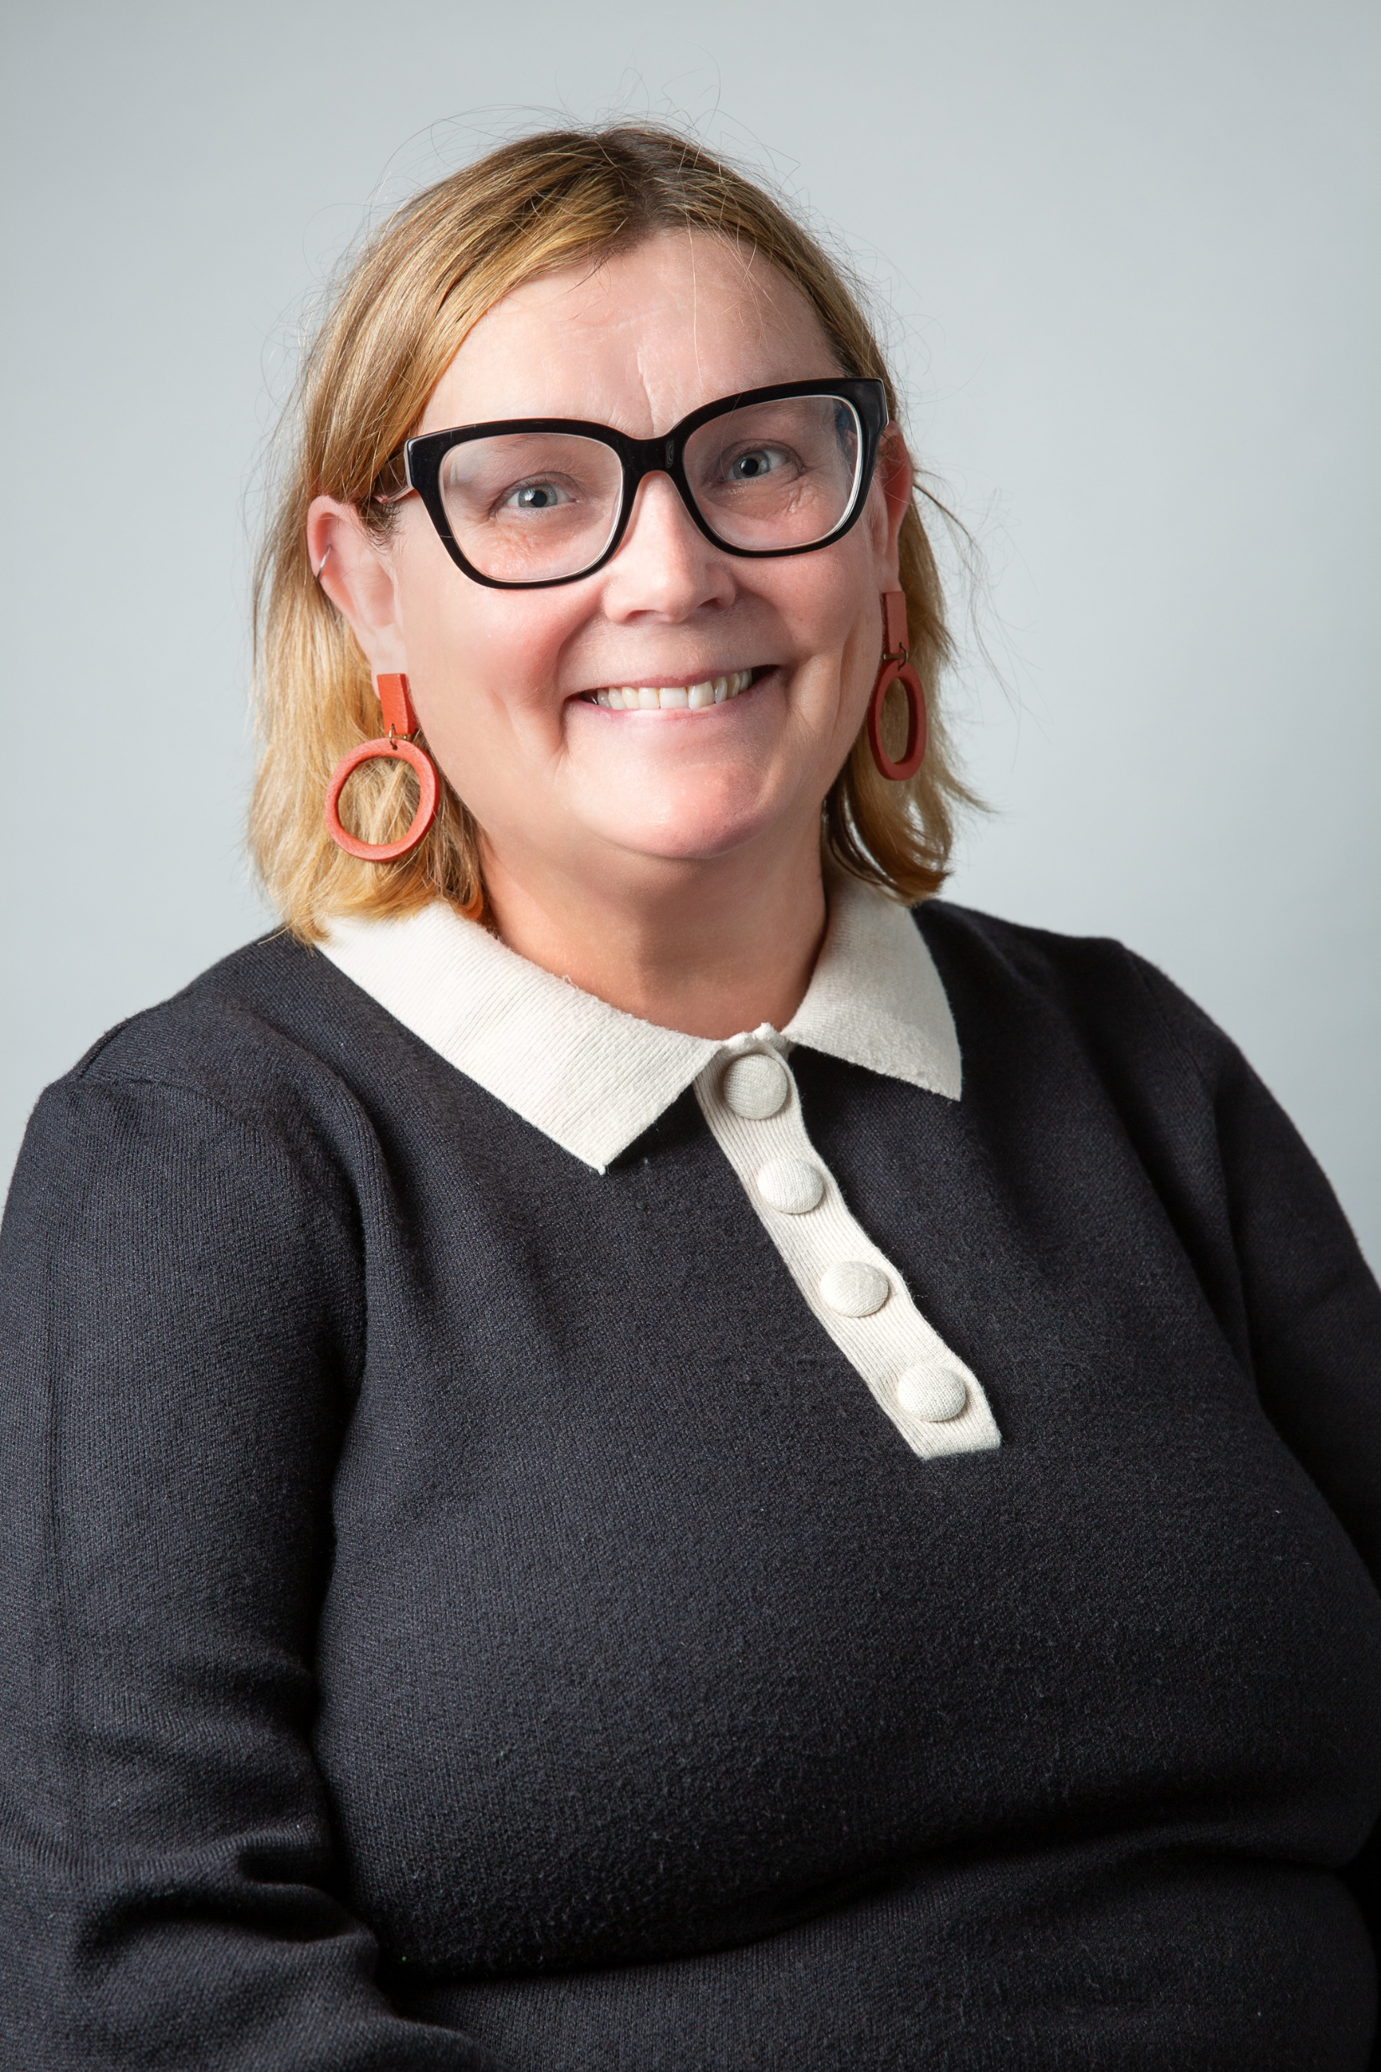
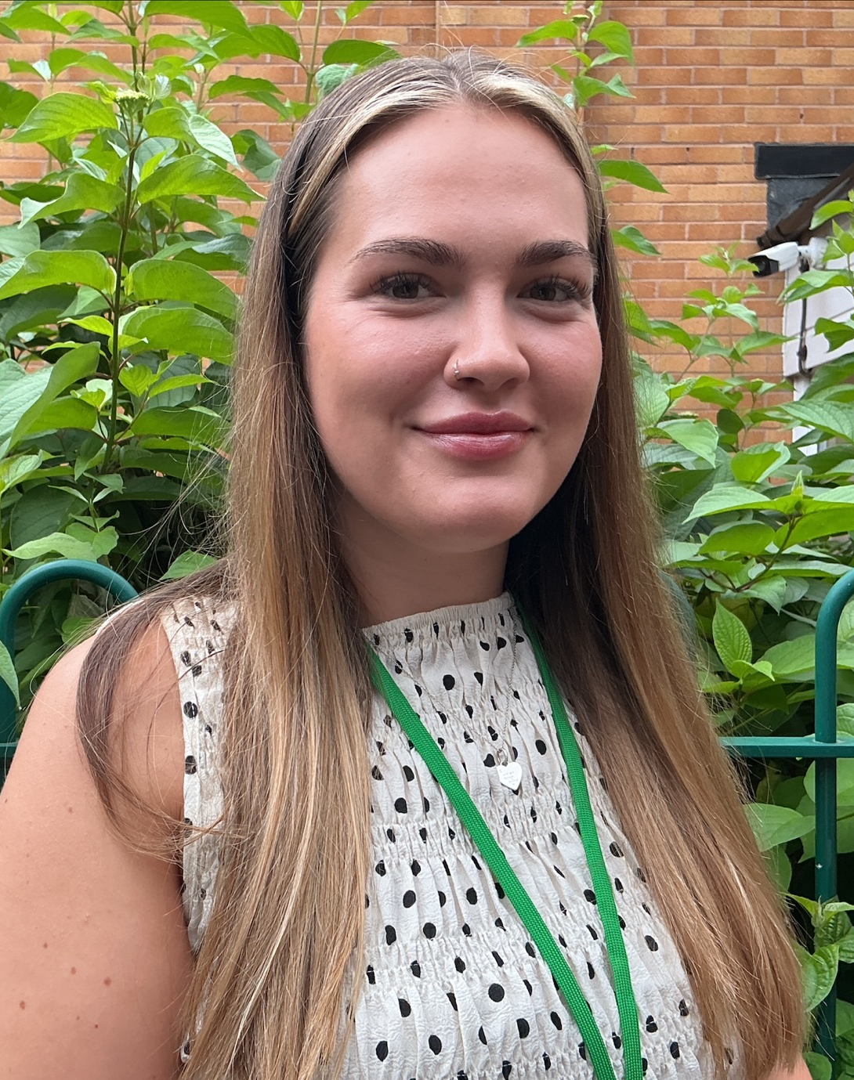
Welcome to Year 2 Elm
Miss Cheryl Pearson
Miss Leah Riley

Slide 2
Our aims for Y2 children
Your child will be happy at school
They will develop to the best of their abilities
To help them to develop strategies to help them deal with challenges they meet. Making mistakes is okay !
They feel supported and cared for
Work hard and try their best
Learn new things and try new skills
We really do want to support each and every one of your children, and that support extends to you and your family too.

Slide 3
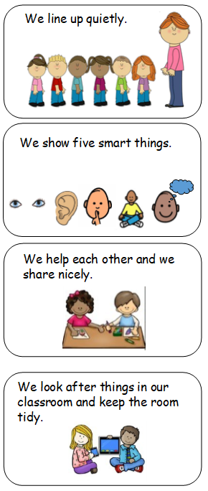
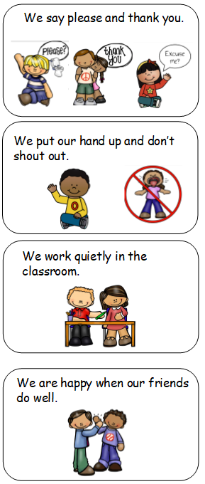
Our Classroom
Rules

Slide 4
Our Listening Ladder
Big Focus on Oracy Skills
Listening and Responding to others
Please support us with clear sentence structure when speaking and maintaining eye contact in conversation.
Try to correct Toddler Talk – eg mote control, or Traffic Centre

Slide 5
Our Rewards
Our Consequences
Positive Praise
House points
Stickers
Move up the Beehive
Star of the Day
Merit Certificates
Super Pupil
Praise from another adult.
CARE values award
A Warning 1
B Warning 2
C Time in Pod for reflection
D Warning 3
E Working in Pod or Lunchtime in
Pod

Slide 6
Coming to School
Doors will open at 8.40am.
Please encourage independence by leaving your child away from the door area.
Most messages can be sent in via email (48 hrs) to the school office, or handed to member of staff on the door.
There will always be a member of staff from Elm available to help the children coming in. May not be able to speak at that time but can arrange a time for conversation.
Children responsible for handing in letters, reading books etc.
Please feel free to send notes into school.

Slide 7
Homework
As you are aware Homework has changed in school.
Children will need to record
Daily Reads
Online Learning forms Homework for our school. Doodle Maths and Emile Spelling (4/5 times a week).

Slide 8
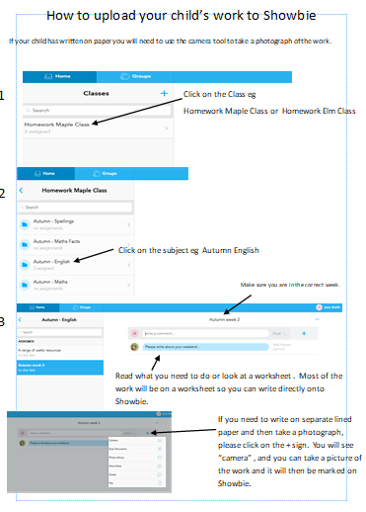
Showbie
We love to see things that you have been doing at home.
Please help us by uploading photographs or messages.
This forms part of your homework too.

Slide 9
Homework – How you can help.
Spellings- Use Emile spelling 4 times a week
Maths- Doodle maths for 10 mins 4 times a week will make a big difference.
Reading- Focus on comprehension . If your child has a longer book please do not finish the whole book, but read a shorter amount and discuss the story/predict what might happen next.
Please work towards the Bronze reading target for Autumn term

Slide 10
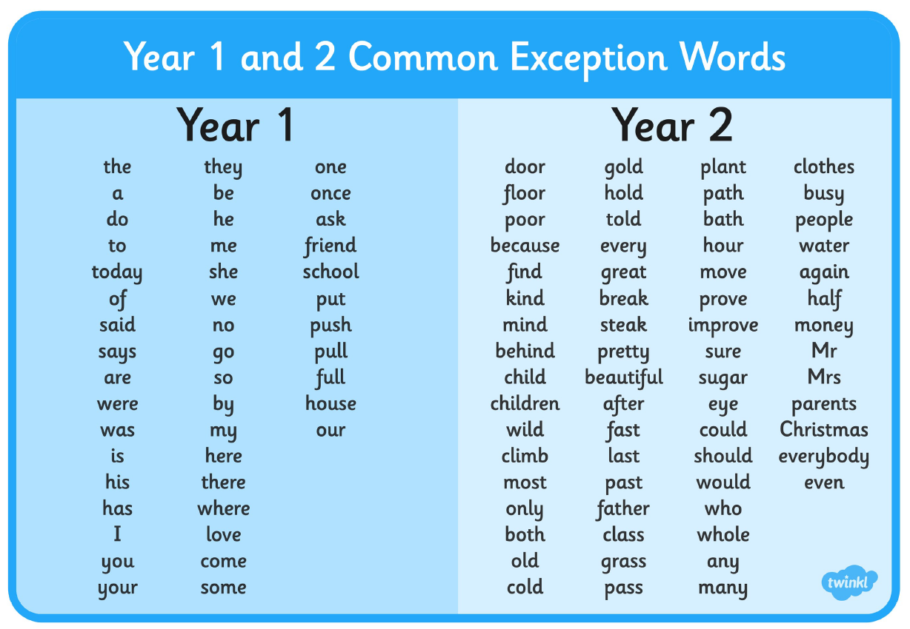

Slide 11
Handwriting and Phonics
New Scheme for Handwriting – Kinetic Letters YOUR CHILD WILL NEED A SOCK !!!
New Style Reading Books – Not RWI books. Using Red Rose Phonics and reading books will be linked to this scheme.
Whole Class Spelling Alongside Phonics. Emile online spelling used.

Slide 12


Slide 13
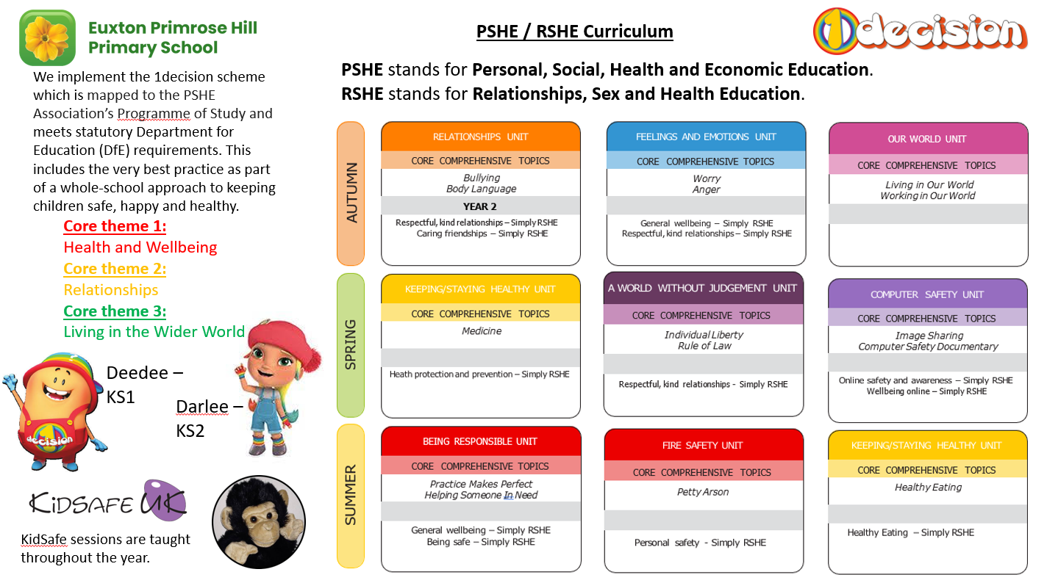

Slide 14


Slide 15
The Curriculum
Higher expectations for pupils especially in Maths and English.
For high achievers, rather than moving onto the following year group’s work, more in-depth and investigative work to allow greater understanding of concepts and ideas.
English and Maths take up a substantial part of the learning week.
Phonics Scheme – Red Rose Phonics
Maths- A big focus on understanding place value, recognising number bonds to 20 and fractions, knowing maths facts.
English- A big focus on spelling, punctuation and grammar.
Any Children who did not pass the Phonics Screening Test will be tested again in June 2026.

Slide 16
PE
Children are continuing to come to school in their PE kits. PE kit – just as with school uniform, Name everything please !!!
Days – Possibly Thursday and Friday
FOREST SCHOOL CONTINUES IN YEAR 2.
Please ensure your child has the correct size of Wellies! All children will need waterproofs.

Slide 17
General Information
All children should bring a Green School Reading Bag. Please do not attach more than 1 keyring as they become difficult to store. Backpack bags are not needed, so please leave those till KS2.
Please ensure all uniform is named. Children are responsible for their own cardigans/jumpers (we do try to check at the end of the day).
Please put a label on your child’s water bottle. All children need a water bottle every day in school. Plain bottle with Straw
PPA afternoon Wednesday – Covered by Mrs J Moss

Slide 18
General Information
Year 2 Curriculum Letters
Termly grade cards – Sent home
Parents' Evening

Slide 19
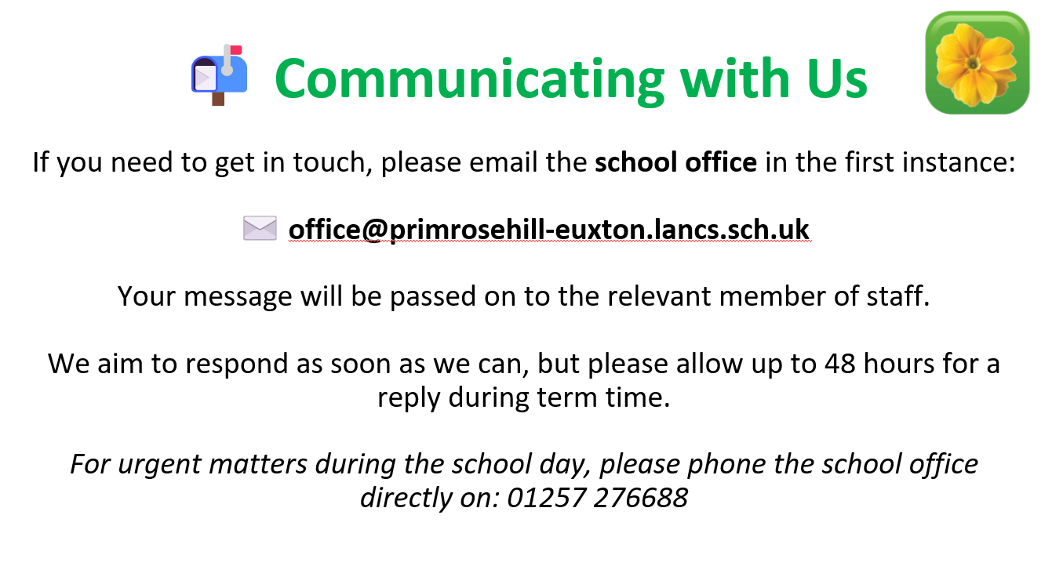
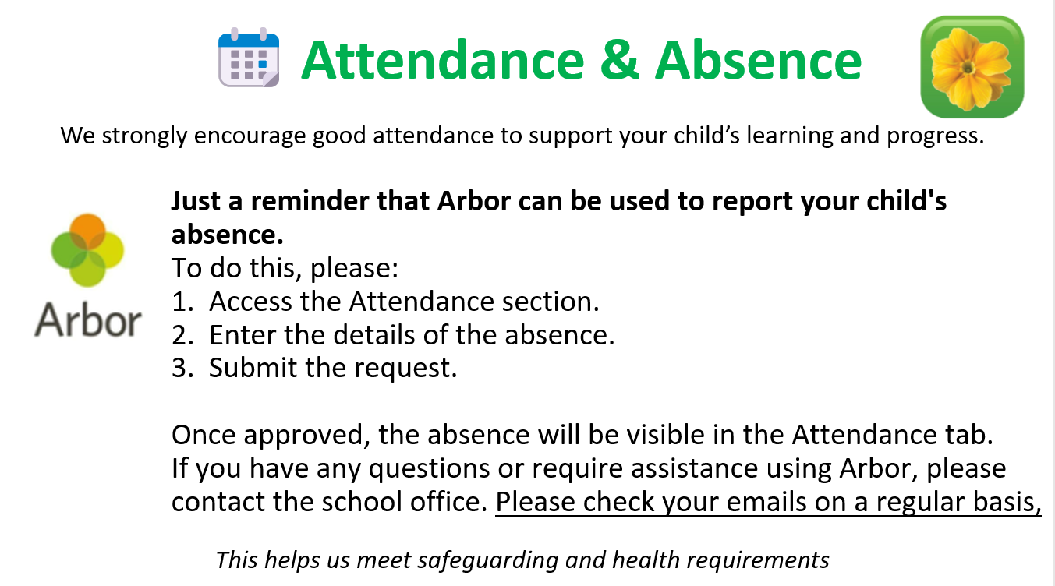

Slide 21
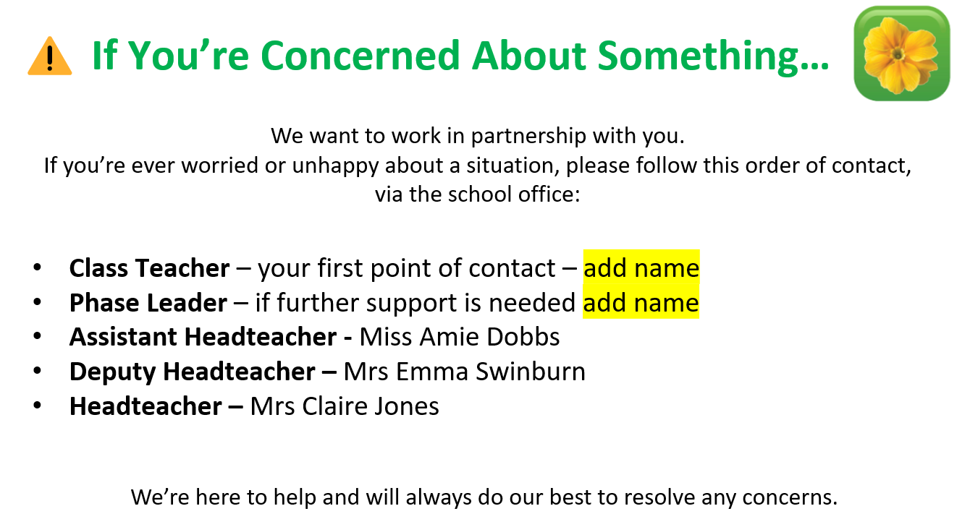

Slide 22
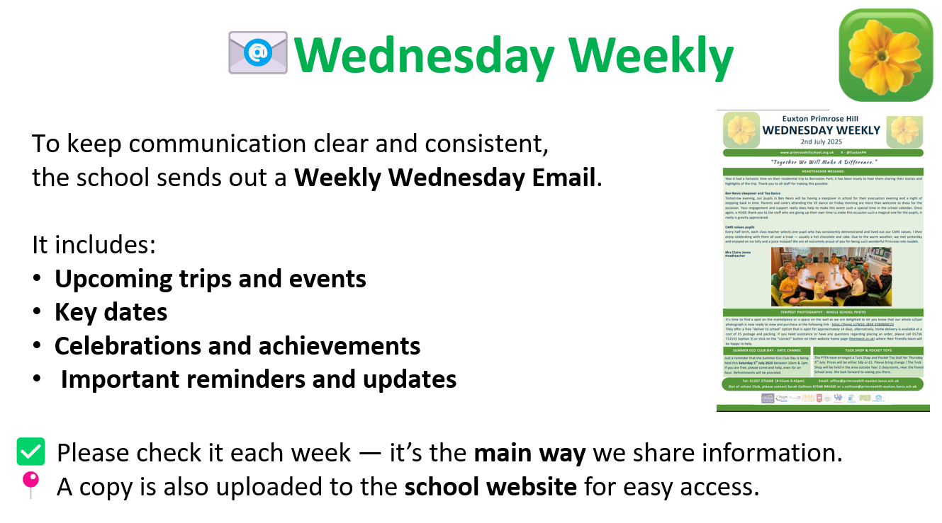

Slide 23
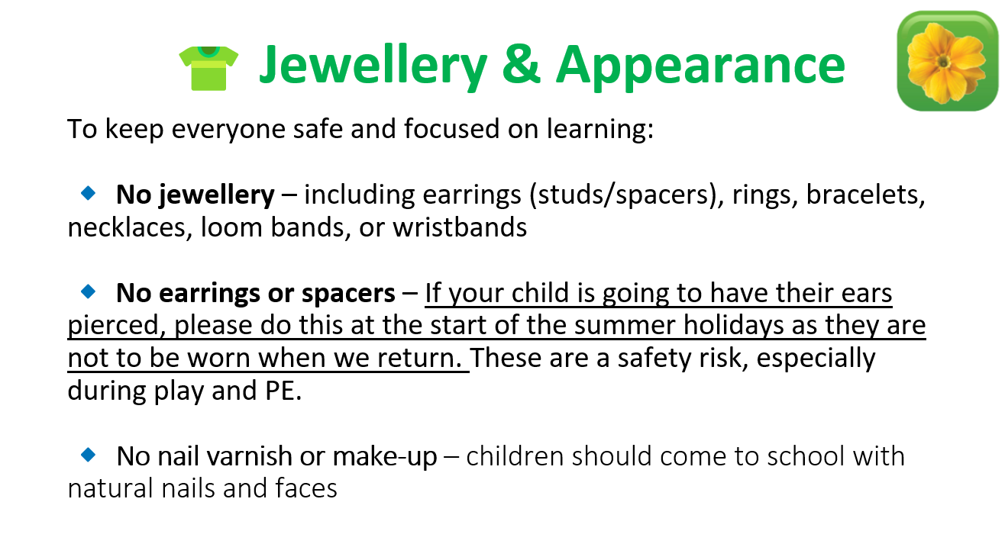

Slide 24


Slide 25
.
Together we CAN make a difference.

