Slide 1


MEET THE TEACHER
Year 2 - Maple

Slide 2
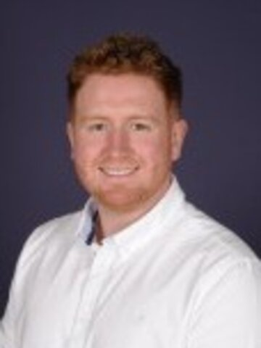
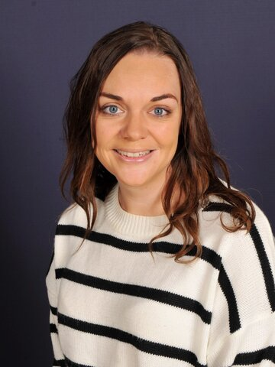
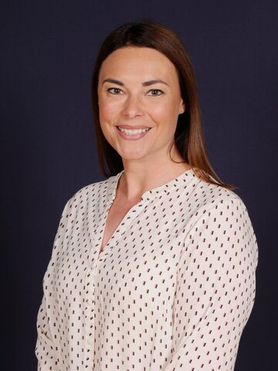
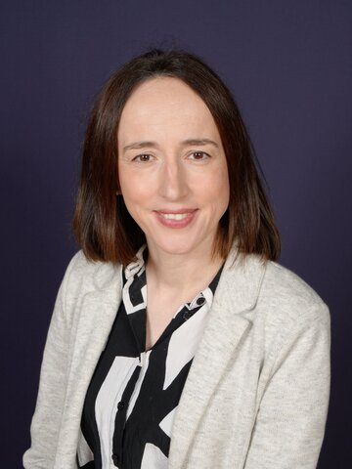
Maple Class Staff
Welcome to Maple Class
Mr Wilson
(Class teacher)
Mrs Davies
(Teaching Assistant)
Mrs Caunce (Thursday afternoon)
Mrs Moss (Thursday Science)

Slide 3
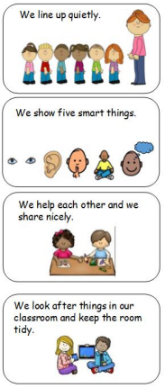
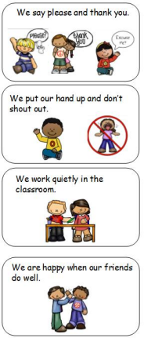

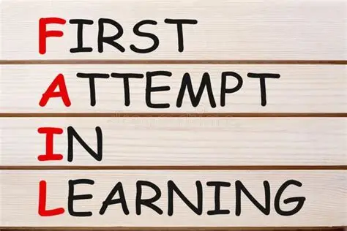
Our aims for Y2 children
Your child will be happy at school
• They will develop to the best of their abilities.
• To help them to develop strategies to help them deal. with challenges they meet. Making mistakes is okay !
• They feel supported and cared for.
• Work hard and try their best.
• Learn new things and try new skills.

Slide 4
Class Routines
Classroom door opens at 8.40 am with registers closing at 8.50am
Finish time : 3.10pm
Morning – Toast if you wish to purchase
Afternoon – School fruit
Daily Maths, English, handwriting and Phonics.
Mastering Number to build fluency
Foundation subjects, PE & PSHE
Enhanced provision
Library – every Friday
Forest School – every 2 weeks (Split into 2 groups)
Assemblies – Whole School, Singing and Celebration

Slide 5
What children need in school each day:
Sock – for Kinetic letters (handwriting)
Simple water bottles with a spout (no special features)
Green reading bag and Phonics pack with reading record
Waterproof coat/ hats (weather dependent)
Forest School and Opal waterproofs and wellies
Wear P.E Kits on P.E days, days TBC
All items of uniform to be named

Slide 6
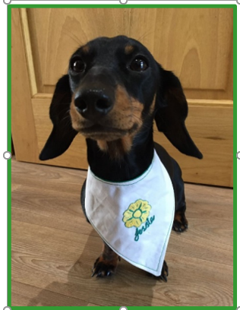
Rewards:
House points
Certificates in Friday assembly
Super Pupil – school dog Jessie reward time
CARE value reward each term
Behaviour system – stages

Slide 7
PSHE & Relationships Education (RSE)
Updated Government Guidance
The Department for Education has published updated statutory guidance for Relationships, Sex and Health Education (RSHE), which schools are implementing from September 2026. We have reviewed our curriculum to ensure it reflects the new requirements and continues to meet the needs of our pupils.
Our updated PSHE/RSE Policy will be published on our school website in September, and a link will be shared with all parents and carers. Our curriculum is taught in an age-appropriate way and supports children's wellbeing, safety, healthy relationships and respect for others.
If you have any questions, please don't hesitate to speak to us.

Slide 8
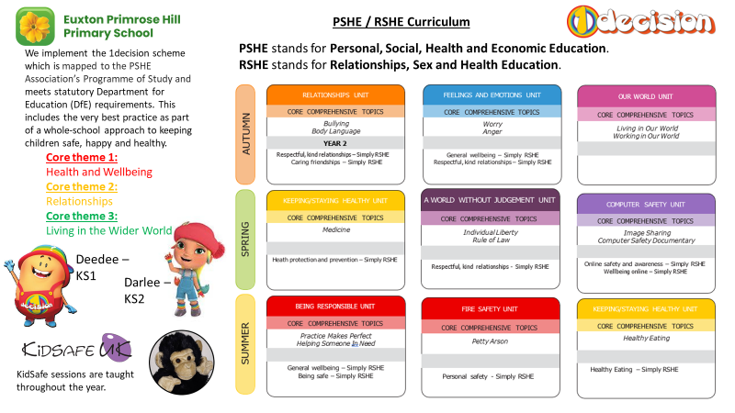

Slide 9

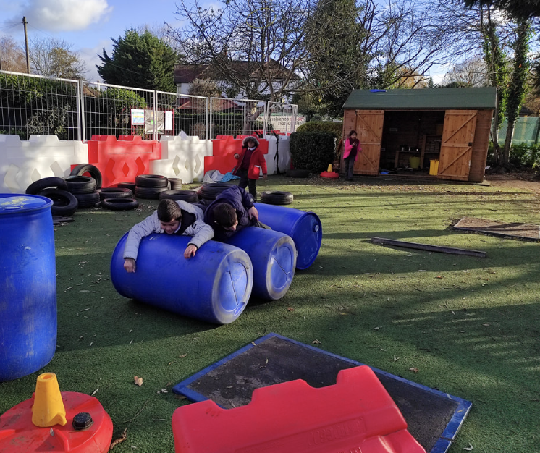
Children in British primary schools spend 20% or 1.4 years of their school attendance in play
Play is the process through which children learn everything that they need to know that cannot be taught. Play wires the brain, builds capable bodies, and is the foundation of building relationships.
OPAL's programme enables schools to provide every child with rich opportunities to be creative, collaborative and active in their outdoor play, in environments that are safe enough for 'health and safety' but challenging enough for children's ongoing development.
We will be beginning our whole school OPAL journey in September and are excited to share this journey - with your help and support.

Slide 10
📬 Communicating with Us
If you need to get in touch, please email the school office in the first instance:
✉️ office@primrosehill-euxton.lancs.sch.uk
Your message will be passed on to the relevant member of staff.
We aim to respond as soon as we can, but please allow up to 48 hours for a reply during term time.
For urgent matters during the school day, please phone the school office directly on: 01257 276688

Slide 11
📆 Attendance & Absence
We strongly encourage good attendance to support your child’s learning and progress.
This helps us meet safeguarding and health requirements.
🔹 If your child is unwell, please contact the school office by 9:00am on each day of absence.
📞 01257 276688
✉️ office@primrosehill-euxton.lancs.sch.uk
🔹 Be specific:
It’s important to give a clear reason – for example:
✅ “Tonsillitis” or “Sickness and temperature”
❌ Not just “unwell” or “poorly”.

Slide 12
⚠️ If You’re Concerned About Something…
We want to work in partnership with you.
If you’re ever worried or unhappy about a situation, please follow this order of contact,
via the school office:
Class Teacher – your first point of contact – Mr Wilson , Mrs Davies
Phase Leader – if further support is needed – Miss Pearson
Assistant Headteacher - Miss Amie Dobbs
Deputy Headteacher – Mrs Emma Swinburn
Headteacher – Mrs Claire Jones
We’re here to help and will always do our best to resolve any concerns quickly and fairly.

Slide 13
📧 Weekly Wednesday Email
To keep communication clear and consistent,
the school sends out a Weekly Wednesday Email.
It includes:
Upcoming trips and events
Key dates
Celebrations and achievements
Important reminders and updates
✅ Please check it each week — it’s the main way we share information.
📍 A copy is also uploaded to the school website for easy access.

Slide 14
🎒 Equipment
PE kit must be worn on PE days. (Monday & Tuesday)
Reading book should be in school every day.
Children need a green bookbag or a small rucksack.
No pencil cases are needed.

Slide 15
👕 Jewellery & Appearance
To keep everyone safe and focused on learning:
🔹 No jewellery – including earrings (studs/spacers), rings, bracelets, necklaces, loom bands, or wristbands
🔹 No earrings or spacers – these are a safety risk, especially during play and PE
🔹 No nail varnish or make-up – children should come to school with natural nails and faces
Thank you for your support!

Slide 16
📢 Communication
You’re welcome to speak to us at the end of the day or first thing in the morning.
You can send a note or letter in with your child.
Feel free to call or email the school for any queries.
Updates are also shared on the school website and Twitter/X.

Slide 17




Homework
Doodle maths
Emile spelling - Weekly Spellings and Phonics work
Numbots
Whiterose maths

