Slide 1
Meet the Teacher
Year 3 - Pendle

Slide 2

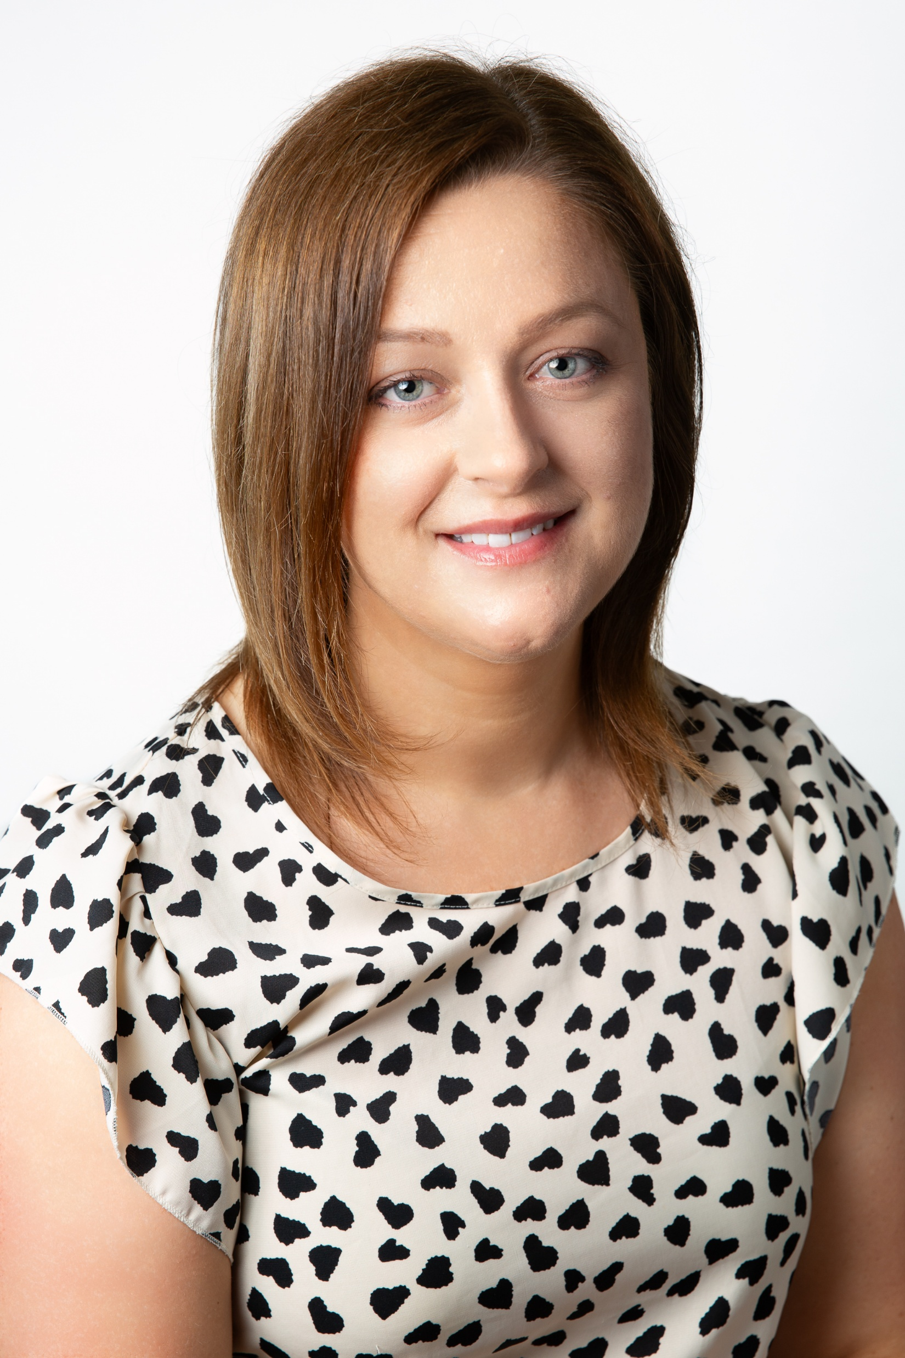
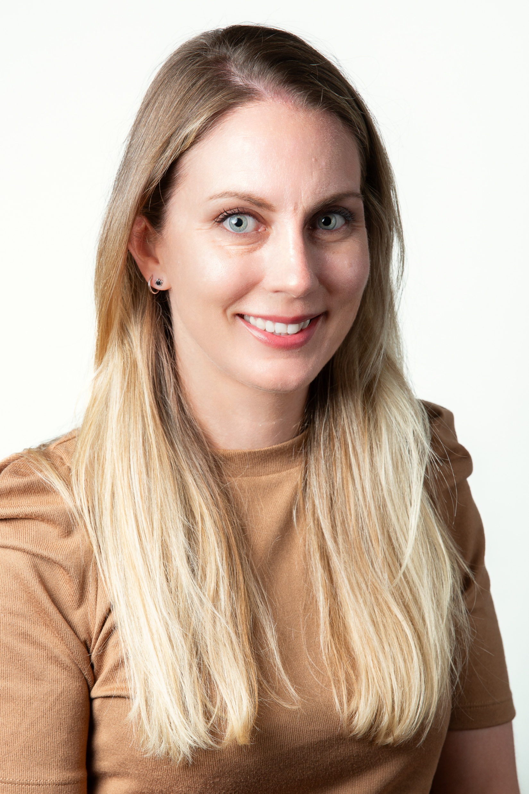
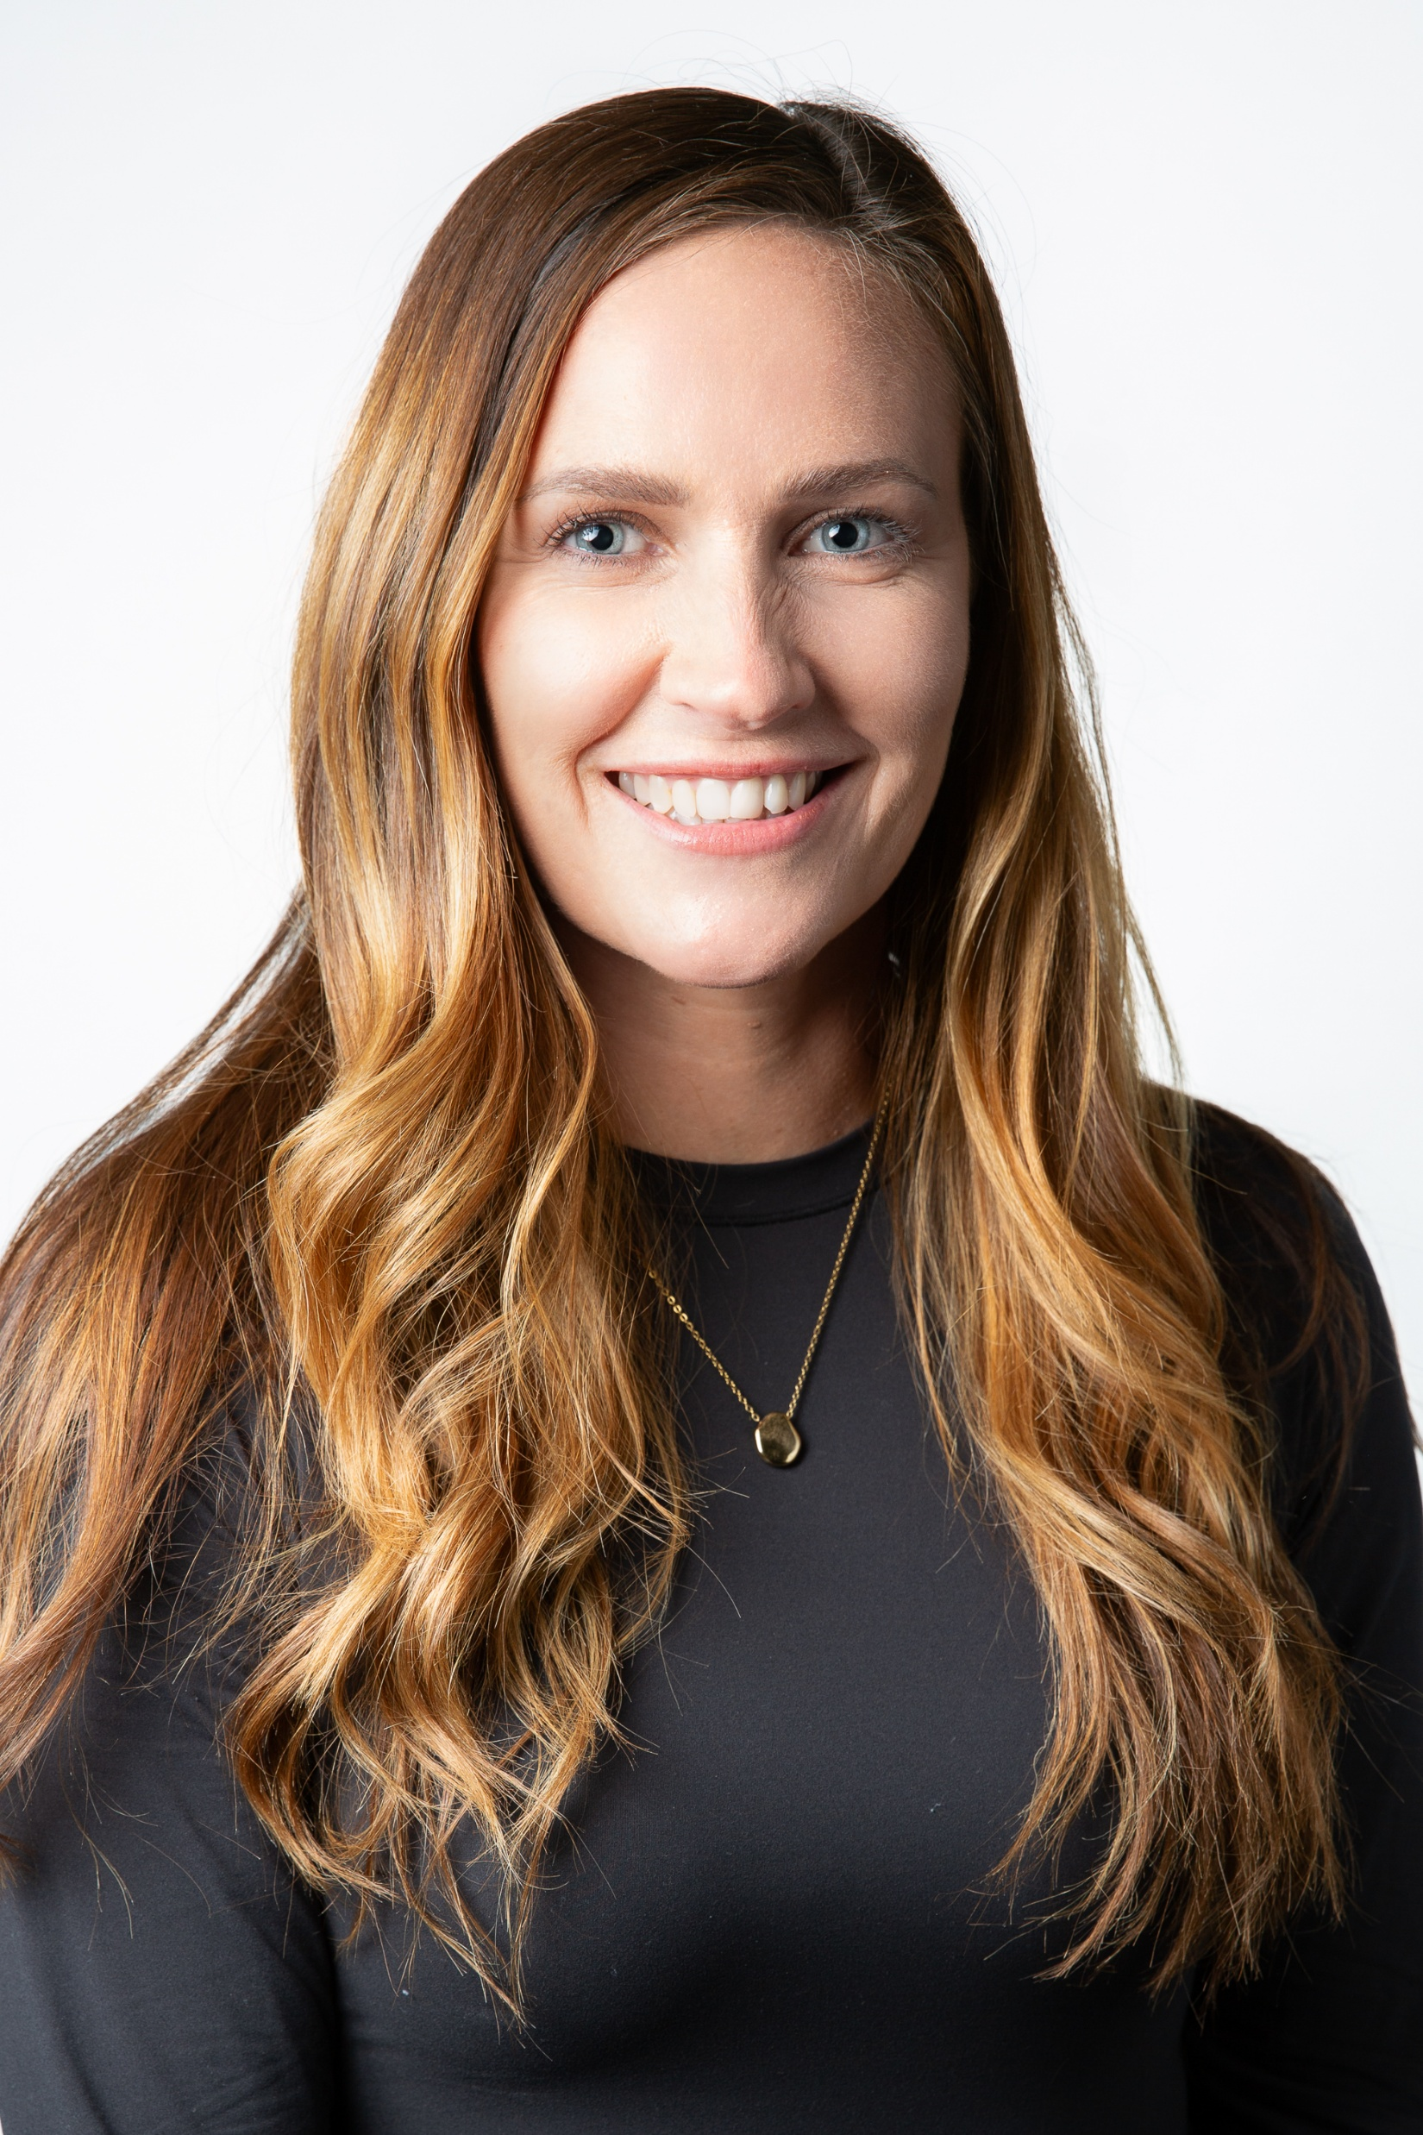
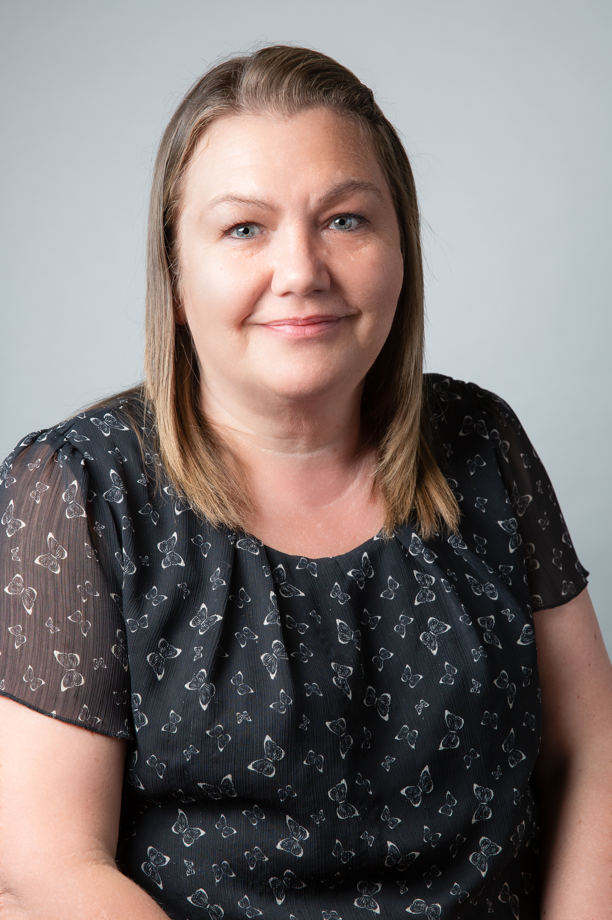
Pendle Class Staff
Miss Dobbs
Mrs Murphy
Mrs Clements
Mrs Cocker

Slide 3

School Routine
Door will open at 8.45am
Children can change their own reading books in this time any morning. Please record reads on Showbie so we can keep a record of how often they are reading. Reading display in class to celebrate.
Playtime 10.15am-10:30am.
In KS2 lunch runs from 12.30pm until 1.30pm. Children eat in the first half an hour of this time, hot dinners are usually in the upper hall and packed lunches in the lower hall.
PE lessons are Tuesday and Thursday.
End of day routine will build independence; children need to remember their own things in a small rucksack or bag.

Slide 4

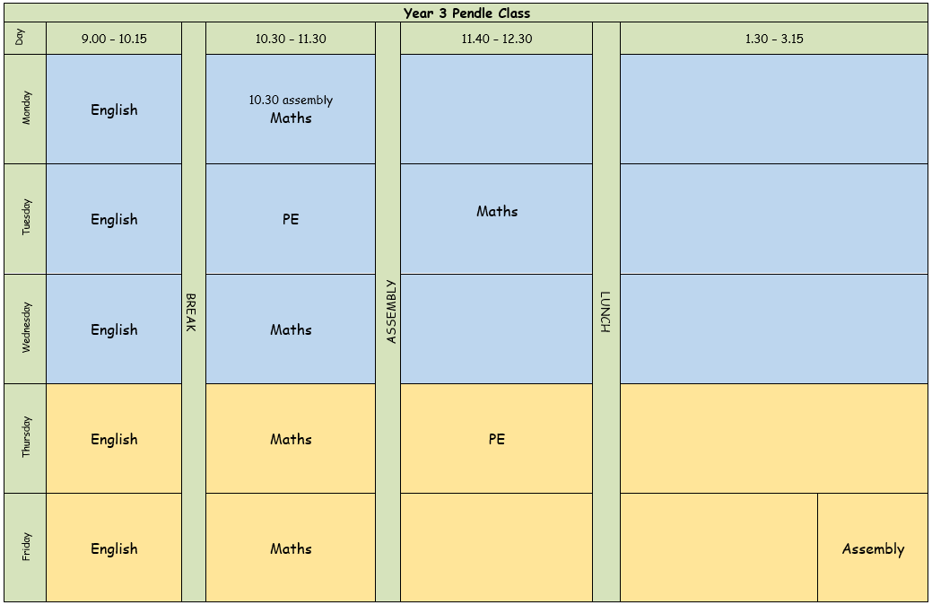
School routine

Slide 5

School life
  House points, class rewards
  Class jobs/monitors
  Celebration assembly on Friday
  Library- time will be given once a week to visit the library.
  iPads
  Toast can be ordered as usual

Slide 6
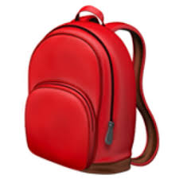
What Children need in school each day.
Sock – for Kinetic Letters (Handwriting)
Water bottles, snacks (fresh fruit/veg)
Reading book in school every day.
PE on Tuesday and Thursday- Come to school in PE kits
No pencil cases
Bookbag or small rucksack
Stylus for iPad (optional)

Slide 7

Year 3 changes
Reading pathways
Ties/shirts
School day changes
1:1 iPads (styluses)
Independence and organisation (please label clothing!)
New part of the building
Lunchtimes – packed lunches
OPAL
Handwriting – bring a sock!

Slide 8

Home Learning
Reading – in class rewards for termly target reads. Record on Showbie.
Online learning-TT Rockstars, Doodle Maths, Showbie and Emile
All login details are on Showbie.

Slide 9
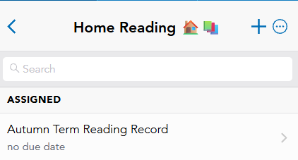
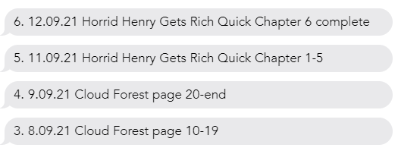
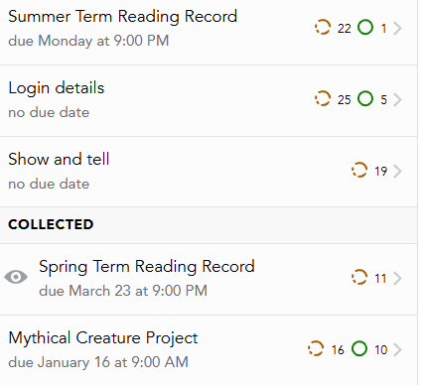
Reads are recorded on Showbie. There may be the occasional homework task or project linked to a topic.

Slide 10

PSHE & Relationships Education (RSE)
Updated Government Guidance
The Department for Education has published updated statutory guidance for Relationships, Sex and Health Education (RSHE), which schools are implementing from September 2026. We have reviewed our curriculum to ensure it reflects the new requirements and continues to meet the needs of our pupils.
Our updated PSHE/RSE Policy will be published on our school website in September, and a link will be shared with all parents and carers. Our curriculum is taught in an age-appropriate way and supports children's wellbeing, safety, healthy relationships and respect for others.
If you have any questions, please don't hesitate to speak to us.

Slide 11

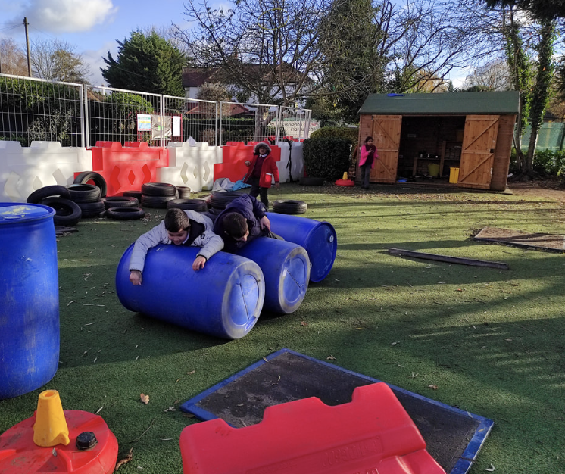
Children in British primary
schools spend 20% or 1.4 years
of their school attendance in play
Play is the process through which children learn everything that they need to know that cannot be taught. Play wires the brain, builds capable bodies, and is the foundation of building relationships.
OPAL's programme enables schools to provide every child with rich opportunities to be creative, collaborative and active in their outdoor play, in environments that are safe enough for 'health and safety' but challenging enough for children's ongoing development.
We will be beginning our whole school OPAL journey in September and are excited to share this journey - with your help and support.

Slide 12

Communication
Come and speak to us at the end of the day/ first thing in the morning
Send in a note/letter with child
Call / email school
Website

Slide 13
⚠️ If You’re Concerned About Something…
We want to work in partnership with you.
If you’re ever worried or unhappy about a situation, please follow this order of contact,
via the school office:
Class Teacher – your first point of contact – Mrs Erika Murphy/Miss Amie Dobbs
Phase Leader – if further support is needed – Mr Lloyd Davies
Assistant Headteacher - Miss Amie Dobbs
Deputy Headteacher – Mrs Emma Swinburn
Headteacher – Mrs Claire Jones
We’re here to help and will always do our best to resolve any concerns

Slide 14
📬 Communicating with Us
If you need to get in touch, please email the school office in the first instance:
✉️ office@primrosehill-euxton.lancs.sch.uk
Your message will be passed on to the relevant member of staff.
We aim to respond as soon as we can, but please allow up to 48 hours for a reply during term time.
For urgent matters during the school day, please phone the school office directly on: 01257 276688

Slide 15

Just a reminder that Arbor can be used to report your child's absence.
To do this, please:
1. Access the Attendance section.
2. Enter the details of the absence.
3. Submit the request.
Once approved, the absence will be visible in the Attendance tab.
If you have any questions or require assistance using Arbor, please contact the school office. Please check your emails on a regular basis,
📆 Attendance & Absence
We strongly encourage good attendance to support your child’s learning and progress.
This helps us meet safeguarding and health requirements

Slide 16

📧 Wednesday Weekly
To keep communication clear and consistent,
the school sends out a Weekly Wednesday Email.
It includes:
Upcoming trips and events
Key dates
Celebrations and achievements
Important reminders and updates
✅ Please check it each week — it’s the main way we share information.
📍 A copy is also uploaded to the school website for easy access.

Slide 17
To keep everyone safe and focused on learning:
🔹 No jewellery – including earrings (studs/spacers), rings, bracelets, necklaces, loom bands, or wristbands
🔹 No earrings or spacers – If your child is going to have their ears pierced, please do this at the start of the summer holidays as they are not to be worn when we return. These are a safety risk, especially during play and PE.
🔹 No nail varnish or make-up – children should come to school with natural nails and faces
👕 Jewellery & Appearance

Slide 18

PTA- Parents and Teachers Association
When combining the power of our Parents &Teachers we are creating a stronger school community- just like in our mission statement- “Together we will make a difference”
Are you passionate about your child’s education and school experience?
Do you want to help shape school events, support teachers, and build a vibrant community?
Then join our PTA – we need YOU!

