Slide 1

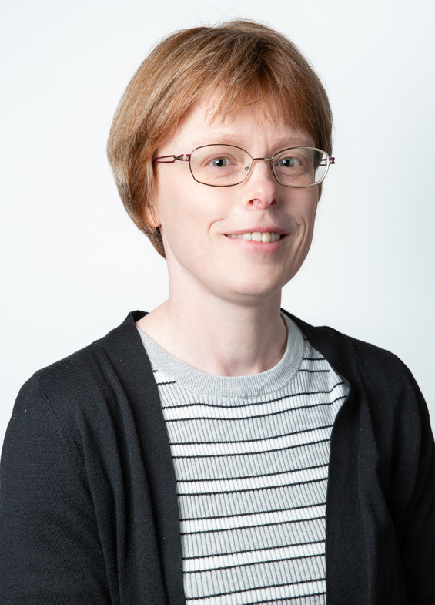
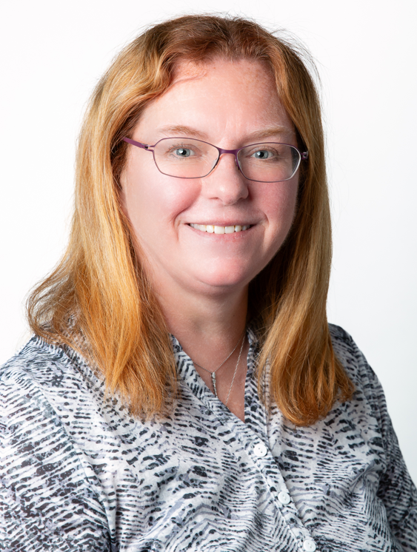
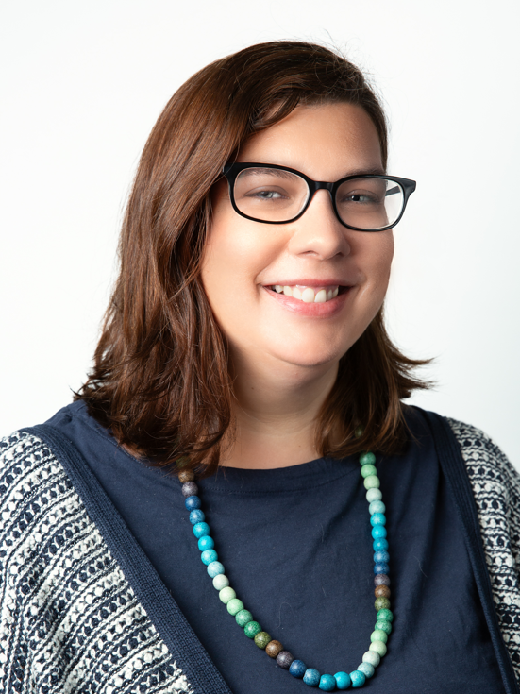
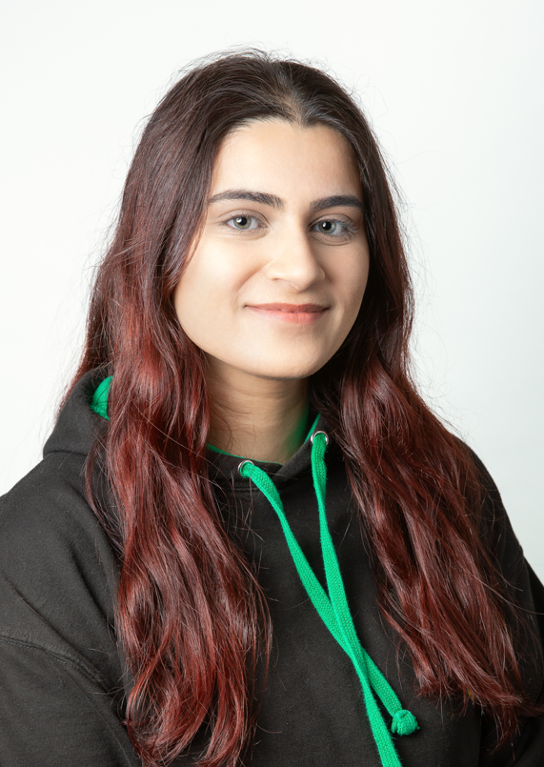
Year 5 Olympus
Miss McKinley
Class teacher
Mrs Yeoman
Teaching assistant
Mrs Millward
HLTA - PPA
Miss Ahmed
PE
Meet the Teacher

Slide 2


Just a reminder that Arbor can be used to report your child's absence.
To do this, please:
1. Access the Attendance section.
2. Enter the details of the absence.
3. Submit the request.
Once approved, the absence will be visible in the Attendance tab.
If you have any questions or require assistance using Arbor, please contact the school office. Please check your emails on a regular basis,
📆 Attendance & Absence
We strongly encourage good attendance to support your child’s learning and progress.
This helps us meet safeguarding and health requirements

Slide 3
📬 Communicating with Us
If you need to get in touch, please email the school office in the first instance:
✉️ office@primrosehill-Euxton.lancs.sch.uk
Your message will be passed on to the relevant member of staff.
We aim to respond as soon as we can, but please allow up to 48 hours for a reply during term time.
For urgent matters during the school day, please phone the school office directly on: 01257 276688

Slide 4
⚠️ If You’re Concerned About Something…
We want to work in partnership with you.
If you’re ever worried or unhappy about a situation, please follow this order of contact,
via the school office:
Class Teacher – your first point of contact – Miss McKinley
Phase Leader – if further support is needed - Miss Burns
Assistant Headteacher - Miss Amie Dobbs
Deputy Headteacher – Mrs Emma Swinburn
Headteacher – Mrs Claire Jones
We’re here to help and will always do our best to resolve any concerns quickly and fairly.

Slide 5
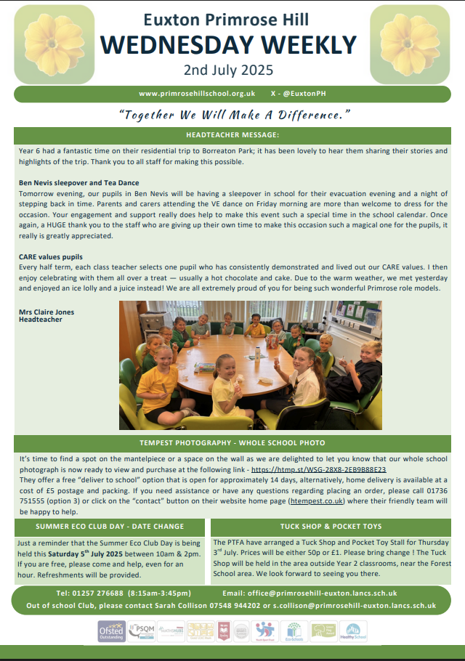
📧 Weekly Wednesday Email
To keep communication clear and consistent,
the school sends out a Weekly Wednesday Email.
It includes:
Upcoming trips and events
Key dates
Celebrations and achievements
Important reminders and updates
✅ Please check it each week — it’s the main way we share information.
📍 A copy is also uploaded to the school website for easy access.

Slide 6
To keep everyone safe and focused on learning:
🔹 No jewellery – including earrings (studs/spacers), rings, bracelets, necklaces, loom bands, or wristbands
🔹 No earrings or spacers – If your child is going to have their ears pierced, please do this at the start of the summer holidays as they are not to be worn when we return. these are a safety risk, especially during play and PE
🔹 No nail varnish or make-up – children should come to school with natural nails and faces
👕 Jewellery & Appearance

Slide 7
PSHE & Relationships Education (RSE)
Updated Government Guidance
The Department for Education has published updated statutory guidance for Relationships, Sex and Health Education (RSHE), which schools are implementing from September 2026. We have reviewed our curriculum to ensure it reflects the new requirements and continues to meet the needs of our pupils.
Our updated PSHE/RSE Policy will be published on our school website in September, and a link will be shared with all parents and carers. Our curriculum is taught in an age-appropriate way and supports children's wellbeing, safety, healthy relationships and respect for others.
If you have any questions, please don't hesitate to speak to us.

Slide 8


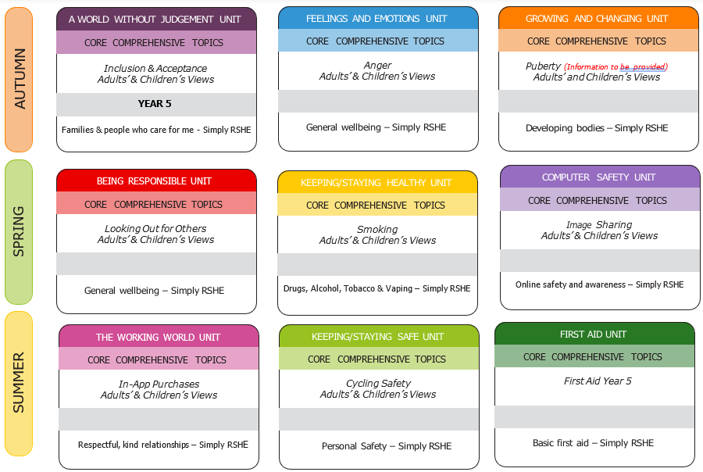
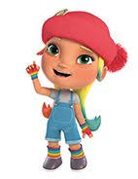


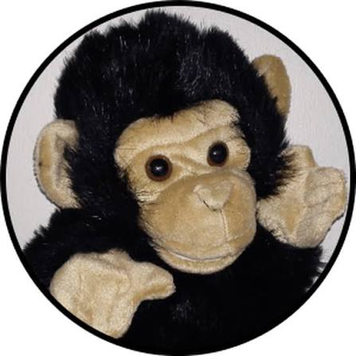
PSHE / RSHE Curriculum
We implement the 1decision scheme which is mapped to the PSHE Association’s Programme of Study and meets statutory Department for Education (DfE) requirements. This includes the very best practice as part of a whole-school approach to keeping children safe, happy and healthy.
PSHE stands for Personal, Social, Health and Economic Education.
RSHE stands for Relationships, Sex and Health Education.
Core theme 1:
Health and Wellbeing
Core theme 2:
Relationships
Core theme 3:
Living in the Wider World
Deedee – KS1
Darlee –
KS2
KidSafe sessions are taught throughout the year.

Slide 9

PE
PE will be on Tuesday and Friday.
During the colder months it is important that children have warm black/grey trousers and a PE hoodie as we will try and go outside as much as possible.
Gymnastics – children need to have shorts or trousers that are tight fitting at the ankle for practical and safety reasons. Shorts can be worn under trousers during cold months.

Slide 10

IPads
Earphones will be provided this year however if children wish to bring their own earphones/headphones they may do so.
It would be helpful if children were able to bring their own stylus
Children are very privileged to have access to their own iPad in school and as such, they are expected to look after them and use them appropriately.
Log in details for the different apps will be in a Showbie folder set up at the beginning of the year in their homework folder – this should make it easier, for as long as they remember their Showbie log in details they can find everything else!

Slide 11

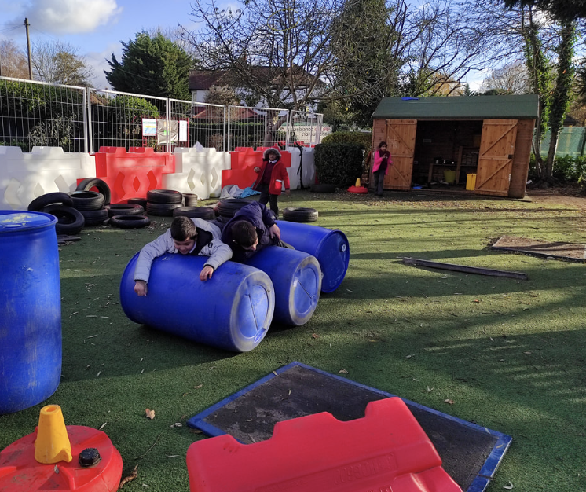
Children in British primary
schools spend 20% or 1.4 years
of their school attendance in play
Play is the process through which children learn everything that they need to know that cannot be taught. Play wires the brain, builds capable bodies, and is the foundation of building relationships.
OPAL's programme enables schools to provide every child with rich opportunities to be creative, collaborative and active in their outdoor play, in environments that are safe enough for 'health and safety' but challenging enough for children's ongoing development.
We will be beginning our whole school OPAL journey in September and are excited to share this journey - with your help and support.

Slide 12

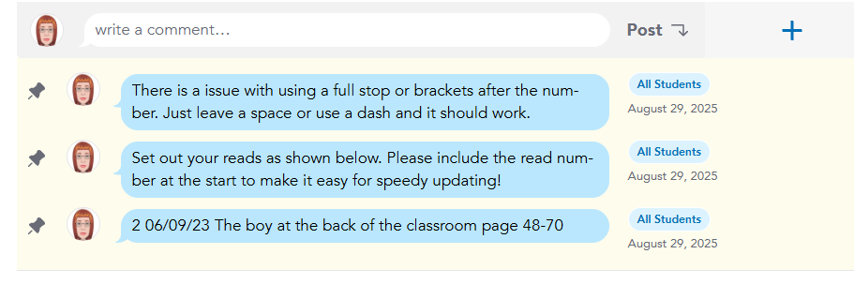




Homework
Spellings will use the spelling programme – children will have practise activities and assessments online.
OPTIONAL: TTRS and Doodlemaths practise
If possible, children should be reading every day. The minimum is at least 3x a week. This can be a reading pathway or another book of their choice. This can be recorded at home or in school.

Slide 13

Reading
Reads are to be recorded on Showbie in homework folder – there is an example format of how to set it out.
The read does not have to be a book from school as long as they are reading!
All children also have access to First News (a children’s newspaper) on Showbie.
Please check your child’s reading record regularly – they should be recording reads each morning in school or each night at home.
Please discuss with your child what they are reading. Most y5 children will read independently however it is important to check that they understand what they are reading.

Slide 14
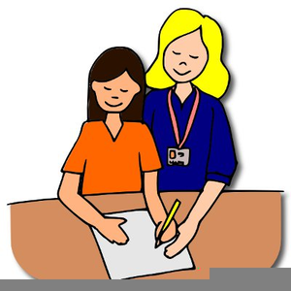
Support at school
Your child may have additional support during the day (either individually or in a group) with Mrs Yeoman – this can and will change during the year based on need and can be a one off or a regular slot.
There may be particular aspects of a subject that your child finds difficult and therefore additional support can be very topic specific.
If your child struggles with anything, please encourage them to speak to myself or Mrs Yeoman.

Slide 15
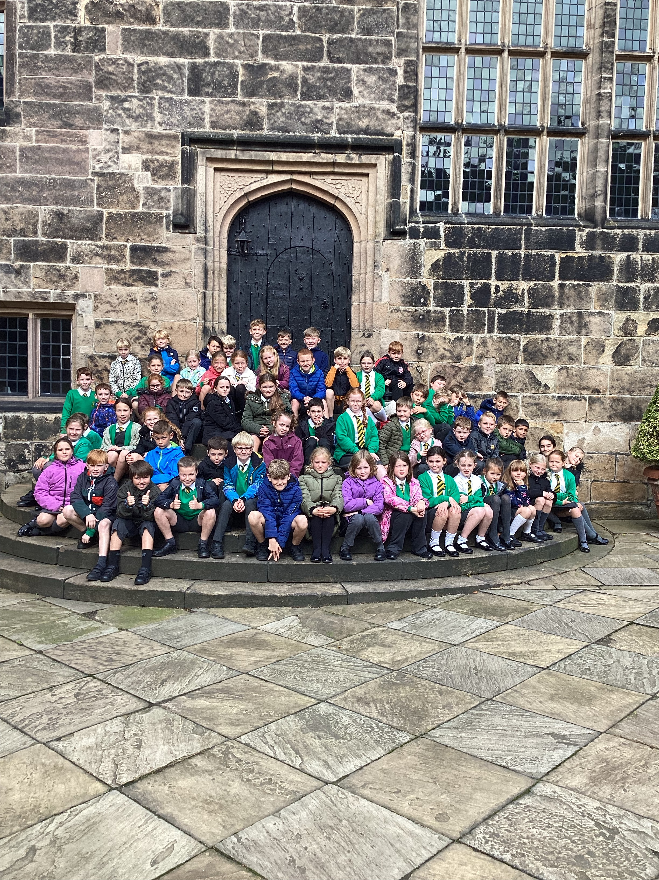
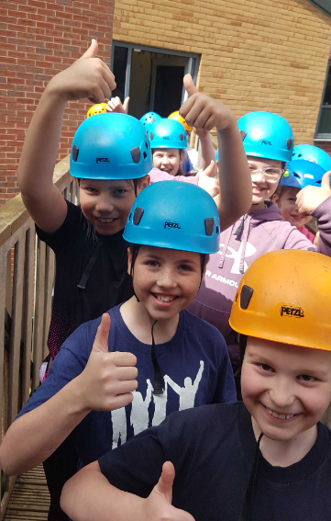
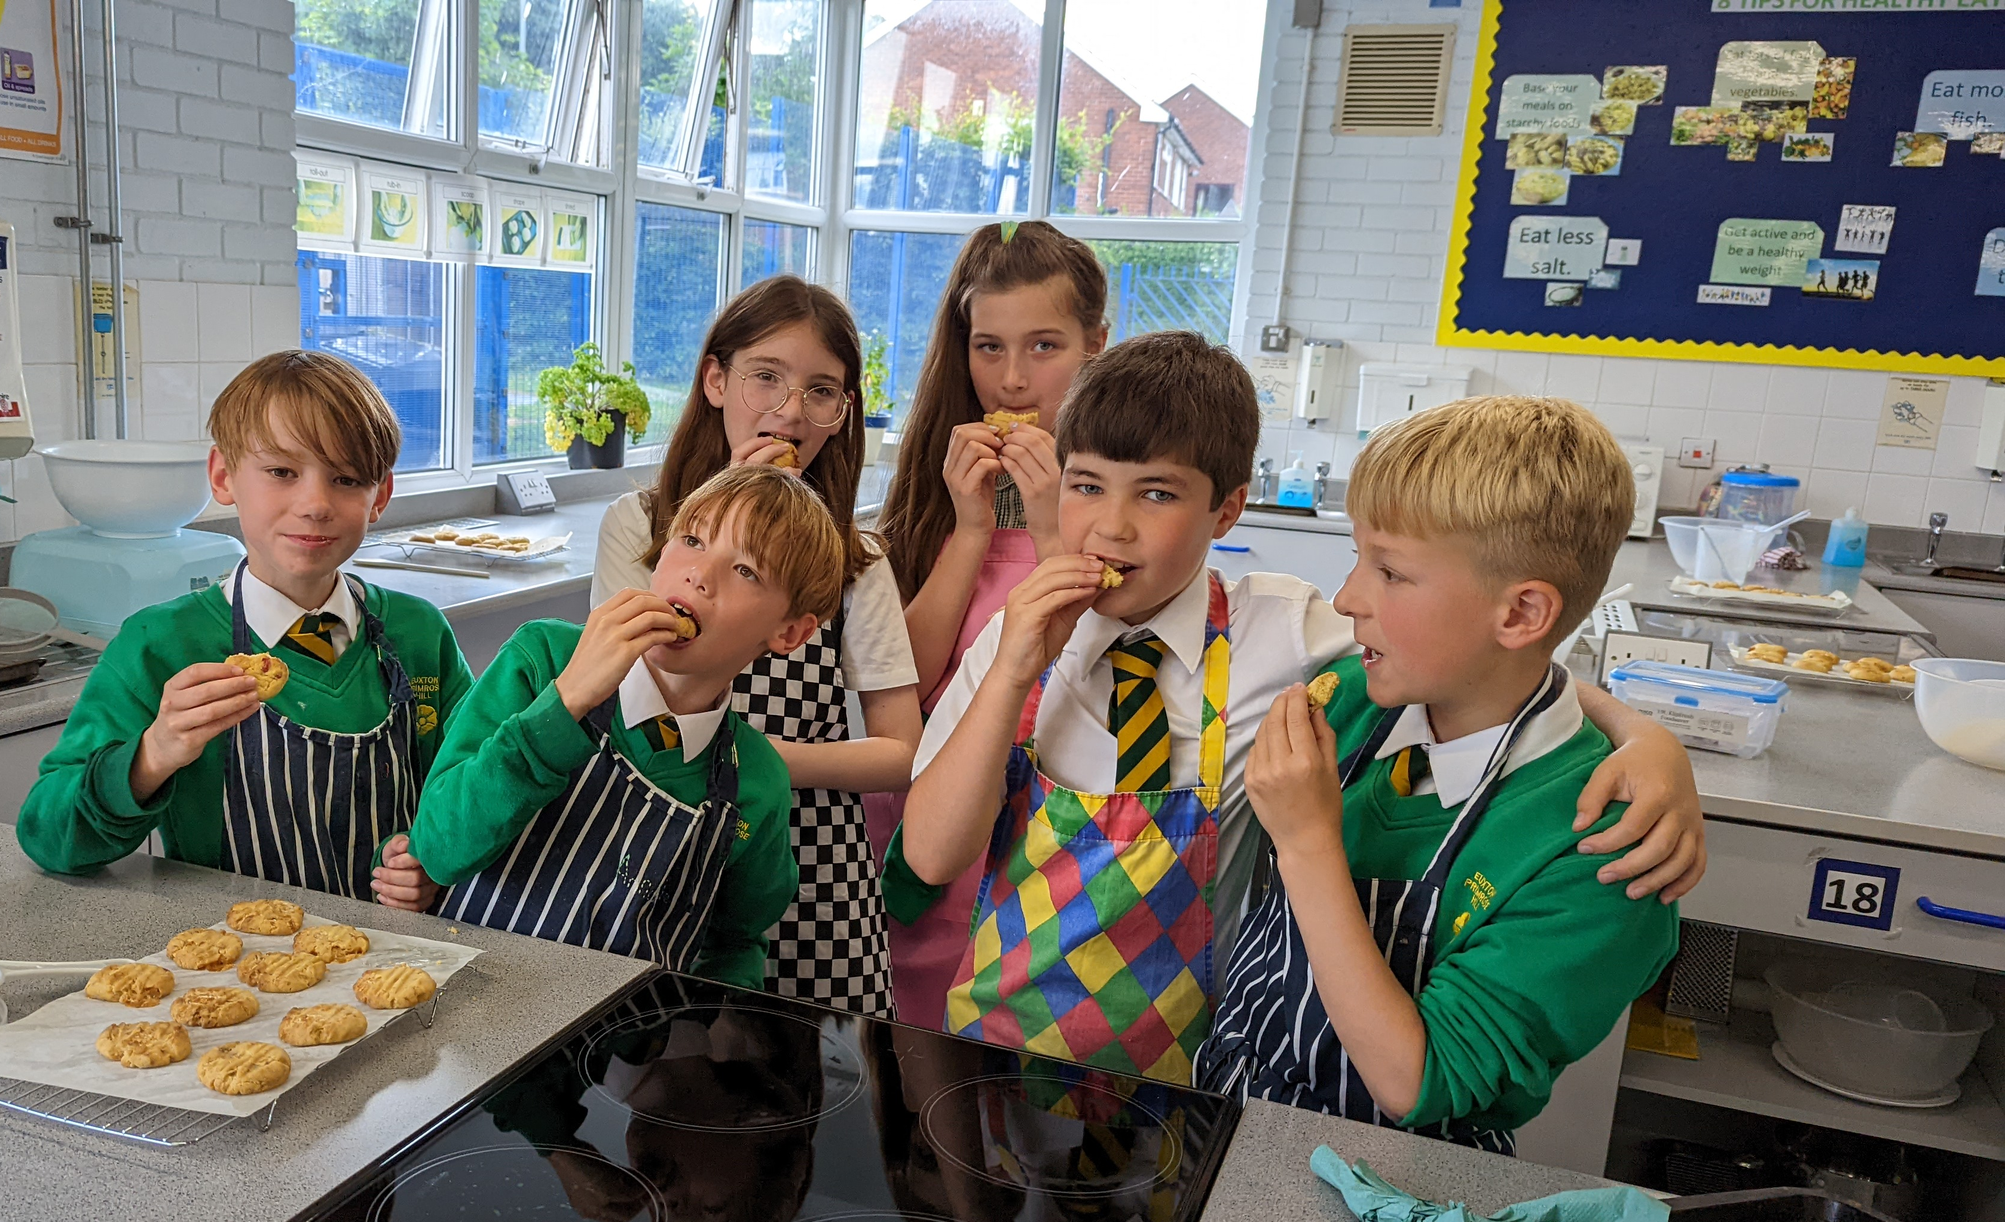
Trips/activities
Hoghton Tower – 22nd September 2026
Bikeability – 15&16th April 2027
Hothersall Lodge – 14-16th June 2027
St Mary’s High School DT – summer term 2027 (tbc)

Slide 16

PTA- Parents and Teachers Association
When combining the power of our Parents &Teachers, we are creating a stronger school community just like in our mission statement- “Together we will make a difference”.
Are you passionate about your child’s education and school experience? Do you want to help shape school events, support teachers, and build a vibrant community?
Then join our PTA – we need YOU!

Slide 17

Why join our PTA here at EPH?
🤝 Opportunities to connect with other parents and staff
🎉 Help plan fun school events and fundraisers
📚 Support educational programs and resources
🗣️ Have a voice in school decisions
💡 Share your ideas, talents and skills with others
🎯Raising funds that are put straight back into the school
No experience needed – just enthusiasm and a desire to help- Whether you can give a little time or a lot, your involvement makes a big impact.
Come along to our annual PTA General meeting on Tuesday 16th September at 5.30pm

