Slide 1

Welcome to Year 6.

Slide 2
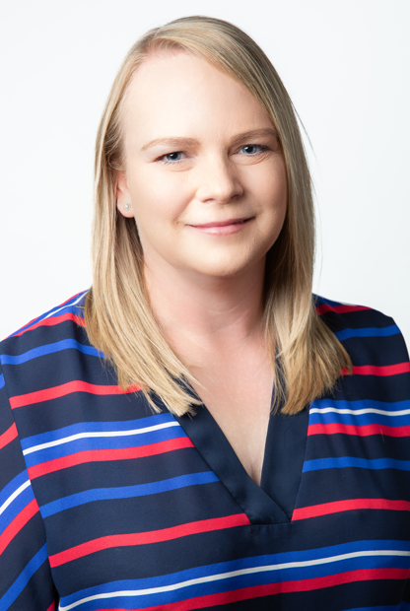
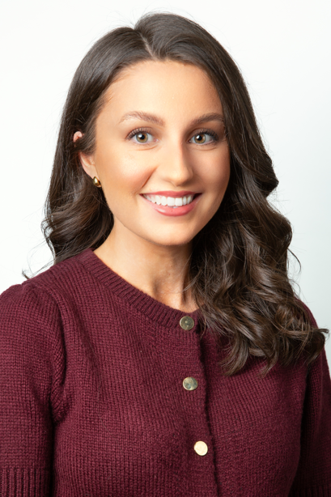
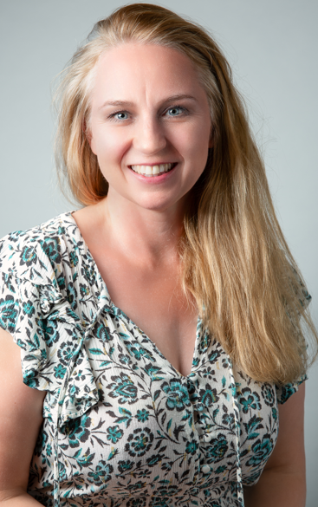
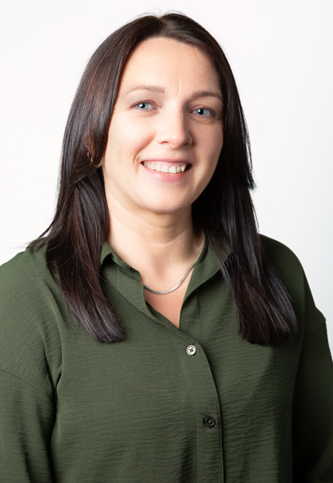
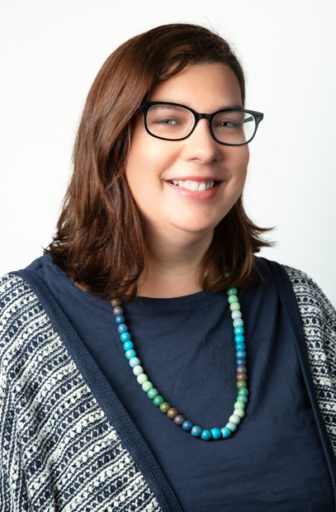
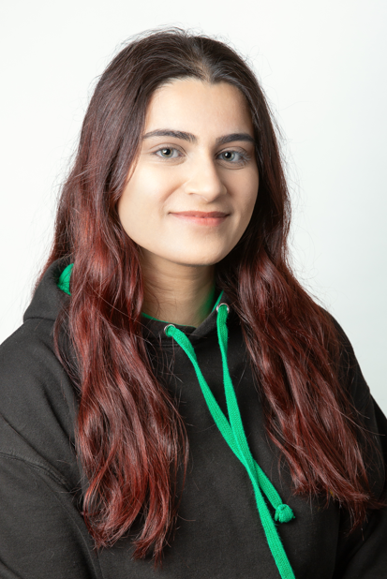
Meet the team
Mrs Brockie –
Everest class teacher.
Miss Burns- K2 Class teacher/UKS2 Lead
Mrs Jeal-
Everest TA.
Miss Holt - K2 TA.
Miss Ahmed – PE specialist PPA cover
Mrs Millward – Art specialist PPA cover

Slide 3

Our aims and expectations
Your child will have a fantastic final year at Primrose Hill
They will develop to the best of their abilities
To help them to develop strategies to help them deal with challenges they face
They feel supported and cared for
Work hard and try their best
Learn new things and try new skills
Be prepared for the next stage of their education

Slide 4
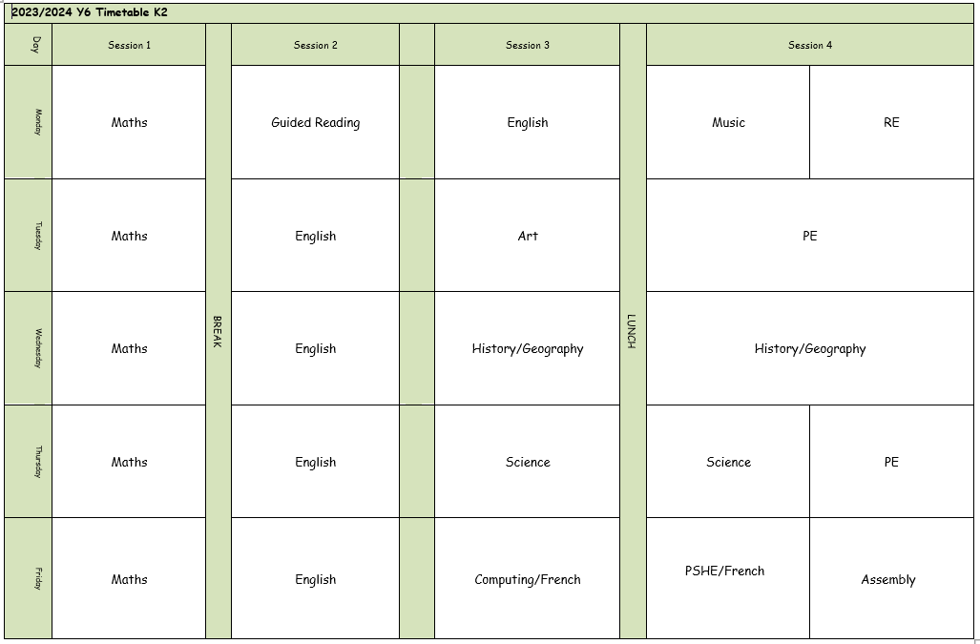
An example of our week in school …

Slide 5

What children need in school each day:
Sock – for Kinetic letters (handwriting)
A glue stick (completely optional, but helps to speed things up!)
A pair of USB C headphones- named

Slide 6

P.E. lessons
P.E. sessions are to be confirmed in due course.
We aim to go outside as much as possible so please ensure your child has jogging bottoms and a jacket when cold.
Children to come to school in school P.E. kits.
Run a mile will continue – no need for extra trainers in school.

Slide 7
To keep everyone safe and focused on learning:
🔹 No jewellery – including earrings (studs/spacers), rings, bracelets, necklaces, loom bands, or wristbands.
🔹 No earrings or spacers – these are a safety risk, especially during play and PE.
🔹 No nail varnish or make-up – children should come to school with natural nails and faces.
👕 Jewellery & Appearance
Thank you for your support!

Slide 8

Showbie
Children have access to Showbie in school and at home.
Your child should know their log ins- we will be using the same ones they have used this year.
Please let us know if you have any problems accessing Showbie at all over the course of the year.

Slide 9
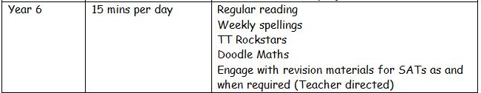
Homework expectations…

Slide 10
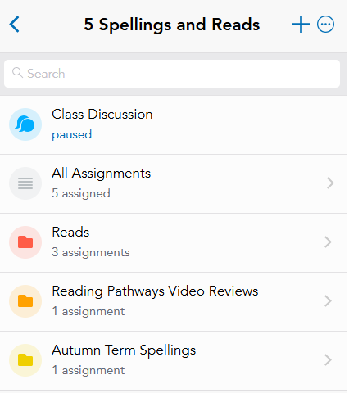
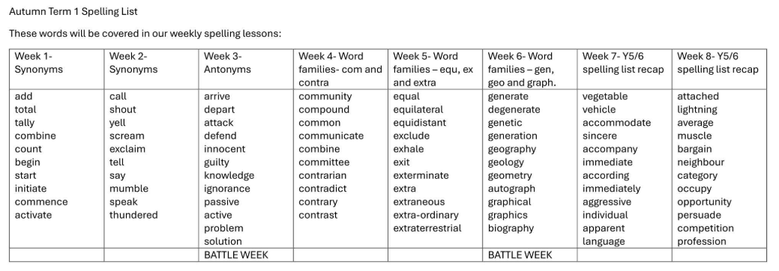
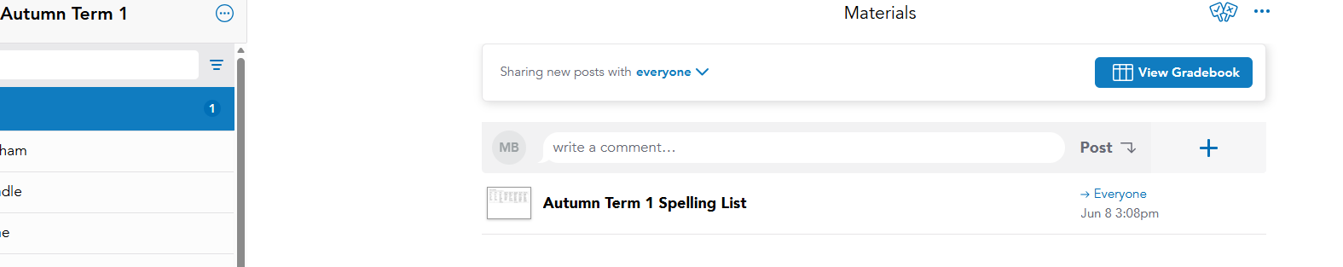
Spellings and Reads
Spellings – children will have spelling lessons in school. We will be moving away from weekly spelling tests, rather using the Emile app to support.
Children will have access to spellings at home and should still practice these as part of their homework.

Slide 11



Reading
Reading is extremely important in Year 6. We want the children to be fluent independent readers ready for high school.
Please encourage your child to read daily for 15-20 mins as part of their homework.
Reading Pathways continues in Year 6. Children will be encouraged to choose from a range of texts that explore a range of genres – essential for their transition to KS3 literature.
Reads can be logged on showbie

Slide 12
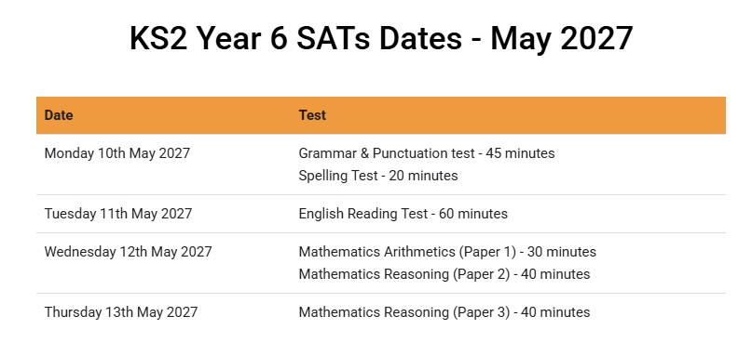
Important dates this year…
High school applications - https://www.lancashire.gov.uk/children-education-families/schools/apply-for-a-school-place/starting-secondary-school/
Applications must be submitted online to LCC by 31st October 2026.
Criteria for application can be found on school websites – check if faith schools require a supplementary form.

Slide 13
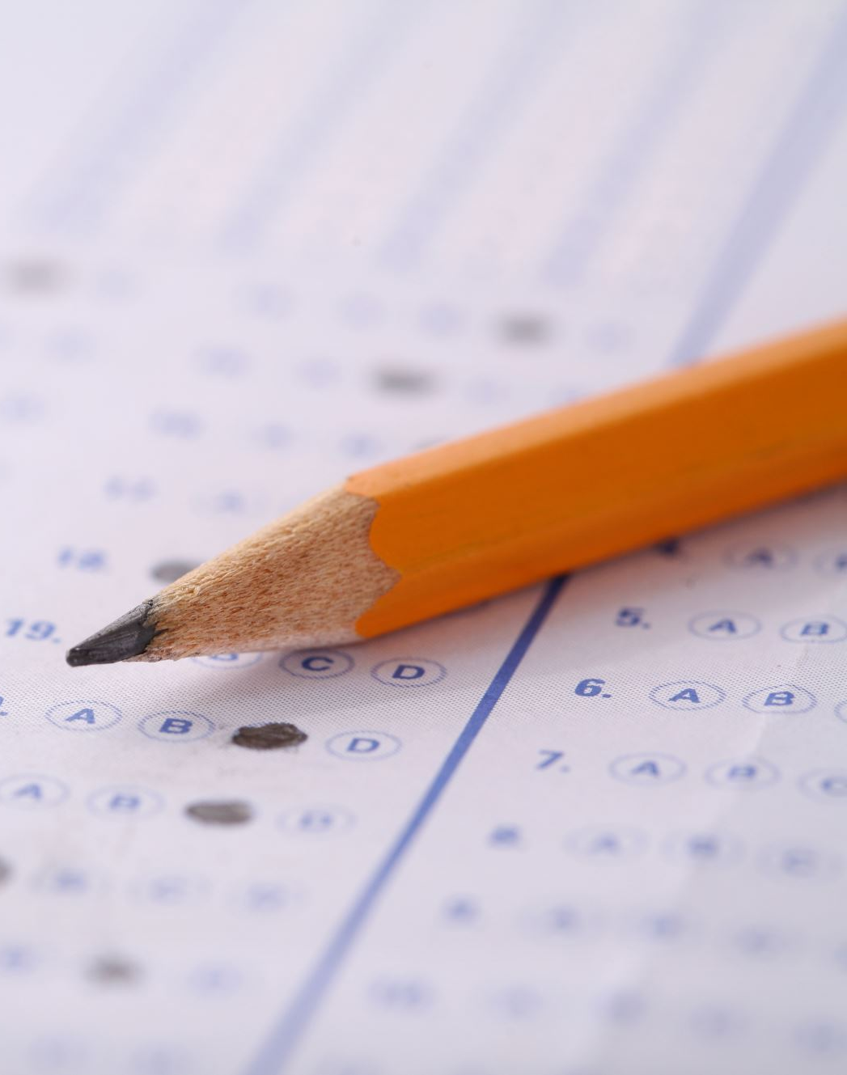
End of Key stage assessments.
Monday 10th May – Thursday 13th May 2027.
All children in Year 6 will sit the National Curriculum Tests for KS2 - formally known as SATS.
Math’s tests will include a short arithmetic test of 30 questions, plus two further reasoning papers. These will cover all the objectives taught from Key Stage 2.
English tests will include a 1 hour reading paper, a grammar and punctuation test and a spelling test as well.
Results are reported as a scaled score, with a score of 100 representing the expected level for each age group.
https://www.gov.uk/education/primary-curriculum-key-stage-2-tests-and-assessments

Slide 14

Other events this year…
Macmillan Coffee Morning – Friday 25th September 2026
SATs meeting – Wednesday 23rd September 2026
Trip to Liverpool Museum – 25th November 2026
Y6 Residential– June 2027

Slide 15
What can you do to help?
Ensure a good bedtime routine for your child, so they are refreshed and ready to learn in school each day.
Encourage self- learning of topics – particularly previous year group objectives and those covered throughout the year.
Promote daily independent reading.

Slide 16
🔹 If your child is unwell, please contact the school office by 9:00am on each day of absence.
📞 01257 276688
✉️ office@primrosehill-euxton.lancs.sch.uk
🔹 Be specific:
It’s important to give a clear reason – for example:
✅ “Tonsillitis” or “Sickness and temperature”
❌ Not just “unwell” or “poorly”.
📆 Attendance & Absence
We strongly encourage good attendance to support your child’s learning and progress.
This helps us meet safeguarding and health requirements

Slide 17
📬 Communicating with Us
If you need to get in touch, please email the school office in the first instance:
✉️ office@primrosehill-euxton.lancs.sch.uk
Your message will be passed on to the relevant member of staff.
We aim to respond as soon as we can, but please allow up to 48 hours for a reply during term time.
For urgent matters during the school day, please phone the school office directly on: 01257 276688

Slide 18
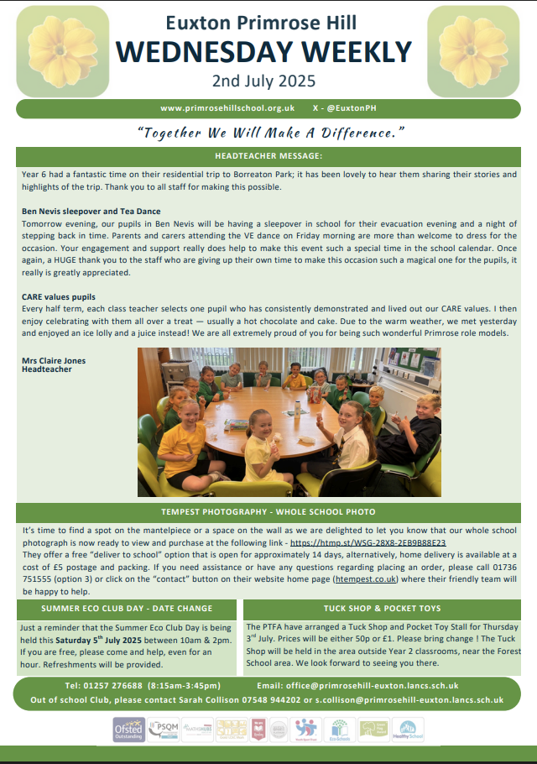
📧 Weekly Wednesday Email
To keep communication clear and consistent,
the school sends out a Weekly Wednesday Email.
It includes:
Upcoming trips and events
Key dates
Celebrations and achievements
Important reminders and updates
✅ Please check it each week — it’s the main way we share information.
📍 A copy is also uploaded to the school website for easy access.

Slide 19
⚠️ If You’re Concerned About Something…
We want to work in partnership with you.
If you’re ever worried or unhappy about a situation, please follow this order of contact,
via the school office:
Class Teacher/Phase Leader – your first point of contact – Miss Molly Burns
Assistant Headteacher - Miss Amie Dobbs
Deputy Headteacher – Mrs Emma Swinburn
Headteacher – Mrs Claire Jones
We’re here to help and will always do our best to resolve any concerns quickly and fairly.

Slide 20
PSHE & Relationships Education (RSE)
Updated Government Guidance
The Department for Education has published updated statutory guidance for Relationships, Sex and Health Education (RSHE), which schools are implementing from September 2026. We have reviewed our curriculum to ensure it reflects the new requirements and continues to meet the needs of our pupils.
Our updated PSHE/RSE Policy will be published on our school website in September, and a link will be shared with all parents and carers. Our curriculum is taught in an age-appropriate way and supports children's wellbeing, safety, healthy relationships and respect for others.
If you have any questions, please don't hesitate to speak to us.

Slide 21


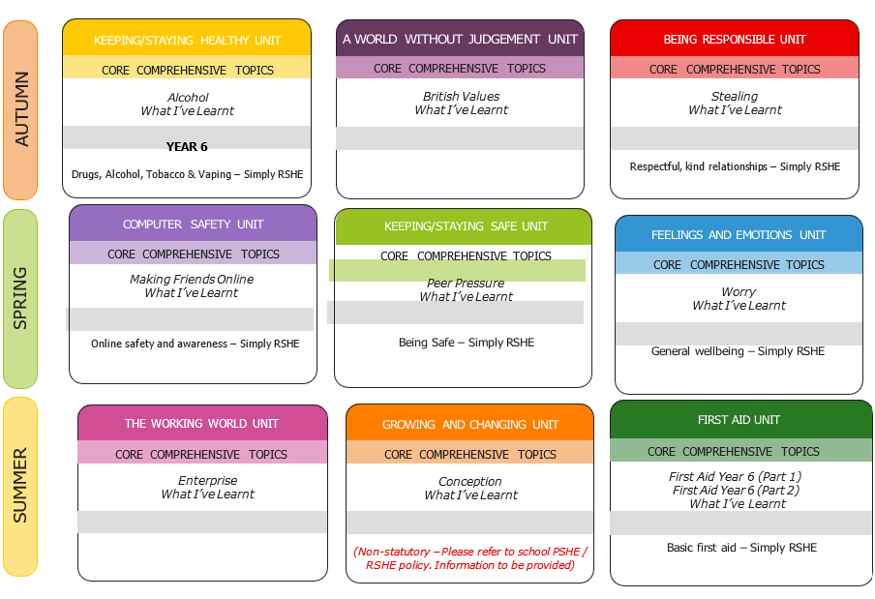
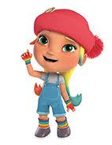


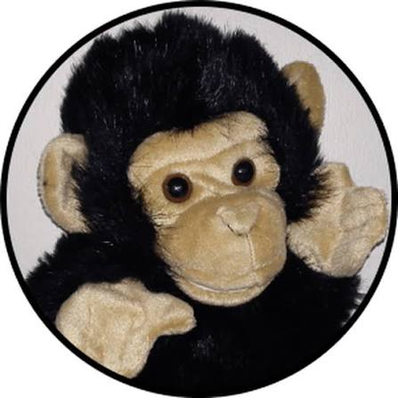
PSHE / RSHE Curriculum
We implement the 1decision scheme which is mapped to the PSHE Association’s Programme of Study and meets statutory Department for Education (DfE) requirements. This includes the very best practice as part of a whole-school approach to keeping children safe, happy and healthy.
PSHE stands for Personal, Social, Health and Economic Education.
RSHE stands for Relationships, Sex and Health Education.
Core theme 1:
Health and Wellbeing
Core theme 2:
Relationships
Core theme 3:
Living in the Wider World
Deedee – KS1
Darlee –
KS2
KidSafe sessions are taught throughout the year.

Slide 22

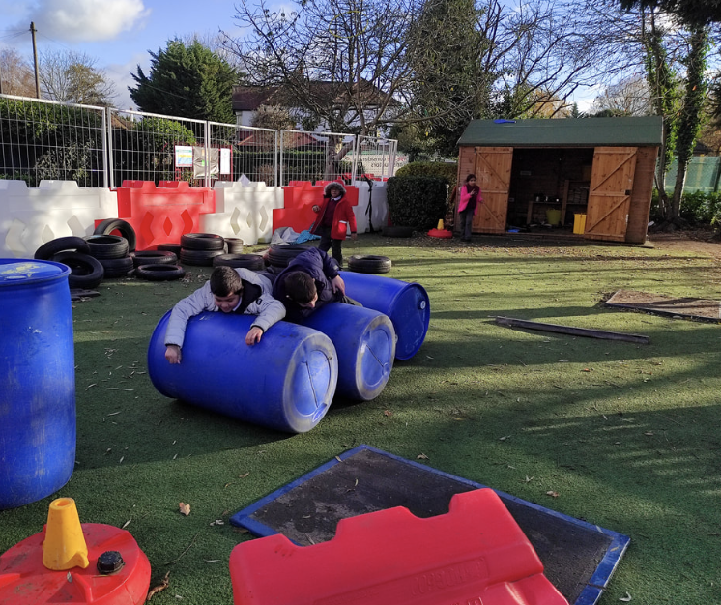
Children in British primary
schools spend 20% or 1.4 years
of their school attendance in play
Play is the process through which children learn everything that they need to know that cannot be taught. Play wires the brain, builds capable bodies, and is the foundation of building relationships.
OPAL's programme enables schools to provide every child with rich opportunities to be creative, collaborative and active in their outdoor play, in environments that are safe enough for 'health and safety' but challenging enough for children's ongoing development.
We will be beginning our whole school OPAL journey in September and are excited to share this journey - with your help and support.

Slide 23

PTA- Parents and Teachers Association
When combining the power of our Parents &Teachers we are creating a stronger school community- just like in our mission statement- “Together we will make a difference”
Are you passionate about your child’s education and school experience?
Do you want to help shape school events, support teachers, and build a vibrant community?
Then join our PTA – we need YOU!

Slide 24


