Slide 1

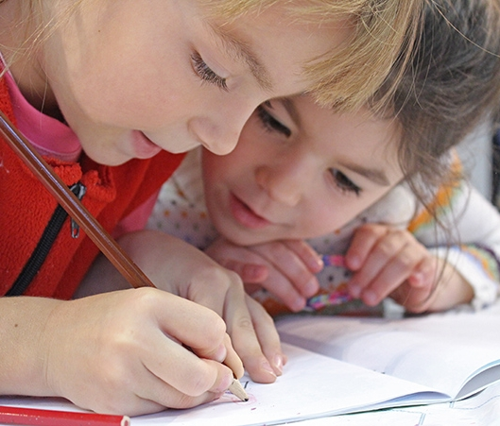
Welcome to Year 1 Transition Meeting
July 2026

Slide 2

Aims of this transition meeting
Transition to Year 1 is really important!
For all the children to experience a smooth transition from Reception to Year 1 in a happy, safe and secure environment
For the children to enjoy the new challenges and approaches to learning in a new year group and class
A gradual implementation of a more formal curriculum and setting
Parents to feel informed about the transition process

Slide 3
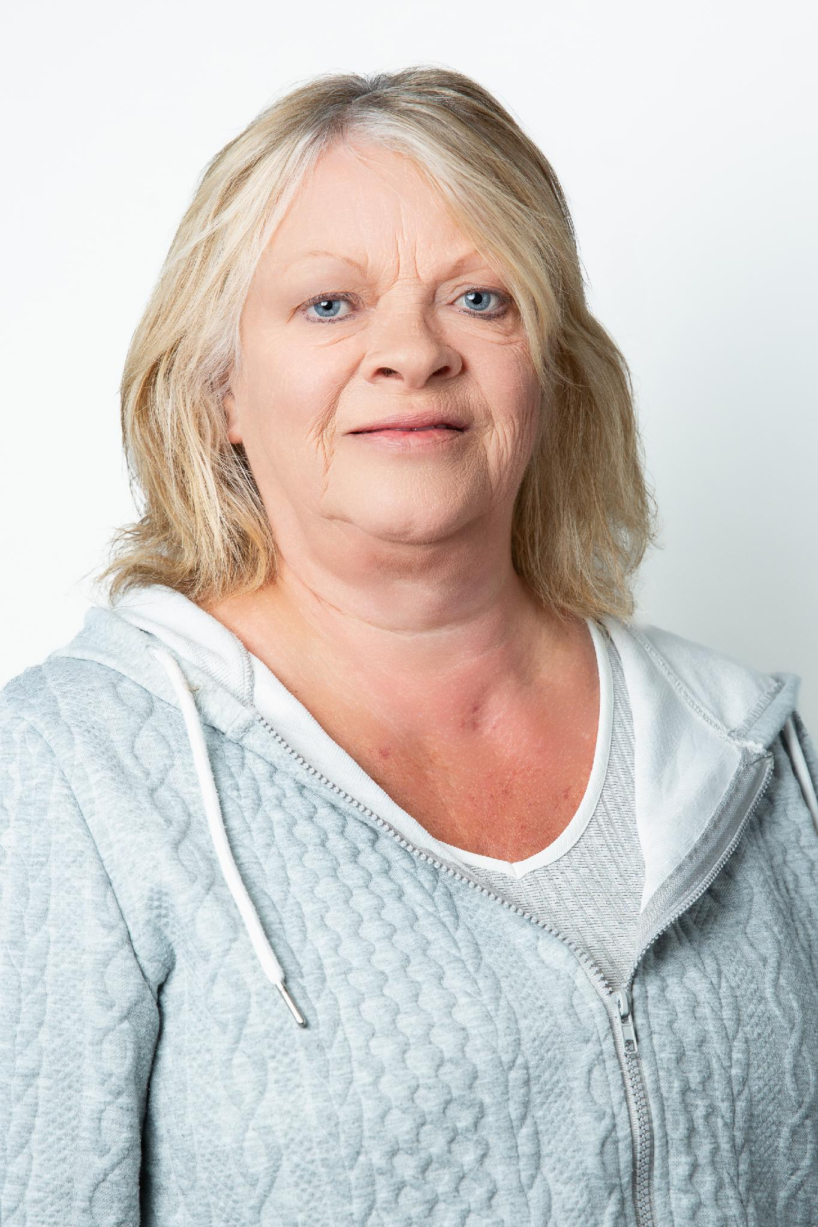
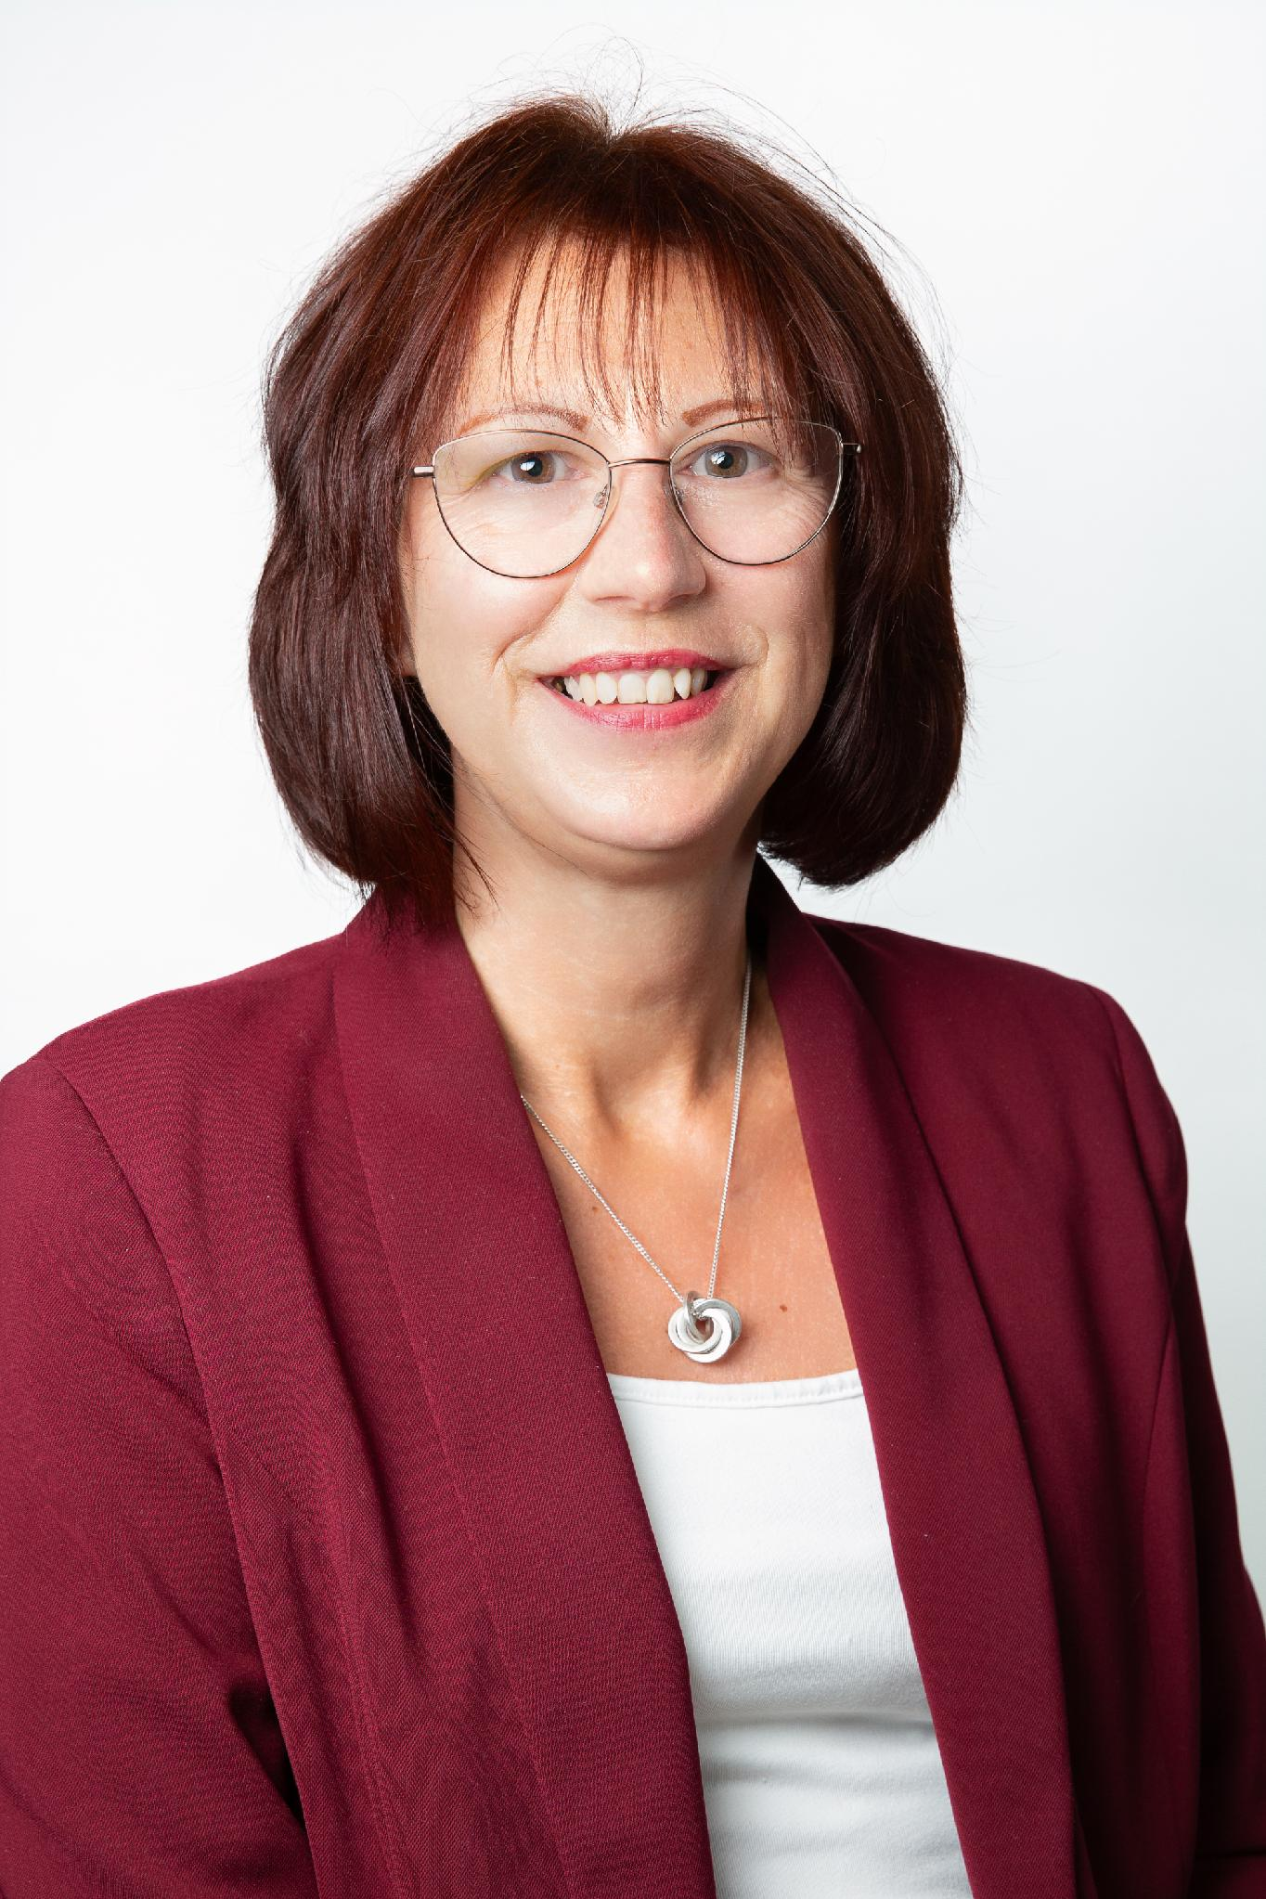
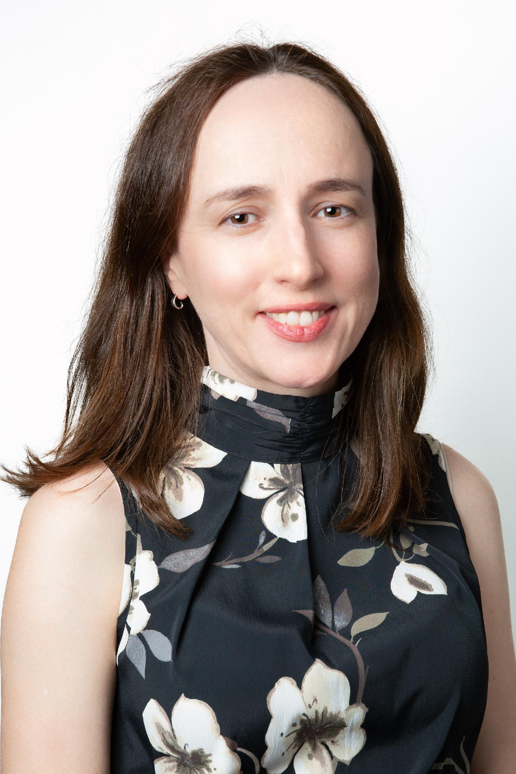
Welcome to Cedar Class
Mrs Sam Hacking
Teacher
Mrs Moss
Teacher PPA cover

Slide 4
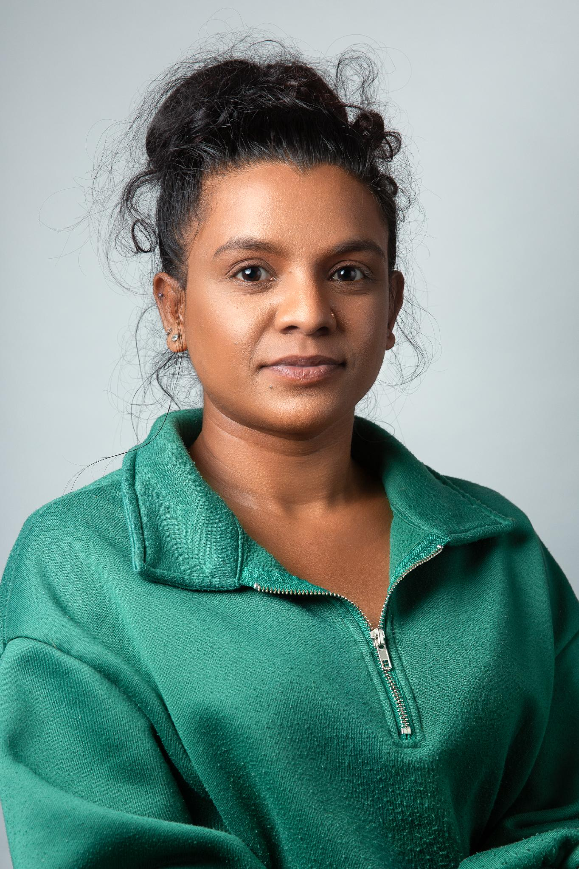
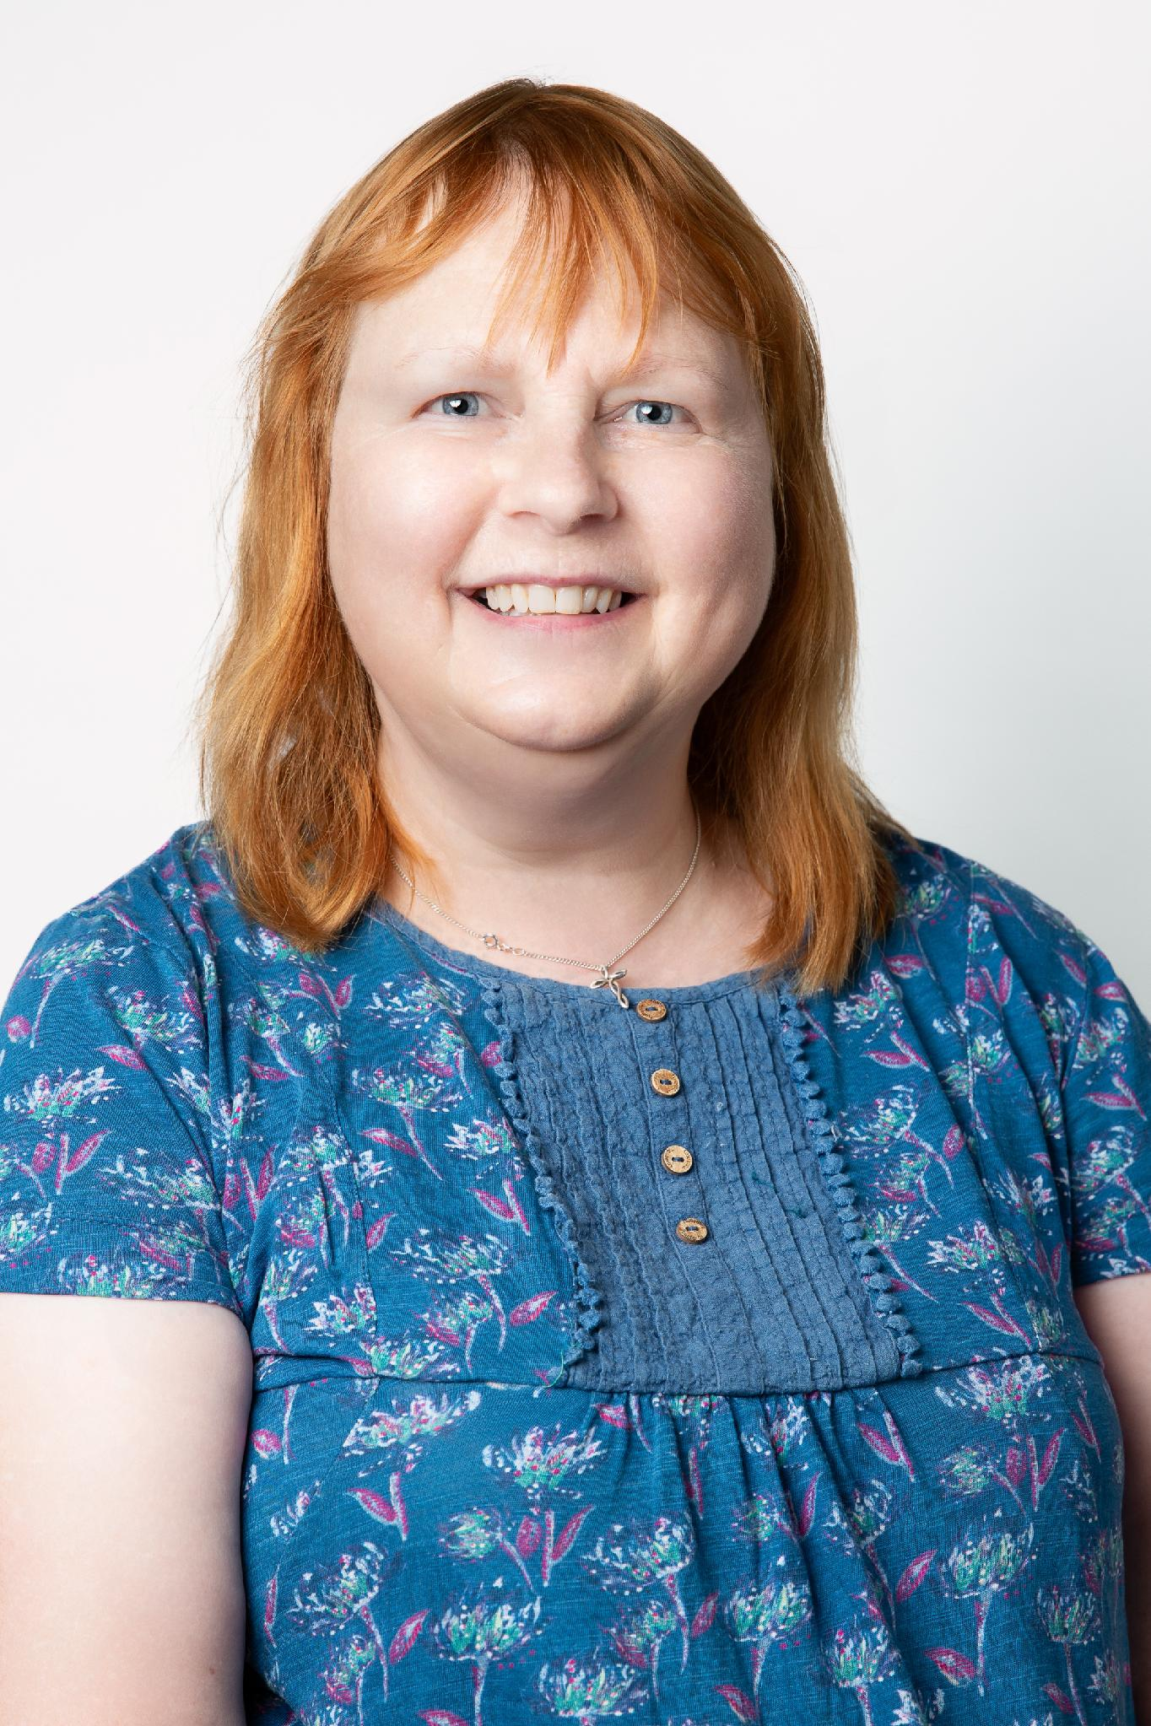
Welcome to Cedar Class
Miss Sandi Kingston
Teaching Assistant
Mrs Janet Mansley
Teaching Assistant
Mrs Jotejko
Forest School/Nurture Teacher

Slide 5
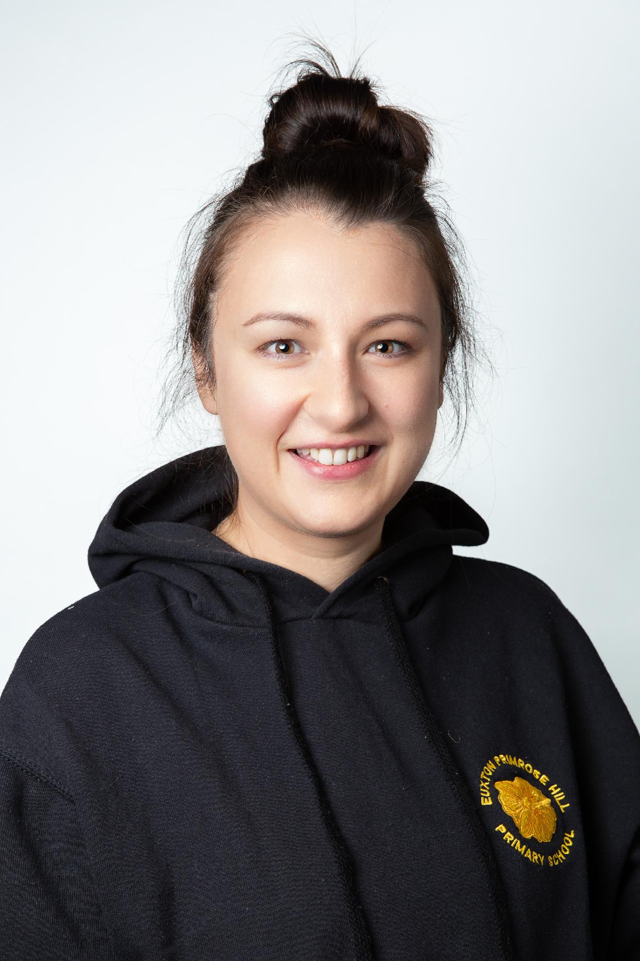
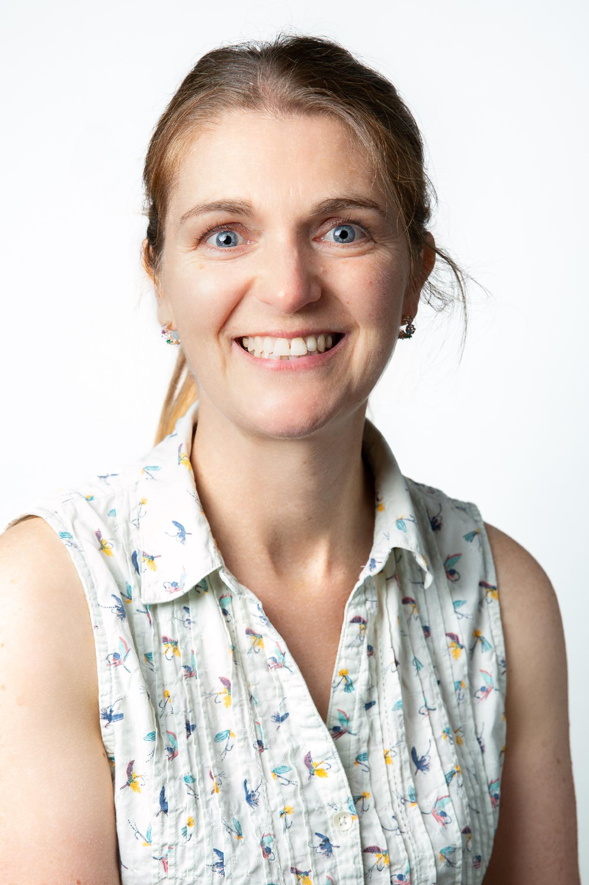
Welcome to Ash Class
Miss Blackwell
Teacher
Mrs Moss
Teacher (Friday)
Mrs Martindale
Teaching Assistant
Mrs Jotejko
Forest School/Nurture Teacher

Slide 6
Class Routines:
Classroom door opens at 8.40 am with registers closing at 8.50am
Finish time : 3.10pm
Morning – Toast & Milk if you wish to purchase or a healthy snack
Afternoon – School fruit
Daily Maths, English, handwriting and Phonics.
Mastering Number to build fluency
Foundation subjects, PE & PSHE
Enhanced provision
Library – every week
Forest School – every 2 weeks
Assemblies – Whole School, Singing and Celebration

Slide 7
What children need in school each day:
Sock – for Kinetic letters (handwriting)
Simple water bottles with a spout (no special features)
Green reading bag and Phonics pack with reading record
Waterproof coat/ hats (weather dependent)
Forest School waterproofs and wellies
Wear P.E Kits on P.E, days ASH – Monday and Thursday. CEDAR – Monday and Wednesday.
All items of uniform to be named

Slide 8
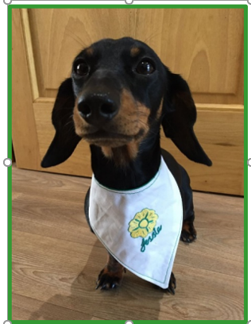
Rewards:
House points
Certificates in Friday assembly
Super Pupil – school dog Jessie reward time
Class bear
CARE value reward each term
Behaviour system – stages

Slide 9
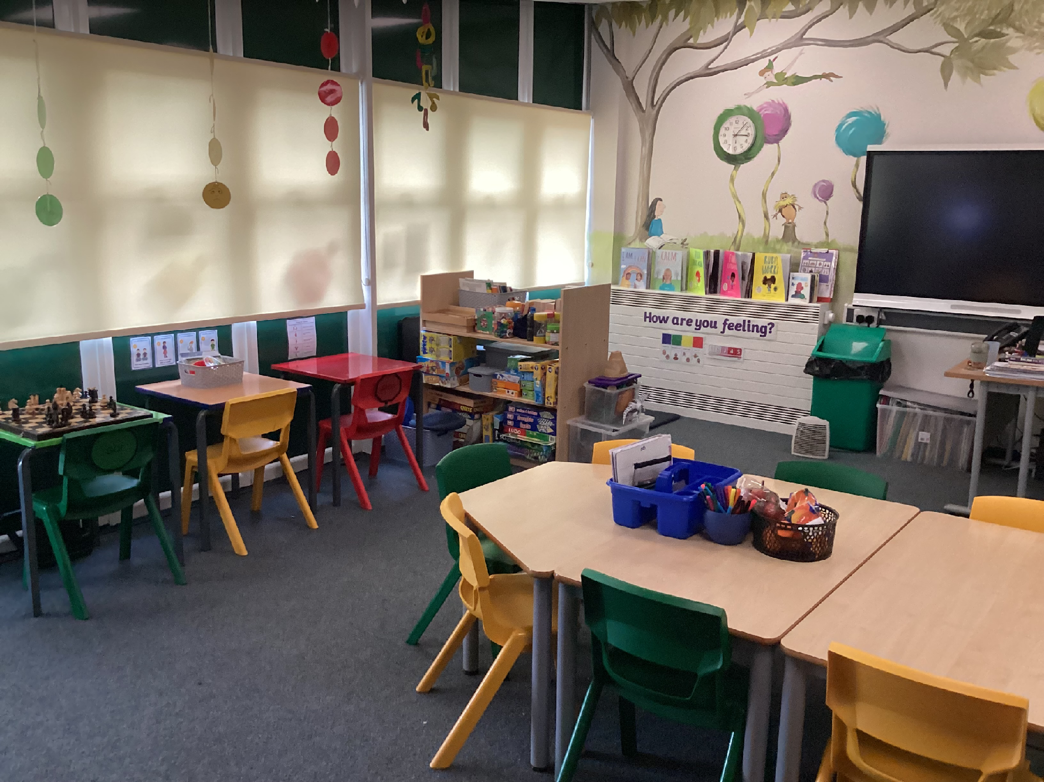
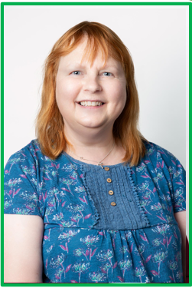
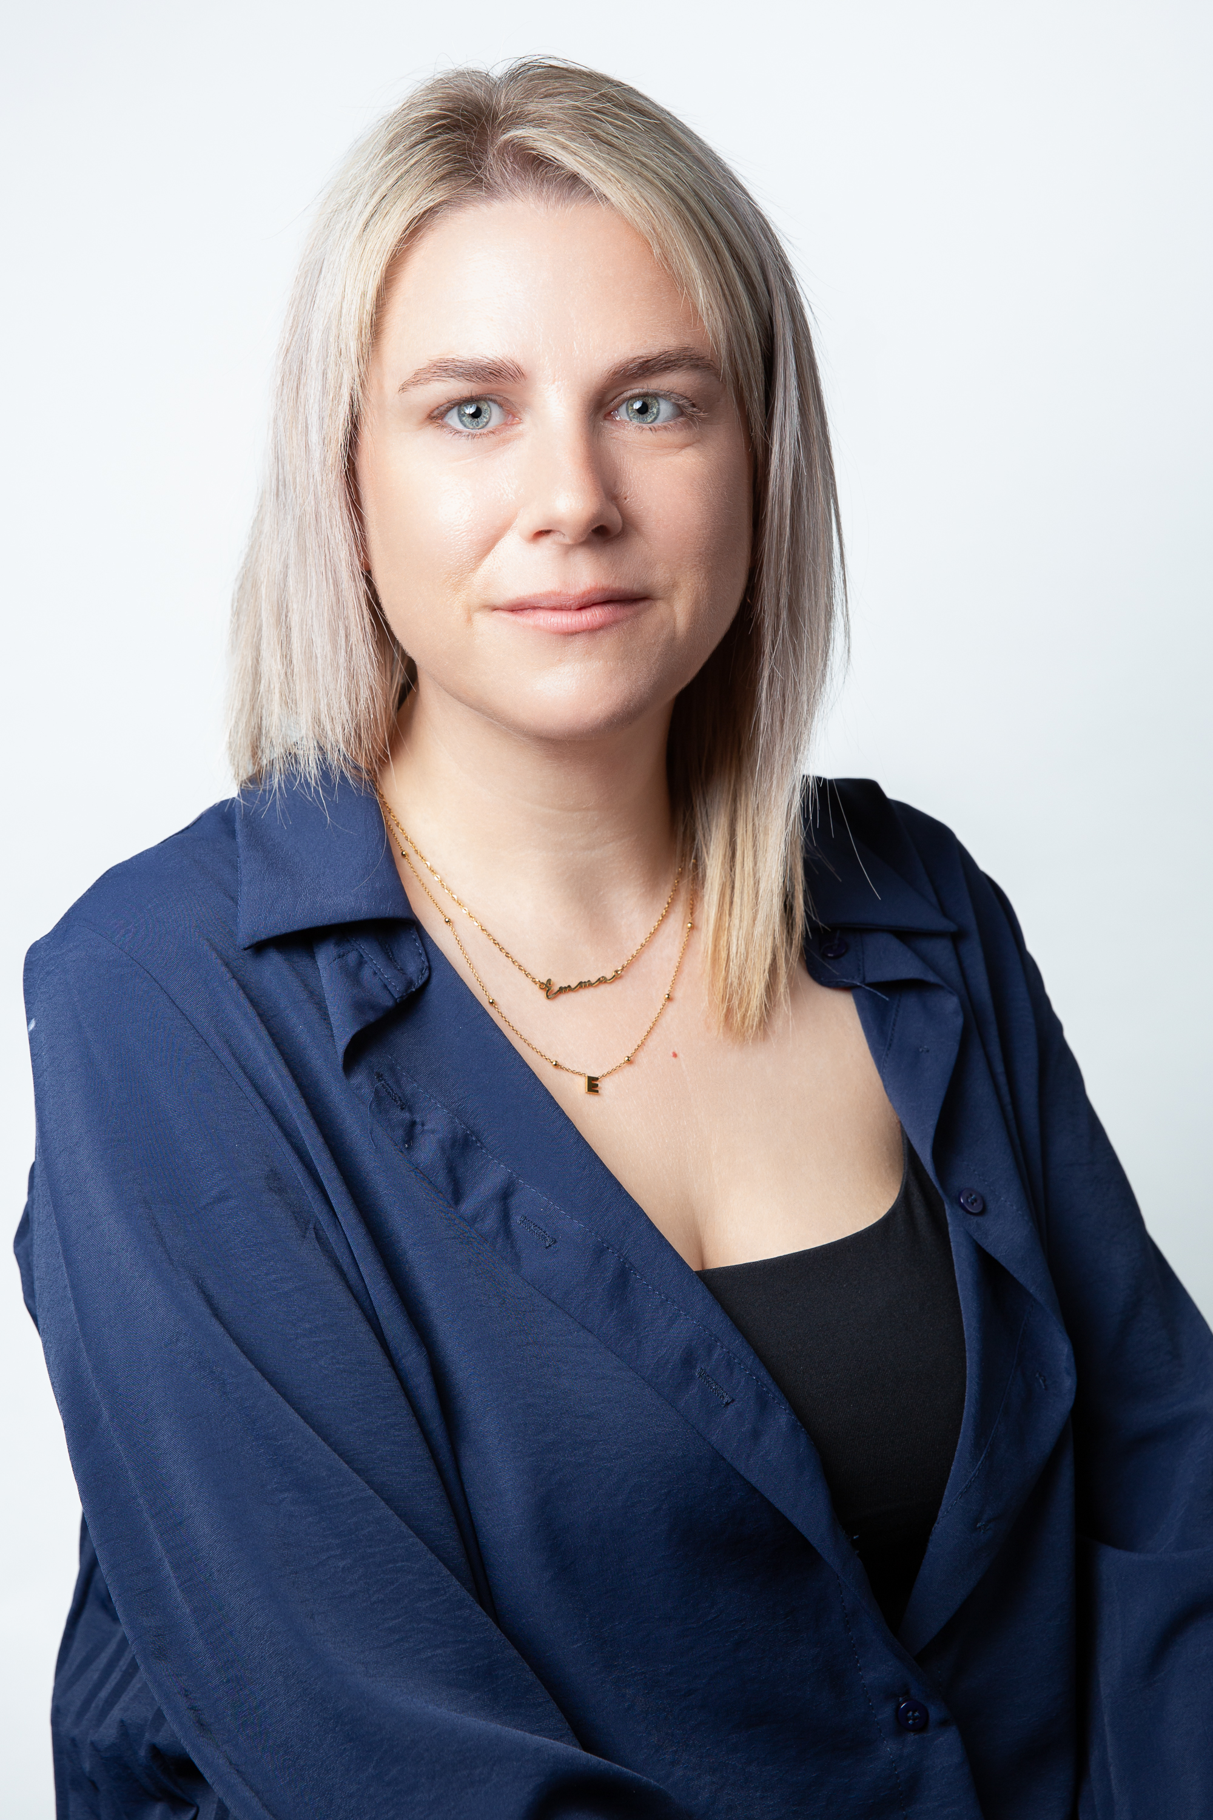
The POD
The Primrose Pod provides a multi – purpose safe space for all pupils and families.
Nurture – we provide social, emotional and mental health support and strategies for pupils within school at any point in their school life.
We also have outstanding links with many local external support agencies which we can signpost families to where appropriate.
This includes : parental workshops, Local Foodbanks and charities, Debt Help etc

Slide 10
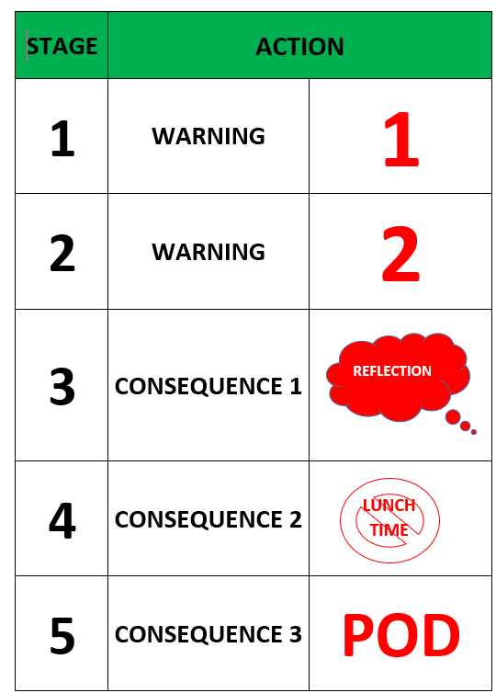
Behaviour system
At Primrose Hill, we have a holistic approach to behaviour. We identify, reflect and repair the child’s behaviour and then put pro- active support measures in place to ensure they can manage a similar situation in the future.

Slide 11
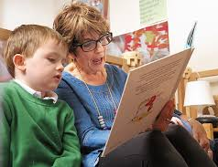
The importance of Reading…
Each child will be given a reading record and a reading book. We suggest that children read everyday at home either with a grown up to develop confidence and fluency. Their reading book is closely matched to their phonics ability. Children are assessed every 6 weeks and groups will change according to progress.
Reading is so important for a child’s development in all subjects.
Children who reach the correct number of reads to earn a reward in class. The total needed will be within the curriculum letter at the start of each term.

Slide 12

Our phonics scheme is Lancashire's 'Red Rose Letters and Sounds'. Our reading books are in line with the phonics scheme that we use and are fully decodable. You may hear your child talk about different rhymes and terminology.
Terminology
• Phoneme- smallest unit of sound in a word.
• Grapheme- a sound written down.
• Digraph- two letters that make one sound, e.g. ‘sh’.
• Consonant diagraph- contains two consonants ‘ch’, ‘ck’.
• Vowel digraph- contains at least one vowel, e.g. ‘ai’, ‘or’.
• Trigraph- three letters that make one sound, e.g. ‘igh’

Slide 13
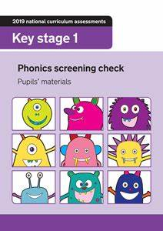
Phonics Screening Check- What is it?
• Children in Year 1will be take part in a Phonics Screening Check Week Commencing Monday 14th June 2027
• The check is designed to confirm whether individual children can decode and blend to a standard set by the government.
• It is mainly used for us as a school to ensure we have a clear understanding of what the children need to learn moving forward.
• The check will be conducted 1:1 with each child and a familiar adult.
• It contains 20 real words and 20 pseudo (nonsense words).
• The assessment will take approximately 10 minutes per child, but this is only a guideline.
• The nonsense words in the check have an alien next to them so we often call them alien words.
• The reason they are included is because they are new to all pupils; they do not favour children with a good vocabulary or visual memory.
• It is important to remember that this text is literally just to assess the children’s ability to segment and blend sounds. It does not assess their understanding

Slide 14
Writing in Year 1
National Curriculum Objectives for Handwriting Year 1
Pupils should be taught to:
Sit correctly at a table, holding a pencil comfortably and correctly
Begin to form lower-case letters in the correct direction, starting and finishing in the right place Form capital letters
Form digits 0-9
Understand which letters belong to which handwriting ‘families’ (ie letters that are formed in similar ways) and to practise these.

Slide 15
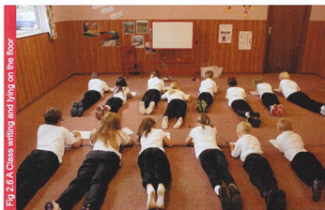
Lizard Position
Kinetic Letters -What is it?
The Four Threads of Kinetic Letters:
Making Bodies Stronger
Holding the Pencil
Learning the Letters
Flow and Fluency
Children can’t hold a pencil effectively or comfortably for very long, unless they have developed physical strength.
Kinetic Letters programme
Essential physical strength is developed by specific activities and working positions.
Children work lying on the floor on their tummies – the optimal position for developing body strength.
Working whilst lying on the floor, holds the hand and arm in the correct positions.
The physical strength required to hold a pencil is developed by specific activities and working positions.

Slide 16
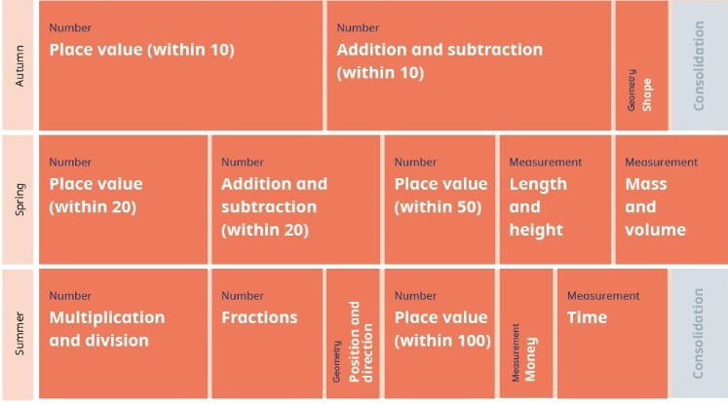
Mathematics
The White Rose Maths curriculum is designed to provide children with a solid foundation in mathematics. Children gain a deep understanding of maths and enjoy solving mathematical problems in different contexts and be able to explain their methods and thinking processes. Below is an overview of all the maths areas we will cover in year 1.

Slide 17


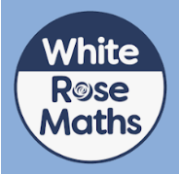

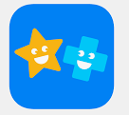
How to support your child:
Showbie – Year1 2026/2027
Maths – Doodle Maths and Numbots log in details to follow and White Rose Maths via an app. These apps all help to consolidate children’s learning in class and build up confidence, stamina and fluency.
Reading daily with comment to count towards the end of term target usually averaging at 3 home reads per week. This can include any type of reading that your child engages with during the week. Reads are counted on a Friday but yellow reading records need to be in every day.
Emilie – Spelling app that engages pupils to complete puzzles and game based activities and look after a virtual character. It enables children to practice their spelling knowledge through games.
Kinetic Letter handwriting techniques will be shared in the Autumn term.
Additional activities occasionally
Summer challenges on Showbie
All these activities support your child’s learning and development.

Slide 18
PSHE & Relationships Education (RSE)
Updated Government Guidance
The Department for Education has published updated statutory guidance for Relationships, Sex and Health Education (RSHE), which schools are implementing from September 2026. We have reviewed our curriculum to ensure it reflects the new requirements and continues to meet the needs of our pupils.
Our updated PSHE/RSE Policy will be published on our school website in September, and a link will be shared with all parents and carers. Our curriculum is taught in an age-appropriate way and supports children's wellbeing, safety, healthy relationships and respect for others.
If you have any questions, please don't hesitate to speak to us.

Slide 19

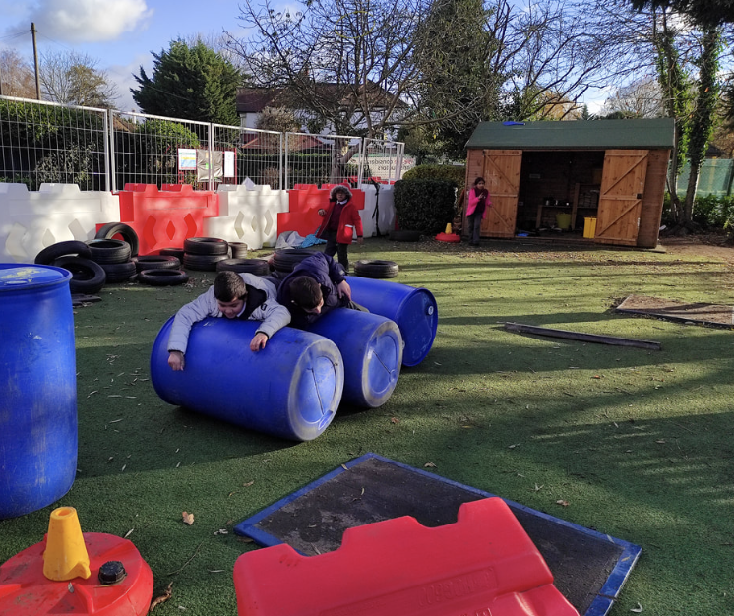
Children in British primary
schools spend 20% or 1.4 years
of their school attendance in play
Play is the process through which children learn everything that they need to know that cannot be taught. Play wires the brain, builds capable bodies, and is the foundation of building relationships.
OPAL's programme enables schools to provide every child with rich opportunities to be creative, collaborative and active in their outdoor play, in environments that are safe enough for 'health and safety' but challenging enough for children's ongoing development.
We will be beginning our whole school OPAL journey in September and are excited to share this journey - with your help and support.

Slide 20

School website and Class Page
www.primrosehillschool.org.uk

Slide 21
⚠️ If You’re Concerned About Something…
We want to work in partnership with you.
If you’re ever worried or unhappy about a situation, please follow this order of contact,
via the school office:
Class Teacher – your first point of contact – Mrs Hacking/ Miss Blackwell
Phase Leader – if further support is needed Mr Tooby
Assistant Headteacher - Miss Amie Dobbs
Deputy Headteacher – Mrs Emma Swinburn
Headteacher – Mrs Claire Jones
We’re here to help and will always do our best to resolve any concerns.

Slide 22
📬 Communicating with Us
If you need to get in touch, please email the school office in the first instance:
✉️ office@primrosehill-euxton.lancs.sch.uk
Your message will be passed on to the relevant member of staff.
We aim to respond as soon as we can, but please allow up to 48 hours for a reply during term time.
For urgent matters during the school day, please phone the school office directly on: 01257 276688

Slide 23

Just a reminder that Arbor can be used to report your child's absence.
To do this, please:
1. Access the Attendance section.
2. Enter the details of the absence.
3. Submit the request.
Once approved, the absence will be visible in the Attendance tab.
If you have any questions or require assistance using Arbor, please contact the school office. Please check your emails on a regular basis,
📆 Attendance & Absence
We strongly encourage good attendance to support your child’s learning and progress.
This helps us meet safeguarding and health requirements

Slide 24
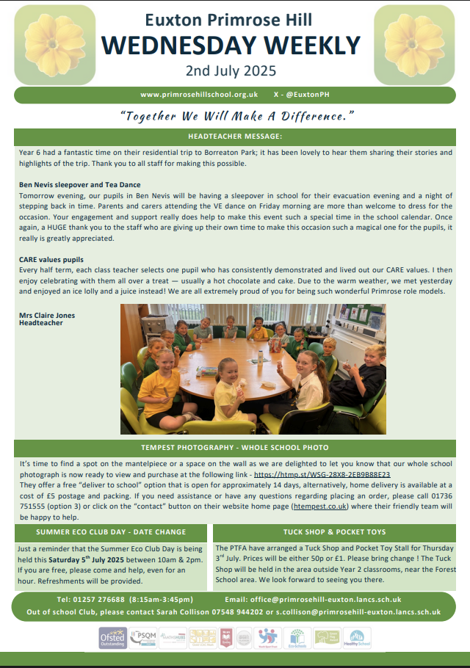
📧 Wednesday Weekly
To keep communication clear and consistent,
the school sends out a Wednesday Weekly Email.
It includes:
Upcoming trips and events
Key dates
Celebrations and achievements
Important reminders and updates
✅ Please check it each week — it’s the main way we share information.
📍 A copy is also uploaded to the school website for easy access.

Slide 25
To keep everyone safe and focused on learning:
🔹 No jewellery – including earrings (studs/spacers), rings, bracelets, necklaces, loom bands, or wristbands
🔹 No earrings or spacers – If your child is going to have their ears pierced, please do this at the start of the summer holidays as they are not to be worn when we return. These are a safety risk, especially during play and PE.
🔹 No nail varnish or make-up – children should come to school with natural nails and faces
👕 Jewellery & Appearance

Slide 26

PTA- Parents and Teachers Association
When combining the power of our Parents &Teachers we are greeting a stronger school community- just like in our mission statement- “Together we will make a difference”
Are you passionate about your child’s education and school experience?
Do you want to help shape school events, support teachers, and build a vibrant community?
Then join our PTA – we need YOU!

Slide 27
Why join the PTA…
🤝 Opportunities to connect with other parents and staff
🎉 Help plan fun school events and fundraisers
📚 Support educational programs and resources
🗣️ Have a voice in school decisions
💡 Share your ideas, talents and skills with others
🎯Raising funds that are put straight back into the school
No experience needed – just enthusiasm and a desire to help- Whether you can give a little time or a lot, your involvement makes a big impact.
Come along to our annual PTA General meeting in September

Slide 28
Any Questions?
We are always on the door to answer questions or listen to your concerns.
Please check book bags for letters, notes or accident slips.
We will try to communicate via Showbie and send photos information and school events but if its something urgent then please email the office so that we can address your matter efficiently.
Thank you for listening and we look forward to working together in September!

