Slide 1

Transition to Year 1
July
2024

Slide 2

Aims
Our aims are:
• For all the children to experience a smooth transition from Reception to Year 1 in a happy, safe and secure environment
• For the children to enjoy the new challenges and approaches to learning in a new year group and class
A gradual implementation of a more formal curriculum and setting
• Parents to feel informed about the transition process

Slide 3
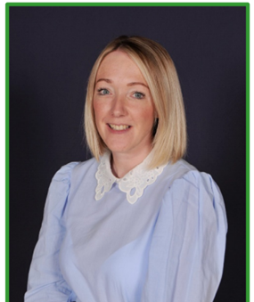
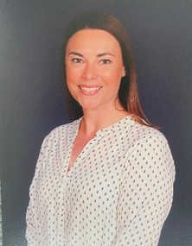
Who’s who?
Ash Class Staff
Mrs Goodyear – Ash class teacher, KS1 lead/Assistant Headteacher, Primary Mastery Specialist for Abacus Maths Hub
Mrs.Caunce – Class teacher on Thursday and Friday morning

Slide 4
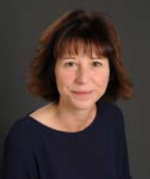
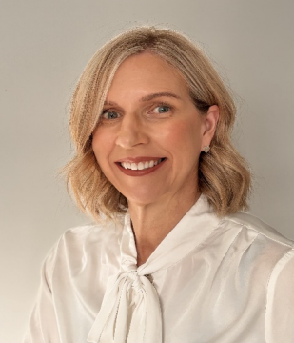
Who’s who?
Cedar Class Staff
Mrs.Hacking – Cedar class teacher, PE and Sport Leader
Mrs Jones – Headteacher & PPA cover

Slide 5
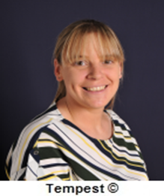
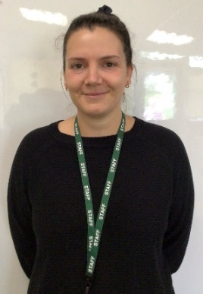
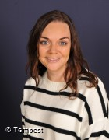
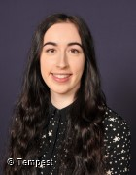
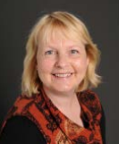
TA staff
Ash & Cedar Class
Mrs Devine
Mrs Kevan
Mrs Davies
Miss Dickinson
Mrs Jotejko (Forest School)

Slide 6

Transition
Transition to Year 1 is really important!
First few weeks, establishing routines and expectations, developing confidence within new classroom setting.

Slide 7
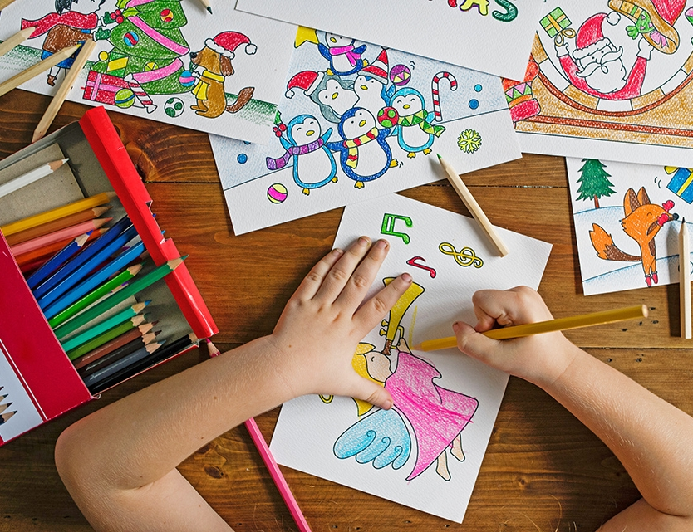
School Routine
Classroom door opens at 8.40 am with registers closing at 8.50am
New finish time : 3.10pm
Please ensure your child has a coat everyday and their reading bag/water bottle!

Slide 8
School Routine
Maths, English and Phonics daily with Mastering Number
Foundation subjects, PE & PSHE
Enhanced provision
Library – every week
Forest School – every 2 weeks

Slide 9

Equipment
Water bottles - named
Morning – Toast from Pat if you wish or a healthy snack
Afternoon – milk if you wish to buy and a piece of fruit
Wear PE kits on Tuesday & Wednesday all day
Forest school waterproofs and wellies
All items of uniform to be named

Slide 10
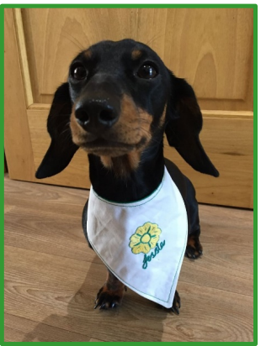
School Life
House points
Certificates in Friday assembly
Super Pupil – school dog Jessie reward time
Class bear
Behaviour system – stages

Slide 11
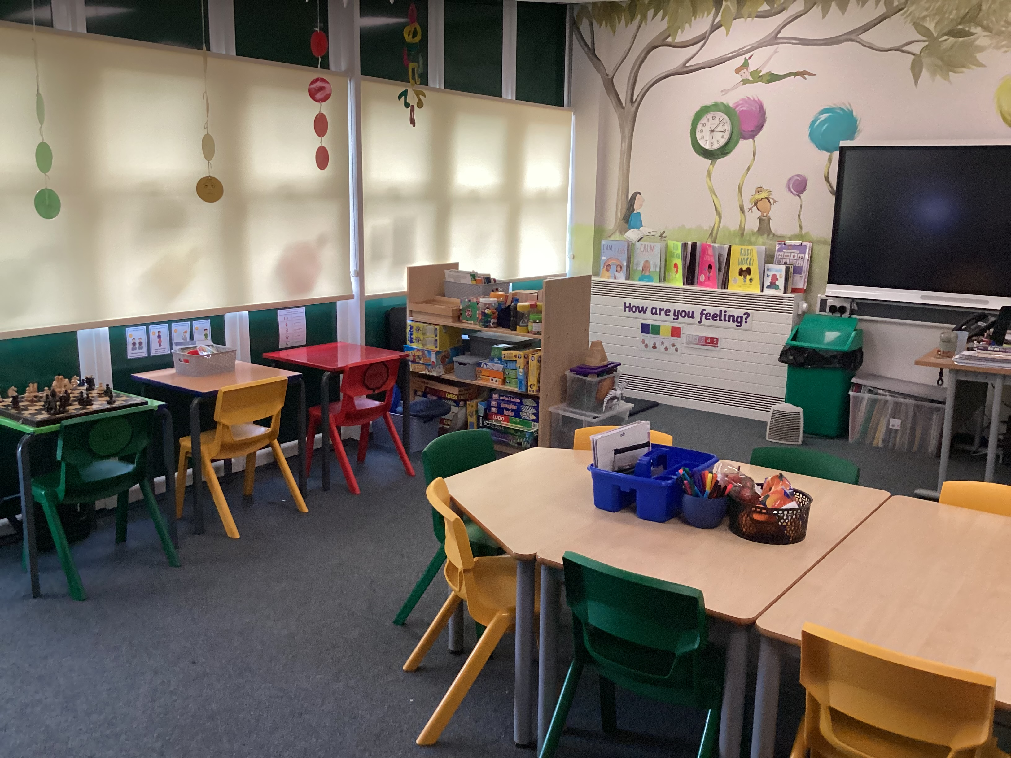
The Primrose Pod

Slide 12
The Primrose Pod
The Primrose Pod provides a multi – purpose safe space for all pupils and families.
Nurture – we provide social, emotional and mental health support and strategies for pupils within school at any point in their school life.
We also have outstanding links with many local external support agencies which we can signpost families to where appropriate.
This includes : parental workshops, Local Foodbanks and charities, Debt Help etc

Slide 13
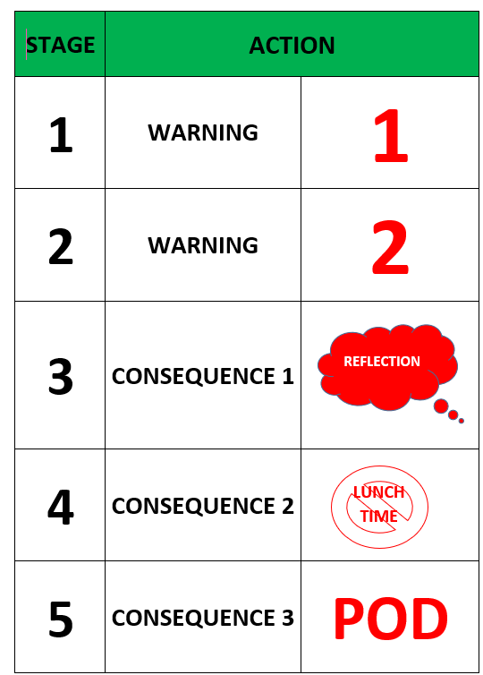
Behaviour Matters
At Primrose Hill, we have a holistic approach to behaviour. We identify, reflect and repair the child’s behaviour and then put pro- active support measures in place to ensure they can manage a similar situation in the future.

Slide 14
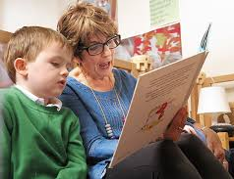
Reading
Each child will be given a reading record and a reading book. We suggest that children read everyday at home either with a grown up to develop confidence and fluency. Their reading book is closely matched to their phonics ability. Children are assessed every 6 weeks and groups will change according to progress. We use RWI phonics scheme.
Reading is so important for a child’s development in all subjects!
Children can reach the correct number of reads to earn a reading badge. The total needed will be within the curriculum letter at the start of each term.

Slide 15

Phonics Screening
The phonics screening check is taken individually by all children in Year 1 in England, and is taken week commencing 9th June 2025.
It is designed to give teachers and parents information on how your child is progressing in phonics. It will help to identify whether your child needs additional support at this stage so that they do not fall behind in this vital early reading skill.

Slide 16

Communication
Showbie – Log in details in packs.
Any key messages – please let us know at handover or alternatively email school office FAO class teacher.

Slide 17
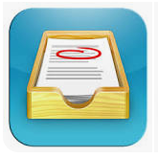
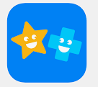
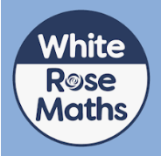
Homework
Showbie – Log in details in packs
Maths – Set on Friday and to be completed by following Thursday
Reading daily with comment
Additional activities occasionally
Summer challenges!
17

Slide 18

School website and Class Page

Slide 19
Finally…
Check book bags for letters, notes or accident slips.
Try to check the website/X regularly for photos, information and school events.
Wednesday Weekly to keep up to date.
Lovely to meet you!
@AshTreeEPH
@EuxtonPH
@CedarTreeEPH

Slide 20

Thank You!
Please feel free to ask any questions

