Slide 1
Meet the Teacher
Year 3 - Pendle

Slide 2


Pendle Class Staff

Slide 3

School Routine
Door will open at 8.45am
Children can change their own reading books in this time any morning. Please record reads in Showbie so we can keep a record of how often they are reading. Reading display in class to celebrate.
Playtime 10.15am-10:30am.
In KS2 lunch runs from 12.30pm until 1.30pm. Children eat in the first half an hour of this time, hot dinners are usually in the upper hall and packed lunches in the lower hall.
PE lessons are Tuesday and Friday.
End of day routine will build independence; children need to remember their own things in a small rucksack or bag.

Slide 4

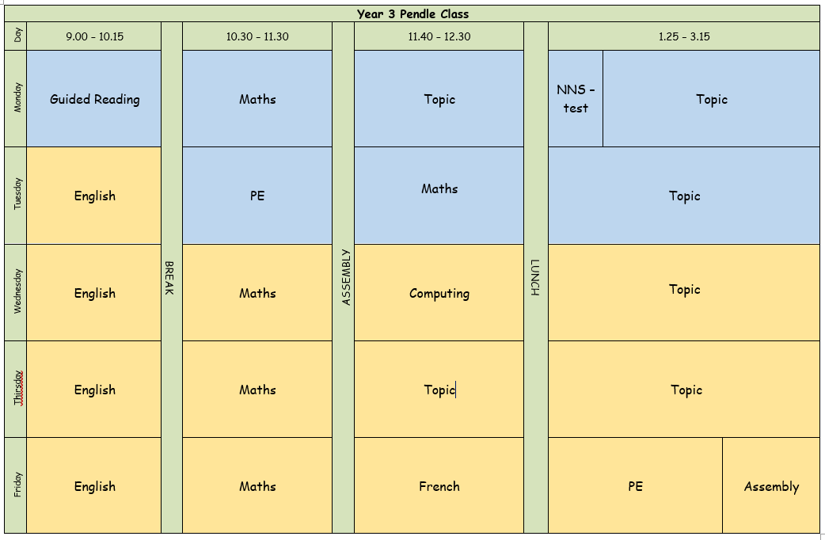
School routine

Slide 5

School life
House points, class rewards
Class jobs/monitors
Celebration assembly on Friday
Library- time will be given once a week to visit the library.
iPads
Toast can be ordered as usual

Slide 6
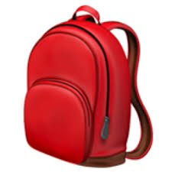
Equipment
Water bottles, snacks (fresh fruit/veg)
Reading book in school every day.
PE on Tuesday and Friday- Come to school in PE kits
No pencil cases
Bookbag or small rucksack
Stylus for iPad (optional)

Slide 7

Year 3 changes
Reading pathways
Ties/shirts
School day changes
1:1 iPads (styluses)
Independence and organisation (please label clothing!)
New part of the building
Lunchtimes – packed lunches

Slide 8

Homework
Spelling test on Monday – in their Spelling book.
Reading – in class rewards for termly target reads.
Online learning-TT Rockstars, Doodle Maths, Showbie and Language Nut
All login details are on Showbie.

Slide 9
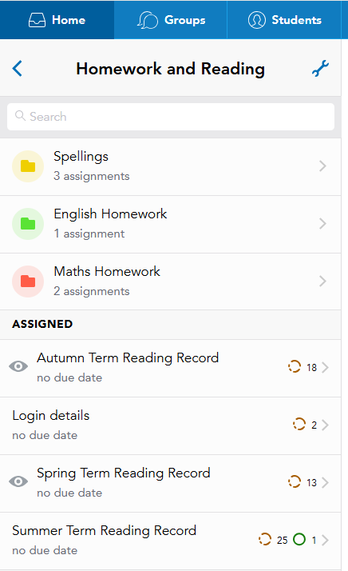
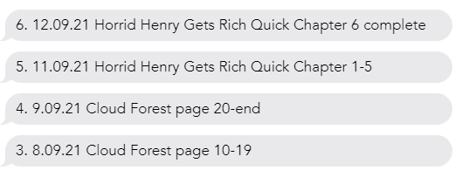
We will update with areas and topics being taught. Doodle assignments etc.
Spellings for the term will be here. Children will post their results after a test here.

Slide 10

Communication
Come and speak to us at the end of the day/ first thing in the morning
Send in a note/letter with child
Call / email school
Website and Twitter/X

Slide 11
📬 Communicating with Us If you need to get in touch, please email the school office in the first instance: ✉️ office@primrosehill-euxton.lancs.sch.uk Your message will be passed on to the relevant member of staff. We aim to respond as soon as we can, but please allow up to 48 hours for a reply during term time. For urgent matters during the school day, please phone the school office directly on: 01257 276688

Slide 12
🔹 If your child is unwell, please contact the school office by 9:00am on each day of absence. 📞 01257 276688 ✉️ office@primrosehill-euxton.lancs.sch.uk 🔹 Be specific: It’s important to give a clear reason – for example: ✅ “Tonsillitis” or “Sickness and temperature” ❌ Not just “unwell” or “poorly”.
📆 Attendance & Absence
We strongly encourage good attendance to support your child’s learning and progress.
This helps us meet safeguarding and health requirements

Slide 13
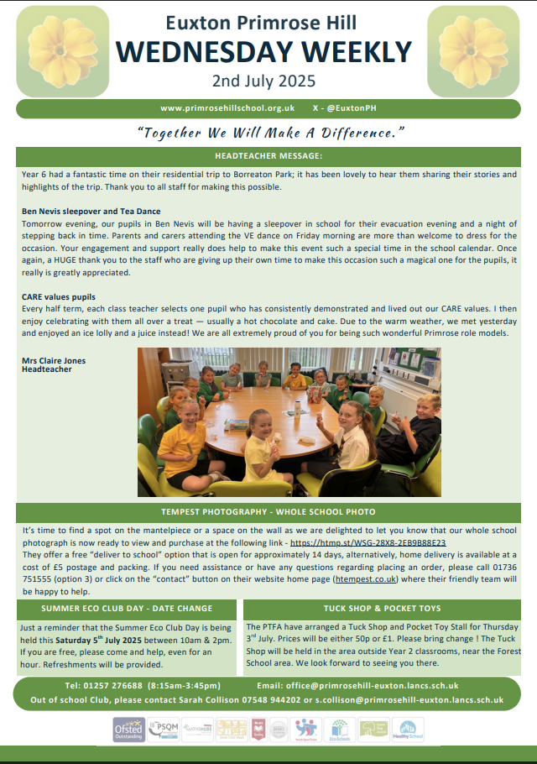
📧 Weekly Wednesday Email
To keep communication clear and consistent, the school sends out a Weekly Wednesday Email.
It includes:
Upcoming trips and events
Key dates
Celebrations and achievements
Important reminders and updates
✅ Please check it each week — it’s the main way we share information. 📍 A copy is also uploaded to the school website for easy access.

Slide 14
⚠️ If You’re Concerned About Something…
We want to work in partnership with you. If you’re ever worried or unhappy about a situation, please follow this order of contact, via the school office:
Class Teacher – your first point of contact – Mrs Kanski/Miss Dobbs
Phase Leader – if further support is needed – Mr Lloyd Davies
Assistant Headteacher - Miss Amie Dobbs
Deputy Headteacher – Mrs Emma Swinburn
Headteacher – Mrs Claire Jones
We’re here to help and will always do our best to resolve any concerns quickly and fairly.

Slide 15
To keep everyone safe and focused on learning: 🔹 No jewellery – including earrings (studs/spacers), rings, bracelets, necklaces, loom bands, or wristbands 🔹 No earrings or spacers – these are a safety risk, especially during play and PE 🔹 No nail varnish or make-up – children should come to school with natural nails and faces
👕 Jewellery & Appearance
Thank you for your support!

Slide 16


PTA- Parents and Teachers Association
When combining the power of our Parents & Teachers we are creating a stronger school community- just like in our mission statement- “Together we will make a difference”
Are you passionate about your child’s education and school experience?
Do you want to help shape school events, support teachers, and build be part of a vibrant community?
Then join our PTA – we need YOU!

Slide 17

Why join our PTA here at EPH?
🤝 Opportunities to connect with other parents and staff
🎉 Help plan fun school events and fundraisers
📚 Support educational programs and resources
🗣️ Have a voice in school decisions
💡 Share your ideas, talents and skills with others
🎯Raise funds which are used to support all the children in school
No experience needed – just enthusiasm and a desire to help - whether you can give a little time or a lot, your involvement will have a big impact.
Come along to our PTA Annual General Meeting on Tuesday 16th September at 5.30pm – we look forward to meeting you!

