Slide 1

Welcome to Year 6.

Slide 2
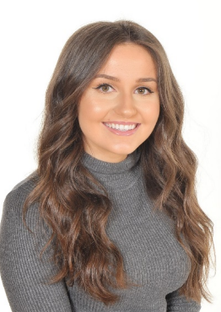
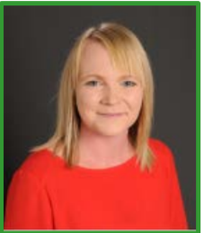
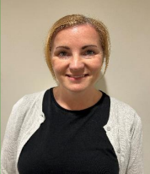
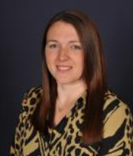
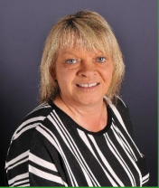
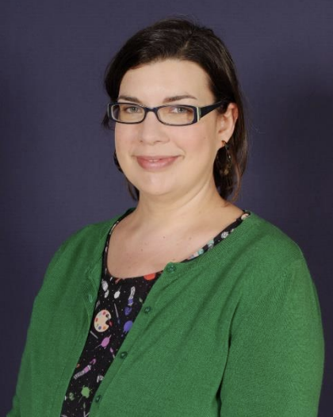
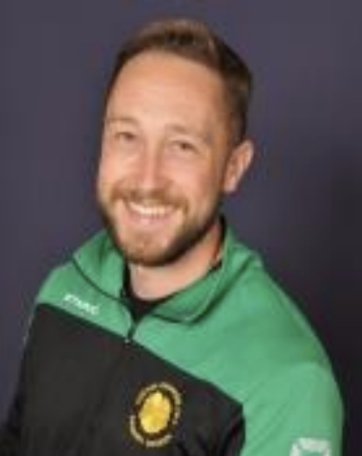
Meet the team
Mrs Brockie –
Everest class teacher.
Miss Burns- K2 Class teacher/UKS2 Lead
Mrs Pendleton-
K2 TA.
Mrs Jeal-
Everest TA.
Mrs Mansley-
K2 TA.
Mrs Millward – Art specialist PPA cover
Mr Halsall – PE PPA cover.

Slide 3

Our aims and expectations
Your child will have a fantastic final year at Primrose Hill
They will develop to the best of their abilities
To help them to develop strategies to help them deal with challenges they face
They feel supported and cared for
Work hard and try their best
Learn new things and try new skills
Be prepared for the next stage of their education

Slide 4
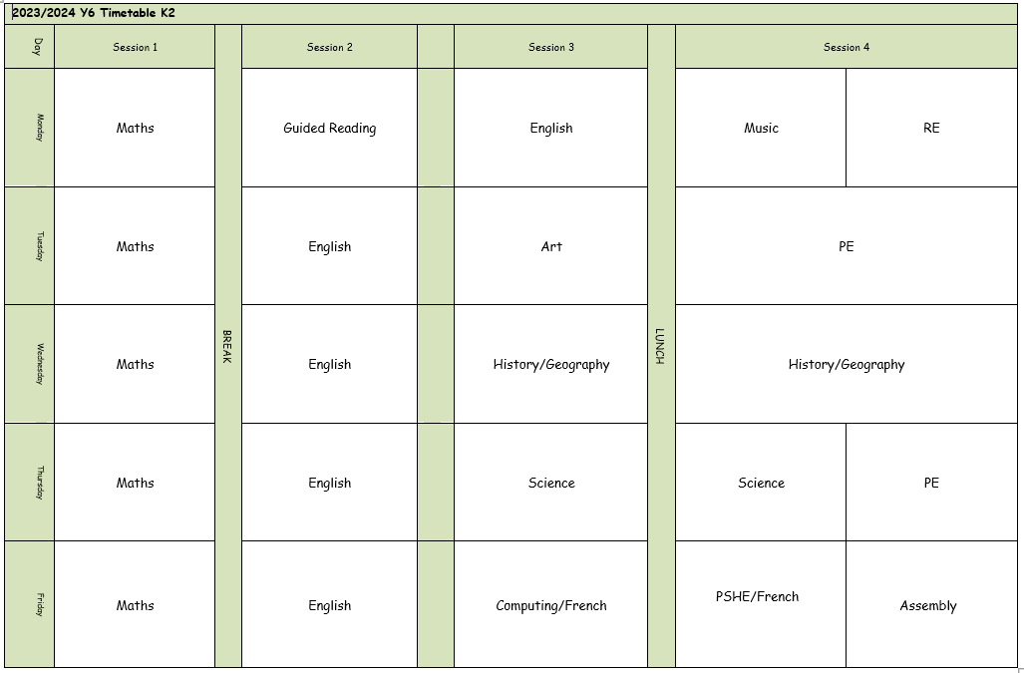
An example of our week in school …

Slide 5

P.E. lessons
P.E. sessions are to be confirmed in due course.
We aim to go outside as much as possible so please ensure your child has jogging bottoms and a jacket when cold.
Children to come to school in school P.E. kits.
Run a mile will continue – no need for extra trainers in school.

Slide 6
To keep everyone safe and focused on learning:
🔹 No jewellery – including earrings (studs/spacers), rings, bracelets, necklaces, loom bands, or wristbands
🔹 No earrings or spacers – these are a safety risk, especially during play and PE
🔹 No nail varnish or make-up – children should come to school with natural nails and faces
👕 Jewellery & Appearance
Thank you for your support!

Slide 7

Showbie
Children have access to Showbie in school and at home.
Your child will have been given a log in card with all the details they need to access this.
Please let us know if you have any problems accessing Showbie at all over the course of the year.

Slide 8
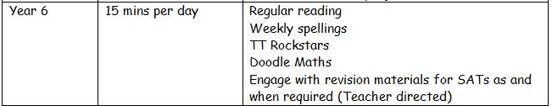
Homework expectations…

Slide 9
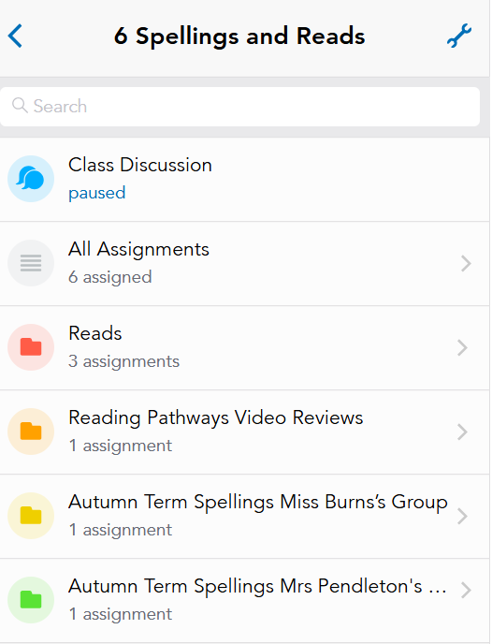
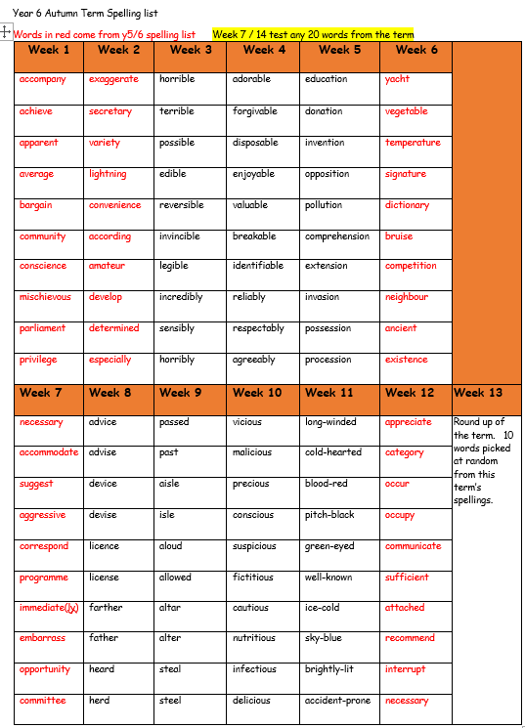
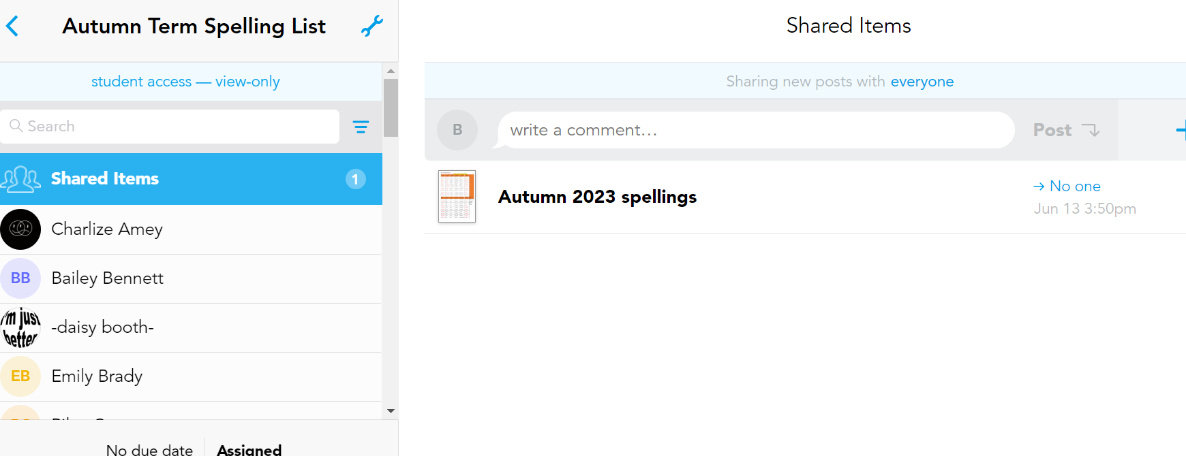
Spellings and Reads
Spellings – termly list on showbie and tested on a Friday.

Slide 10



Reading
Reading is extremely important in Year 6. We want the children to be fluent independent readers ready for high school.
Please encourage your child to read daily for 15-20 mins as part of their homework.
Reading Pathways continues in Year 6. Children will be encouraged to choose from a range of texts that explore a range of genres – essential for their transition to KS3 literature.
Reads can be logged on showbie

Slide 11
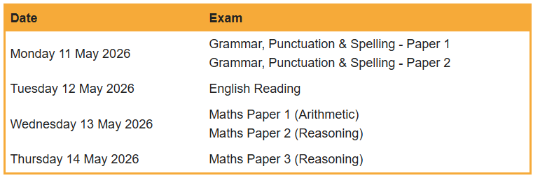
Important dates this year…
Key Stage 2 SATS Dates 2026.
High school applications - https://www.lancashire.gov.uk/children-education-families/schools/apply-for-a-school-place/starting-secondary-school/
Applications must be submitted online to LCC by 31st October 2025.
Criteria for application can be found on school websites – check if faith schools require a supplementary form.

Slide 12

End of Key stage assessments.
Monday 11th May – Thursday 14th May 2026
All children in Year 6 will sit the National Curriculum Tests for KS2 - formally known as SATS.
Math’s tests will include a short arithmetic test of 30 questions, plus two further reasoning papers. These will cover all the objectives taught from Key Stage 2.
English tests will include a 1 hour reading paper, a grammar and punctuation test and a spelling test as well.
Results are reported as a scaled score, with a score of 100 representing the expected level for each age group.
https://www.gov.uk/education/primary-curriculum-key-stage-2-tests-and-assessments

Slide 13

Other events this year…
Macmillan Coffee Morning – Friday 26th September 2025
SATs meeting – Wednesday 17th September 2025
Trip to Liverpool Museum – November 2025
Y6 Residential– June 2026

Slide 14
What can you do to help?
Ensure a good bedtime routine for your child, so they are refreshed and ready to learn in school each day.
Encourage self- learning of topics – particularly previous year group objectives and those covered throughout the year.
Promote daily independent reading.

Slide 15
🔹 If your child is unwell, please contact the school office by 9:00am on each day of absence.
📞 01257 276688
✉️ office@primrosehill-euxton.lancs.sch.uk
🔹 Be specific:
It’s important to give a clear reason – for example:
✅ “Tonsillitis” or “Sickness and temperature”
❌ Not just “unwell” or “poorly”.
📆 Attendance & Absence
We strongly encourage good attendance to support your child’s learning and progress.
This helps us meet safeguarding and health requirements

Slide 16
📬 Communicating with Us
If you need to get in touch, please email the school office in the first instance:
✉️ office@primrosehill-euxton.lancs.sch.uk
Your message will be passed on to the relevant member of staff.
We aim to respond as soon as we can, but please allow up to 48 hours for a reply during term time.
For urgent matters during the school day, please phone the school office directly on: 01257 276688

Slide 17

📧 Weekly Wednesday Email
To keep communication clear and consistent,
the school sends out a Weekly Wednesday Email.
It includes:
Upcoming trips and events
Key dates
Celebrations and achievements
Important reminders and updates
✅ Please check it each week — it’s the main way we share information.
📍 A copy is also uploaded to the school website for easy access.

Slide 18
⚠️ If You’re Concerned About Something…
We want to work in partnership with you.
If you’re ever worried or unhappy about a situation, please follow this order of contact,
via the school office:
Class Teacher/Phase Leader – your first point of contact – Mrs Helen Brockie
Assistant Headteacher - Miss Amie Dobbs
Deputy Headteacher – Mrs Emma Swinburn
Headteacher – Mrs Claire Jones
We’re here to help and will always do our best to resolve any concerns quickly and fairly.

Slide 19


Slide 20


Slide 21


