Slide 1

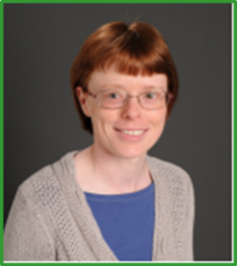
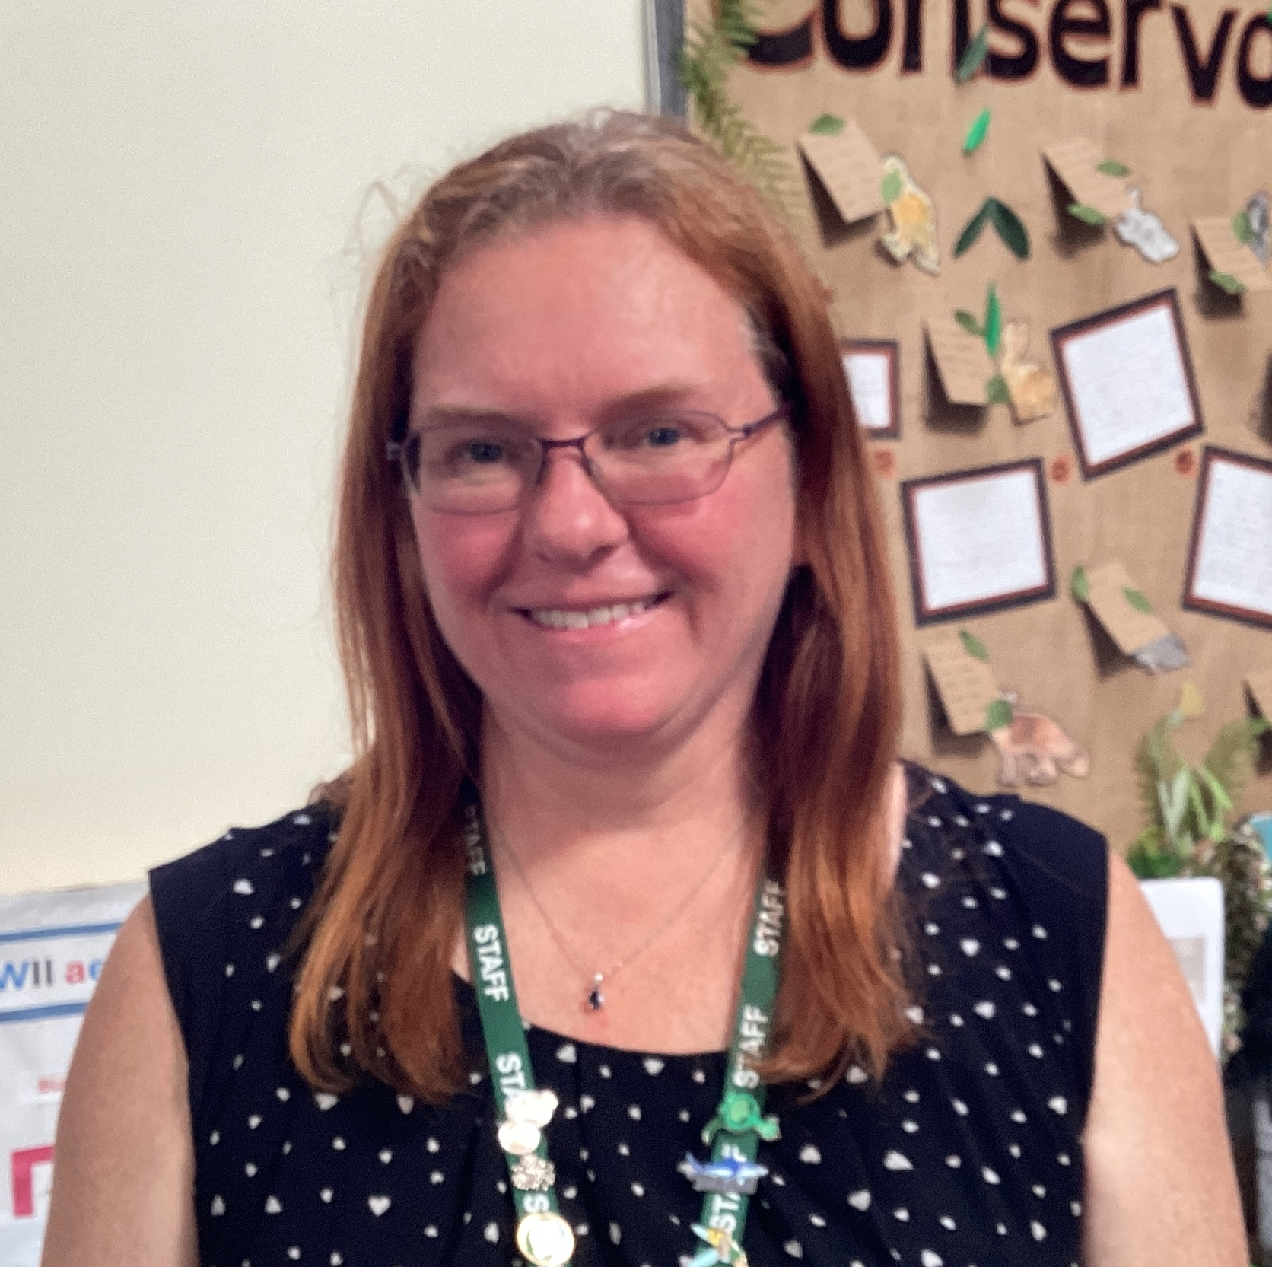
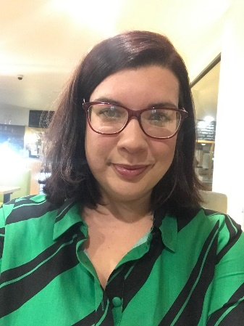
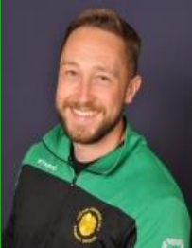
Year 5 Olympus
Miss McKinley
Class teacher
Mrs Yeoman
Teaching assistant
Mrs Millward
HLTA - PPA
Mr Halsall
PE - PPA
Meet the Teacher

Slide 2
🔹 If your child is unwell, please contact the school office by 9:00am on each day of absence. 📞 01257 276688 ✉️ office@primrosehill-Euxton.lancs.sch.uk 🔹 Be specific: It’s important to give a clear reason – for example: ✅ “Tonsillitis” or “Sickness and temperature” ❌ Not just “unwell” or “poorly”.
📆 Attendance & Absence
We strongly encourage good attendance to support your child’s learning and progress.
This helps us meet safeguarding and health requirements

Slide 3
📬 Communicating with Us If you need to get in touch, please email the school office in the first instance: ✉️ office@primrosehill-Euxton.lancs.sch.uk Your message will be passed on to the relevant member of staff. We aim to respond as soon as we can, but please allow up to 48 hours for a reply during term time. For urgent matters during the school day, please phone the school office directly on: 01257 276688

Slide 4
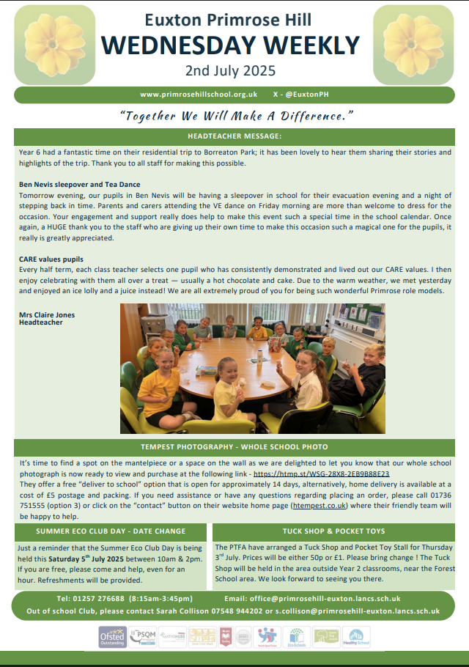
📧 Weekly Wednesday Email
To keep communication clear and consistent, the school sends out a Weekly Wednesday Email.
It includes:
Upcoming trips and events
Key dates
Celebrations and achievements
Important reminders and updates
✅ Please check it each week — it’s the main way we share information. 📍 A copy is also uploaded to the school website for easy access.

Slide 5
⚠️ If You’re Concerned About Something…
We want to work in partnership with you. If you’re ever worried or unhappy about a situation, please follow this order of contact, via the school office:
Class Teacher – your first point of contact – Miss McKinley
Phase Leader – if further support is needed - Miss Burns
Assistant Headteacher - Miss Amie Dobbs
Deputy Headteacher – Mrs Emma Swinburn
Headteacher – Mrs Claire Jones
We’re here to help and will always do our best to resolve any concerns quickly and fairly.

Slide 6
To keep everyone safe and focused on learning: 🔹 No jewellery – including earrings (studs/spacers), rings, bracelets, necklaces, loom bands, or wristbands 🔹 No earrings or spacers – these are a safety risk, especially during play and PE 🔹 No nail varnish or make-up – children should come to school with natural nails and faces
👕 Jewellery & Appearance
Thank you for your support!

Slide 7
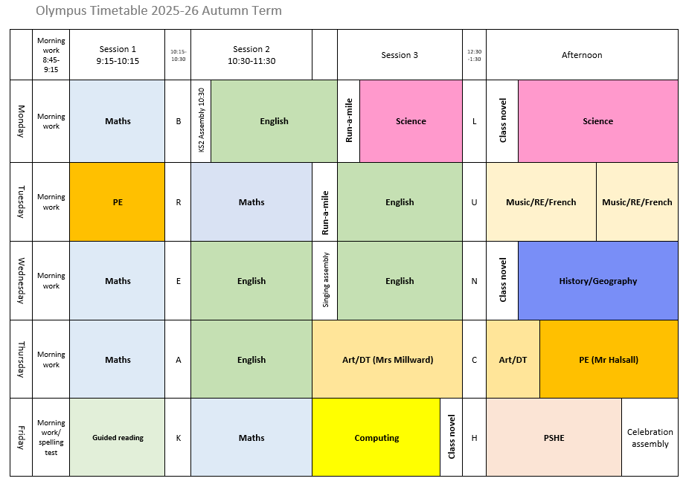
Potential timetable (subject to change)

Slide 8

PE
Tuesday morning and Thursday afternoon.
During the colder months it is important that children have warm black/grey trousers and a PE hoodie as we will try and go outside as much as possible.
Gymnastics – children need to have shorts or trousers that are tight fitting at the ankle for practical and safety reasons. Shorts can be worn under trousers during cold months.

Slide 9
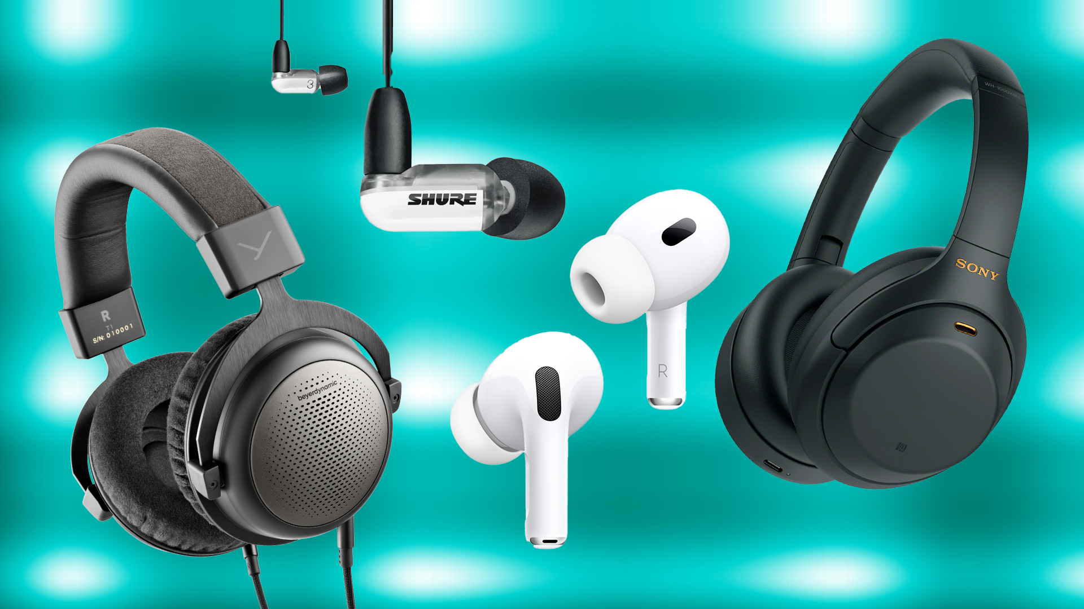
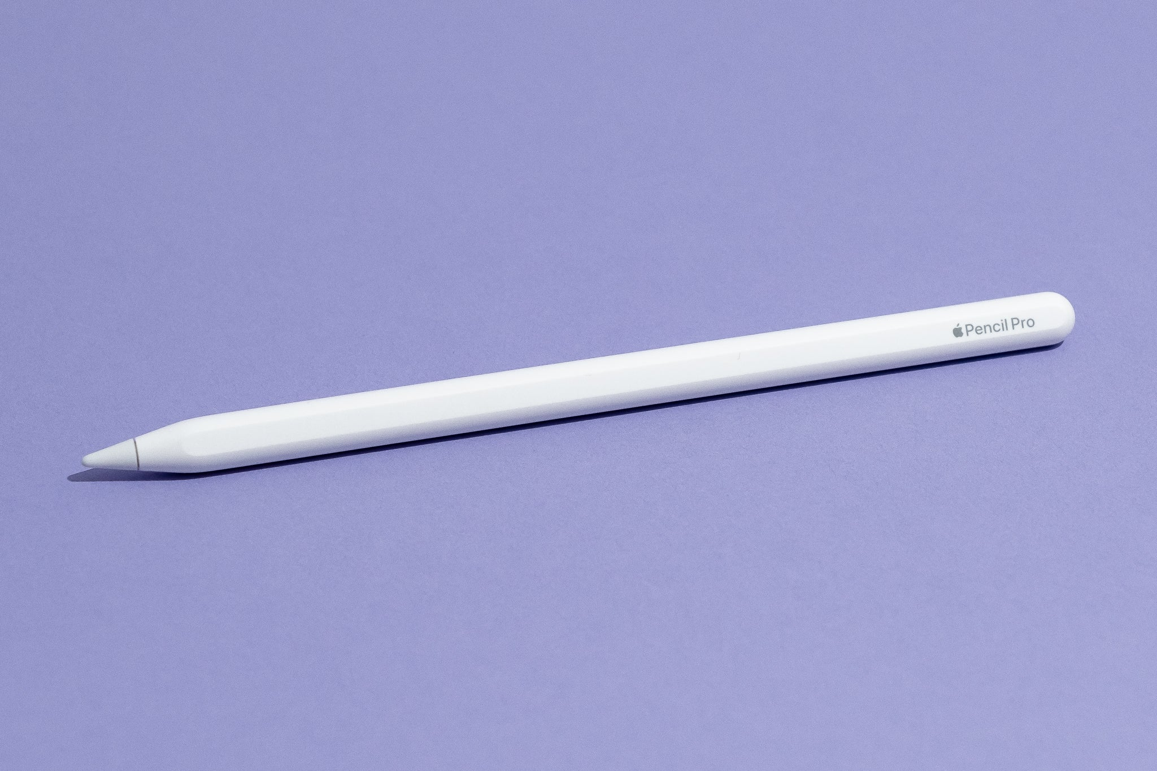
IPads
It would be very helpful if children were able to provide their own earphones or headphones (that fold flat to fit in trays) for use when watching videos, creating music or any other time sound is involved. This can speed things up when working in class however there are also headphones in school. They may also have their own named (cheap) stylus. PLEASE ENSURE EVERYTHING IS NAMED!
Children are very privileged to have access to their own iPad in school and as such, they are expected to look after them and use them appropriately.
Log in details for the different apps will be in a Showbie folder set up at the beginning of the year in their homework folder – this should make it easier, for as long as they remember their Showbie log in details they can find everything else!

Slide 10



Homework
Spelling tests are every 2 weeks – we will practise in school the first week and then children need to practise at home the second week ready for a spelling test on the Friday. Spellings will be in their Showbie homework folder.
If possible, children should be reading every day. The minimum is at least 3x a week. This can be a reading pathway or another book.
OPTIONAL: TTRS, Doodlemaths practise and readtheory (reading comprehension app – the children will login and do baseline assessment in September)

Slide 11

Reading
Reads are to be recorded on Showbie in homework folder – there is an example format of how to set it out.
The read does not have to be a book from school as long as they are reading!
All children also have access to First News (a children’s newspaper) on Showbie.
Please check your child’s reading record regularly – they should be recording reads each morning in school or each night at home.
Please discuss with your child what they are reading. Most y5 children will read independently however it is important to check that they understand what they are reading and are picturing it in their mind to help them remember.

Slide 12
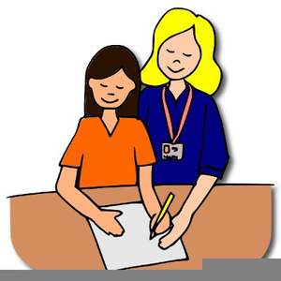
Support at school
Your child may have additional support during the day (either individually or in a group) with Mrs Yeoman – this can and will change during the year based on need and can be a one off or a regular slot.
There may be particular aspects of a subject that your child finds difficult and therefore additional support can be very topic specific.
If your child struggles with anything, please encourage them to speak to myself or Mrs Yeoman.

Slide 13
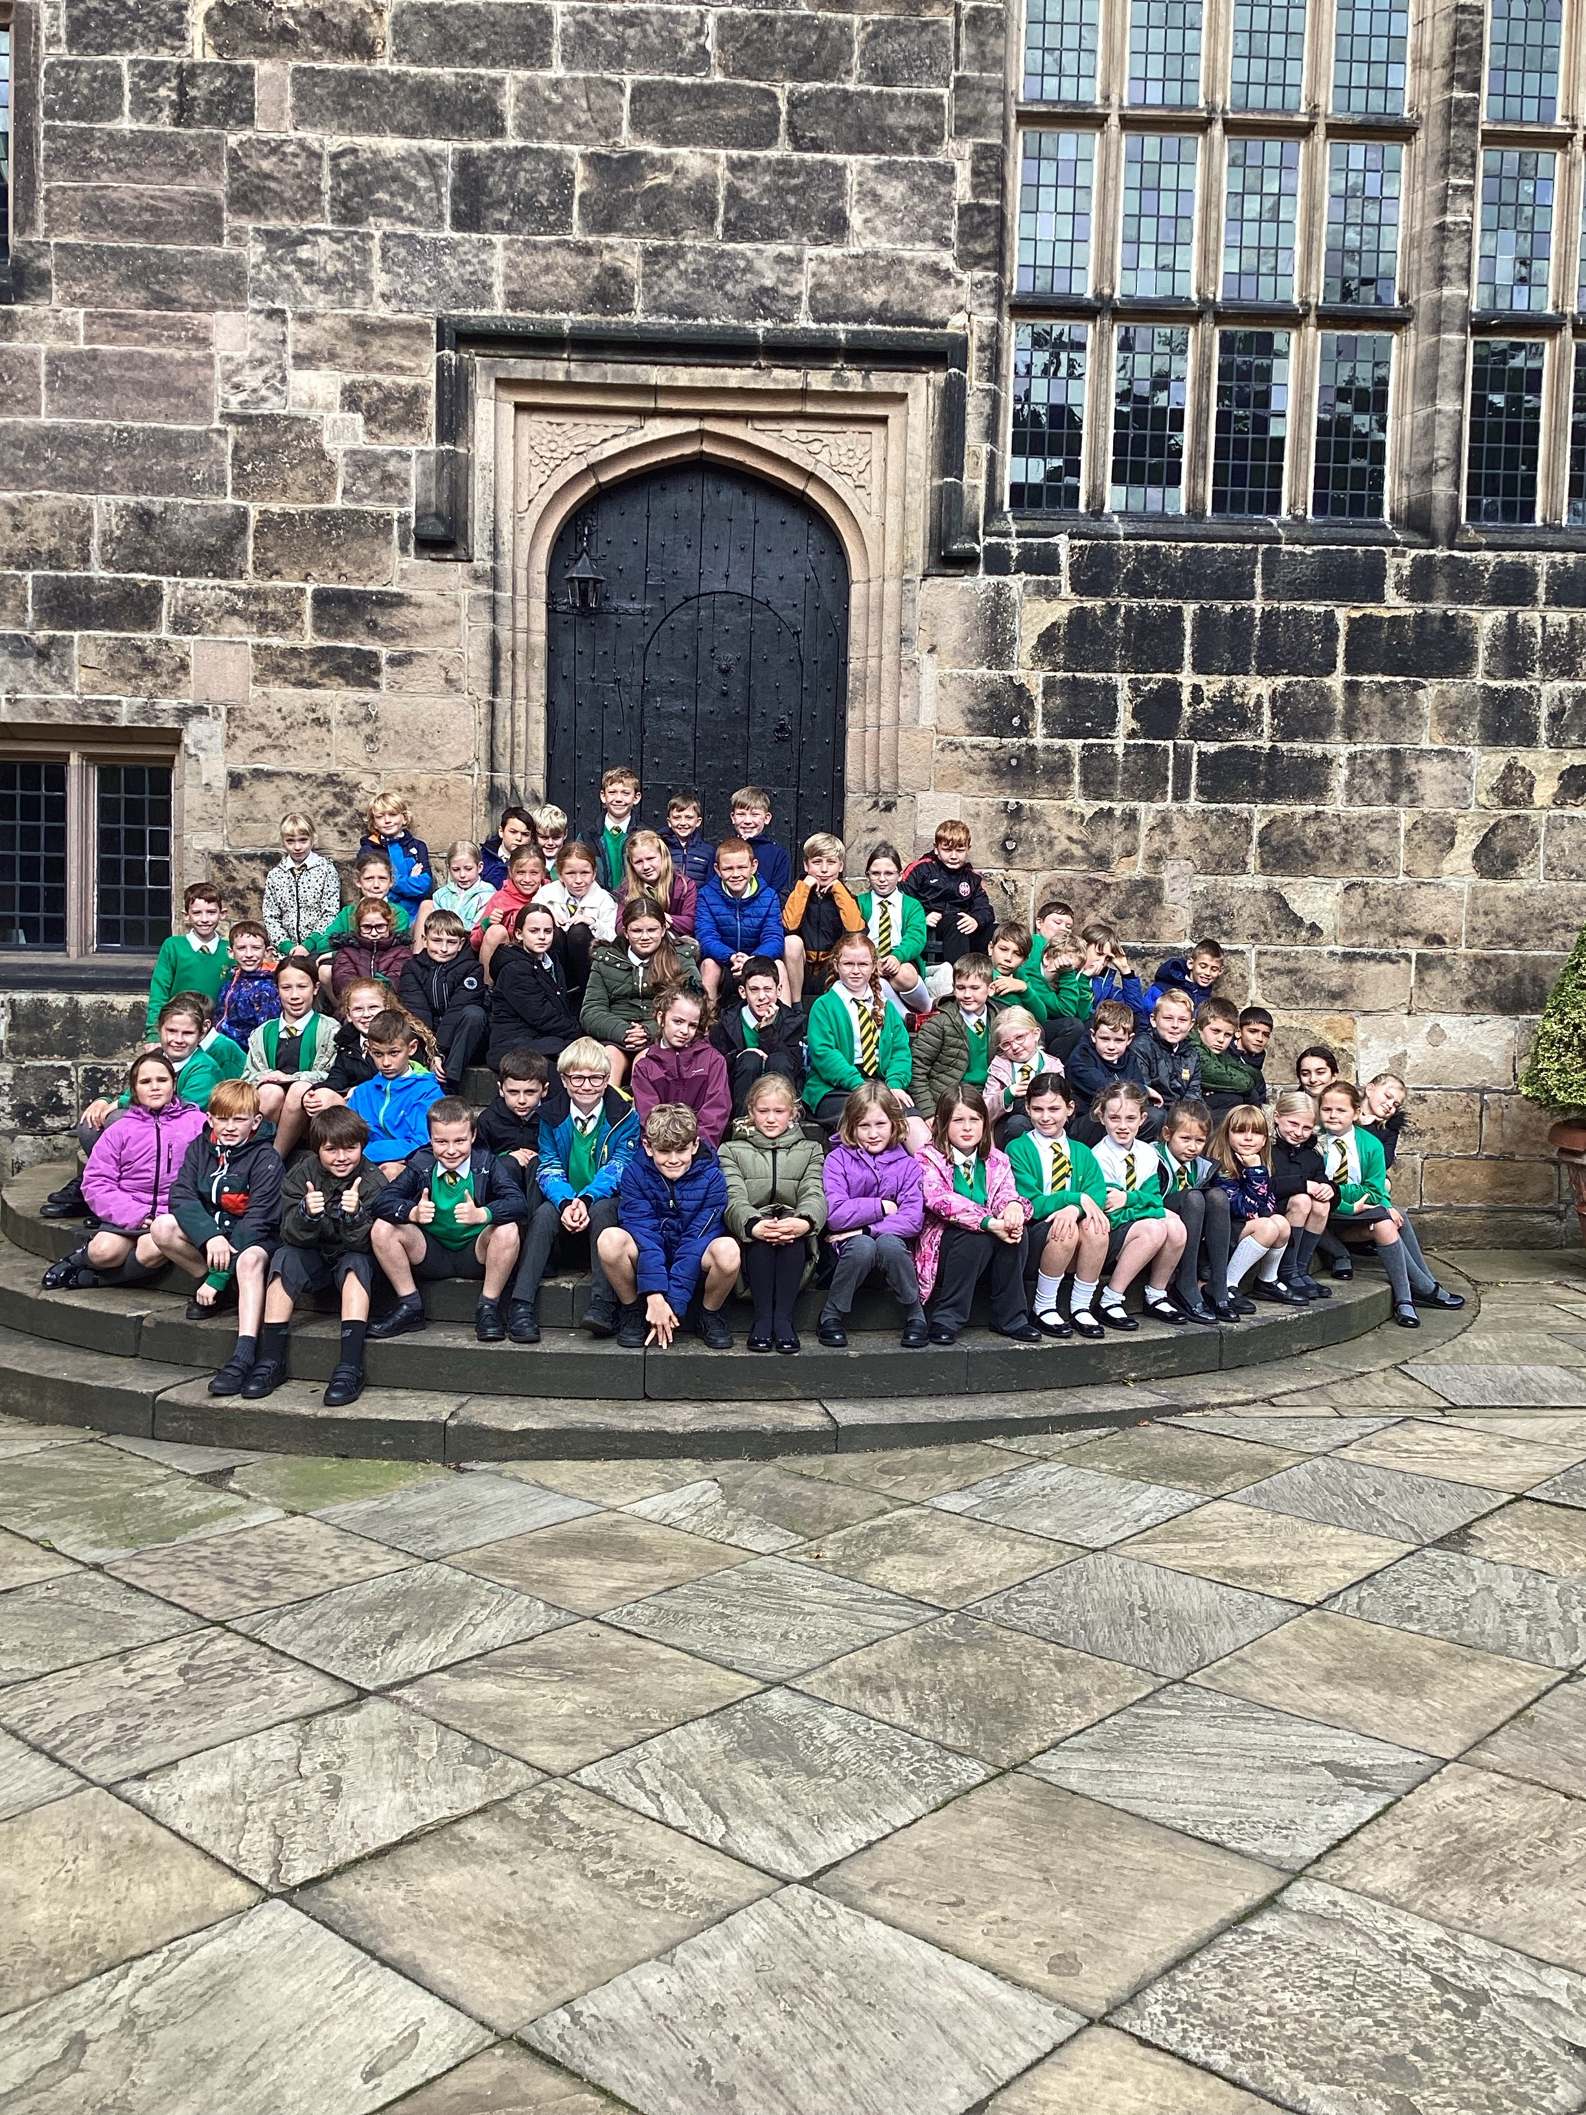
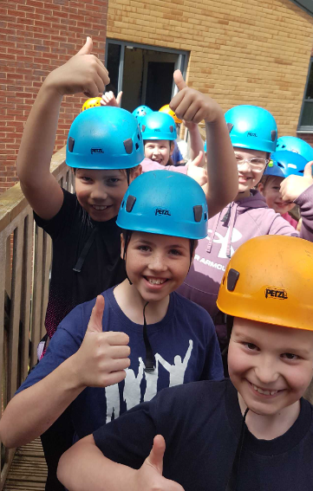
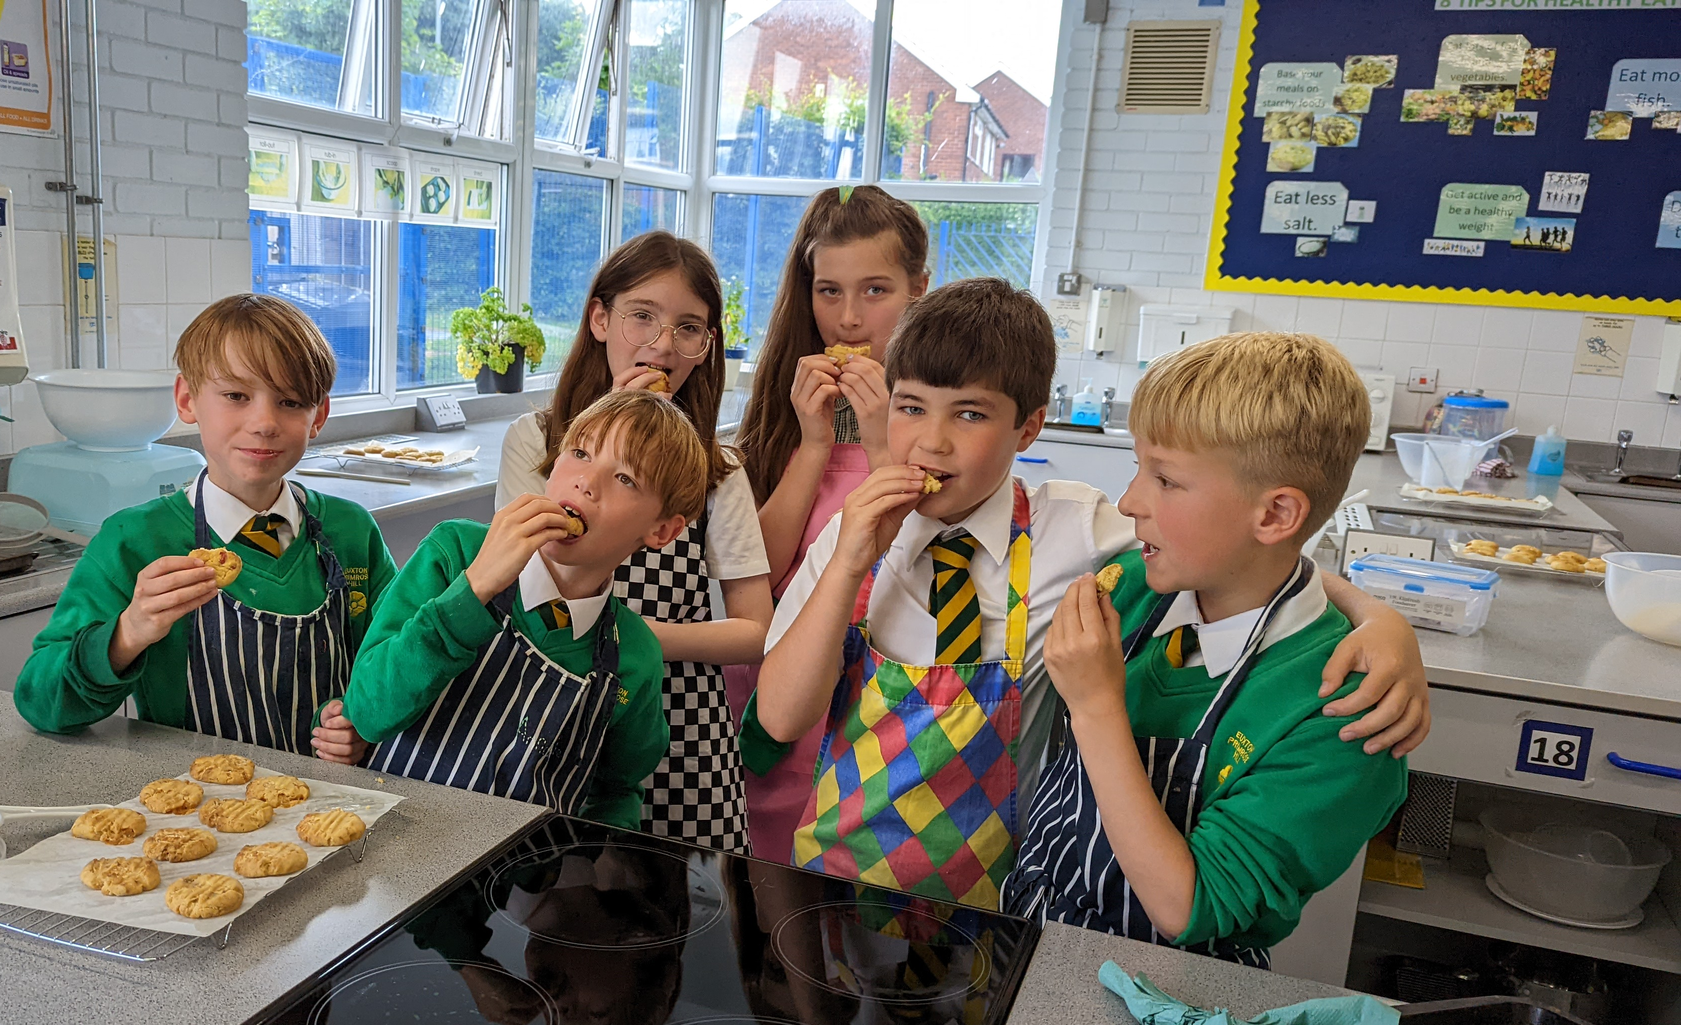
Trips/activities
Hoghton Tower - 23rd September 2025
Inspire - Chorley Crucial Crew Child Safety Event 14th October 2025
Hothersall Lodge – 15-17th June 2025
Bikeability – summer term 2026 (tbc)
St Mary’s High School DT – summer term 2026 (tbc)

Slide 14


PTA- Parents and Teachers Association
When combining the power of our Parents &Teachers, we are creating a stronger school community just like in our mission statement- “Together we will make a difference”.
Are you passionate about your child’s education and school experience? Do you want to help shape school events, support teachers, and build a vibrant community?
Then join our PTA – we need YOU!

Slide 15

Why join our PTA here at EPH?
🤝 Opportunities to connect with other parents and staff
🎉 Help plan fun school events and fundraisers
📚 Support educational programs and resources
🗣️ Have a voice in school decisions
💡 Share your ideas, talents and skills with others
🎯Raising funds that are put straight back into the school
No experience needed – just enthusiasm and a desire to help- Whether you can give a little time or a lot, your involvement makes a big impact.
Come along to our annual PTA General meeting on Tuesday 16th September at 5.30pm

