Slide 1
HABITATS and ECO-SYSTEMS
Science Week Beginning 1st June 2020
In this session, the children will learn what is meant by an eco system / habitat and microhabitat and carry out a MICROHABITATS INVESTIGATION. Please accompany your child and remember that you don’t need any special equipment to carry out this investigation, but the items below might help if your children want to get a closer look at the living things they find: Clear containers are useful for holding any mini-beasts while they study them. Use a spoon or small paintbrush to gently scoop up their finds. A magnifying glass is great for examining really tiny details.
A camera to record the microhabitat and findings.
Key words:
HABITAT - A type of natural environment where plants and animals live.
MICRO-HABITAT - A small-scale environment that forms part of a larger habitat.
ECO-SYSTEM - A geographic area where plants, animals, and other organisms, as well as weather and landscape, work together to form a bubble of life.

Slide 2
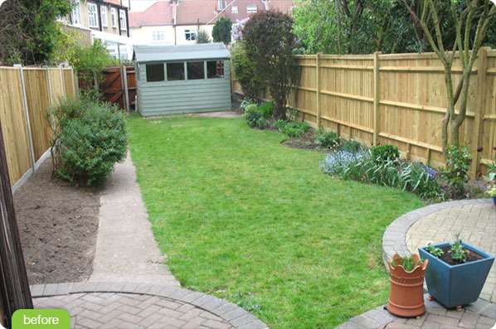
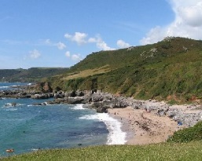
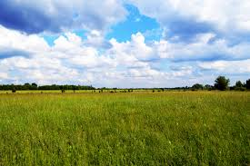
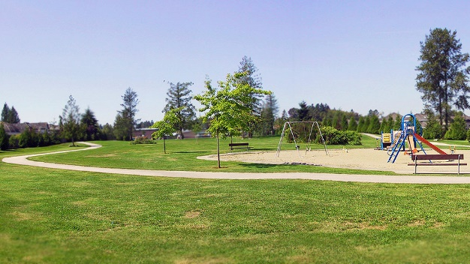
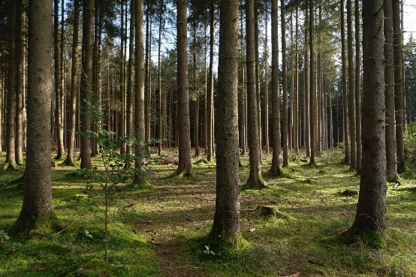
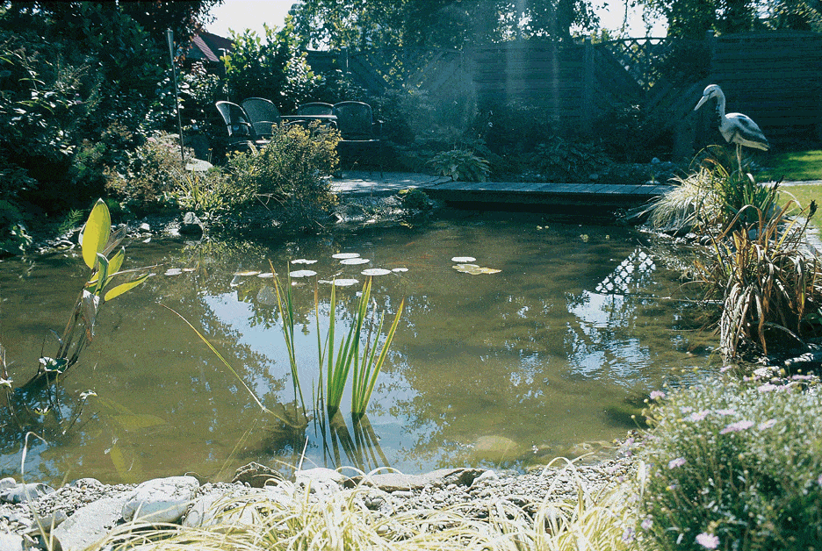
What is a habitat?
A habitat provides the four basic survival needs include:
food
shelter from weather and predators
water
a place to raise young
It is the place where a plant or animal lives
It could be a …
A beach
A meadow
A garden
A park
or anywhere else that plants and animals live!
Take a look at how many animals might call a garden home !
A wood
A pond
https://www.bbc.co.uk/teach/class-clips-video/biology-ks1-ks2-wonders-of-nature-wildlife-in-our-gardens/zkx2t39

Slide 3
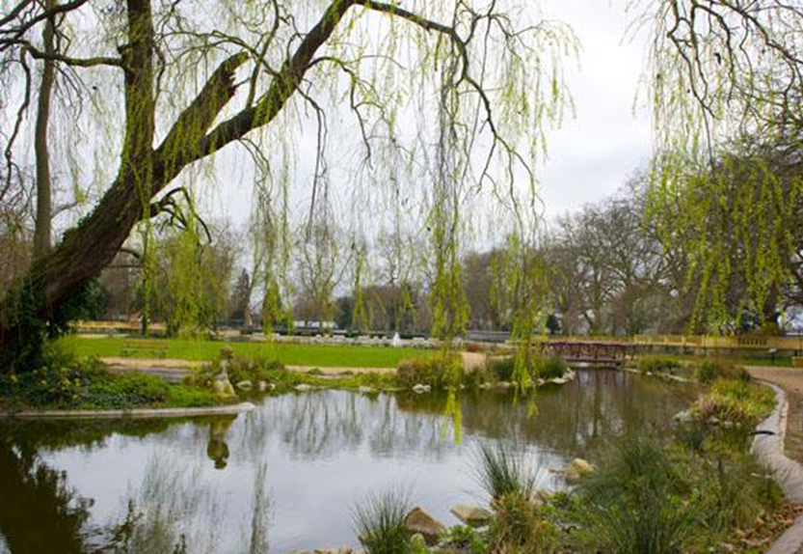
What plants and animals might live in this park habitat?
In you book list your suggestions under the headings PLANTS and ANIMALS – do this now before going any further in the PDF.

Slide 4
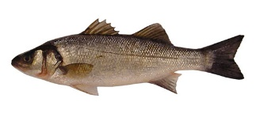
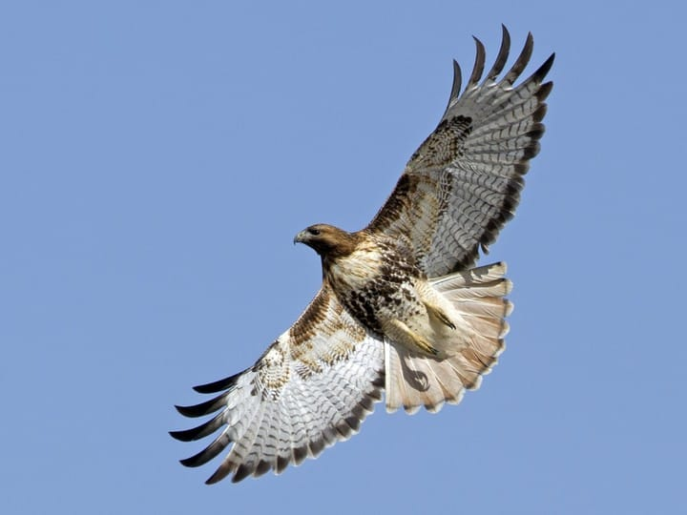
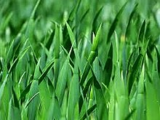
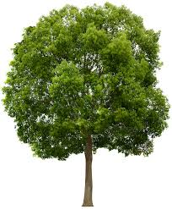
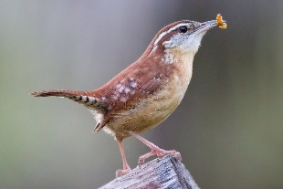
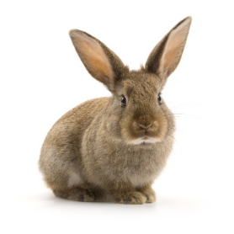
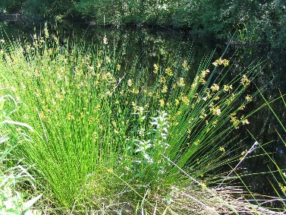
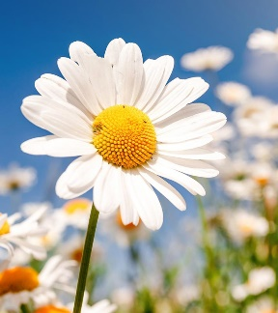
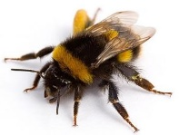
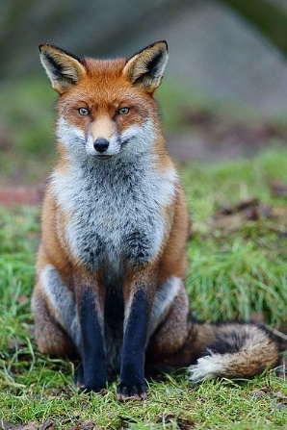
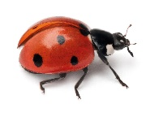
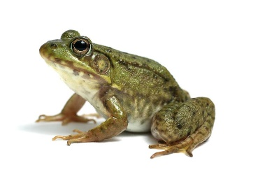
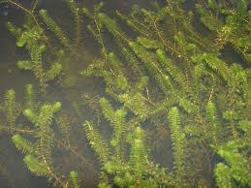
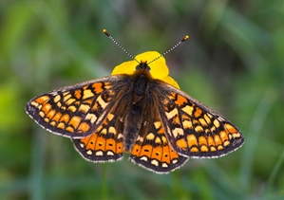
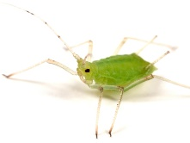
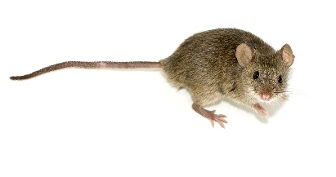
What plants and animals might live in this park habitat?
Here are some animals you may have thought of
Here are some plants you may have thought of
fish
grass
birds of prey
trees
small birds
rabbits
water rushes
flowering plants
bees
ladybirds
frogs
pond weed
greenfly
foxes
butterflies
mice

Slide 5
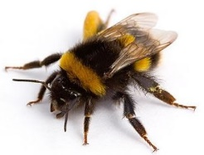
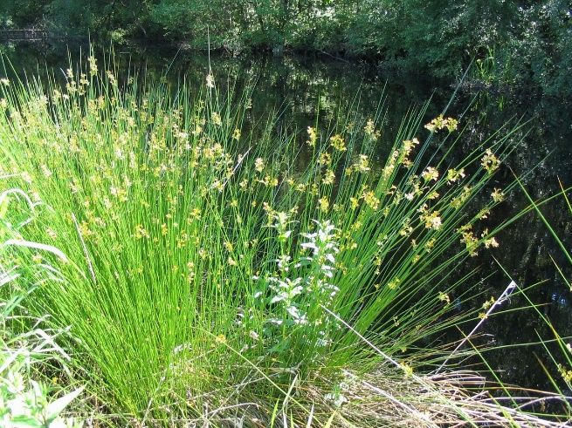
The different plants and animals that live in a habitat are dependent on each other in different ways.
Can you think how?
The trees and other plants provide …
food and shelter for many of the animals

Slide 6
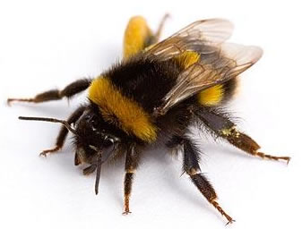
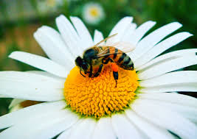
The butterflies, bees and other insects help the plants by …
pollinating their flowers

Slide 7
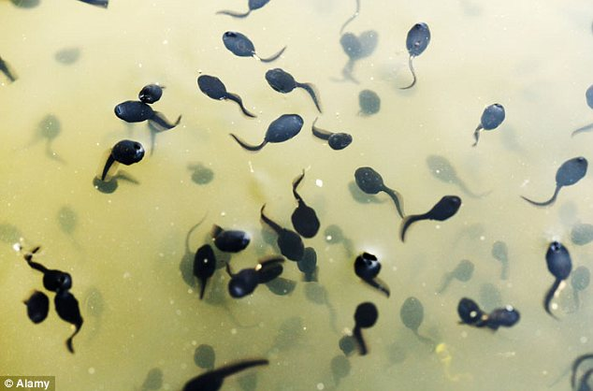
The pond weed …
puts oxygen into the water. Without oxygen the fish and other pond creatures could not survive.

Slide 8
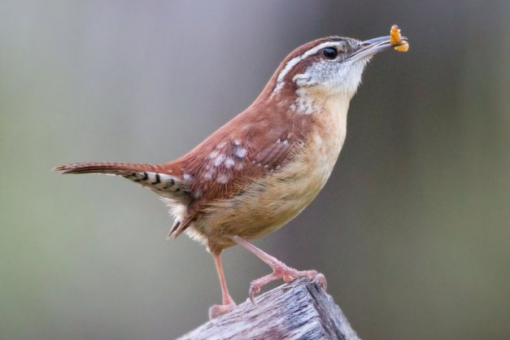
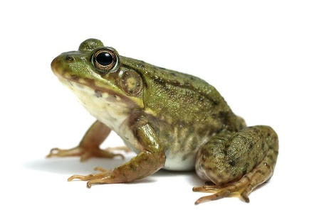
The insects and other small animals in the habitat provide …
food for other animals.

Slide 9
These animals in turn will provide …
food for the top predators in the habitat.

Slide 10
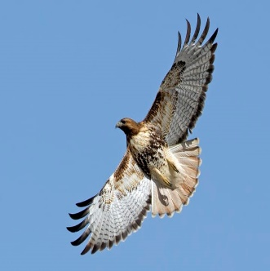
bees
ladybirds
fish
grass
greenfly
small birds
birds of prey
water rushes
rabbits
trees
A habitat, together with all the plants and animals that live there, as well as weather and landscape, are together known as an ecosystem.
foxes
butterflies
mice
pond weed
flowering plants
frogs

Slide 11
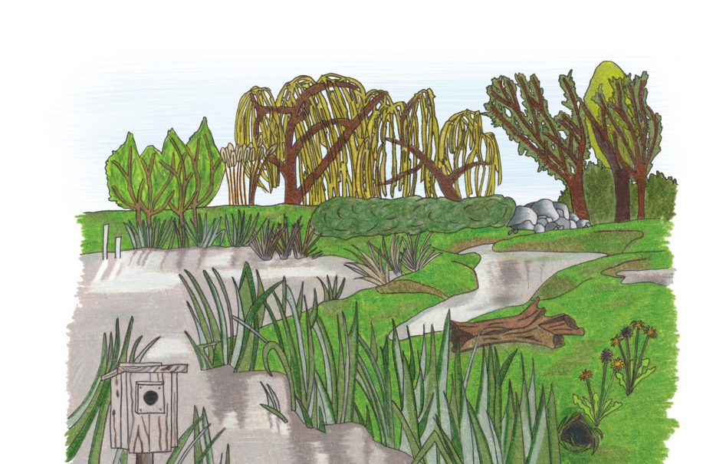
What is a microhabitat?
Micro means extremely small so a microhabitat is therefore a very small home or habitat, it is one part of a bigger habitat.
This is a wetland habitat, but there are several different microhabitats here … can you spot any ?
Activity 1 – If you can print out the activity sheet using a thick coloured pen identify and circle all the microhabitats they can see on the visual and label the microhabitats you have identified – name them. If you cannot print out just list them in your book under the heading – Wetland Microhabitats.

Slide 12
Take a look ….
In this video clip you will visit a garden that has 3 different microhabitats, it includes a woodland edge habitat, a pond habitat and a ditch habitat. The woodland edge habitat has plants which need shade. Dead wood is vital to this habitat for insects such as woodlice. The pond habitat has typical aquatic plants and animals as well as visiting insects such as dragonflies. Toads, frogs and newts need two habitats. They need a pond area for breeding and a moist ditch area during the summer months. The plants in this area rely on the moisture in the ditches and need these conditions to be able to survive.
https://www.bbc.co.uk/bitesize/clips/zf6mhyc

Slide 13
Here are some examples of microhabitats that you might find in and around our local area – We would like you to do an investigation – a survey of 3 different microhabitats.
When you do any wildlife investigation you will require sharp eyes and some patience. But here are a few other things that may come in handy:
Pen/Pencil and Paper – to record what you find
The items below might help if you want to get a closer look at the living things you find: Clear containers are useful for holding any mini-beasts while you study them. Use a spoon or small paintbrush to gently scoop up your finds. A magnifying glass is great for examining really tiny details.
A camera to record the microhabitat and findings.
Remember you must not hurt
or remove any living things as
you carry out your investigation -
always treat other living things
with respect.
Examples of Habitats | Garden | Woodland | River | Beach
Examples of Micro-Habitats | Lawn/in grass Pond Under a rock Under a log On a tree In a tree or bush | In long grass Under a log (dead wood) In a hole in a tree Among the roots Under leaves In the soil In a tree or bush | River bank Under stones (in and out of the water) | Rock pools In the sand Under stones Under seaweed

Slide 14
Micro-habitats Investigation – You are going to be nature detectives so use your best skills to discover and track things down that live in your chosen microhabitats. We have included some plant and animal ID guides to help you with your investigation. Please look at the Activity Sheet, it has more detail about what we would like you to do.

