Slide 1
Phase 3 Phonics
Session 2

Slide 2
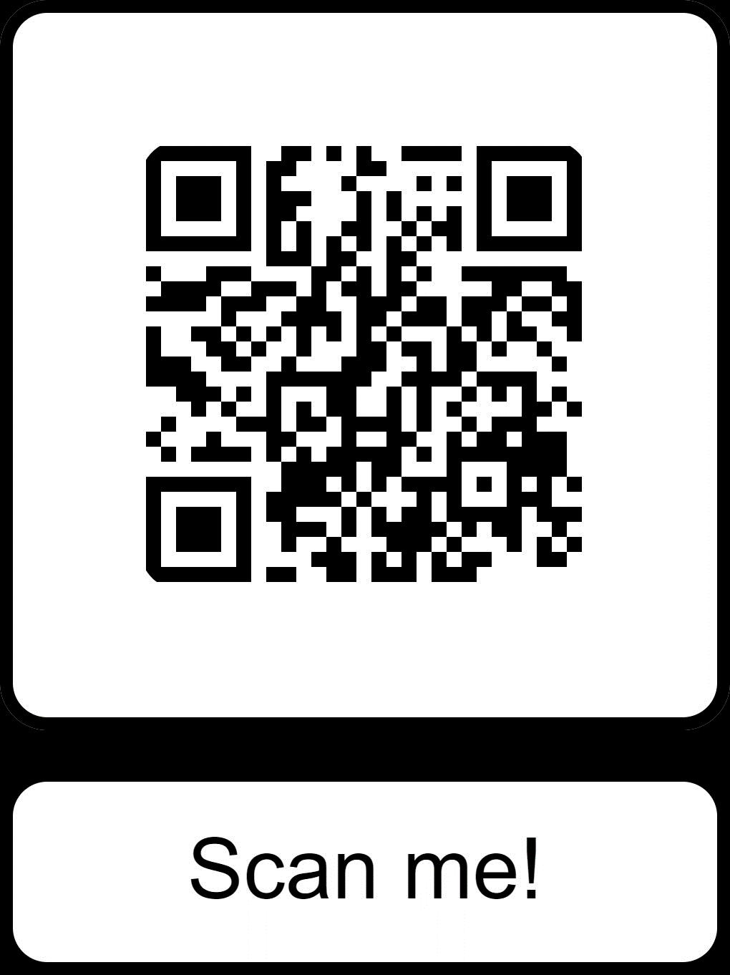
Parent page
https://www.littlewandlelettersandsounds.org.uk/resources/for-parents/

Slide 3
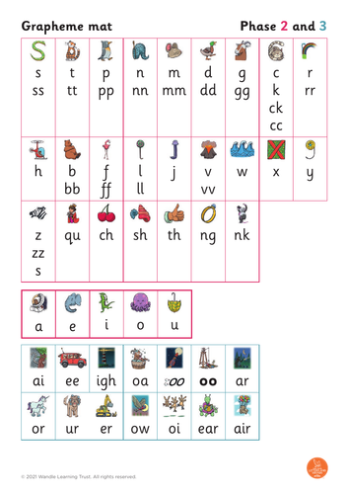
https://www.littlewandlelettersandsounds.org.uk/resources/for-parents/ Watch how to pronounce sounds

Slide 4
https://www.littlewandlelettersandsounds.org.uk/resources/for-parents/#tabnametabHowWeTeach

Slide 6
https://www.littlewandlelettersandsounds.org.uk/resources/for-parents/#tabnametabBooksComingHome

