Slide 1
Phase 5 Phonics
Session 4

Slide 2
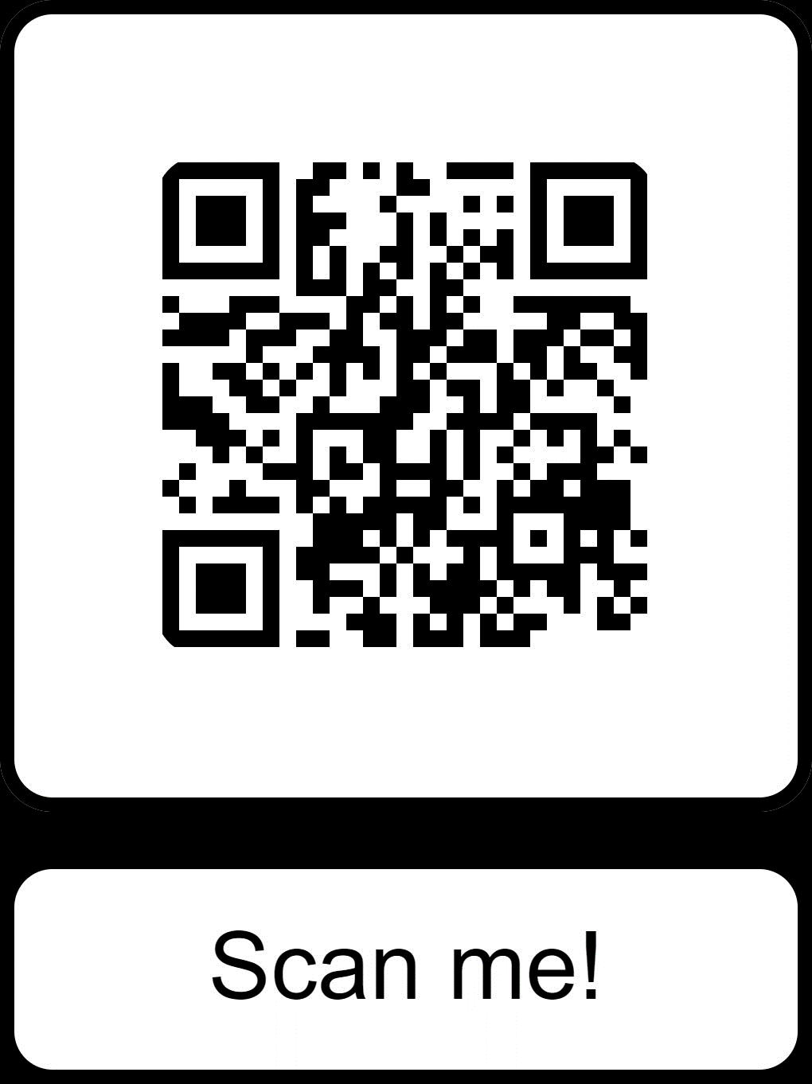
Parent page
https://www.littlewandlelettersandsounds.org.uk/resources/for-parents/

Slide 3
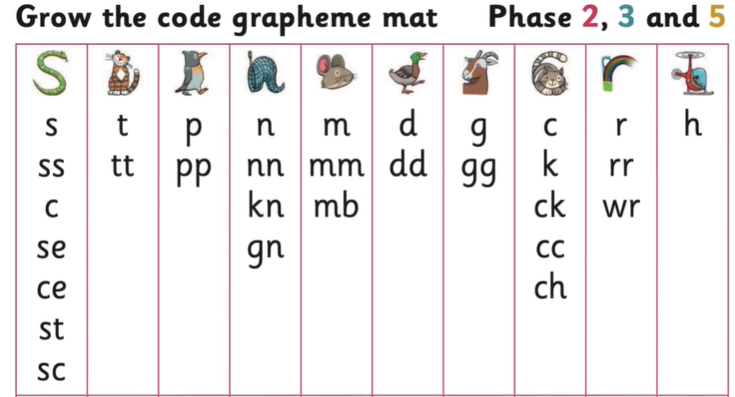
https://www.littlewandlelettersandsounds.org.uk/resources/for-parents/ Watch how we grow the code

Slide 4
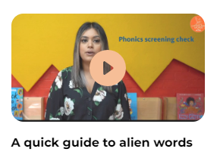
https://www.littlewandlelettersandsounds.org.uk/resources/for-parents/#tabnametabHowWeTeach

Slide 6
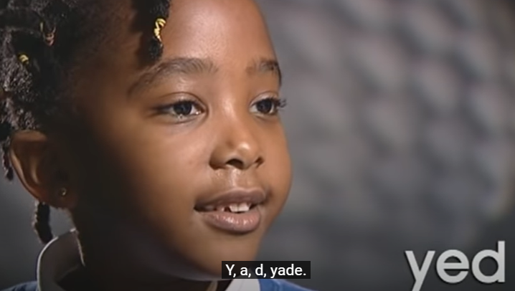
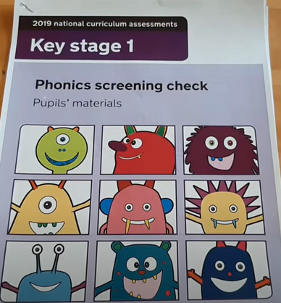
Phonics Screening Check during June
https://www.youtube.com/watch?v =IPJ_ZEBh1Bk
https://www.youtube.com/watch?v=urP7QkMSReg

Slide 7
https://www.littlewandlelettersandsounds.org.uk/resources/for-parents/#tabnametabBooksComingHome

