Slide 1
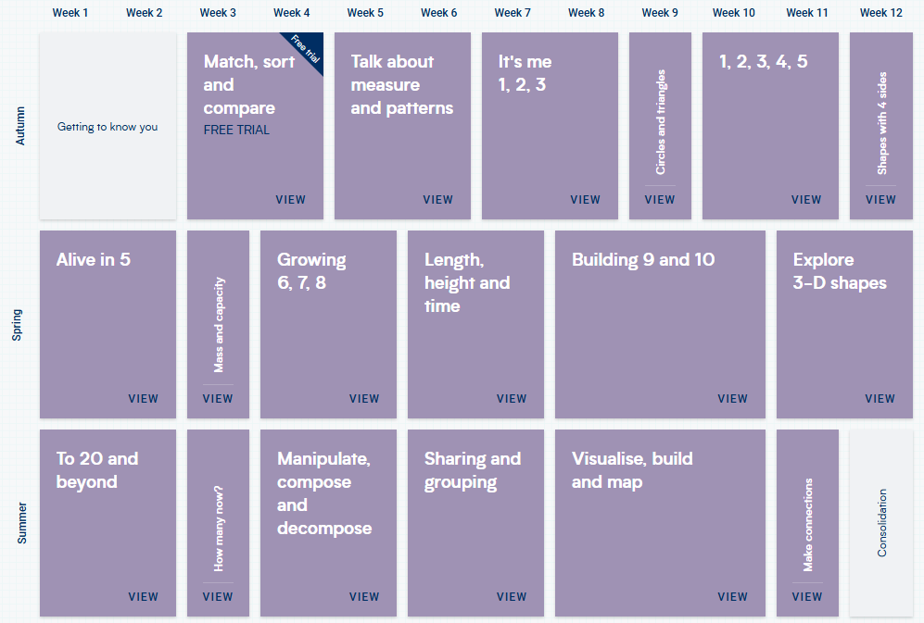
Reception

Slide 2
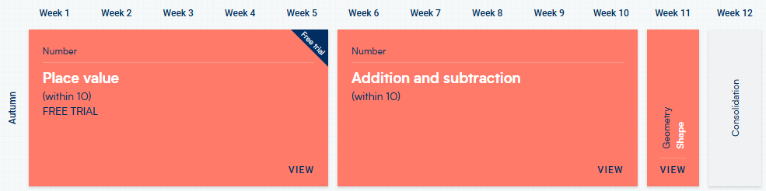
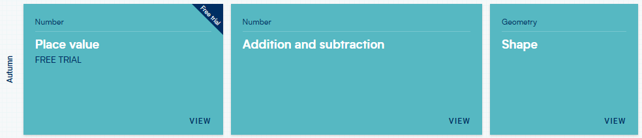
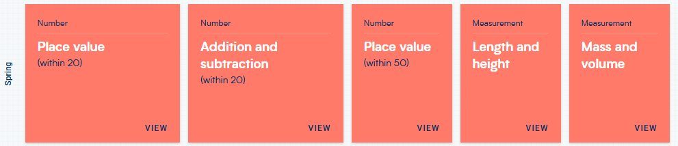
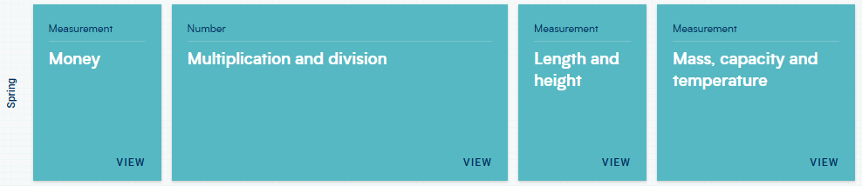
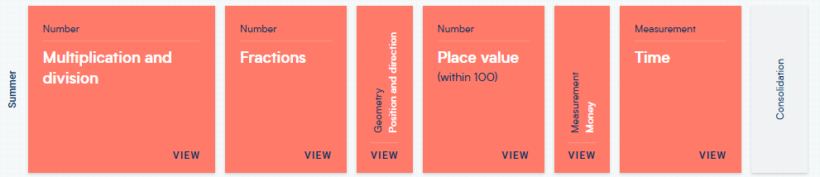
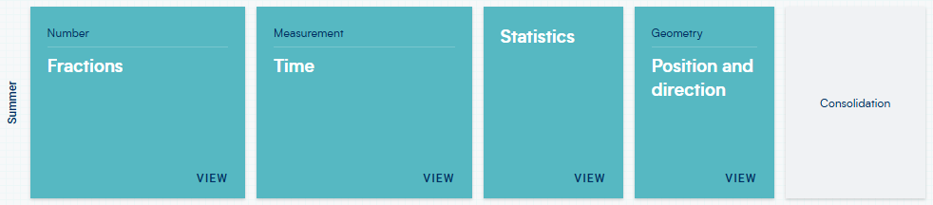
Year 1 and 2
1
2
1
2
1
2

Slide 3
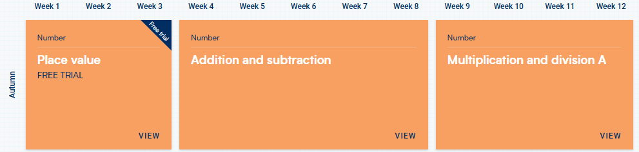
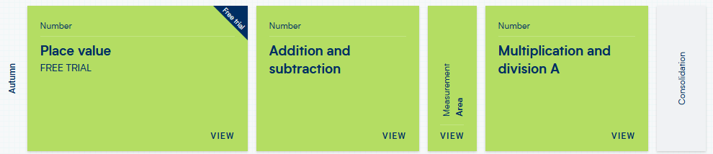
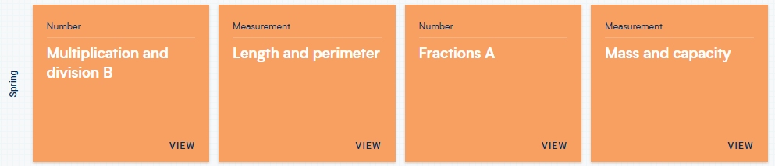
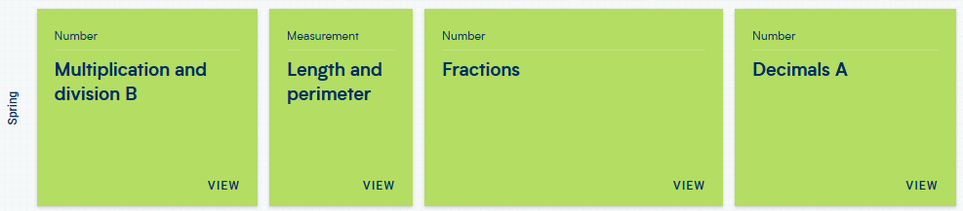
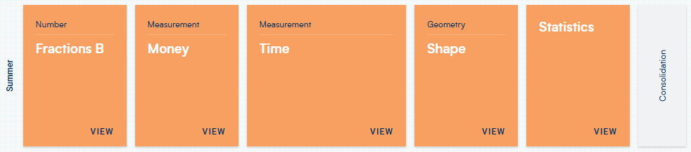
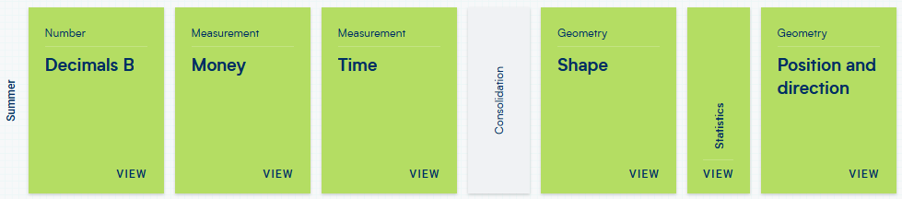
Year 3 and 4
3
4
3
4
3
4

Slide 4
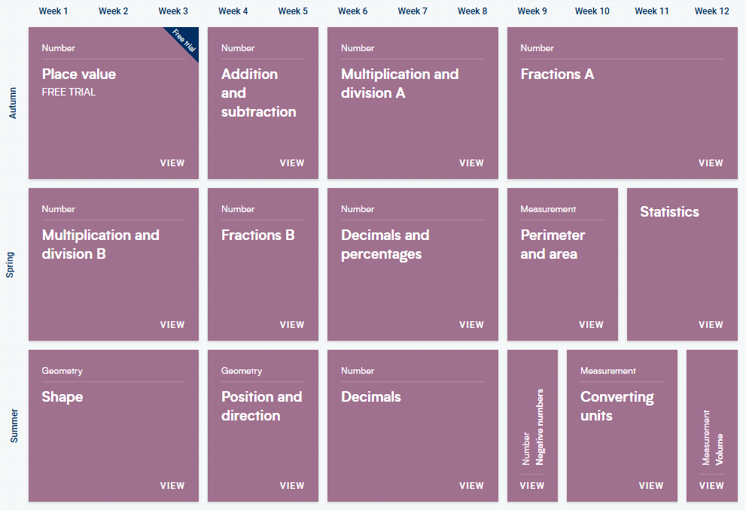
Year 5

Slide 5
Year 6
Week 1 | Week 2 | Week 3 | Week 4 | Week 5 | Week 6 | Week 7 | Week 8 | Week 9 | Week 10 | Week 11 | Week 12
Properties of Number |  | Compare, order and simplify fractions |  | Calculating with fractions |  |  |  |  | Place Value to 10 million | Multiply and divide by tens, hundreds or thousands | Order of operations
Calculation (written) |  | Converting decimals to fractions and calculating with decimals |  | Percentages |  | Ratio | Geometry – Properties of Shape |  | Geometry – Position and movement |  | Algebra
Area and perimeter | Volume | Converting Measures | Solving Worded Problems | SATs WEEK | Recap the four operations with whole numbers and decimals |  |  |  | Recap percentages, decimals and fractions

