Slide 1
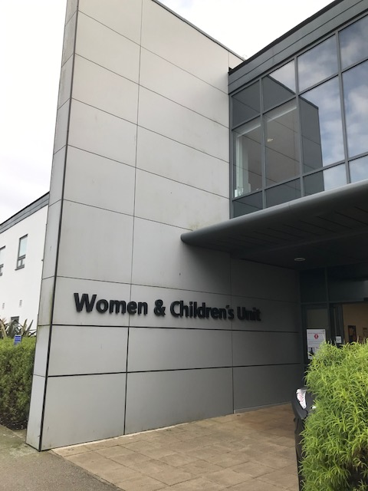
CASHER
During the current period, as an alternative/addition to our groups, 1:1 URGENT Support will be offered. Please ring the CASHER mobile to book an appointment
.
The Child & Adolescent Support & Help Enhanced Response Team
URGENT SUPPORT DURING CORONAVIRUS
PERIOD
Suitable for:
Children and young people aged under 16 who present with:
Anxiety/Depression
Feeling worried or upset
Low self-esteem/Low confidence
Need Advice/Someone to talk to?
Available 7 days a week
Please go online to 111.nhs.uk for advice about any Coronavirus symptoms. If you have symptoms and would like support around anxiety and your emotional health and wellbeing you can ring the CASHER phone number.
Please ring the CASHER team to arrange where to meet.
07810 696565
To book a place at this clinic, please contact the CASHER Team within their duty hours ( please leave a msg if necessary & we will contact you asap ):
07810 696565 Mon-Fri 5pm-10pm or Sat/Sun 10am-10pm. ( Bank holiday times can vary) …… please email :
bfwh.casher.team@nhs.net

