Slide 1
Federation of Boldmere Schools – Ofsted information briefing
Good evening and welcome.
Aims of the session:
- To answer, why are we leading this session?
- To provide appropriate information in relation to Ofsted inspections
- Provide information regarding the current Ofsted landscape of outcomes
- Provide information regarding school self evaluation currently
- Respond to questions and feedback

Slide 2
Why are we leading this session?
This is not something that we have to do, not a statutory requirement, but we feel it is good practice.
This session has been discussed with our FGB and arranged accordingly, as the FGB have 3 core functions:- a) Ensuring clarity of vision, ethos and strategic direction b) Holding the executive leaders to account for the educational performance of the organisation and its pupils along with the performance management of staff and c) Overseeing the financial performance of the organisation and making sure its money is well spent.
These core functions all play an important part in relation to Ofsted outcomes.
Both the infant and junior schools were last inspected in 2011 and the Schools Inspection handbook has changed dramatically since then, including the removal of ‘outstanding schools’ being exempt from inspection (from 13th November 2020). So the majority of our staff have no experience of Ofsted.
All formerly exempt schools will receive an initial graded inspection by July 2025 (Boldmere).
Ofsted expectations and outcomes have been raised significantly since our last inspection. So we felt it important to share this with the school community.

Slide 3
Key details
Ofsted’s ‘Schools inspection handbook’ is a statutory document that describes the main activities carried out during inspections of maintained schools and academies in England under section 5 and 8 of the Education Act 2005, and in accordance with the ‘Education inspection framework’ (EIF). It sets out the grade descriptors that inspectors use to make their judgements and is made available to schools to ensure they are informed about the process and procedures for an inspection.
From September 2022, there are four types of school inspection: graded, ungraded, urgent, and monitoring.

Slide 4
Part 1: How schools will be inspected
Part 1 of the ‘Schools inspection handbook’ contains information about the basics of inspection and the processes before, during and after inspections.
Graded inspections
A graded inspection uses the full framework and grades the school against the key judgement grade descriptors and overall effectiveness, as well as any relevant provision judgement.
Inspectors evaluate schools against the following key judgements:
Quality of education
Behaviour and attitudes
Personal development
Leadership and management

Slide 5
Part 1: How schools will be inspected
Risk assessment
To select schools for inspection and determine whether good and outstanding schools will receive an ungraded or graded inspection, Ofsted undertakes a desk-based review of relevant information pertaining to the school. (also the process between May 2012 and November 2020)
Due to the coronavirus (COVID-19) pandemic, the DfE data that is normally analysed was not collected in 2020 and 2021; therefore, 2019 data is continuing to be used. Data from 2022 will be used for risk assessment purposes when available.

Slide 6
‘Outstanding’ schools that were formerly exempt from routine inspections
All formerly exempt schools are now eligible for inspection and will receive an initial inspection by July 2025 as per the government remit to inspect all schools by this date
Schools that last had a graded inspection before September 2015 will receive an initial graded inspection.
Schools that last received a graded inspection after this date will receive an initial ungraded inspection.
If that ungraded inspection indicates that outstanding performance may not have been maintained, a graded inspection will normally be carried out within the next academic year or as soon as possible thereafter, though before 1 August 2025.

Slide 7
How Ofsted Works- Before the inspection
Notification and lead inspector’s preparation
To announce an inspection, Ofsted will normally contact a school by telephone between 10:30am and 2:00pm on the school day before the inspection. The inspector will speak to the headteacher or, if they are unavailable, the most senior member of staff available. The school will be asked to confirm information held about the provision, including:
The number of pupils on roll at the school.
The governance arrangements for the school.
Whether the school has any SEND provision, nursery provision for two- and three-year-olds, or additional resource provision.
The school will then be sent a letter setting out the key information for leaders to be aware of before the inspection and outlining a range of information be made available to inspectors by 8:00am the next day.

Slide 8
Seeking the views of parents, staff and pupils
When a school is notified of an inspection, leaders and those responsible for governance should take reasonable steps to inform all registered parents of registered pupils at the school, as well as any relevant bodies, including alternative provision (AP) providers, of the inspection.
Schools should note that, for graded inspections, they are required by law to take any reasonably practicable steps to notify the parents of registered pupils at the school.
Inspectors will review the evidence from Ofsted Parent View throughout the inspection and take into account any other evidence from parents, including the results of any past surveys the school has carried out or commissioned.
The views of pupils and school staff will be gathered through online questionnaires via links provided and should be completed by 3:00pm on the first day of the inspection.
Inspectors may also gather views from parents, pupils or other stakeholders in person, formally or informally.

Slide 9
Before the inspection
Preparatory telephone calls from the lead inspector to the headteacher
Once informed of the inspection, the lead inspector will contact the headteacher to conduct a preparatory telephone conversation (normally lasting around 90 minutes) consisting of:
A short inspection-planning conversation that focusses on practical and logistical issues.
A longer reflective, educationally-focussed conversation about the school’s progress since the last inspection, including how coronavirus has affected this.

Slide 10
The inspection
Graded and ungraded inspections will not normally last for longer than two days.The size of the inspection team will vary according to the size and nature of the school.
Inspectors will also carry out ‘Deep Dives’ always in reading (phonics), probably maths and at least 2 other subjects.
Inspectors will not arrive before 8:00am nor leave after 6:00pm on each day of inspection, except in exceptional circumstances.
Inspection methodology
The aim of inspection is to gather evidence on how a school’s activities deliver a high-quality education for its pupils and contribute to achieving the highest possible standards. Inspectors’ priority during inspections is to collect first-hand evidence.

Slide 11
The inspection
Inspectors will follow a three-part methodology to inspect schools receiving graded and ungraded inspections, comprising:
Pre-inspection.
On-site inspection activity.
Collation and evaluation of evidence.
Inspectors will focus on gathering a range of first-hand evidence via:
Meeting with and keeping leaders informed.
Meeting and observing ECTs (Early Career Teachers) and trainees.
Meeting those responsible for governance.
Other evidence, e.g. school records, documentation and information relating to the key judgments.

Slide 12
Specific matters for graded and ungraded inspections
Graded inspections
The handbook outlines two specific matters for schools to be aware of in relation to graded inspections:
Inspection of RE and collective worship
Inspection of the school’s approach to harmful sexual behavior
Providing feedback
The inspection will end with a final feedback meeting with school leaders in which the lead inspector will inform the school about the judgements made, the main findings of the inspection, any recommendations for improvement, the next steps after the inspection, and how to make a complaint about the inspection.

Slide 13
After the inspection
The lead inspector is responsible for writing the inspection report, the text of which should explain the judgements and reflect the evidence and be consistent with the feedback given to the school at the end of the inspection.
Reporting timeline
Schools will receive a draft inspection report within 18 working days.
They then have 5 working days to comment on the draft report.
Schools will receive the final report within 30 working days after the inspection.
Schools have 5 working days after the final report has been shared to make a complaint. If no complaints are submitted, Ofsted will publish the report on its website 3 working days later.
For graded inspections, once a school has received its final report, it is required to take reasonable steps to ensure that every parent of a registered pupil at the school receives a copy of the report within 5 working days.
After that time, the report will normally be published on Ofsted’s website.

Slide 14
Part 2: Explanation of Ofsted’s judgements
Part 2 of the handbook sets out how Ofsted will evaluate schools on the two most common types of inspection – graded and ungraded inspections.
Inspectors will evaluate schools against the following four key judgements:
Quality of education
Behaviour and attitudes
Personal development
Leadership and management
Schools should note that there are differences of approach and application for both types of inspection. The ‘evaluating the quality of education’ section applies to both graded and ungraded inspections, whereas the other judgement sections are split into specific graded and ungraded inspections sections.
In ungraded inspections, the purpose of inspection is to confirm whether a school remains good or outstanding under the definition of overall effectiveness set out in the grade descriptors in Part 3 of the handbook. These differ from graded inspections, where inspectors make an overall effectiveness judgement, as well as the other four key judgements set out in Part 3.

Slide 15
Part 2: Explanation of Ofsted’s judgements
Alongside an explanation of how Ofsted evaluate the four key judgements and the activities inspectors may undertake, Part 2 also covers how the inspection framework will be applied in relation to:
The teaching of early reading in infant, junior, primary and lower-middle schools.
The teaching of mathematics.
Maintained nursery schools.
Junior, middle and studio schools, and university technical colleges.
Special schools and mainstream schools’ provision for pupils with SEND.
PRUs and academy AP.
Evaluating early years and sixth form provision.

Slide 16
Current Ofsted ‘landscape’
https://schoolsweek.co.uk/four-in-five-outstanding-schools-lose-top-ofsted-grade/#:~:text=And%20in%20July%2C%20Schools%20Week,'%20than%20non%2Dselective%20schools.
Four in five ‘outstanding’ schools lose top Ofsted grade

Slide 17
School Self Evaluation
Mrs Kenny and Mr Sadler.
‘Good is the new outstanding’

Slide 18
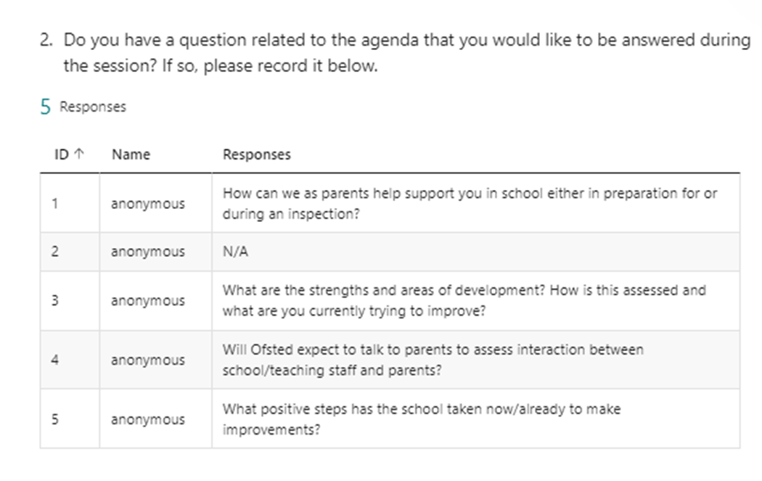

Slide 19
Thanks for listening.
Any further questions?
Feedback

