Slide 1

Finchampstead C of E (Aided) Primary School
SEND Information Report 2026-2027
Head Teacher – Mrs Jacquie Vanstone
SENCo – Miss Laura Thurston
To be updated September 2027
‘This is the day that the Lord has made, let us rejoice and be glad in it’

Slide 2

Our School
Finchampstead C of E is a “small, friendly school with a big heart” (Ofsted 2025). With capacity of just 119 children, staff quickly build strong relationships with each individual pupil and friendships blossom across year groups.
The school is set up voluntarily by the Church of England and we have close connections with St James’ Church in Finchampstead.
Our school ethos is based on our 6 values:
Thankfulness
Hope
Friendship
Forgiveness
Honesty
Compassion

Slide 3
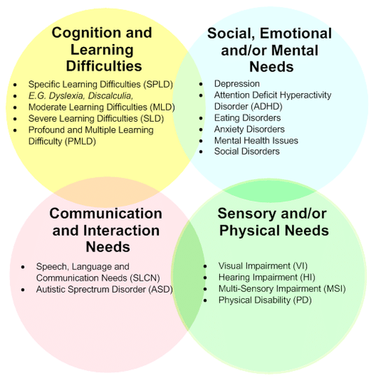




What needs can be met at our school?
At Finchampstead C of E Primary School, we embrace the fact that every child is unique and pride ourselves in supporting children with a variety of needs.
According to the SEND code of practice 2015, children’s special educational needs are generally thought of in the following four broad areas:

Slide 4


What is Ordinarily Available Provision?
Ordinarily Available Provision (OAP) is a guide we – and all local schools - receive from Wokingham Borough. It outlines inclusive provision and support that schools in Wokingham Borough are expected to implement from within their own resources for all learners.
It underpins the principle that enables an inclusive learning environment to be established so that every child can succeed.
Our aim at Finchampstead C of E Primary school is to create a culture of the ordinary where no child feels different. This inclusive approach is available to all pupils and is often most effective when built into everyday classroom practice.

Slide 5
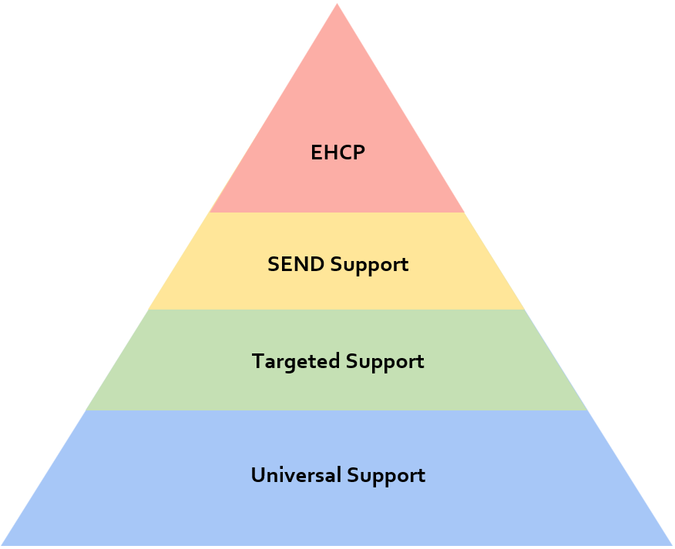
What is Ordinarily Available Provision?
We follow a graduated approach which helps us to determine the support each child receives.
Ordinarily Available Provision encompasses both Universal and Targeted support.

Slide 6



Ordinarily Available Provision:
Universal Support
This is available every day to every learner.
Examples include:
Learning environment | Sensory aids e.g., wobble cushions, fidget tools
Predictability and preparation for change | Low sensory environment
Seating arrangements | Consistent and explicit boundaries
Sense of belonging | Sensory aids e.g., wobble cushions, fidget tools
Pedagogical Principles | Sensory aids e.g., wobble cushions, fidget tools
Chunking instructions | Explicit modelling
Effective questioning | Repeating instructions and allowing for processing time
Pre-teaching vocabulary | Scaffolding/ sentence starters
Visual Approaches | Sensory aids e.g., wobble cushions, fidget tools
Visual scaffolds e.g., word webs | Whole class visual timetable
Labelling resources pictorially | Visual reminders/ cues

Slide 7
Ordinarily Available Provision:
Targeted Support
These are marginally more targeted and may not be required all the time. They are reasonable adjustments to those who need the provision.
Examples include:
Learning environment | Sensory aids e.g., wobble cushions, fidget tools
‘Now Next’/ ‘Now Then Next’ boards | Additional prompting
Small group work
Pedagogical Principles | Sensory aids e.g., wobble cushions, fidget tools
Overlearning and consolidation | Language/ communication boards e.g., ‘Can I tell you board’
Tweaks to lessons to gain personal interest and engagement | Intervention support
Visual Approaches | Sensory aids e.g., wobble cushions, fidget tools
Individual visual reminders | Individual visual timetable

Slide 8
Beyond Ordinarily Available Provision
How do we identify children with special educational needs?
If ordinarily available provision is not providing sufficient support to enable progress, then further investigations into Special Educational Needs (SEN) support may be required.
We will identify these children in a variety of ways, including:
It is important to note, we may not identify a child as having SEN just because they are making slower progress or receive a low test score; we will be curious and consider other factors alongside continuous monitoring and assessment.
Concerns raised by class teacher | Parents sharing concerns
Low attainment and/ or lack of progress in reading, writing or maths | Observations by SENCO, Head Teacher or other staff
Information from health visitors or previous settings (e.g., nursery) | Information from other professionals (e.g., Educational Psychologists, Speech and Language assessment etc.

Slide 9
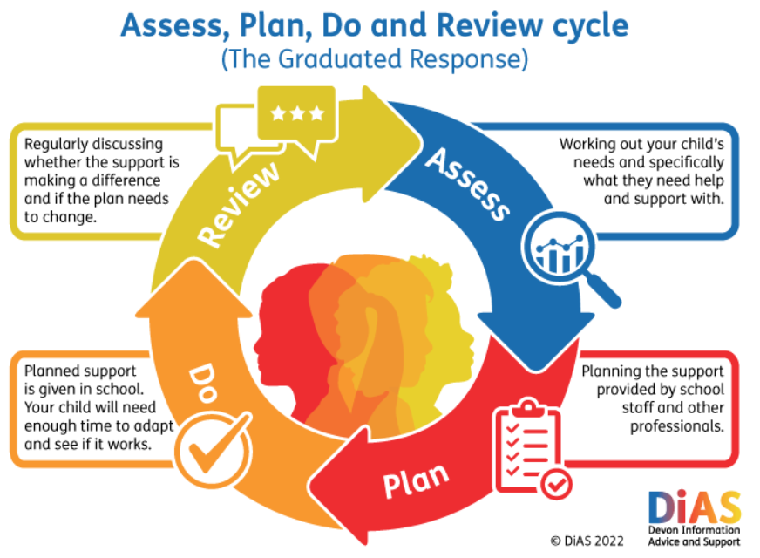
Beyond Ordinarily Available Provision:
SEND Support
Children who have been identified as having a special educational need will be put on a SEND Support Plan (SSP).
This is a written, working document created by school and follows the ‘Assess, Plan, Do and Review’ cycle every term.
It is important to note, a child with a diagnosis (e.g., autism, ADHD etc.) does not automatically go onto a SSP. We are needs led rather than diagnosis led and often children with diagnosis’ can make progress under our ordinarily available provision. They will, however, be placed on our monitoring list.

Slide 10

Beyond Ordinarily Available Provision:
EHCP
On rare occasions, a child may still not be making sufficient progress despite additional support through implementing an SSP.
At this stage, it may be decided that an Education, Health and Care Plan (EHCP) should be applied for. Applications are made to the local authority (Wokingham) who will consider all the evidence submitted; it is their decision whether a plan is to be granted.
An EHCP brings together information about a child or young person’s educational, health and social care needs and sets out the additional support and provision that they require to help them make progress.

Slide 11




What professionals do we work with?
The school is able to work collaboratively with other professionals and access a variety of services. Reasons for this vary greatly, depending on the area and level of need.
Below are some examples of who we have worked with recently:
Referrals to these services are subject to their own guidelines and time frames.
Educational Psychologist | Learning Support Services
Foundry College | CAMHS
Addington Outreach | Speech and language therapists
Educational Welfare Service | The Grove

Slide 12
How do we support transitions?
We recognise that transitions can lead to a mixture of emotions; it can be an exciting time exploring new settings and friendships but with this can bring high levels of anxiety, particularly those with special educational needs. A robust transition plan can help ease these worries, creating familiarity, predictability and awareness of new environments.
Starting Reception (EYFS)
Class teacher visits the children in their current setting (pre-school, nursery or childminder) and gathers information from the setting staff
An information evening with parents/ carers, giving an opportunity to find out more about the school, meet staff, ask questions and socialise with other parents/ carers
The children are invited to two sessions at school – one with parents/ carers and one without
An individual transition plan if required (e.g., extra visits, transition booklet etc.)

Slide 13
How do we support transitions?
Moving between classes
Two transition sessions to spend time with their new teacher(s)
An individual transition plan if required (e.g., extra visits, transition booklet etc.)
Moving to secondary school
Each secondary school will have their own plan that they follow however this usually involves staff visiting the primary school to meet the pupils and to gather information from the current class teacher
The secondary SENCO usually meets with the primary SENCO for those with an EHCP
Extra transition sessions for those with special educational needs
An individual transition plan can be put in place if required (e.g., extra visits, transition booklet etc.)

Slide 14



Support for parents/ carers
Who? | What? | Where?
 | Free, confidential and impartial advice/ support for those with SEND. | https://www.sendiasswokingham.org.uk
 | An independent group of parent carers of children and young people with SEND. | https://www.sendvoiceswokingham.org.uk/Voices Wokingham
 | A family support service for children who have an autism diagnosis or are waiting for an assessment. | assist@wokingham.gov.uk

Slide 15

Compliments and complaints
We hope any concerns can be quickly resolved and we warmly welcome any positive feedback too. Your child’s class teacher is the first point of call. It may be beneficial to meet with the SENCO too.
Please contact Mrs Vanstone if your concerns are yet to be resolved who will be happy to help.
Our complains policy can be found on our website.

Slide 16

Contact details
Finchampstead CofE Primary School
The Village
Finchampstead
Wokingham
RG40 4JR
0118 9732166
admin@finchampstead.Wokingham.sch.uk

