Slide 1
Welcome to Chaffinch Class
Year 3 and 4
Mrs Baker: Class Teacher
Miss Knox: Class Learning Support Assisstant
Mrs Coulson and parental volunteers in the afternoons
Sports Coach – Mr O’Reilly ( Monday & Wednesday)

Slide 2
Equipment
PE kit Monday, Wednesday and maybe extra days
Art shirt or apron Fridays or when advised
Reading book and reading record in school every day – children to hand in on Thursday
School water bottle in school every day – (not metal)
Healthy snack – fruit or veg only please.
We provide, pens, pencils etc. so there’s no need for a pencil case. We are always very thankful for class donations of glue sticks which seem to disappear!

Slide 3
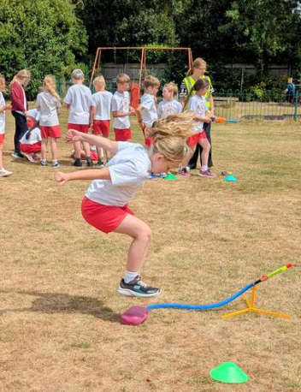
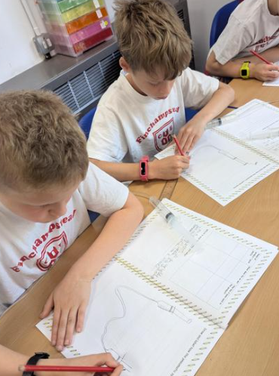
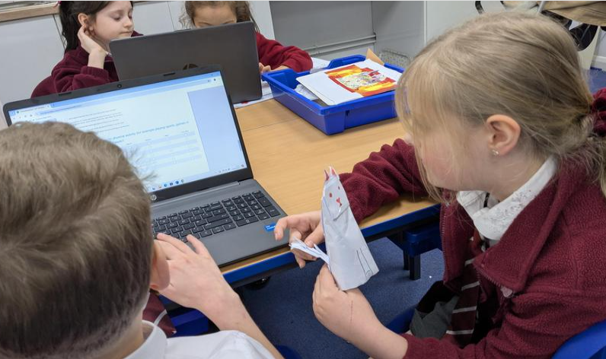
Chaffinch Curriculum and updates - school website
We often share photos of our learning and have copies of the spelling lists etc on our class page. https://www.finchampsteadschool.org/

Slide 4
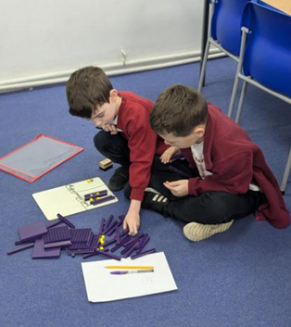
Times tables – Y4 statutory assessment
Statutory Assessment in June 2027
Up to 12 x 12
Accuracy and recall speed
Keyboard fluency
Focus in school and at home
Practice ideas on school website

Slide 5
Reading Challenge
Please see separate presentation

Slide 6
Home learning expectations
Children should read regularly and record in the reading record at least 4 times a week
Spellings are tested each Monday. The termly overview of spellings and dates is sent home at the start of term and available on the class page.
Multiplication regular practice – ideas and links etc. are on the class page.
We also set optional challenges to engage children in the term's learning and extend their interest.

