Slide 1
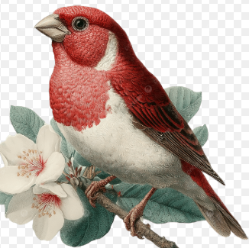
Welcome to Rosefinch Class
Reception and Year 1
Adults working with Rosefinch class:
Mrs Crowe: Monday
Mrs Paterson: Tuesday -Friday
LSA Support:
Miss Remmington: Monday – Friday
Mr Lam- 1-1 support
Sports coach – Mr O’Reilly ( Tuesday afternoon)

Slide 2
Equipment
Children will be provided with most things that they need for their learning.
Each day they should bring:
Their plastic water bottle with a sports cap lid - no metal bottles please
A healthy snack for break time (it’s a long time to 12.10pm) - fresh fruit or veg only please. This will help them to concentrate for longer in the morning.
Their packed lunch, or their pre-ordered school lunch
Their coloured wallets – every day
PE Kit should be worn on Tuesdays and Thursdays

Slide 3
Daily Routines
8.40-8.50am – doors open
9.00am – Learning activities
10.00am - collective worship
10.20am - break
10.35 - learning activities
12.10 pm -- lunchtime
1.10 pm –afternoon learning activities
3.15pm - children should be collected from the playground door.
.

