Slide 1
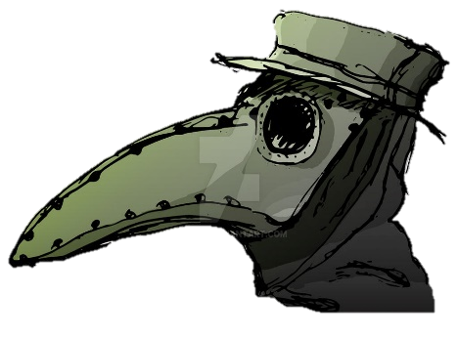
Please bring your homework in to show to the class on the last week of half term so that we can share and celebrate all of your hard work!
The Great Plague
Fleetwood’s Charity Primary School
Homework Menu
Willow Class – Autumn 2
Weekly Activities
Reading | Read to an adult or independently for 15 minutes each day; this could be a story book, newspaper, recipe or even a comic!
Spelling | Spellings will be set weekly to practise on Spelling Shed; practise for 10 minutes, 3 times a week.
Times Tables | Times tables will be set on Times Tables Rockstars weekly; practise for 10 minutes, 3 times a week.
RE:
This half term we are looking at Christmas and how Jesus is the Light of the World. Can you create something that represents light that we could hang on our Christmas tree? Think about candles, bulbs, the sun, even Jesus!
Science
Your challenge this half term is to find as many objects around your house that make noise. Create a mind map or a list to show this. Tell me whether the object makes noise naturally or whether it needs to be hit against something etc.
History
This half term, our History topic is The Great Plague. Once we have had our first few lessons, can you create a poster to warn people of the Plague? Think about what symptoms they might need to look after, and think about what they can do to try to avoid it.
Nativity
Please make sure you are practising your lines and the songs, our performance will arrive before we know it!

