Slide 1
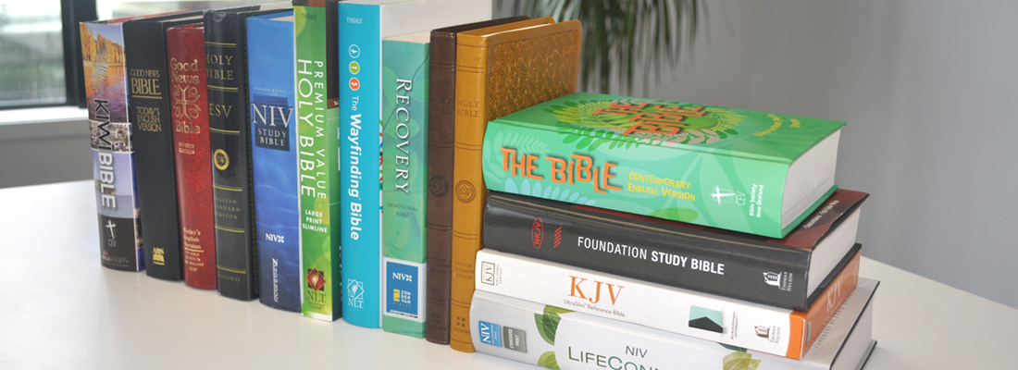
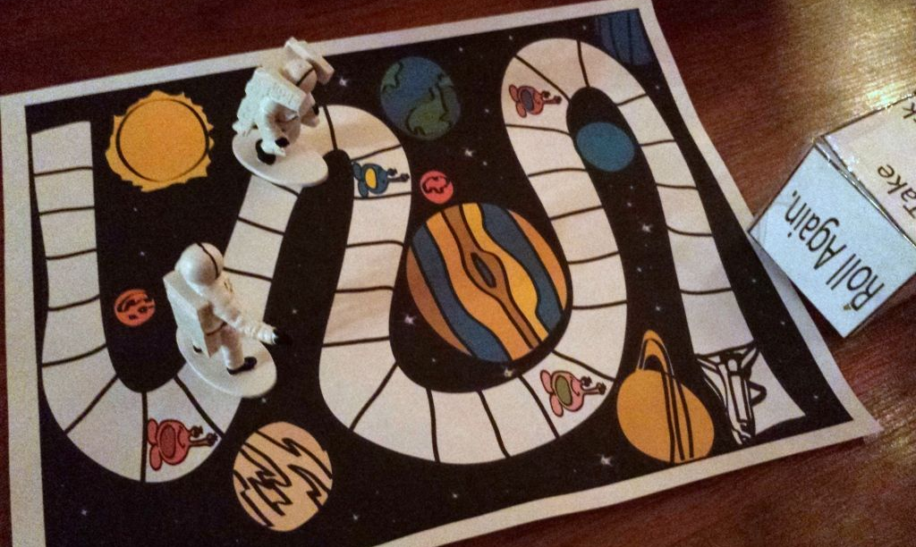
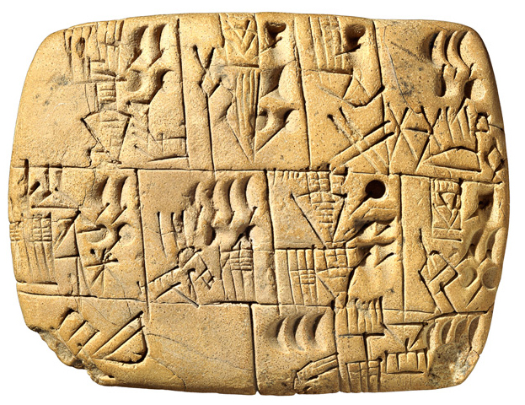
Please bring your homework in to show to the class on the last week of half term so that we can share and celebrate all of your hard work!
To Infinity and Beyond
Fleetwood’s Charity Primary School
Homework Menu
Maple Class – Autumn 1
Weekly Activities
Reading | Read to an adult or independently for 15 minutes each day; this could be a story book, newspaper, recipe or even a comic!
Spelling | Spellings will be set weekly to practise on Spelling Shed; practise for 10 minutes, 3 times a week.
Times Tables | Times tables will be set on Times Tables Rockstars weekly; practise for 10 minutes, 3 times a week.
RE
Have a look around your house or the library. How many different versions of Bible can you find? Write down their names.
Science
Using your new knowledge about Earth and Space, create a fun board game to show off your knowledge or test the knowledge of your friends.
History
Using the Ancient Mesopotamian alphabet (on the next page), write your name or a message for a friend or family member to translate!
Art
Research the artwork of Wassily Kandinsky. Look at the different types of lines and shapes he uses in his work. Using a pen, pencil or even 2Paint (on Purple Mash) create your own picture inspired by his work.

Slide 2
