Slide 1
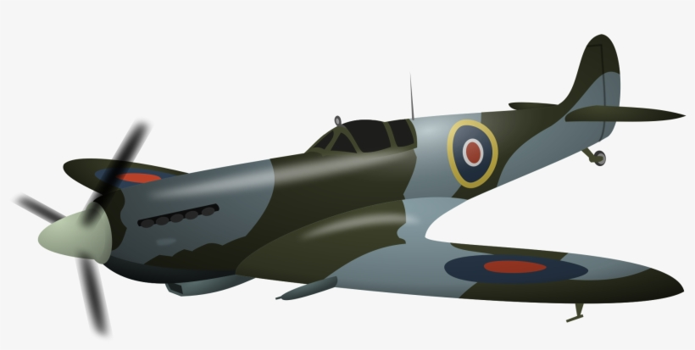
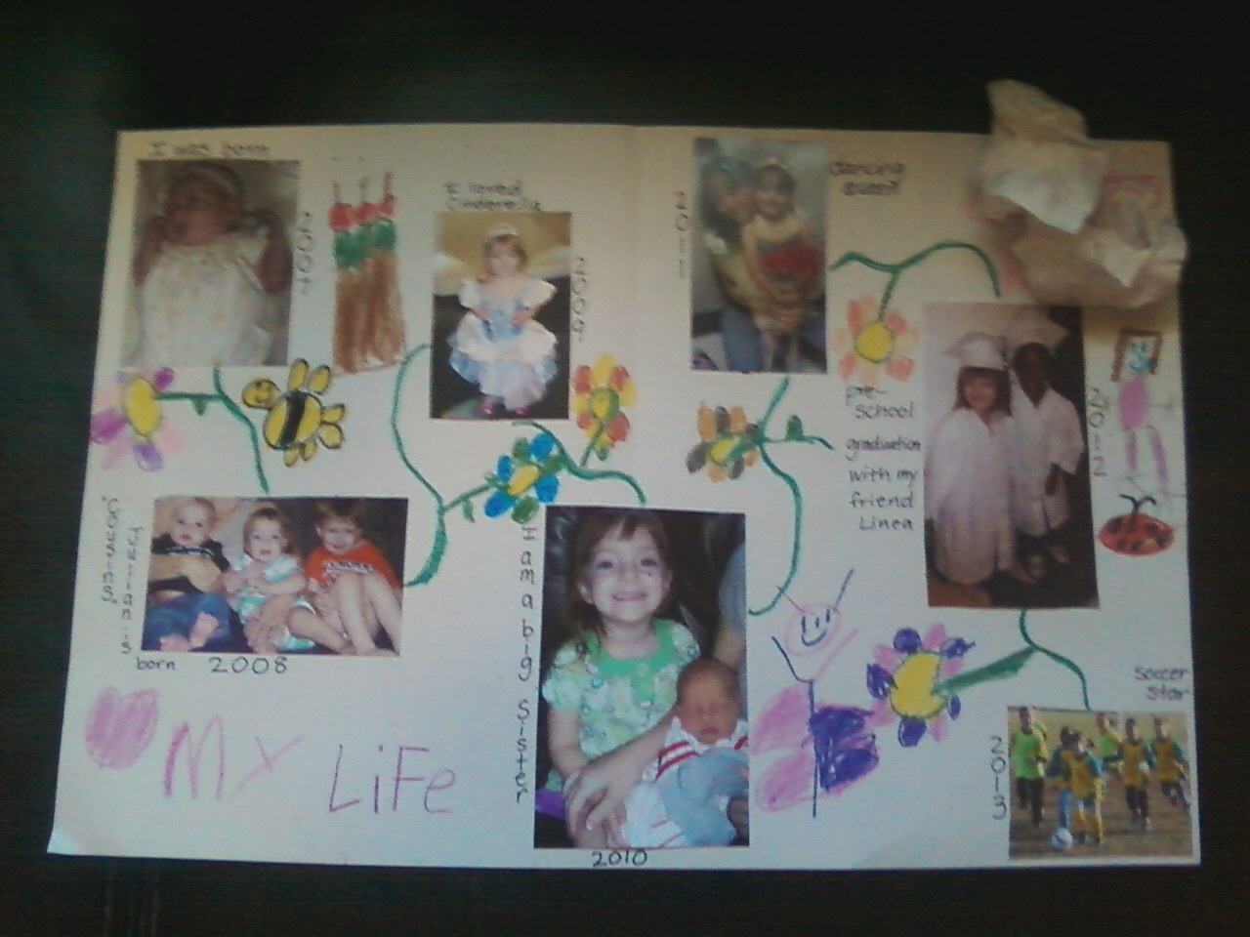
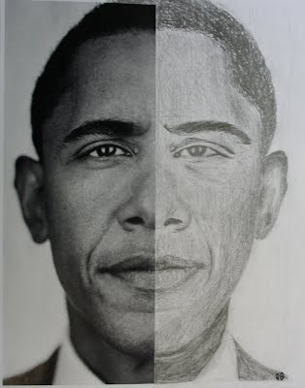
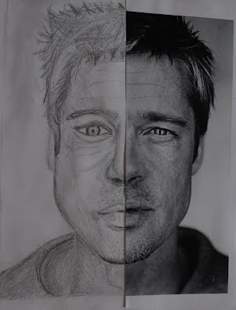
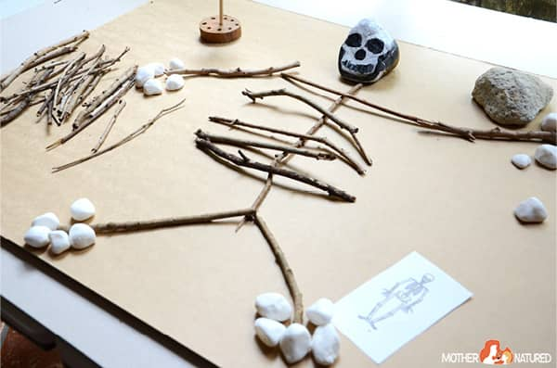
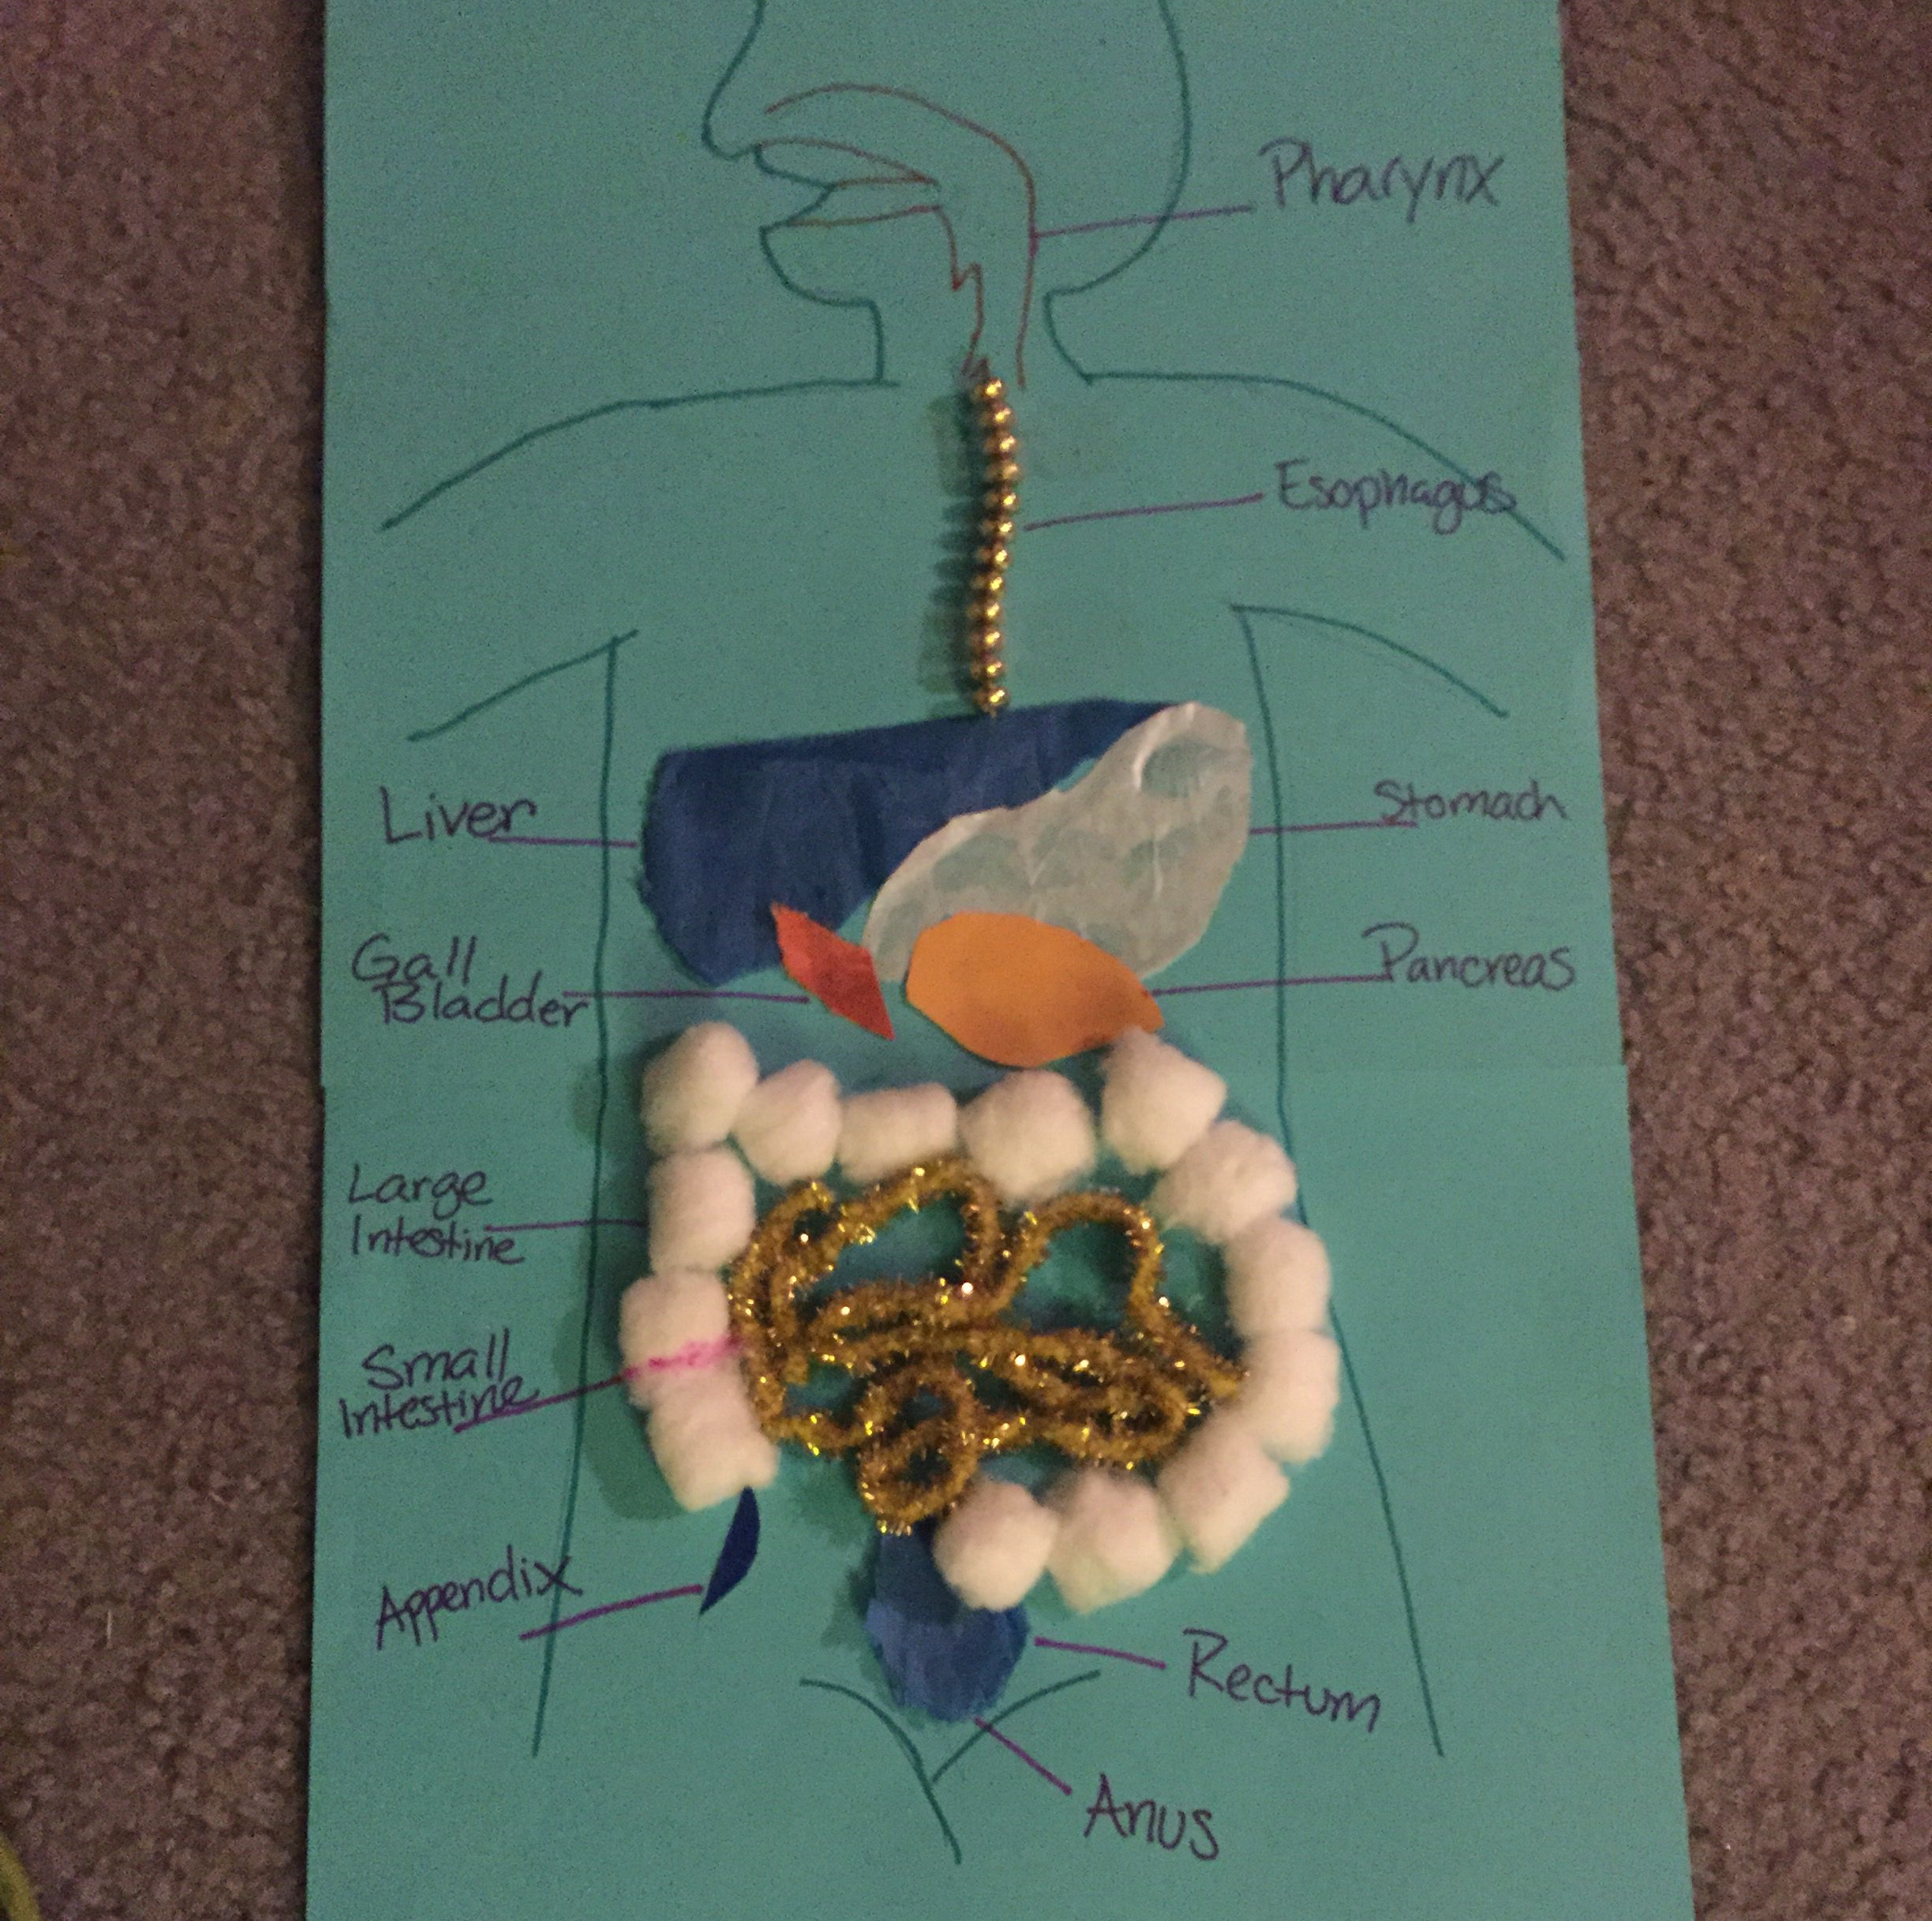
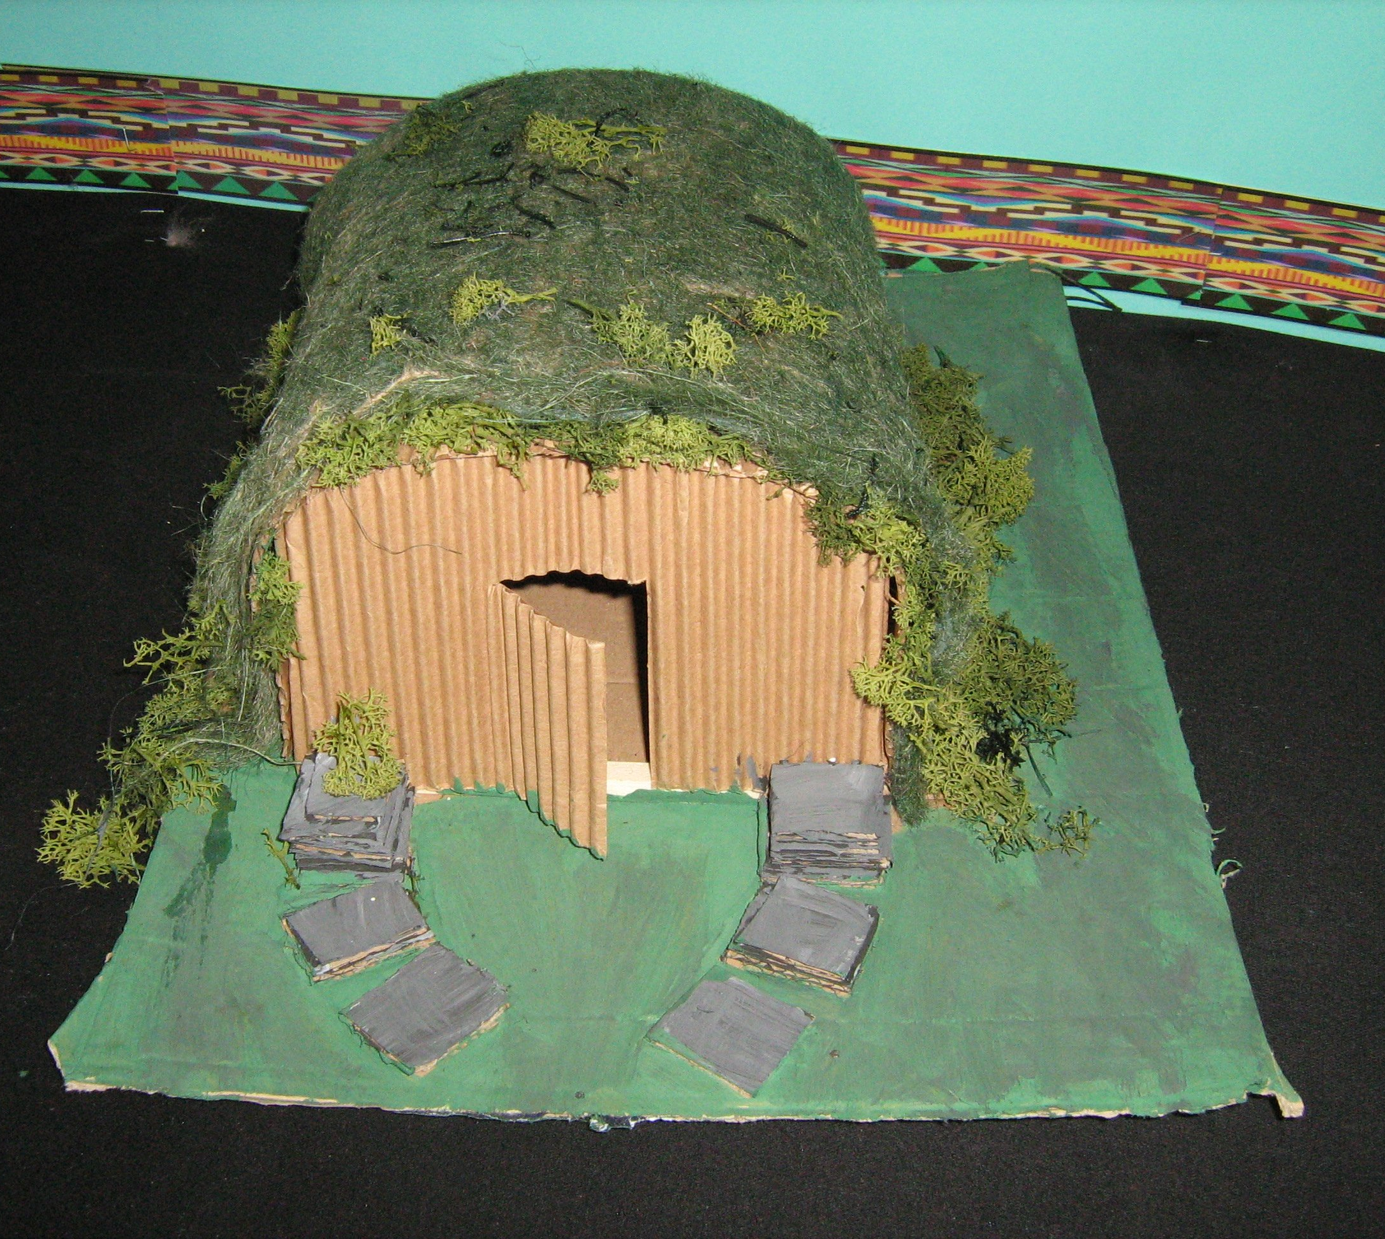
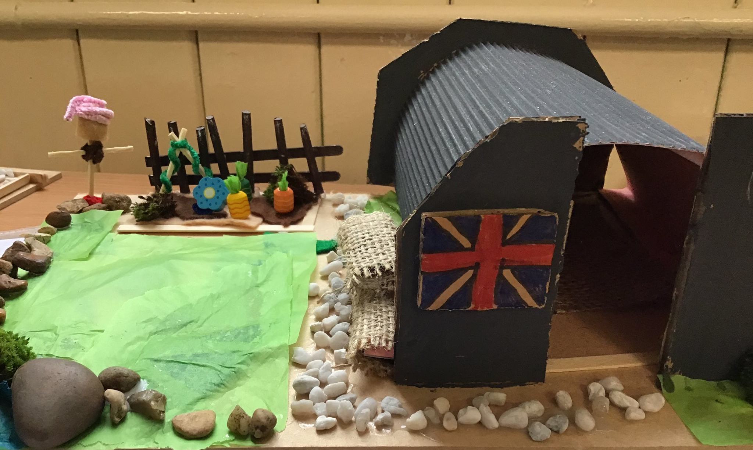
Fleetwood’s Charity Primary School
Homework Menu
Elm Class – Autumn 1
World War 2
RE
In RE we are exploring the concept of ‘Life is a Journey’. Create a timeline of your own life using pictures of yourself from being a baby all the way to now.
Weekly Activities
Reading | Read to an adult or independently for 15 minutes each day; this could be a story book, newspaper, recipe or even a comic! Don’t forget to fill in your reading record.
Times Tables | Times tables will be set on Times Tables Rockstars weekly; practise for 10 minutes, 3 times a week.
Science
In science we are learning about the circulatory system. Use natural resources to recreate any of the human body systems (e.g. skeletal, circulatory, digestive).
Art
In art we are looking at the skills needed to draw a realistic portrait. Draw the other half of the WW2 portrait provided in your homework book.
History
In history we are learning about WW2. Research and create your own Anderson bomb shelter using materials of your choice.

