Slide 1
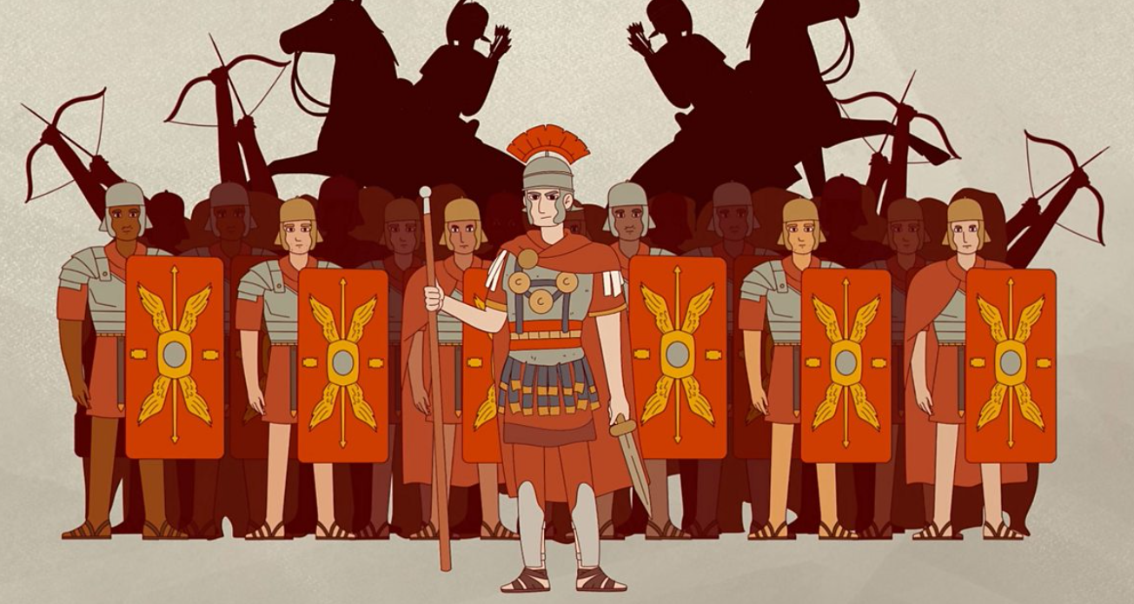

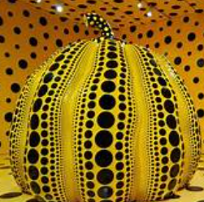


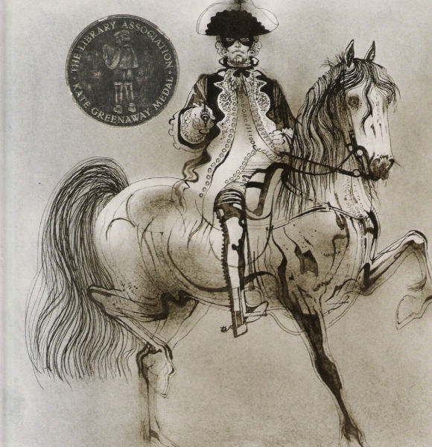
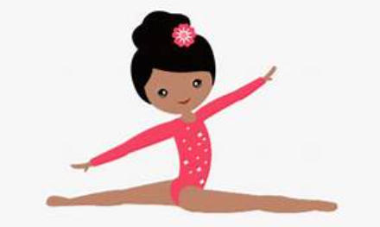
Fleetwood’s Charity Primary School
Homework Menu
Maple Class – Autumn 1
Please bring your homework in to show to the class on the last week of half term so that we can share and celebrate all of your hard work!
Weekly Activities
Reading | Read to an adult or independently for 10 minutes each day; this could be a story book, newspaper, recipe or even a comic!
Spellings | Practise the Common Exception Words (CEW) which you are still unsure of. Read and write these trying to apply them in sentences too.
Times Tables | Continue to learn your times tables up to 12 x 12-use TTRS or Topmarks ‘hit the button’.
Art
Using inspiration from Yayoi Kusama, create your own ‘dot art’ painting or sculpture.
PE
Using outdoor space, have a go at applying some of the skills you have been learning in gymnastics to create a gymnastics routine.
History
https://www.historyskills.com/classroom/ancient-history/roman-food-and-drink/
Use the above site to learn about the typical Roman diet, use this information to make your own Roman meal (with adult supervision).
DT
English
This half term we are focusing on poetry based on ‘The highway man’.
Have a go at writing your own poem based on a villain or thief!

