Slide 1
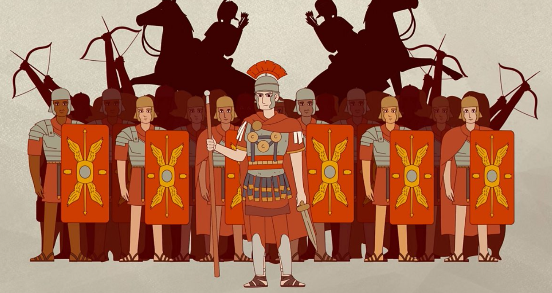



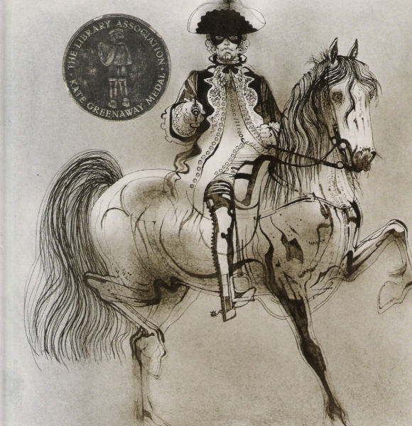
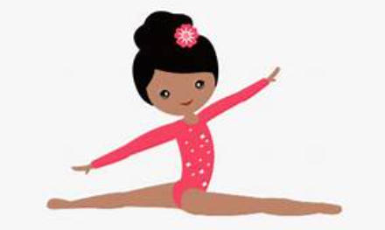
Fleetwood’s Charity Primary School
Homework Menu
Willow Class – Autumn 1
Please bring your homework in to show to the class on the last week of half term so that we can share and celebrate all of your hard work!
Weekly Activities
Reading | Read to an adult or independently for 10 minutes each day; this could be a story book, newspaper, recipe or even a comic!
Spellings | Practise the Common Exception Words (CEW) which you are still unsure of. Read and write these trying to apply them in sentences too.
Times Tables | Continue to learn your times tables up to 12 x 12.
Science
In science we are learning all about rocks. Create a poster including facts and showing examples of how different rocks are used. For example, slate is often used to make walls and on the roofs of buildings.
PE
Using outdoor space, have a go at applying some of the skills you have been learning in gymnastics to create a gymnastics routine.
History
https://www.historyskills.com/classroom/ancient-history/roman-food-and-drink/
Use the above site to learn about the typical Roman diet, use this information to make your own Roman meal (with adult supervision).
DT
English
This half term we are focusing on poetry based on ‘The Colour Collector’.
Have a go at writing your own poem!

