Slide 1
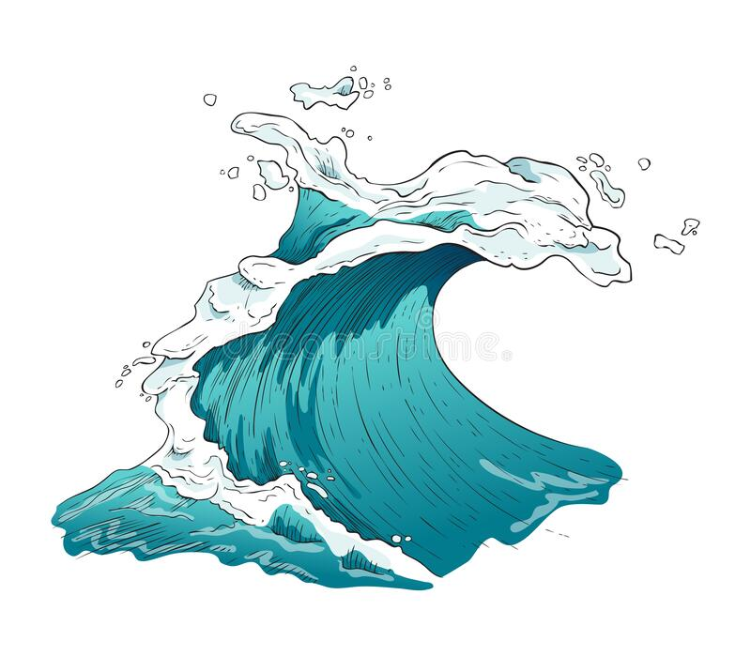
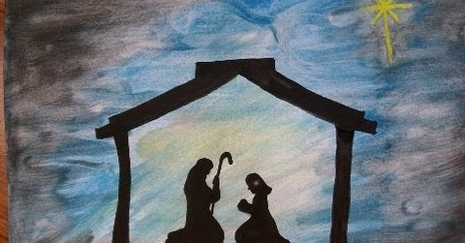
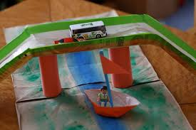
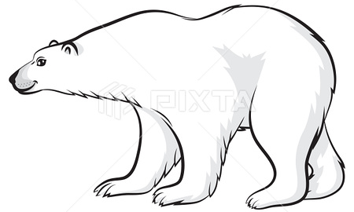
Please bring your homework in to show to the class on the last week of half term so that we can share and celebrate all of your hard work!
Raging Rivers
Fleetwood’s Charity Primary School
Homework Menu
Elm Class – Autumn 2
RE
This half term we are going to be learning about advent as we are approaching Christmas. Can you create a piece of artwork showing a scene of your choice from the Christmas story?
Weekly Activities
Reading | Read to an adult or independently for 15 minutes each day; this could be a story book, newspaper, recipe or even a comic!
Times Tables | Times tables will be set on Times Tables Rockstars weekly; practise for 10 minutes, 3 times a week.
Science
In science we are learning about how animals adapt to help them survive in different places. Make a fact file about an animal of your choice and describe the way it has adapted to survive where it lives.
Geography
In geography we have been learning about rivers. Use the sheet in your homework book to help you create your own river and observe what happens when you shake it up and make waves.
Design and Technology
In DT we are going to be building bridge structures out of wood. Can you build a bridge structure using a different material e.g. clay, newspaper etc.

