Slide 1
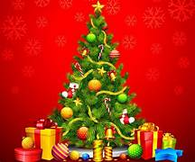

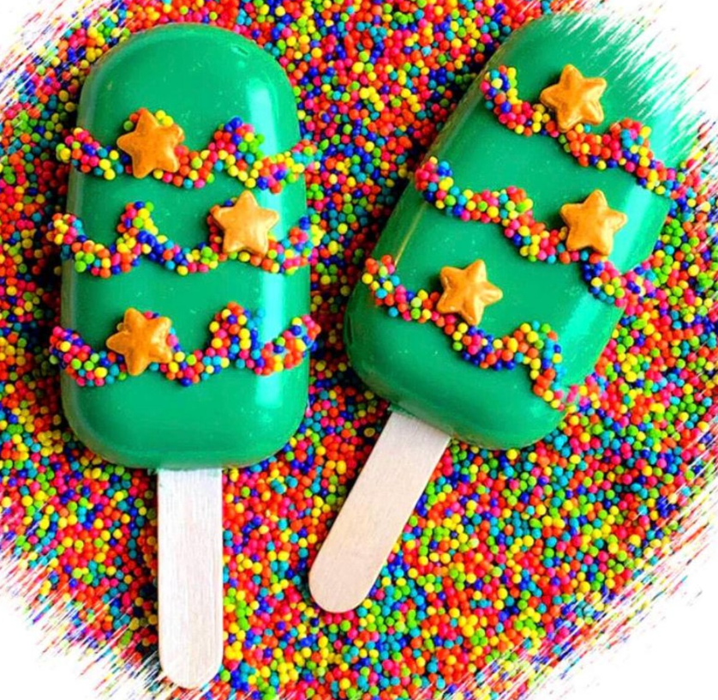



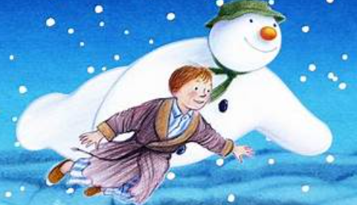

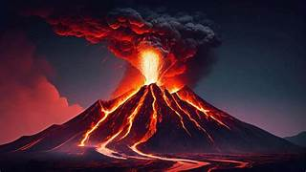
Fleetwood’s Charity Primary School
Homework Menu
Maple Class – Autumn 2
Please bring your homework in to show to the class on the last week of half term so that we can share and celebrate all of your hard work!
Weekly Activities
Reading | Read to an adult or independently for 10 minutes each day; this could be a story book, newspaper, recipe or even a comic!
Spellings | Practise the Common Exception Words (CEW) which you are still unsure of. Read and write these trying to apply them in sentences too.
Times Tables | Continue to learn your times tables up to 12 x 12-use TTRS or Topmarks ‘hit the button’.
DT
Research further existing festive treats. Design, make and create packaging for your own brand and product.
PSHE
This half-term we are learning about ‘valuing differences’-use what you have learnt in our PSHE lessons to create a song/dance celebrating to celebrate diversity. This could be shown in class or sent via dojo as a video.
Geography
Create a leaflet or poster showing your understanding of volcanoes/earthquakes. Consider where they might happen and the impact they have!
English
This half term we are focusing on ‘The Snowman’ by Raymond Briggs.
Have a go at writing your own magical story using descriptive language and exciting ways to open your sentences!

