Slide 1
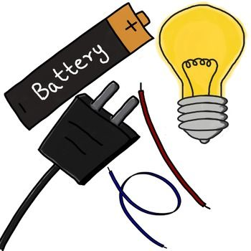
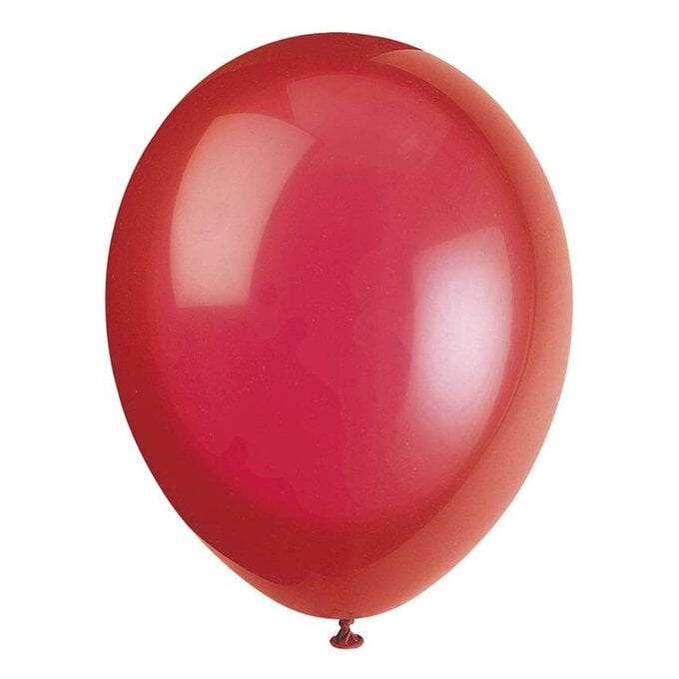
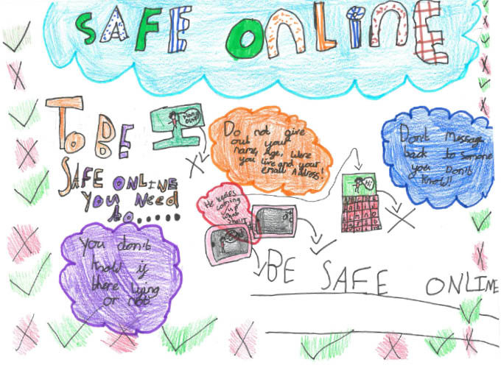
Fleetwood’s Charity Primary School
Homework Menu
Elm Class – Spring 1
Please bring your homework in to show to the class on the last week of half term so that we can share and celebrate all of your hard work!
Electricity
Weekly Activities
Reading | Read to an adult or independently for 15 minutes each day; this could be a story book, newspaper, recipe or even a comic!
Times Tables | Times tables will be set on Times Tables Rockstars weekly; practise for 10 minutes, 3 times a week.
SATs | The children will be given a selection of revision sheets on a Friday based on SATs material. Any children who bring completed sheets in on the following Monday will get 5 dojos!
Science
Tear up paper into small pieces and put on a table. Blow up a balloon and rub it approximately 10 times back and forth on either your hair or a piece of clothing, a jumper works really well. Now hold the balloon over the paper, can you pick it up? Try placing your charged balloon next to a tap that is turned on, do you notice anything?
Record your observations in your homework book; you could add photos or diagrams to add to your explanation.
Geography
In geography we are learning about coastal features. Can you spot any coastal features when you are out and about? Take pictures and either send them to Mrs Simpson on dojo or stick them in your homework book.
PSHE
We are learning about different ways we can keep ourselves safe. Create a poster to inform other children how they
can stay safe online!

