Slide 1



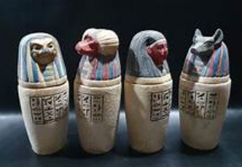

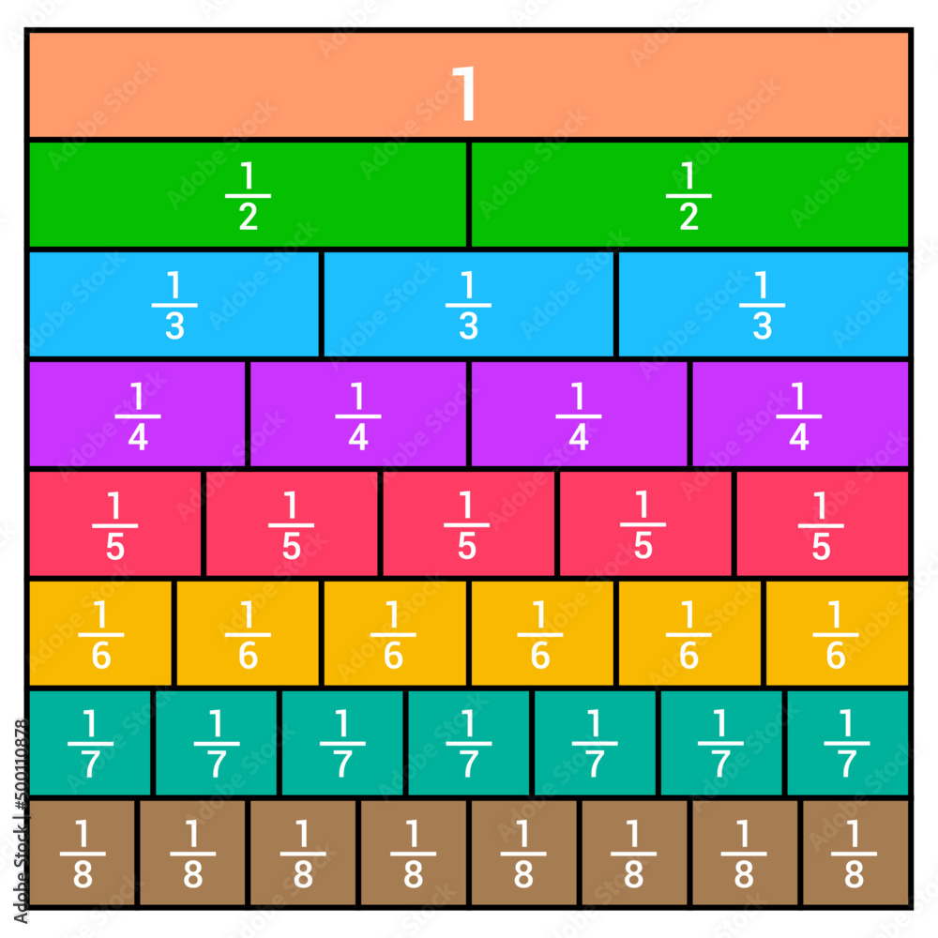
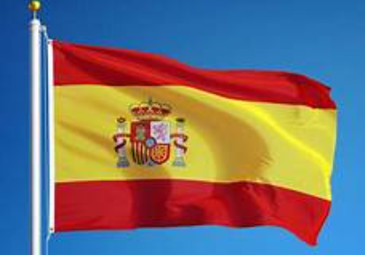
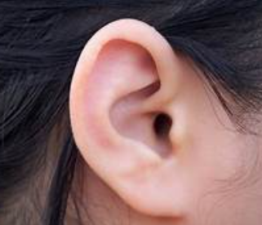
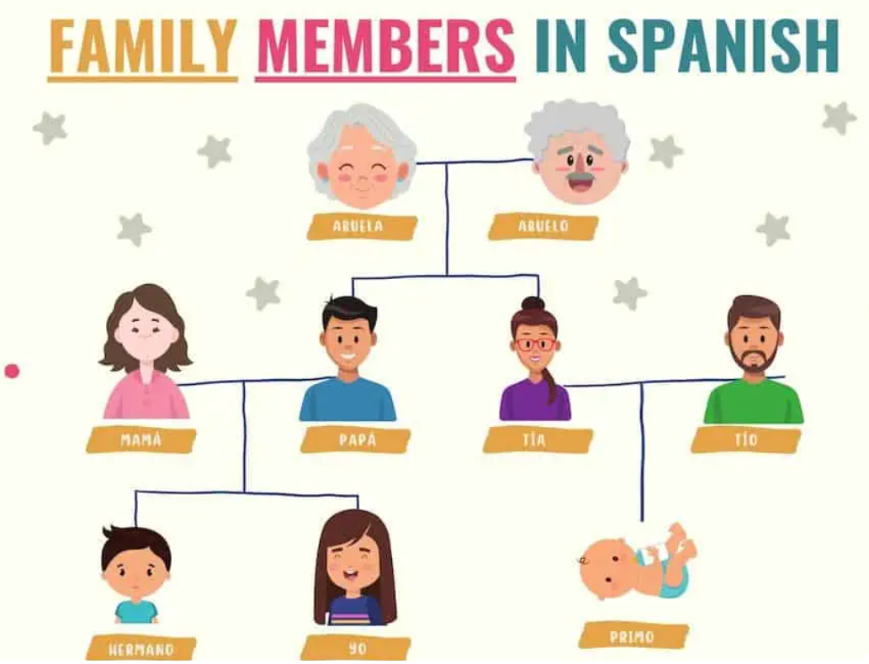
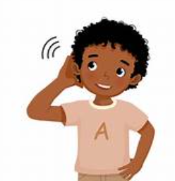
Fleetwood’s Charity Primary School
Homework Menu
Maple Class – Spring 1
Please bring your homework in to show to the class on the last week of half term so that we can share and celebrate all of your hard work!
Weekly Activities
Reading | Read to an adult or independently for 10 minutes each day; this could be a story book, newspaper, recipe or even a comic!
Spellings | Practise the Common Exception Words (CEW) which you are still unsure of. Read and write these trying to apply them in sentences too. Please also complete Spelling shed assignments.
Times Tables | Continue to learn your times tables up to 12 x 12-use TTRS or Topmarks ‘hit the button’.
History
Research about ‘canopic jars’ and what they were used for. Design and make your own to look after something you’d like to protect.
Science
Create a video or a poster demonstrating and explaining all about SOUND. Maybe you could include facts about volume and pitch and draw/model how our ears hear sound.
Spanish
Spanish
Create a family tree for those in your family. Label the member using the Spanish which you have learnt.
Maths
Maths
Practice creating equivalent fractions. Using slices of bread or pieces of paper, measure (using a ruler) splitting the whole into equal parts. Repeat this into different sized fractions.
Can you show an understanding of equivalent fractions from the same sized ‘whole’?

