Slide 1


Flowery Field Primary School
Nursery
2026-2027
Key Learning/Progression of Skills

Slide 2
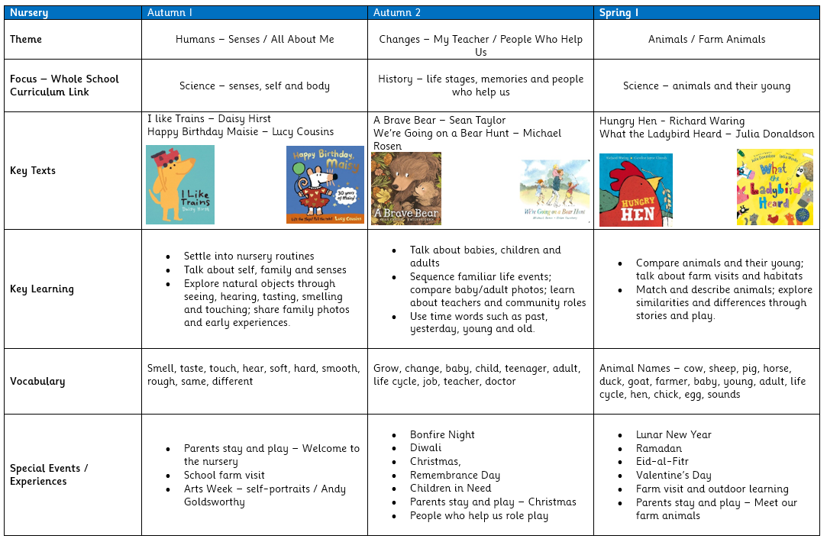

Slide 3
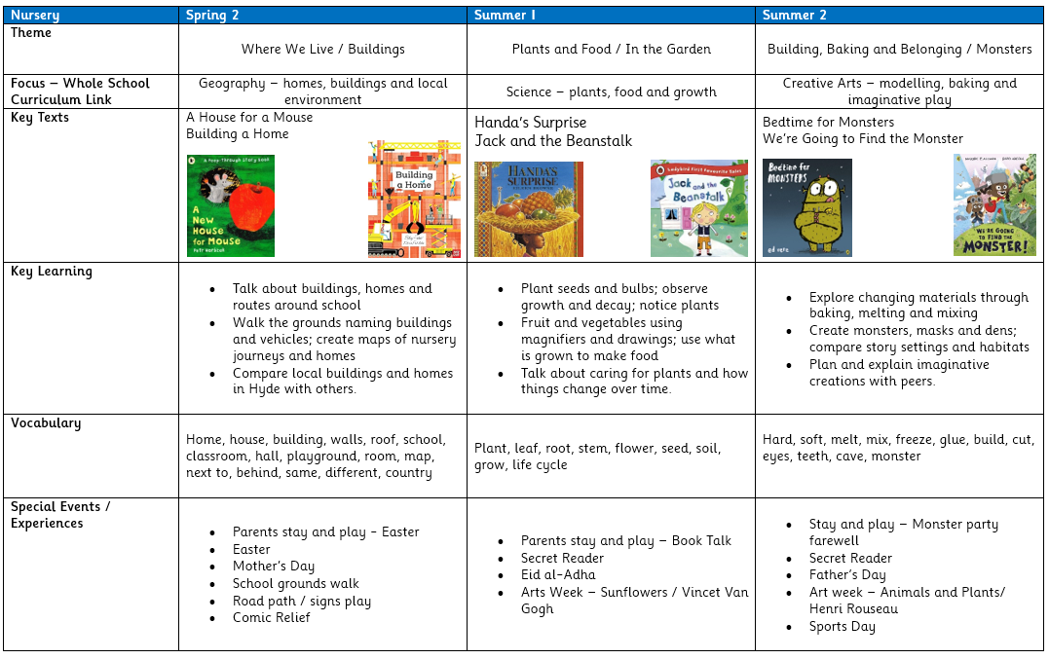

Slide 4

Progression for Communication and Language (Prime Area)
Listening, Attention & Understanding | Speaking
• Enjoy listening to longer stories and can remember much of what happens. • Can find it difficult to pay attention to more than one thing at a time. • Understand a question or instruction that has two parts, such as “Get your coat and wait at the door”. • Understand ‘why’ questions, like: “Why do you think the caterpillar got so fat?” • Can shift from one task to another if you fully obtain their attention. | • Use a wider range of vocabulary. • Sing a large repertoire of songs. • Know many rhymes, be able to talk about familiar books, and be able to tell a long story. • Develop their communication, but may continue to have problems with irregular tenses and plurals, such as ‘runned’ for ‘ran’, ‘swimmed’ for ‘swam’. • May have problems saying: - some sounds: r, j, th, ch, and sh - multisyllabic words such as ‘pterodactyl’, ‘planetarium’ or ‘hippopotamus’ • Use longer sentences of four to six words. • Be able to express a point of view and to debate when they disagree with an adult or a friend, using words as well as actions. • Can start a conversation with an adult or a friend and continue it for many turns. • Use talk to organise themselves and their play: “Let’s go on a bus... you sit there... I’ll be the driver. • Uses sentences of four to six words e.g. I want to play with cars. Can join up sentences using ‘because/ or/ and’ and use future and past tense. Can answer simple why questions.
 | Autumn 1 | Autumn 2 | Spring 1 | Spring 2 | Summer 1 | Summer 2
Listening, Attention and Understanding | I can listen to longer stories, shift my attention when an adult helps me, and follow simple prompts. | I can remember key parts of a story, follow a one-step instruction, and listen in a small group. | I can pay attention to more than one thing at a time and follow slightly longer instructions. | I can understand a two-part instruction and listen carefully on walks and journeys. | I can enjoy longer stories, remember more of what happens, and listen to explanations about planting and cooking. | I can listen for longer in imaginative play, join in with familiar books and rhymes, and remember more of what I hear.
Speaking | I can talk about myself, my likes and dislikes, and what I can see, hear, smell, taste and touch. | I can start a conversation, keep it going for longer, and talk about events in more detail. | I can use a wider range of words and use talk to organise my play and retell stories. | I can use longer sentences to describe routes, homes and local places. | I can answer simple why questions and explain how to care for plants and food. | I can talk about familiar books, tell a longer story, and explain my ideas and creations.
Opportunities for Oracy | I can join in with book talk, rhymes, role play and family-photo talk. | I can use re-enactment, storytelling and discussion to share my ideas. | I can use role play, questioning and animal talk to explain my thinking. | I can join in with drama, book talk and collaborative play about buildings and journeys. | I can debate likes and dislikes and explain how to care for the garden. | I can explain my monster models, dens and story ideas in imaginative play.

Slide 5
Progression for Personal, Social and Emotional Development (Prime Area)
Managing Self | Self-Regulation | Building relationships
• Select and use activities and resources, with help when needed. This helps them to achieve a goal they have chosen, or one which is suggested to them. • Increasingly follow rules, understanding why they are important. • Do not always need an adult to remind them of a rule. • Child can play alongside others and take part in pretend play. | • Help to find solutions to conflicts and rivalries. For example, accepting that not everyone can be Spider-Man in the game, and suggesting other ideas. • Develop appropriate ways of being assertive. • Talk with others to solve conflicts. • Talk about their feelings using words like ‘happy’, ‘sad’, ‘angry’ or ‘worried’. • Begin to understand how others might be feeling. • Sometimes manage to share or take turns with others, with adult guidance and understanding ‘yours’ and ‘mine’. | • Develop their sense of responsibility and membership of a community. • Become more outgoing with unfamiliar people, in the safe context of their setting. • Show more confidence in new social situations. • Play with one or more other children, extending and elaborating play ideas
 | Autumn 1 | Autumn 2 | Spring 1 | Spring 2 | Summer 1 | Summer 2
Self-Regulation | I can begin to settle into routines, respond to prompts and talk about my feelings in simple ways. | I can think about other people’s feelings and begin to regulate my behaviour with support. | I can keep trying, pay attention for longer and feel proud of my achievements. | I can use talk to solve simple problems, negotiate roles and begin to manage my impulses. | I can reflect on what I have done well, keep trying and persevere with shared tasks. | I can start my own play, keep an imaginative story going and explain my ideas simply.
Managing Self | I can become more independent with eating, toileting, handwashing and toothbrushing. | I can use areas and equipment appropriately, try new things and follow simple rules. | I can show a preference for a dominant hand and manage my own care needs more independently. | I can put on my coat and shoes and begin to use zips; I know what helps me feel safe and ready to learn. | I can hold pencils and tools with more control and talk about what I have achieved. | I can begin to use a knife and fork and make healthy choices about food, drink, activity and toothbrushing.
Building Relationships | I can play alongside others, begin to make friends and feel confident with familiar adults. | I can take turns, share and notice that other people’s homes and experiences can be different to mine. | I can play cooperatively and work positively with adults and children. | I can negotiate roles with my friends, ask questions and listen to other people’s ideas. | I can help with shared garden, cooking and classroom jobs and feel that I belong to my class. | I can sustain friendships, appreciate differences and work together in imaginative play.

Slide 6
Progression for Personal, Social and Emotional Development (SCARF PSHE)
Me and My Relationships | Valuing Difference | Keeping Safe
Marvellous me! I'm special People who are special to me | Me and my friends Friends and family Including everyone | People who help me and keep me safe Safety Indoors and Outdoors What's safe to go into my body
Rights and Respect | Being my Best | Growing and Changing
Looking after myself Looking after others Looking after my environment | What does my body need? I can keep trying I can do it! | Growing and changing in nature When I was a baby Girls, boys and families
Link for more information:
Parents and schools together - Family SCARF

Slide 7
Progression for Physical Development (Prime Area)
Gross Motor | Fine Motor
• Be increasingly independent as they get dressed and undressed, for example, putting coats on and doing up zips. • Be increasingly independent in meeting their own care needs, e.g. brushing teeth, using the toilet, washing and drying their hands thoroughly. • Make healthy choices about food, drink, activity and tooth brushing. | • Use one-handed tools and equipment, for example, making snips in paper with scissors. • Use a comfortable grip with good control when holding pens and pencils. • Start to eat independently and learning how to use a knife and fork. • Show a preference for a dominant hand.
 | Autumn 1 | Autumn 2 | Spring 1 | Spring 2 | Summer 1 | Summer 2
Fine Motor | I can use one-handed tools, begin to eat independently and make free movements with ribbons, scarves and crayons. | I can make snips in paper with scissors and become more independent with aprons and dress-up. | I can show a preference for a dominant hand, use small parts in art and practiсe pre-writing shapes. | I can become more independent with coats, shoes and zips and make pre-writing shapes with dry-wipe tools. | I can hold pens and pencils with a comfortable grip and use more control in my mark making. | I can begin to use a knife and fork, write my name and use known letters in early writing.
Gross Motor | I can roll, crawl, walk, climb and balance, developing strength and co-ordination. | I can use big movements in role play; water play and outdoor play and move with growing confidence. | I can care for living things and use large movements for ribbons, kites and flags. | I can walk around the school grounds, ride bikes and trikes and move using direction words. | I can dig, carry, plant, cook and explore in the garden using my whole body. | I can build dens, compare spaces and keep an energetic imaginative game going with my friends.
 | Autumn 1 | Autumn 2 | Spring 1 | Spring 2 | Summer 1 | Summer 2
PE Overview | Agility, balance and coordination | Gymnastics | Orienteering | Basketball/ invasion games | Striking and fielding | Net and wall. Sports Day.

Slide 8
Progression for Literacy (Specific Area)
Comprehension | Word reading
• Understand the five key concepts about print: - print has meaning - print can have different purposes - we read English text from left to right and from top to bottom - the names of the different parts of a book - page sequencing. • Engage in extended conversations about stories, learning new vocabulary. | • Develop their phonological awareness, so that they can: - spot and suggest rhymes - count or clap syllables in a word - recognise words with the same initial sound, such as money and mother
 | Autumn 1 | Autumn 2 | Spring 1 | Spring 2 | Summer 1 | Summer 2
Word reading / early reading behaviours | I can handle books carefully, know that print has meaning and join in with repeated refrains. | I can begin to understand page order and tune into sounds in phonics. | I can notice that books have parts and recognise words with the same initial sound. | I can understand page sequencing more confidently and spot and suggest rhymes. | I can count or clap syllables and know that we read from left to right and top to bottom. | I can use my print and letter knowledge in early reading and orally segment and blend simple words.
Comprehension | I can listen to and enjoy a wide range of books and retell familiar events from stories and rhymes. | I can talk about what happened in a story and learn new words. | I can retell familiar stories using repeated phrases and my own words. | I can sequence pictures from a story and make simple predictions. | I can join in with extended conversations about stories and non-fiction and use new vocabulary. | I can talk about familiar books, tell longer stories and share my opinions about characters and events.

Slide 9
Progression for Literacy (Specific Area) - continued
Writing
• Use some of their print and letter knowledge in their early writing. For example: writing a pretend shopping list that starts at the top of the page; write ‘m’ for mummy. • Write some or all of their name • Write some letters accurately.
 | Autumn 1 | Autumn 2 | Spring 1 | Spring 2 | Summer 1 | Summer 2
Writing opportunities | I can draw things I like and help to make cards, labels and class poems. | I can sequence story pictures and help create a class poem. | I can sequence story pictures, make a simple map and help create a class poem. | I can make a playground photo map, order story pictures and help make a class poem. | I can make a healthy foods poster and sequence story pictures. | I can design a monster and share a simple book review.
Composition | I can make marks and use talk to organise my play, ideas and special events. | I can begin to give meaning to my marks and orally say what I want to write. | I can hold an idea in mind and use emerging letters or shapes to represent it. | I can say a sentence aloud and attempt to record parts of it. | I can talk through ideas for posters, labels and simple information writing. | I can use my own experiences and stories to create early written messages.
Transcription | I can experiment with mark making and begin to use letters from my name. | I can give meaning to my marks and write some familiar letters. | I can use some letter shapes and initial sounds in writing. | I can write some letters accurately and write some or all of my name. | I can write some letters accurately with a comfortable grip and use known sounds in my writing. | I can write all of my name, write some unfamiliar letters accurately and use print and letter knowledge in early writing.
Handwriting | I can make big free movements with ribbons, scarves and crayons. | I can follow directional language when I move and mark make. | I can practise pre-writing shapes using different tools. | I can make pre-writing shapes on a dry-wipe board. | I can refine pre-writing shapes with pencils and dry-wipe tools. | I can use pencils with greater control to make pre-writing shapes and letters.

Slide 10
Progression for Maths (Specific Area)
Number | Numerical pattern
• Fast recognition of up to 3 objects, without having to count them individually (‘subitising’). • Recite numbers past 5. • Say one number for each item in order: 1,2,3,4,5. • Know that the last number reached when counting a small set of objects tells you how many there are in total (‘cardinal principle’). • Show ‘finger numbers’ up to 5. • Link numerals and amounts: for example, showing the right number of objects to match the numeral, up to 5. | • Experiment with their own symbols and marks as well as numerals. • Solve real world mathematical problems with numbers up to 5. • Compare quantities using language: ‘more than’, ‘fewer than’. • Talk about and explore 2D and 3D shapes (for example, circles, rectangles, triangles and cuboids) using informal and mathematical language: ‘sides’, ‘corners’; ‘straight’, ‘flat’, ‘round’. •Understand position through words alone – for example, “The bag is under the table,” – with no pointing. • Describe a familiar route. • Discuss routes and locations, using words like ‘in front of’ and ‘behind’. • Make comparisons between objects relating to size, length, weight and capacity. • Select shapes appropriately: flat surfaces for building, a triangular prism for a roof etc. • Combine shapes to make new ones – an arch, a bigger triangle etc. • Talk about and identifies the patterns around them. For example: stripes on clothes, designs on rugs and wallpaper. Use informal language like ‘pointy’, ‘spotty’, ‘blobs’ etc. • Extend and create ABAB patterns – stick, leaf, stick, leaf. • Notice and correct an error in a repeating pattern. • Begin to describe a sequence of events, real or fictional, using words such as ‘first’, ‘then...

Slide 11
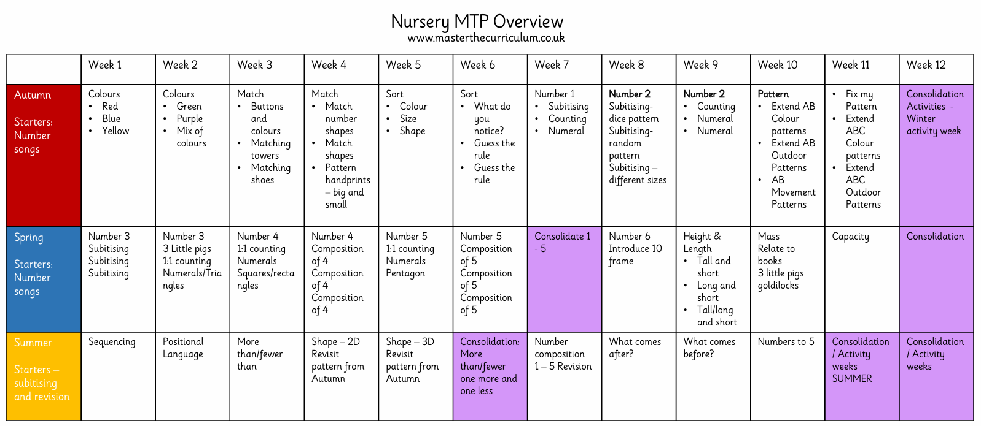
Progression for Maths (Specific Area) - continued

Slide 12
Progression for Understanding the World (Specific Area)
The Natural World | People, Culture & Communities | Past and present
• Use all their senses in hands-on exploration of natural materials. • Explore collections of materials with similar and/or different properties. • Talk about what they see, using a wide vocabulary. • Plant seeds and care for growing plants. • Understand the key features of the life cycle of a plant and an animal. • Begin to understand the need to respect and care for the natural environment and all living things. • Explore and talk about different forces they can feel. • Talk about the differences between materials and changes they notice. | • Begin to make sense of their own life-story and family’s history. • Explore how things work. • Continue to develop positive attitudes about the differences between people. • Know that there are different countries in the world and talk about the differences they have experienced or seen in photos. | • Show interest in different occupations.
 | Autumn 1 | Autumn 2 | Spring 1 | Spring 2 | Summer 1 | Summer 2
Past and Present | I can talk about what happened before I started nursery and who is in my family. | I can understand that adults were once babies and sequence familiar life events using time words. | I can remember my previous experiences of farms and notice how animals change as they grow. | I can remember visits to buildings, homes and journeys and talk about where I have been. | I can remember foods I have tasted and previous experiences of plants and gardens. | I can remember experiences from modelling, cooking, stories and my family life.
The Natural World | I can use my senses to explore natural materials and talk about what I notice. | I can notice seasonal change and changes across human life stages. | I can compare animals and their young and talk about life cycles and animal sounds. | I can explore forces and materials by pushing, pulling, bending, twisting and rolling objects. | I can plant and care for seeds, bulbs and vegetable tops and observe growth and decay over time. | I can explore changing materials through baking, melting, mixing and fizzing.
People, Culture and Communities | I can talk about my family, what makes people special, and some similarities and differences between home and nursery. | I can talk about nursery adults, where they grew up and people who help us in the community, and learn about celebrations such as Diwali, Bonfire Night and Christmas. | I can talk about farms, the countryside and where some animals live in the world, and recognise celebrations such as Lunar New Year and Ramadan / Eid-al-Fitr. | I can name buildings and vehicles around school, make maps of familiar places and recognise that some places are special, including a church and mosque. | I can investigate where some fruit comes from and care for the school vegetable beds. | I can compare story settings and habitats, learn that people and animals live in different places, and talk about belonging and my hopes for the future.

Slide 13
Progression for Expressive Arts and Design (Specific Area)
Being Imaginative and Expressive | Creating with Materials
• Take part in simple pretend play, using an object to represent something else even though they are not similar. • Begin to develop complex stories using small world equipment like animal sets, dolls and dolls houses etc. • Make imaginative and complex ‘small worlds’ with blocks and construction kits, such as a city with different buildings and a park. • Listen with increased attention to sounds. • Respond to what they have heard, expressing their thoughts and feelings. Remember and sing entire songs. • Sing the pitch of a tone sung by another person (‘pitch match’). • Sing the melodic shape (moving melody, such as up and down, down and up) of familiar songs. • Create their own songs, or improvise a song around one they know. • Play instruments with increasing control to express their feelings and ideas. | • Explore different materials freely, in order to develop their ideas about how to use them and what to make. • Develop their own ideas and then decide which materials to use to express them. • Join different materials and explore different textures • Create closed shapes with continuous lines and begin to use these shapes to represent objects. • Draw with increasing complexity and detail, such as representing a face with a circle and including details. • Use drawing to represent ideas like movement or loud noises. • Show different emotions in their drawings and paintings, like happiness, sadness, fear etc. • Explore colour and colour-mixing.
 | Autumn 1 | Autumn 2 | Spring 1 | Spring 2 | Summer 1 | Summer 2
Creating with Materials | I can explore paint, name colours and use natural and loose parts to create portraits. | I can draw humans at different ages and paint people who help us. | I can draw and paint animals and their young with more detail and more accurate colours. | I can draw buildings and experiment with paint colours and different media. | I can print with vegetables and garden materials and draw seeds and bulbs. | I can draw and paint monsters, compare monster footprints and create observational animal drawings.
Being Imaginative and Expressive | I can listen, respond and dance to songs and explore simple instruments. | I can move and dance to music and use a large drum to explore sound and character. | I can dance to different music, keep a steady rhythm and create farm or animal narratives. | I can sing, move and use percussion to clap and play syllables. | I can create garden music using pots and pans and copy simple rhythms. | I can make junk-model instruments, accompany songs and perform dances and imaginative monster stories.

Slide 14
Key Learning Opportunities for Art
I can discuss the different features of artists’ work. I can talk about what I notice, like and dislike when looking at the work of artists. I can use the work of the following artists to inspire my own work. I can reflect on my artwork, accepting praise and constructive criticism. I can add improvements to my artwork.
Autumn 2 | Spring 2 | Summer 2
Andy Goldsworthy – Self Portraits (Seasonal Link) I can talk about what I notice, like and dislike in artwork, and use natural materials, portraits and people studies to create my own art inspired by Andy Goldsworthy. | Vincent Van Gogh – Sunflowers (Landscapes) I can explore colour mixing, tints and shades in landscape and sunflower artwork inspired by Vincent van Gogh. | Henri Rousseau – Animals and Plants (Exploring and creating with materials) I can explore, choose, tear, scrunch, arrange and stick materials to create jungle artwork with animals and plants, inspired by Henri Rousseau.
Key Learning Opportunities for Modelling/DT
Autumn 1 | Autumn 2 | Spring 1 | Spring 2 | Summer 1 | Summer 2
I can make binoculars to explore sight, build a wall for Humpty Dumpty and prepare and taste healthy foods. | I can make tools for people who help us and bake biscuits, juice and bread with support. | I can build houses for the three little pigs and a bridge for the goats. | I can junk-model buildings for a class town and build and test a boat in water. | I can use clay to collect textures from the garden and make a bucket for transporting water. | I can create monsters using mixed media and build dens, caves, masks and props.

