Slide 1
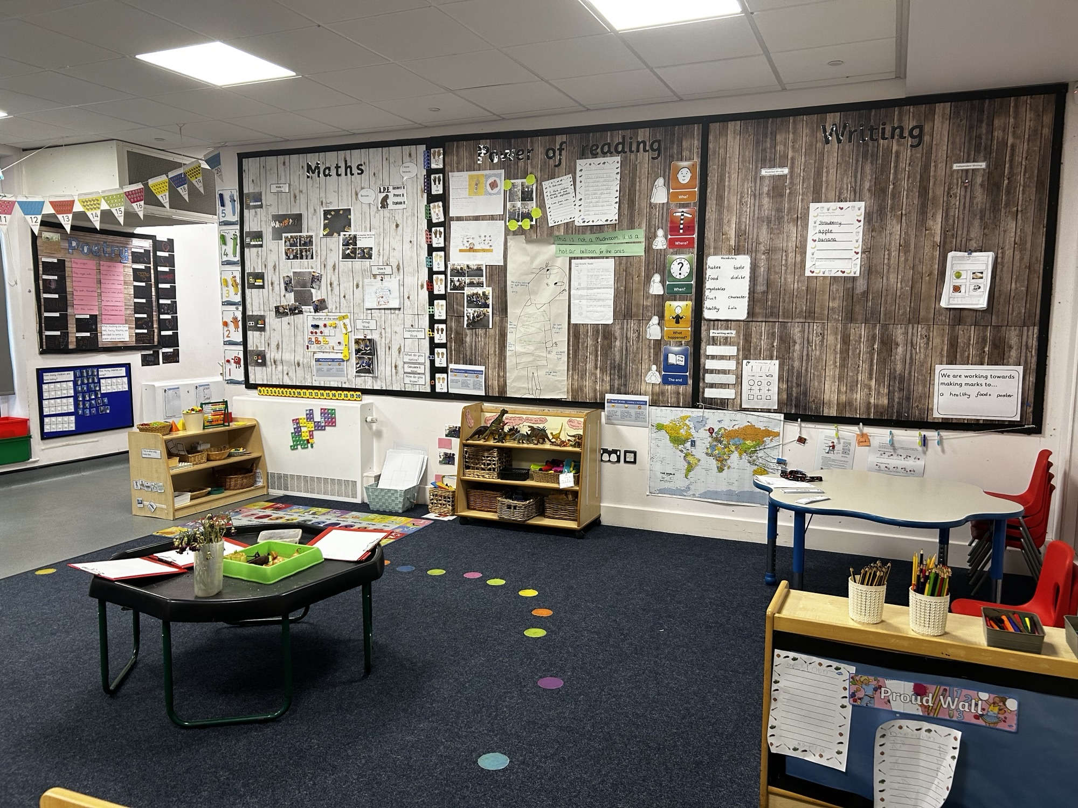
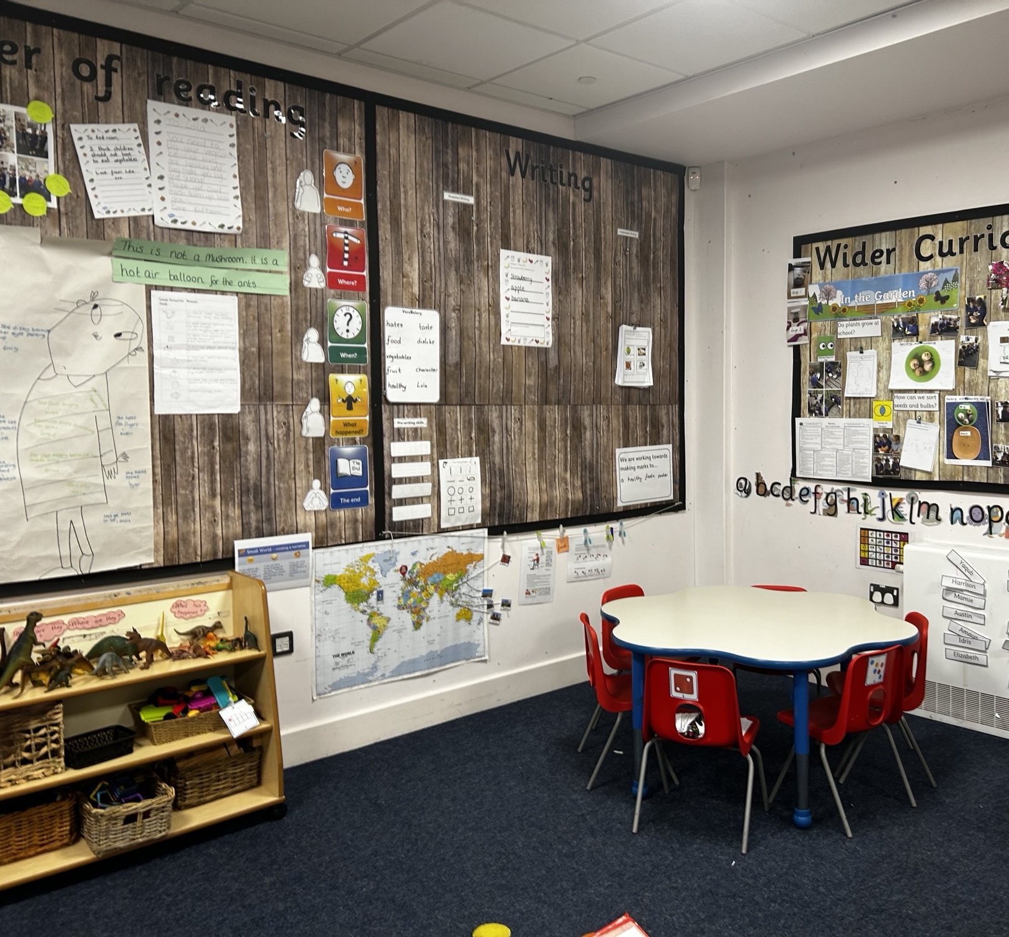
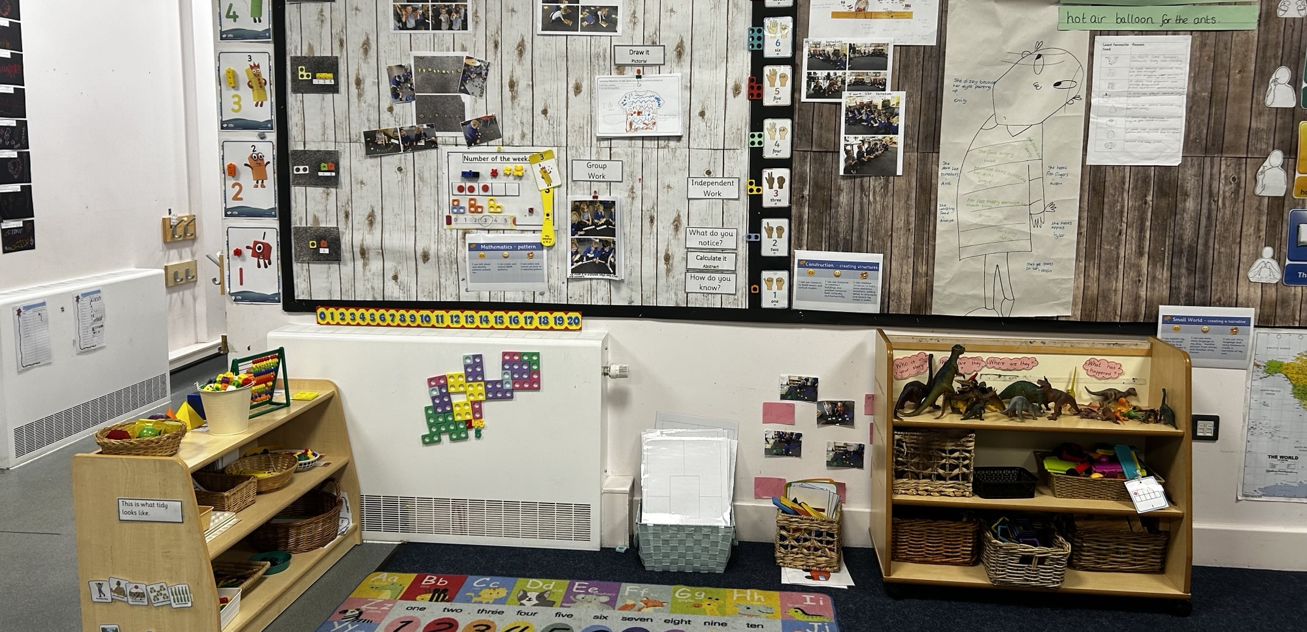
Welcome to Nursery

Slide 2
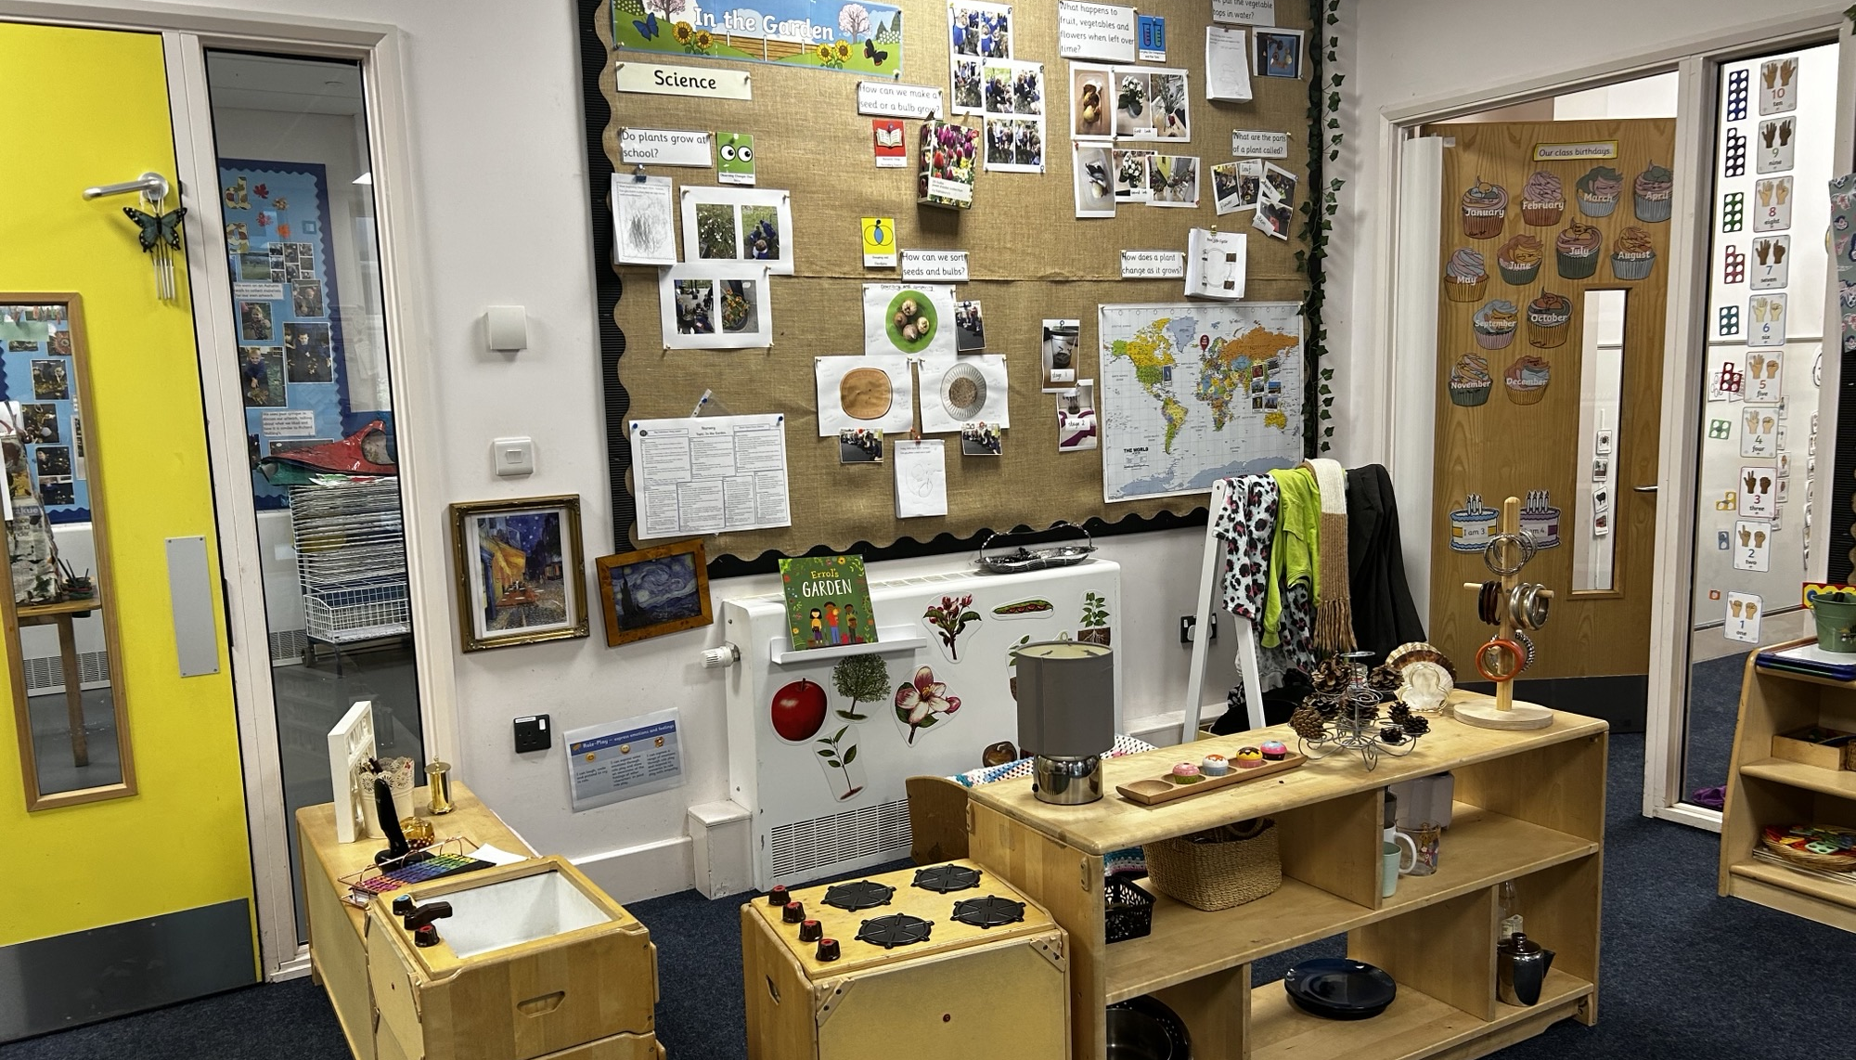
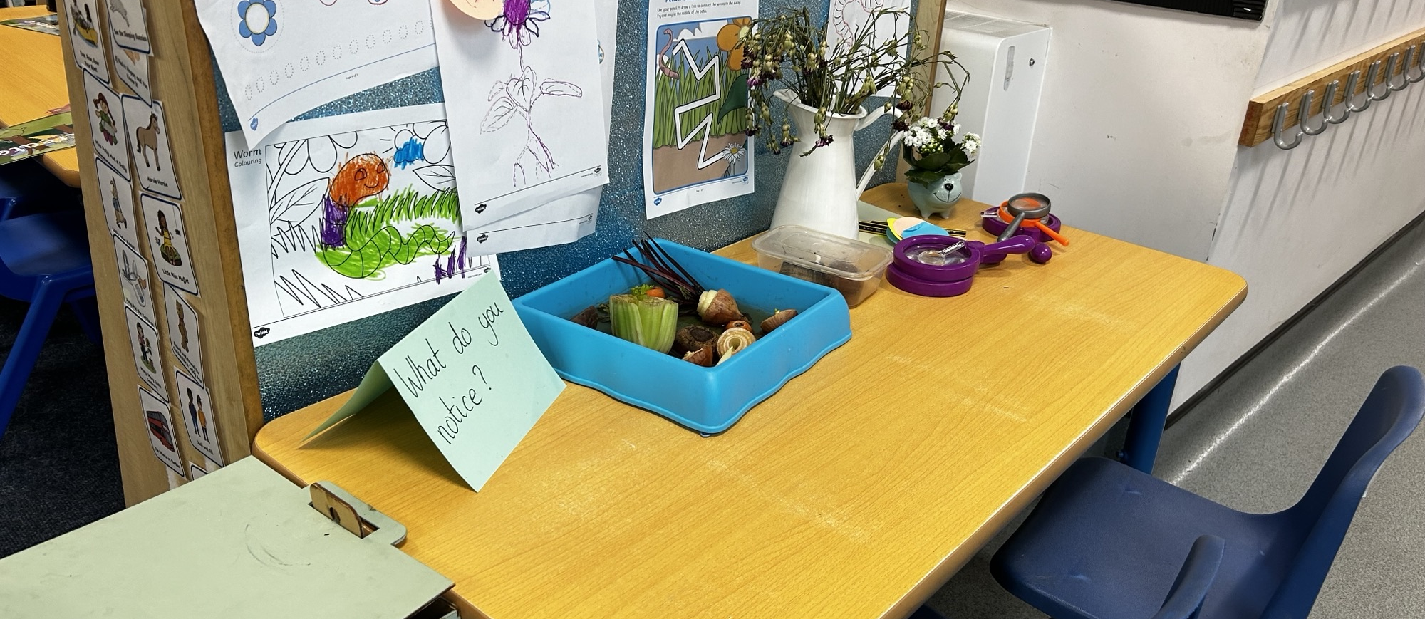
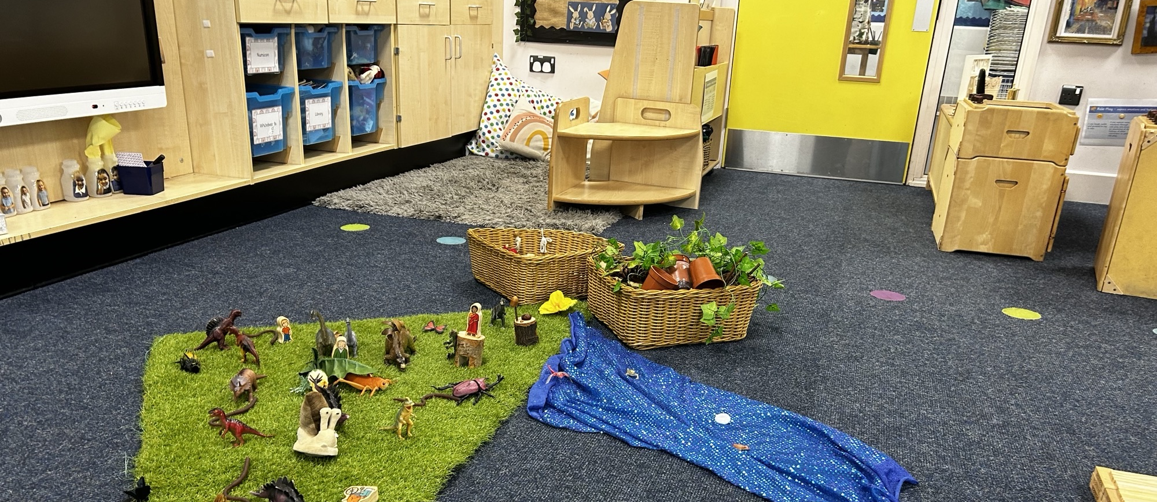
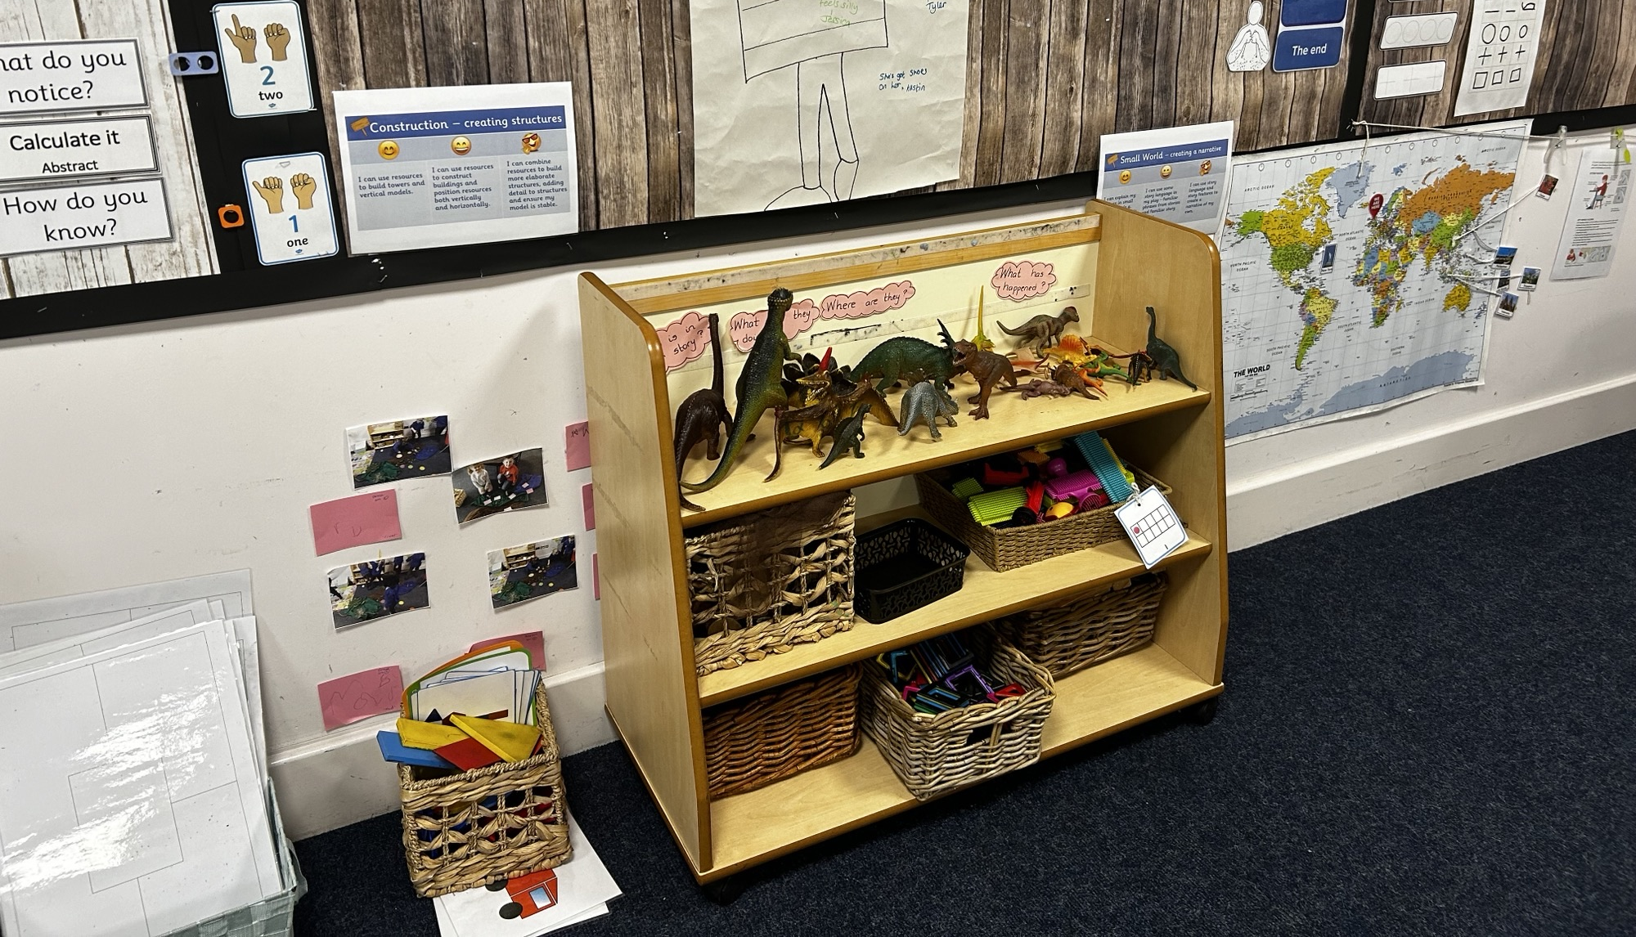

Slide 3
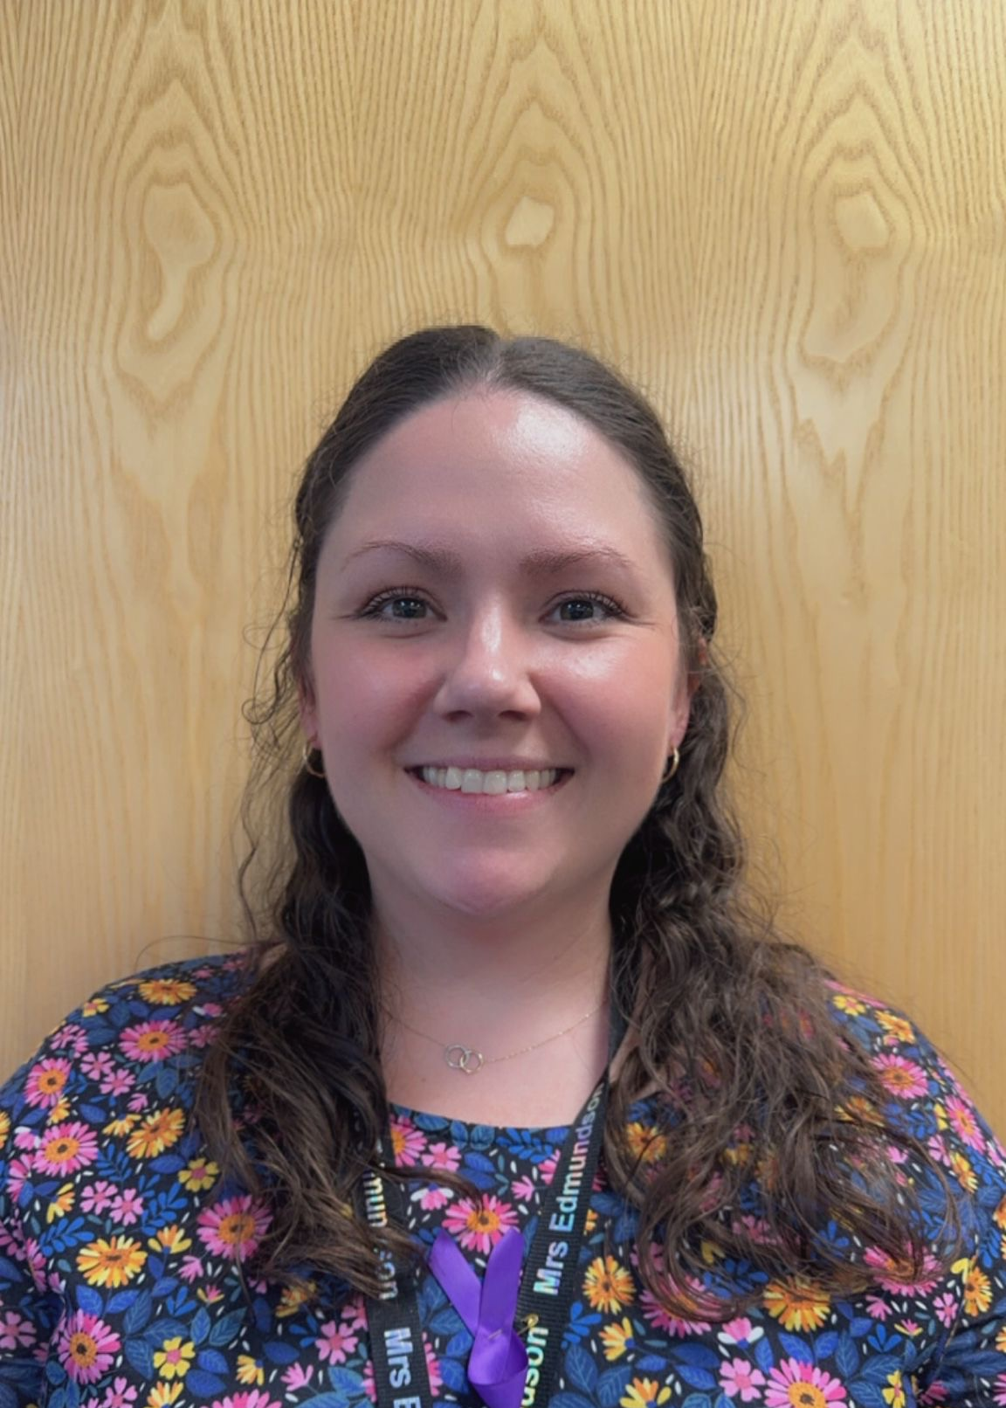
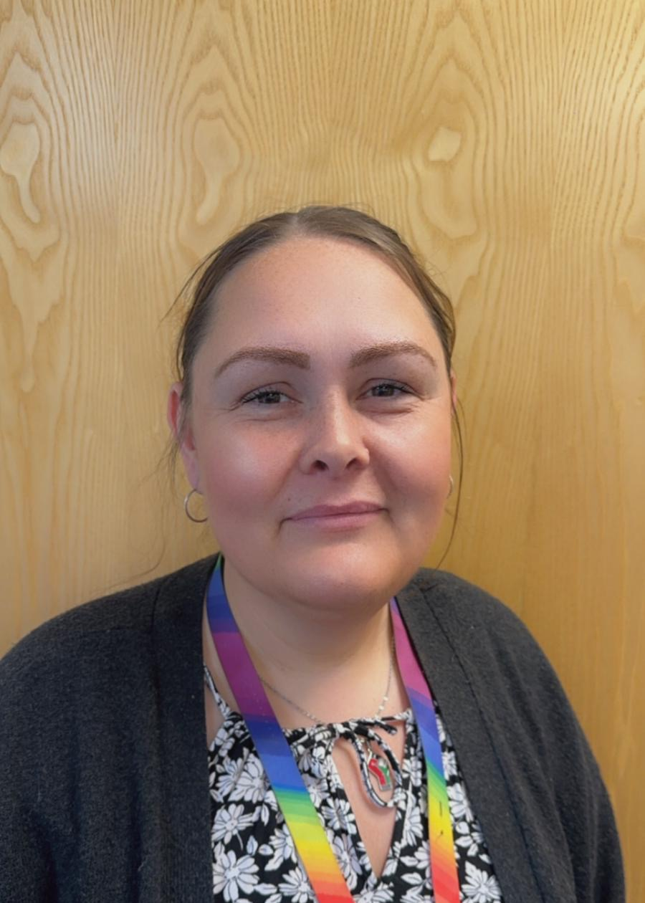
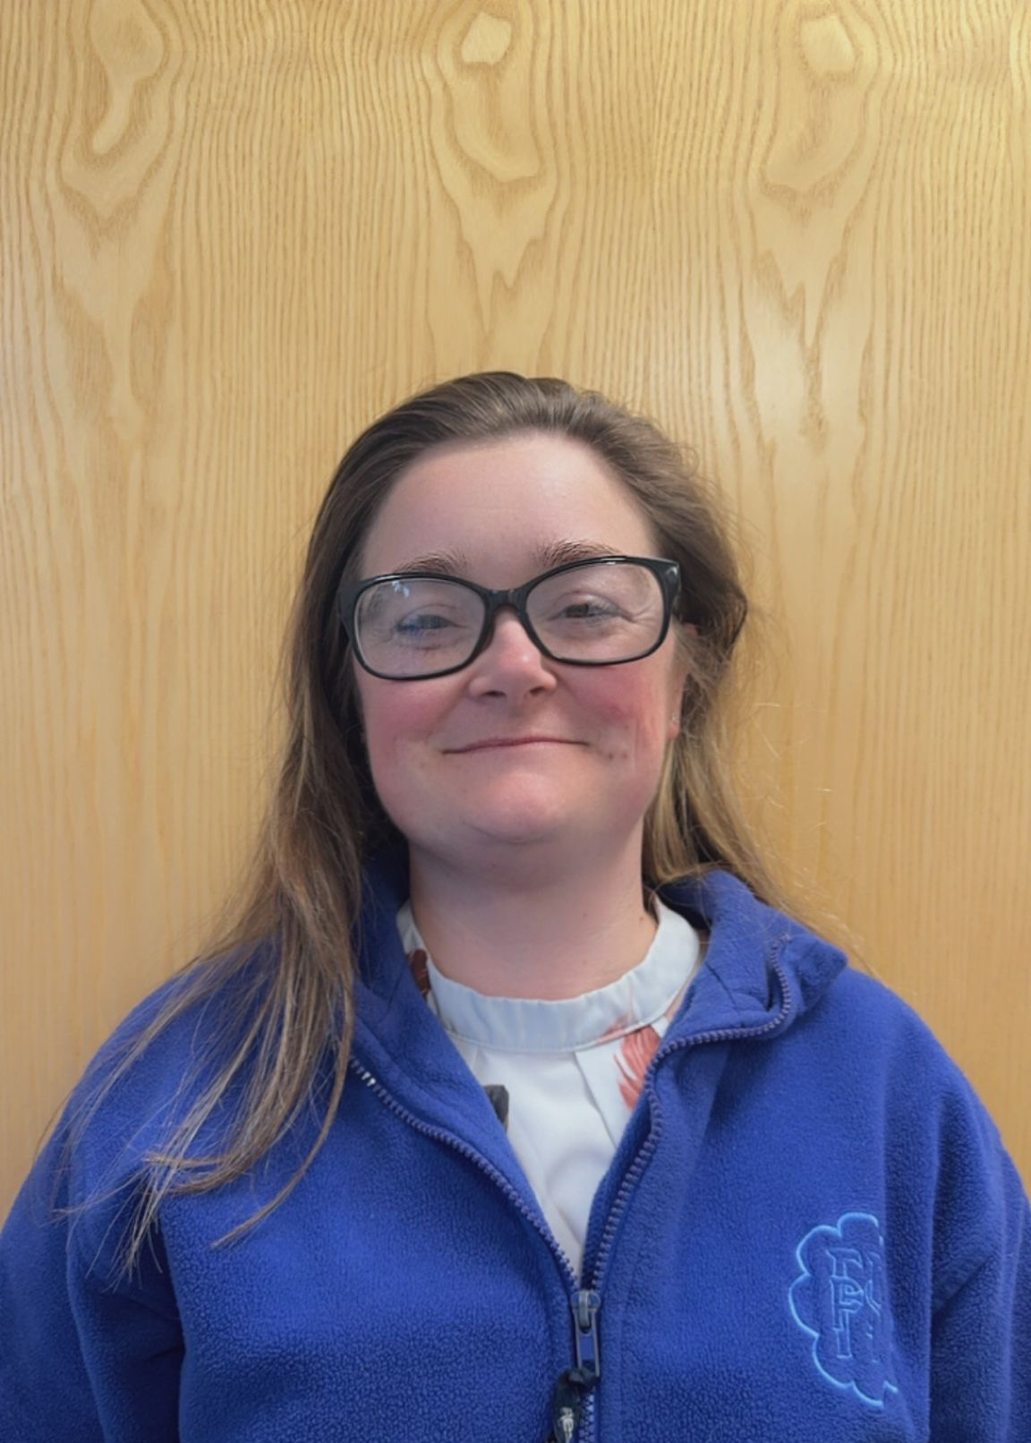
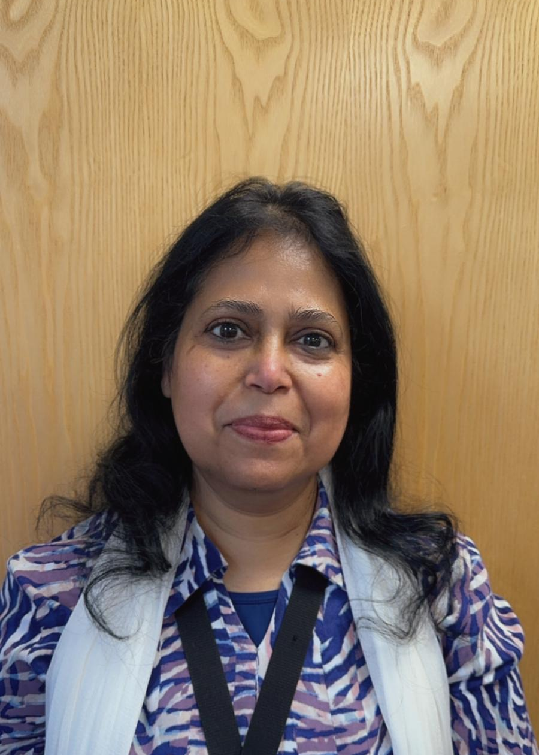
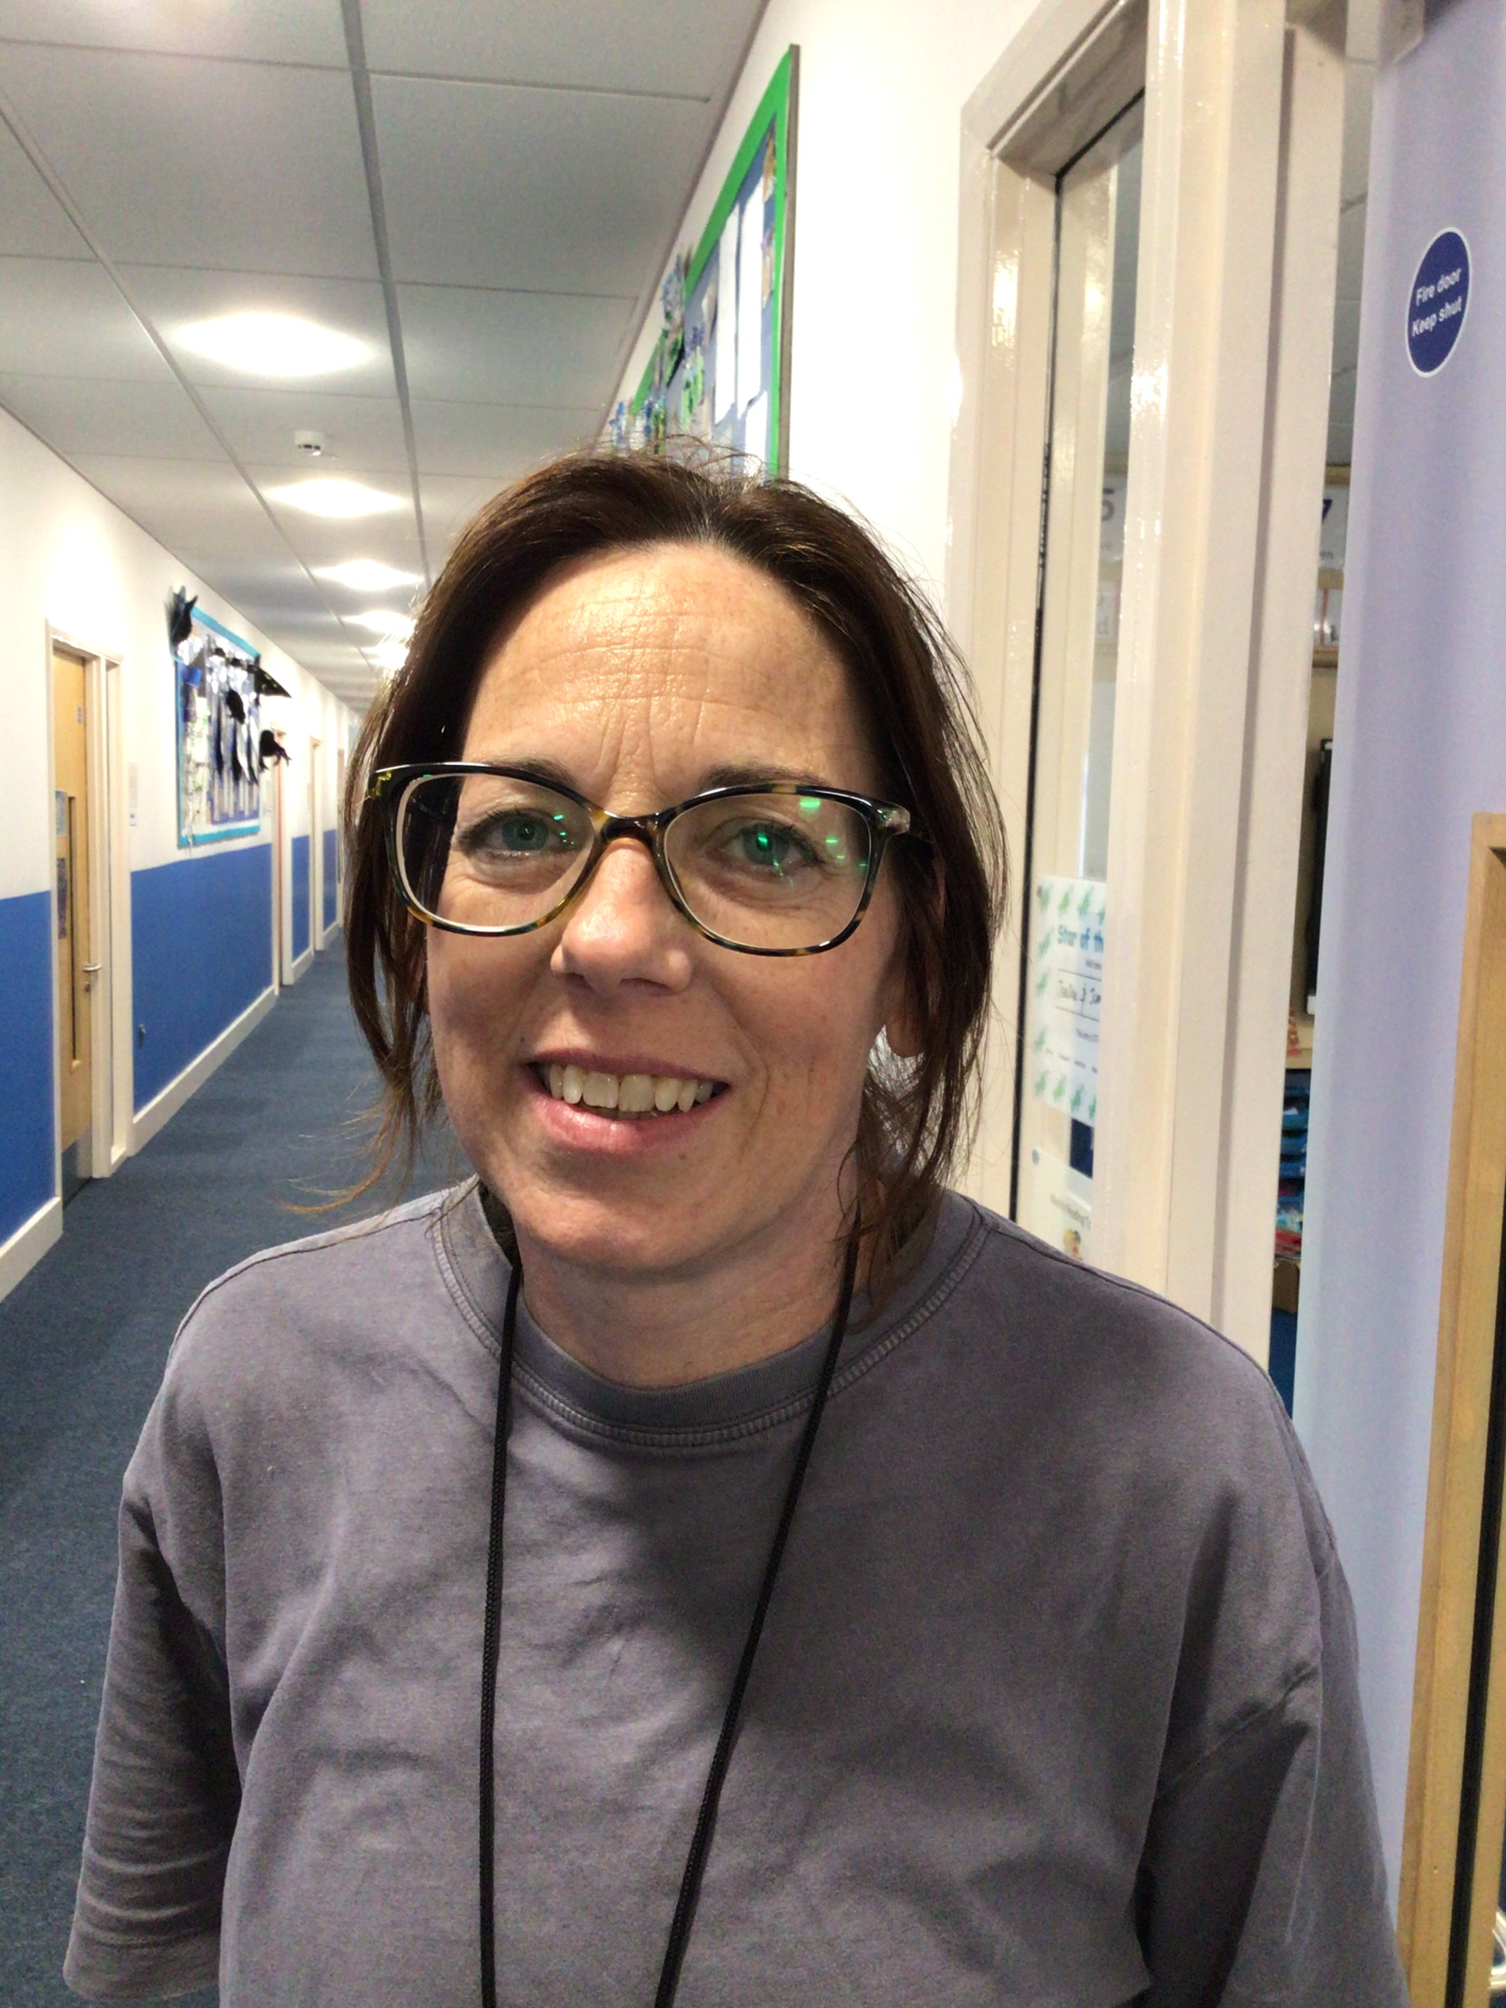
Meet the Staff
My name is Mrs Edmundson.
I am a Nursery teacher. I am the reading and phonics lead.
My name is Miss Murray.
I am a Nursery teacher.
My name is Miss Sharples. I am a teaching assistant, I work with Mrs Edmundson.
My name is Miss Bartlett. I am a teaching assistant, I work with Miss Murray.
My name is Mrs Syed. I am a teaching assistant, I work in both Nursery classrooms.

