Slide 1
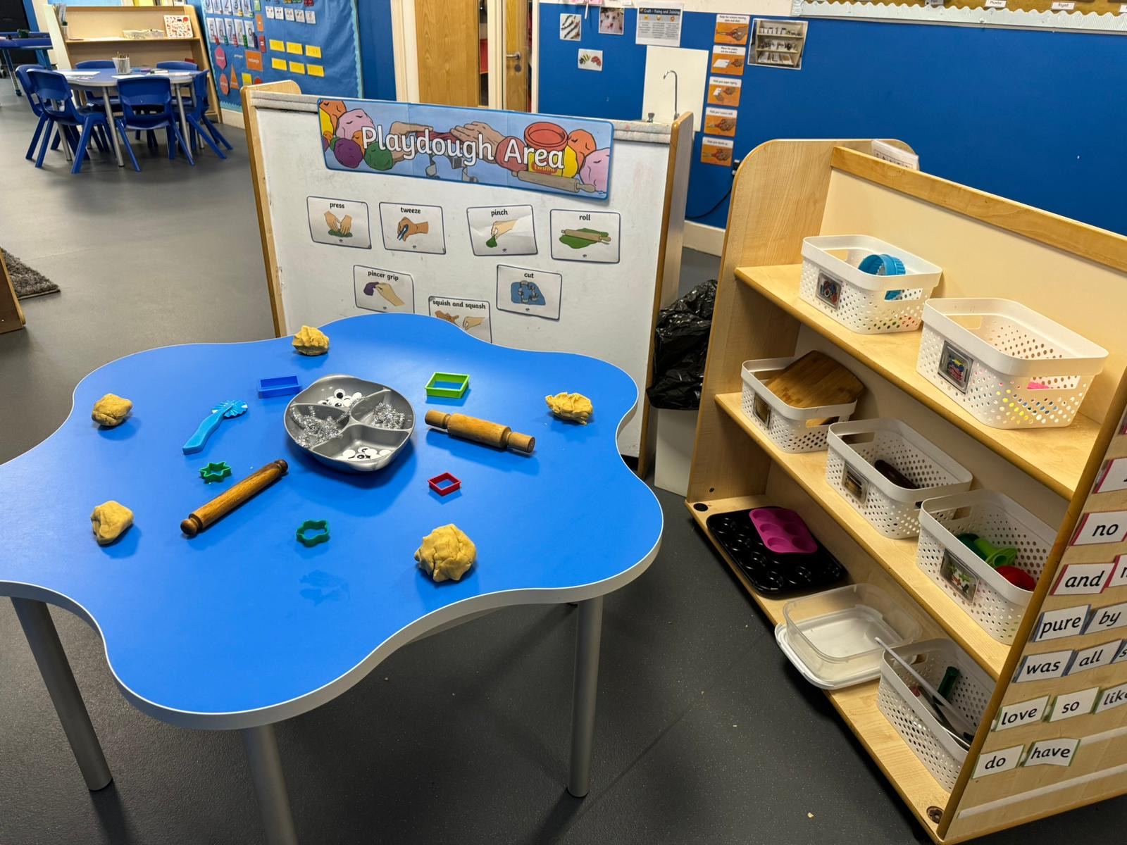
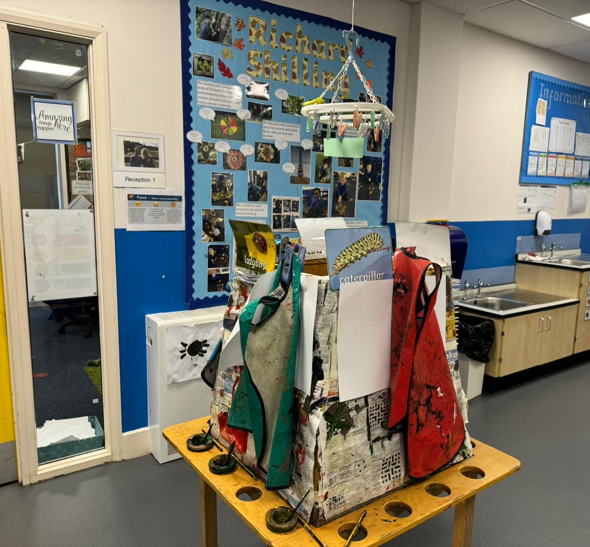
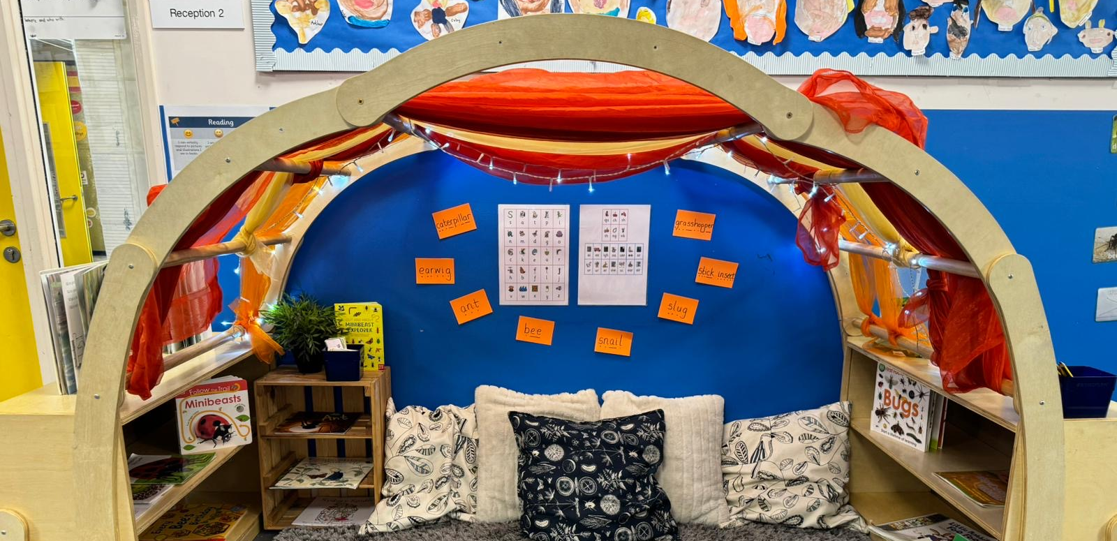
Welcome to Reception

Slide 2
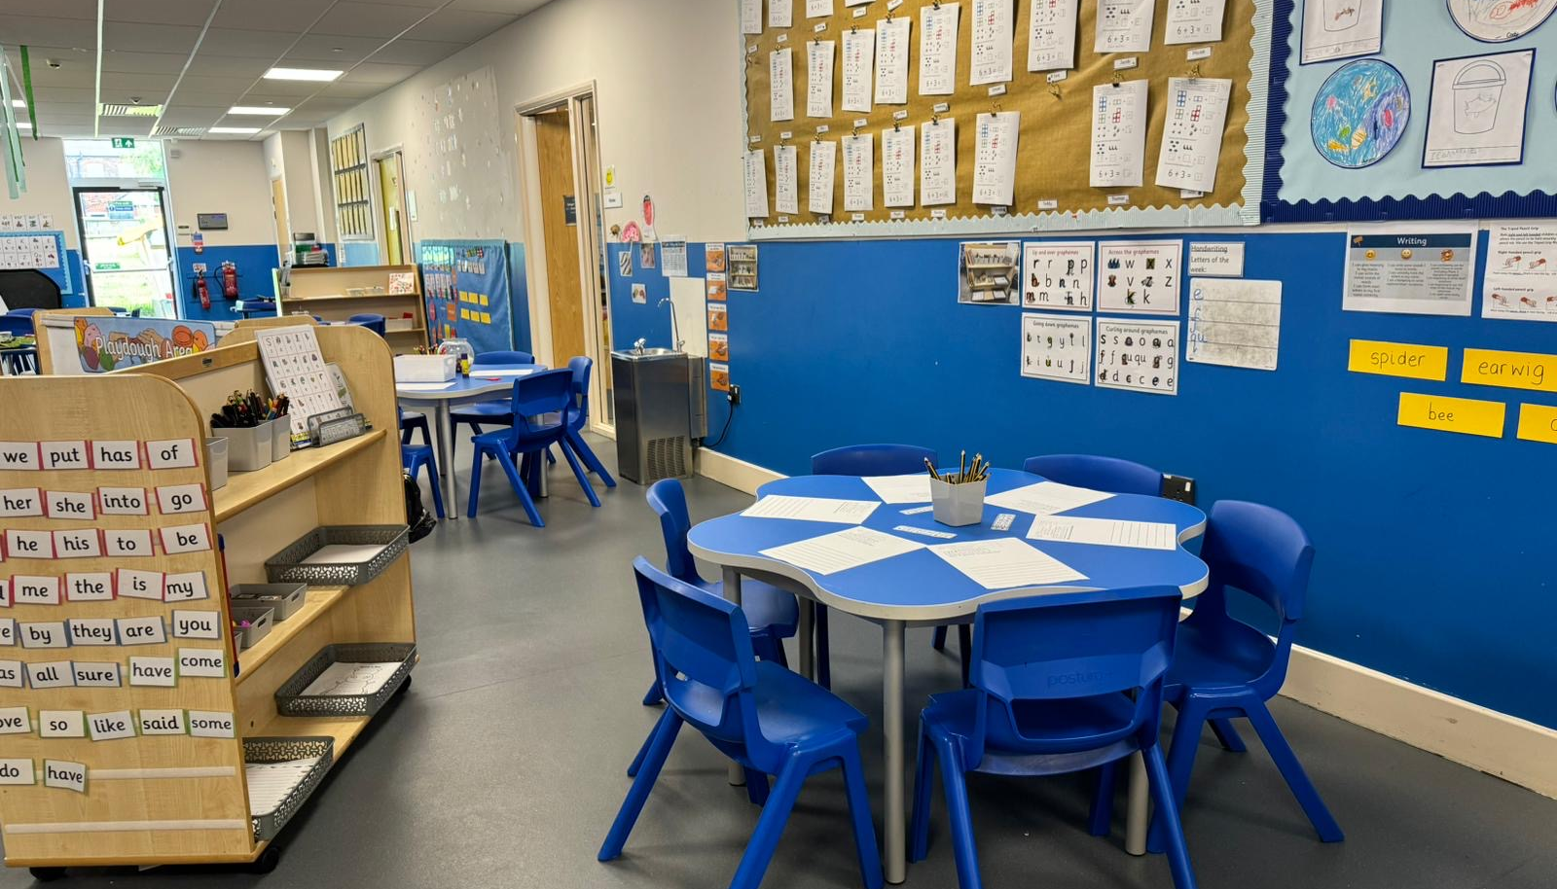
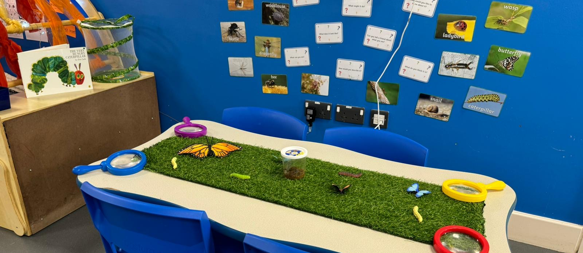
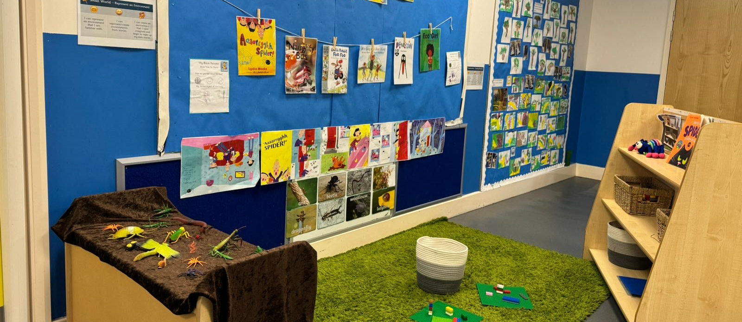
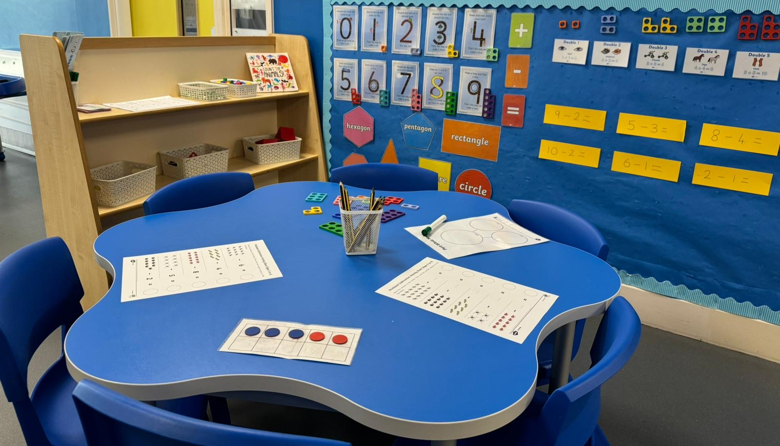

Slide 3
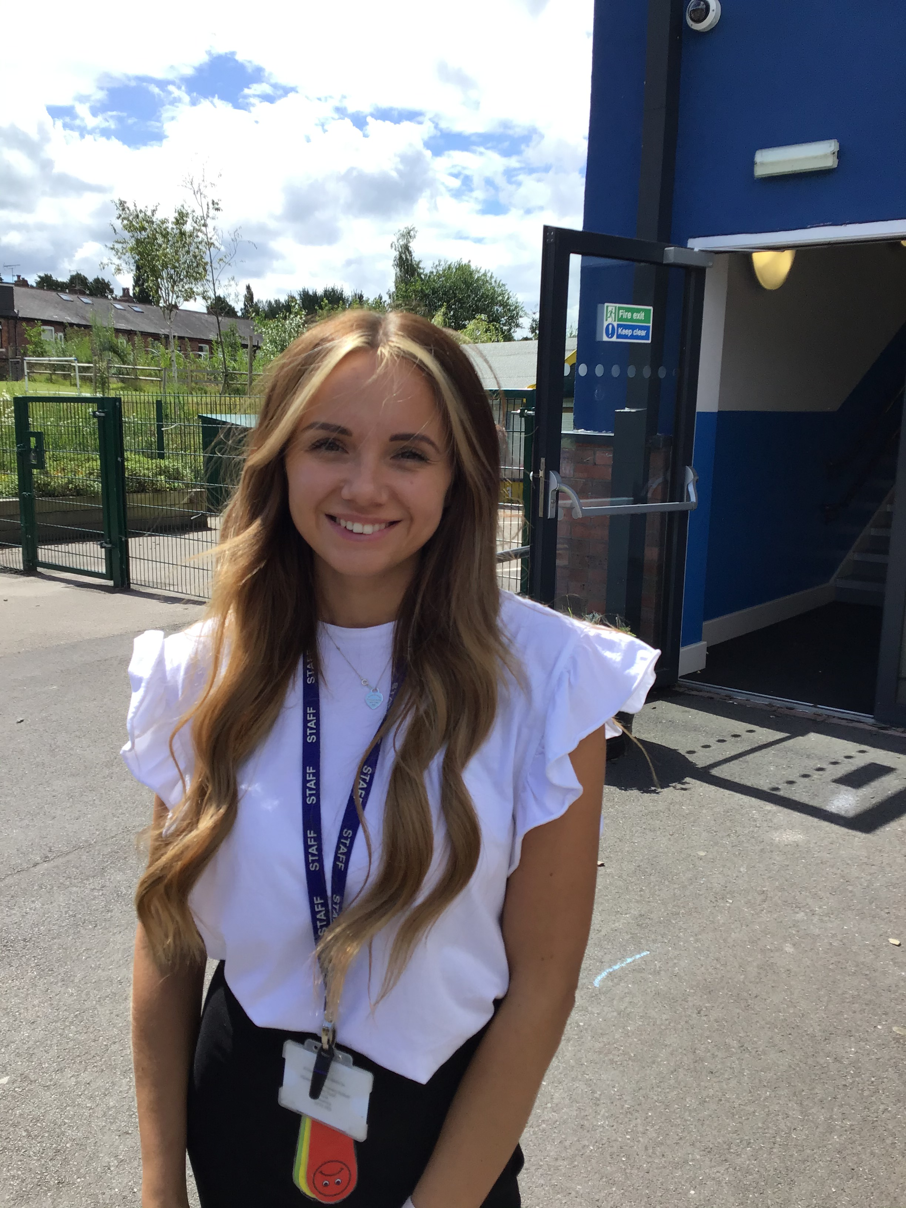
My name is Miss Redfern. I am a Reception teacher and the Early Years Lead.
My name is Mrs Marsh. I am a Reception teacher.
My name is Mrs Roche. I am a Reception teacher.
My name is Mrs Arnold. I work with Miss Redfern.
My name is Mrs Cooke. I work with Mrs Marsh.
My name is Mrs Caldecott. I work with Mrs Roche.

